Slide 1
UPDATE TWO
DATASPIRE PROJECT
KENNETH W.
VANCE B.

Slide 2
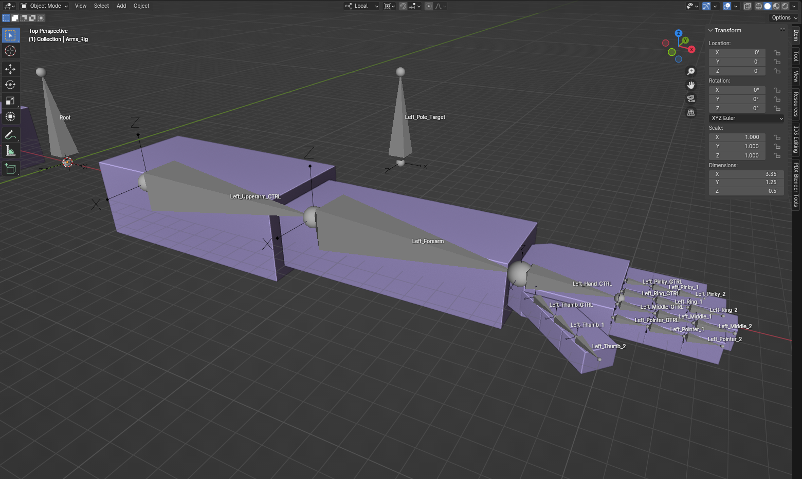
Kenneth Progress
TLDR: Slogging around in Blender
Slowly figuring out how to model, rig, and import an arm + animations to Godot.
Planning out system for advanced skills (Skills unlocked by beating bosses, “Core Cyberhacks”).
Fixed a bug that prevented you from dashing while moving around on the ground.

Slide 3
Advanced Skill Activation
Not to be confused with regular skill activation.
Basic idea:
Enter a “Skill activation mode” where time is slightly slowed.
You must input a specific set of keys to activate, then Click / Punch to confirm.
Skill is activated or ready to be activated (Passive vs Active skills).
Depending on difficulty, activation can be simpler or harder:
Lower difficulty would just let you select the skill to activate.
Higher difficulty would require a specific set of keys to activate, like a combo system in a fighting game.

Slide 4
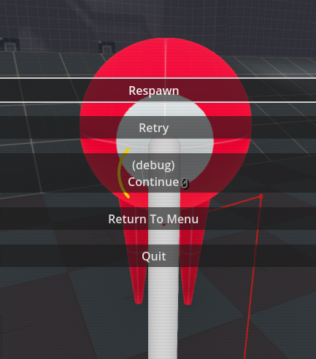


Vance Progress
TLDR: Level management and main menu stuff created.
Made a (very simplistic) main menu to load into upon starting game.
Built a level-loading script and it works… but only for the first load
Another bug! Spawning under the map. Most likely due to bad level load function.
Unreal Engine Method

Slide 5
Unreal Method for Level Management
TLDR: Same concepts as Godot, different execution
Unreal Engine has built-in functionality for level management
Level Streaming system
Editor-based and Code-wise
GameInstance class
Essentially:
The existing LevelManager class within Unreal Engine 5 handles loading and unloading through use of Unreal’s Level Streaming System.
Provides up-front methods to load new levels (scenes in Godot) and reload current level (have to make a custom one in Godot)
It also helps with dynamic loading of maps for memory saving
The GameInstance class spawns and holds a reference TO the LevelManager, and provides public methods to interface with the LevelManager (like LoadLevel() and ReloadCurrentLevel()

Slide 6
Next Update Goals
Kenneth:
Basic attack/block/parry animation(s).
(Blender -> Godot)
Player ability to change gravity.
Without using debug console
Core Cyberhack
Vance:
Fix Main Menu buttons and loading error.
Block / Parry system
Start laying out attack system

