Slide 1
UPDATE THREE
DATASPIRE PROJECT
KENNETH W.
VANCE B.

Slide 2
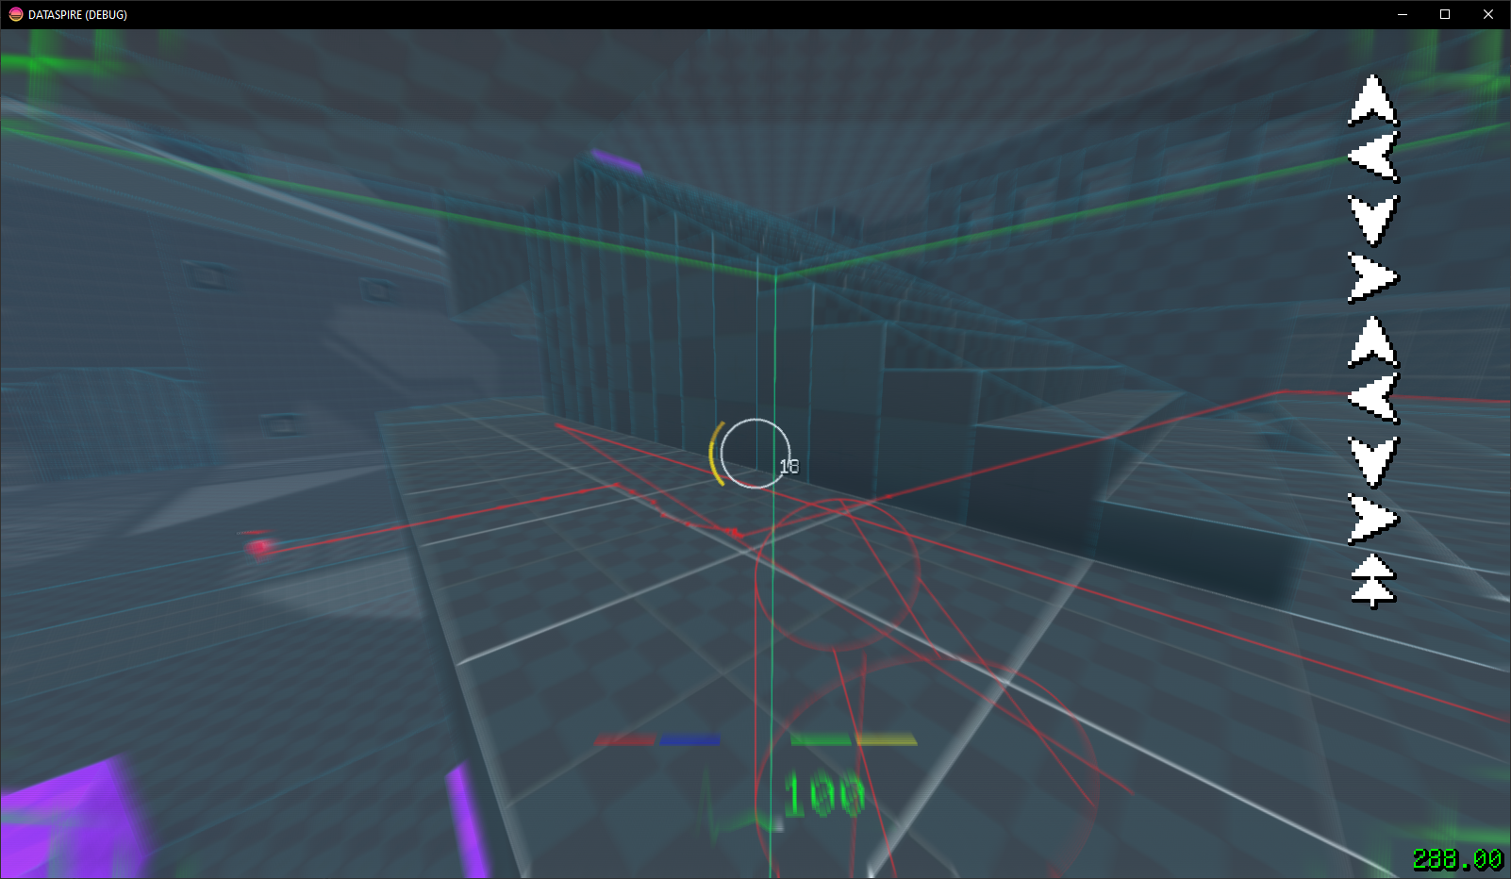
Kenneth Progress
TLDR: Strategems Core Cyberhacks Implemented Successfully
Core Cyberhack System implemented, foundation for combo input and activation as well.
Dynamic time scale modification (time speed up or slow down).
Portal optimization (still bad).

Slide 3
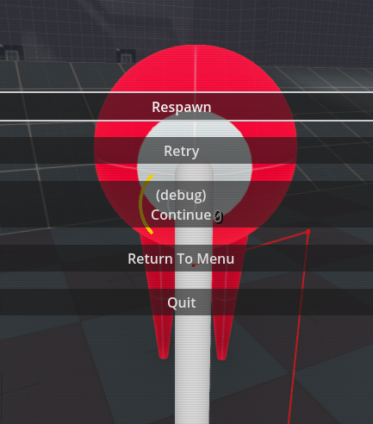


Vance Progress
TLDR: XXX
XXX
XXX
XXX

Slide 4
Next Update Goals
Kenneth:
UI Update:
Main Menu
Pause Menu
Death Screen
Player HUD
Player Animations:
Arms (Attack, Block)
Vance:
XXX
XXX
XXX

