Slide 1
UPDATE FOUR
DATASPIRE PROJECT
KENNETH W.
VANCE B.

Slide 2
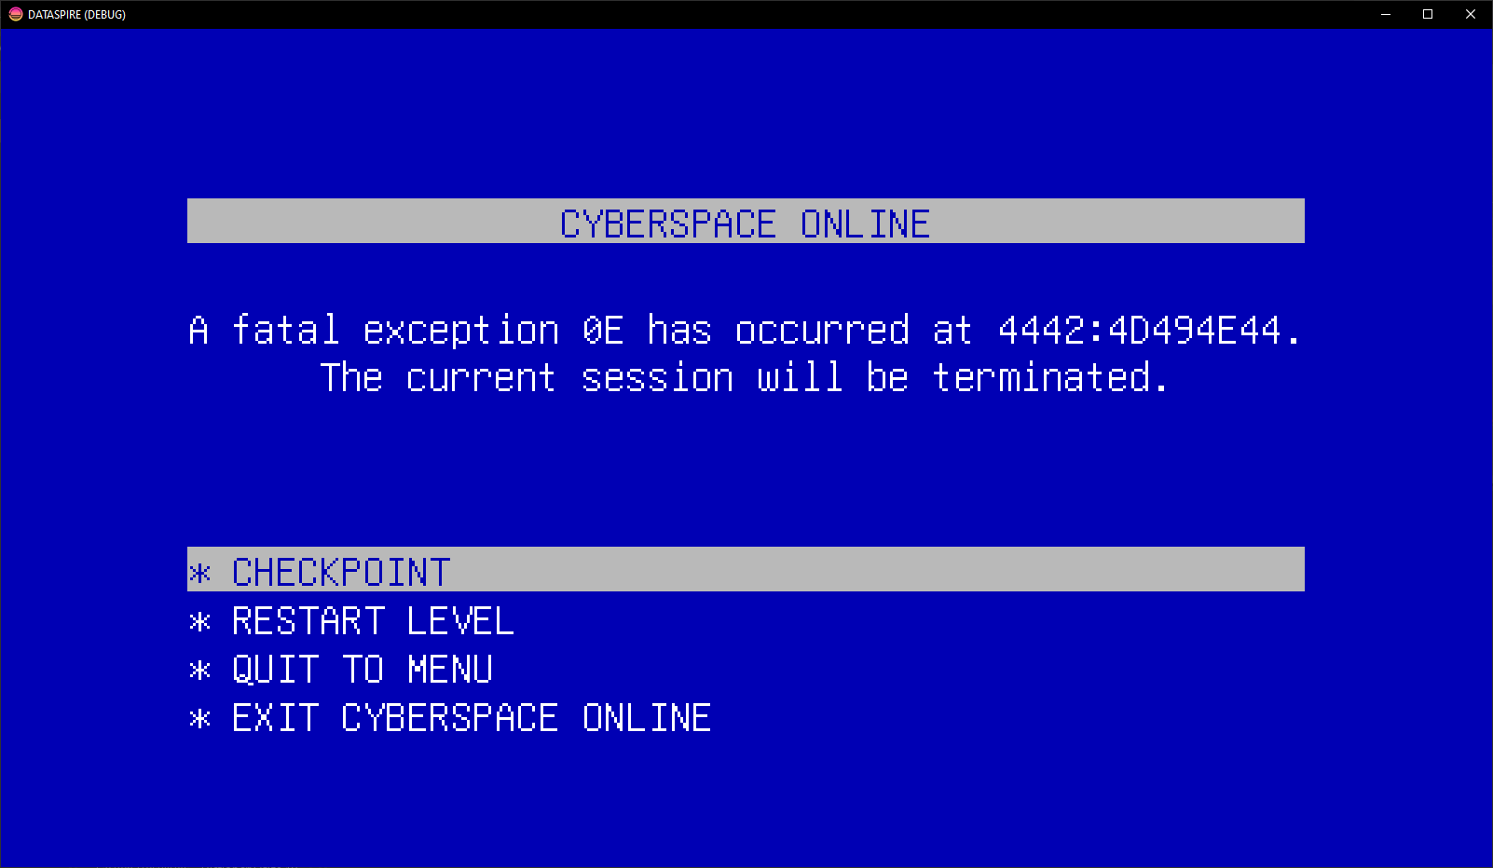
Kenneth Progress
TLDR: UI Update In Progress
Finished Main Menu prototype.
Went through the seven stages of grief and decided to remove the main menu entirely.
Refactored Level Loading, added Loading Screen.
Redid Death Screen and fixed parts of the Player HUD.
Implemented Player Knockback.

Slide 3
Why I Hate (designing) Game UI
It has to look nice with all resolutions.
Usually just prioritize the most common ones:
(1920x1080, 1600x900, etc.)
It has to stay consistent.
You wouldn’t want Win98-style windows in Windows 11.
Likewise, game UI shouldn’t conflict style-wise.
Most importantly…
It must be intuitive to players.
If your players can’t use it without reading a 3-page document
they’re going to quit the game!

Slide 4
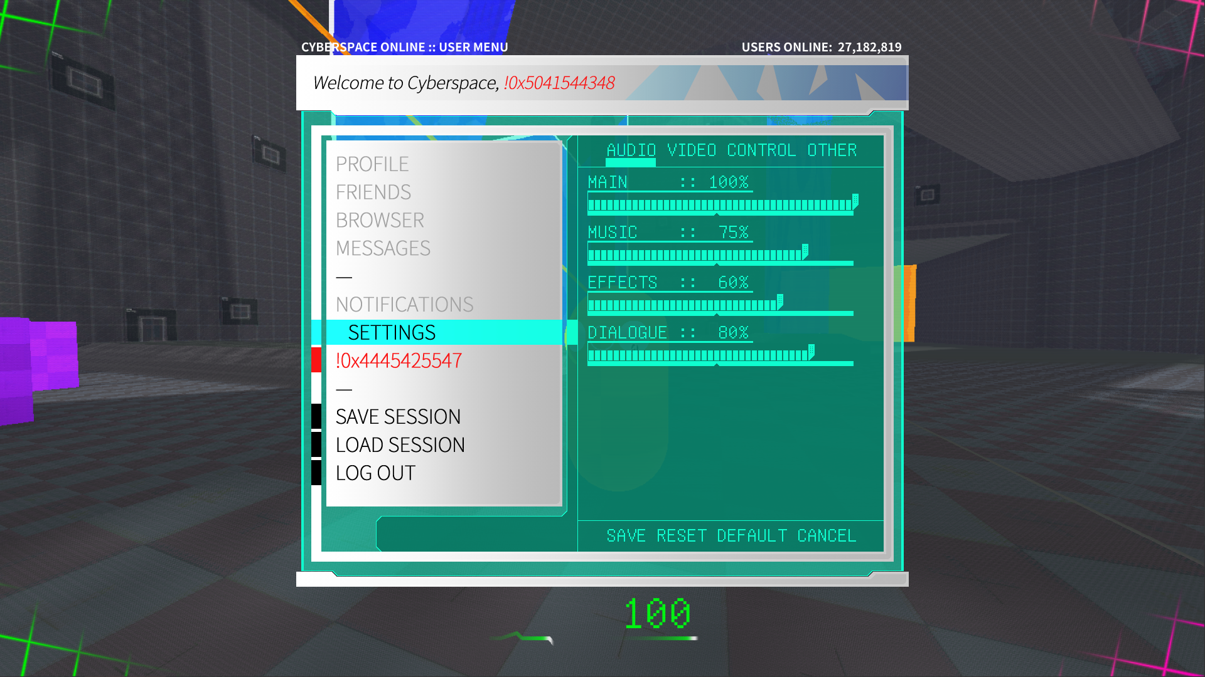

Slide 5
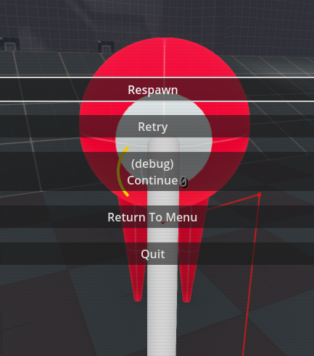


Vance Progress
TLDR: XXX
XXX
XXX
XXX

Slide 6
Next Update Goals
Kenneth:
UI Update:
Pause Menu
Debug Console
Loading Screen/Transition
Player HUD
Enemy Rework:
Movement
Attack Behavior
Knockback
Vance:
XXX
XXX
XXX

