Slide 1
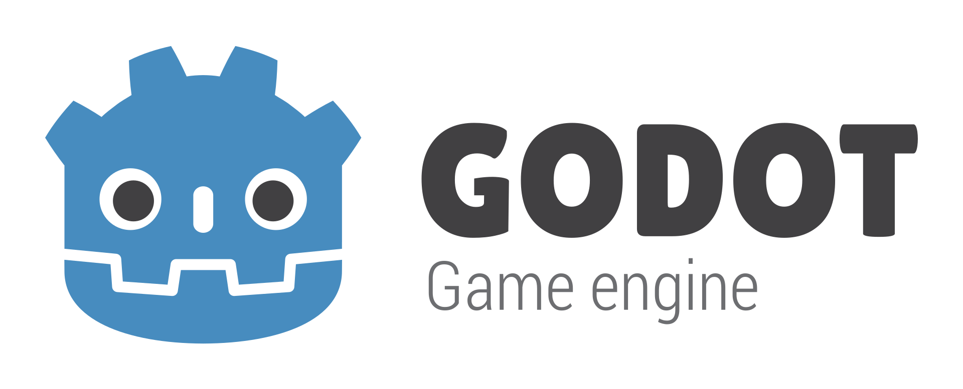
Notes:
Hello everyone! Today I’m talking about Godot.
As you know, Vance and I are using it to develop DATASPIRE.
I want to go over its history, key features, and use in the games industry.

Slide 2
WHAT’S GODOT?
Godot is an open-source game development engine.
Similar to Wikipedia in that anyone can contribute, though all contributions are reviewed.
Also one of the most popular indie game engines:
GMTK Game Jam 2023: 1278/6835 games made with Godot
GMTK Game Jam 2024: 2838/7711 games made with Godot
19% to 37% in one year, mainly opposed by Unity (59% to 43%)
Notes:
So, what is Godot?
It’s an open-source game development engine.
This means that anyone can contribute to it in a similar fashion to Wikipedia.
Any changes are submitted to the Godot GitHub repo for review and, if approved, added to the next Godot update.
Godot has been steadily gaining popularity among the indie developer community, especially due to Unity’s actions as of late.
I’ll get a bit more in detail about it later.
GMTK: Gamemaker’s Toolkit, a popular game development YouTube channel.
Game jams are game development events where participants try to make a game from scratch in a short period of time, generally limited by a theme they must follow and by time constraints.
Stair-stepping proposal: https://github.com/godotengine/godot-proposals/issues/2751

Slide 3
HISTORY OF GODOT
“Larvotor” game engine created
2001
Godot 4.0 released
2023
2018
Godot 3.0 released
2014
Godot 1.0 released on GitHub
Godot 2.0 released
2016
Notes:
Godot started as a closed-source game engine developed by two guys from Argentina, Juan Linietsky and Ariel Manzur.
Godot went open source in 2014 and has been open source since then, with its anniversary coming up this December.
Godot wasn’t very popular back in the early days, but began to pick up an audience with its 3.0 release and has been getting more popular since.
Godot 4.0 was what put it on par with other game engines such as Unreal and Unity.
Without getting into drama, that’s essentially the entire history of Godot.
2001:
Created by Juan Linietsky and Ariel Manzur.
The name “Godot” is a direct reference to the play “Waiting for Godot”.
Godot 1:
Godot 1.0 was released on December 15, meaning its ten year anniversary is soon!
Godot 2:
C# support was added in 2017 after they received a $24,000 donation from Microsoft.
Godot 3:
Surprisingly, Godot received a $250,000 donation from Epic Games in 2020, the developers of Unreal Engine.

Slide 4
KEY FEATURES: SCRIPTING
Supports GDScript, C#, C++, and C
In terms of performance, GDScript == C# < C++ == C
In terms of fun, GDScript == C# > C++ == C
Addons allow support for Rust, Nim, Haskell, Clojure, Swift, D, etc.
Generally use GDScript and C#, though GDScript is more well-integrated.
Code that needs to be optimized is generally written in C++ or C.
Notes:
I want to go over the key features of Godot, starting with scripting.
The thing everyone asks when switching to Godot is if they can use a language they’ve already learned such as C# if you’re coming from Unity.
Godot supports almost every language, either officially or through community addons.
I would still recommend learning and using GDScript as it is the most well-supported of all of the languages, and it is very easy to learn.
Other than GDScript, it’s recommended that you use low-level languages such as C, C++, or Rust when programming resource-intensive code.
GDScript is super easy to learn (Python-like syntax).
You’re still free to use any of the other languages you like, provided you can put up with using an external editor or addon.

Slide 5
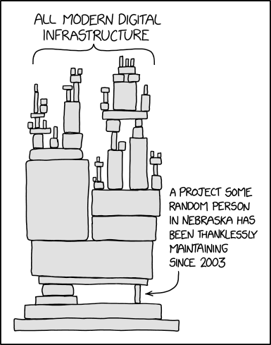
KEY FEATURES: NODES
Semi-relevant XKCD
If the Internet is a series of tubes…
then Godot is a stack of Legos.
Everything is built in containers called Scenes.
Inside scenes are Nodes used to define functionality.
Attached to nodes are Scripts which specialize nodes.
Notes:
The next key feature I’d like to discuss is the node architecture.
This quote that I made up reads: “If the Internet is a series of tubes… then Godot is a stack of Legos.”
It sounds dumb but its genuinely how everything is constructed in Godot.
You have a bunch of containers called Scenes that store everything: Levels, Menus, HUDs, Enemies, et cetera.
You define functionality within a scene by adding Nodes.
These Nodes can be further specialized by giving them Scripts.
“That one piece of code you wrote at the start of the project that you made everything depend on and forgot about.”

Slide 6
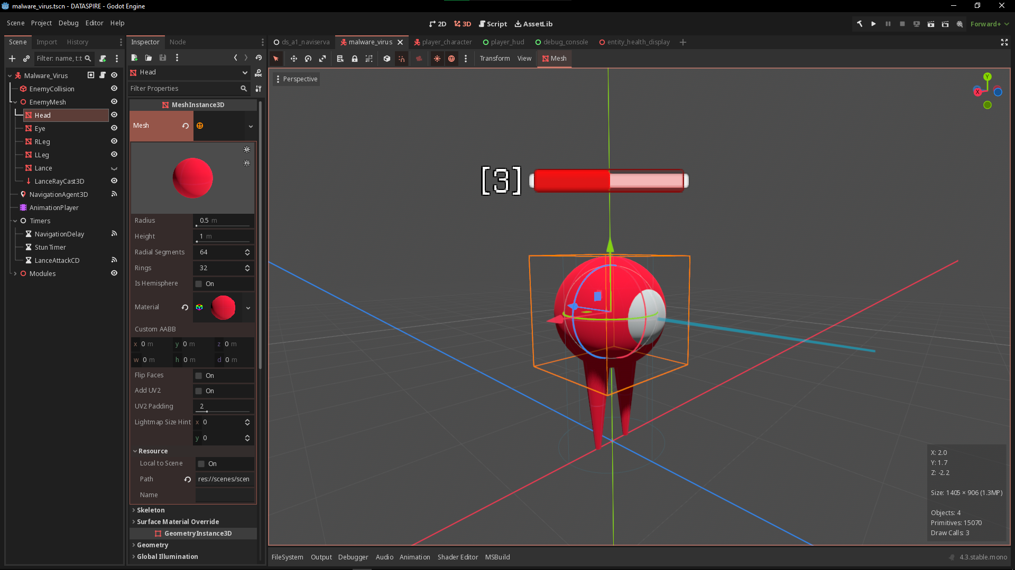
Notes:
Here is a screenshot I took of the suspicious enemy from DATASPIRE, we called it a Virus.
The Virus is contained within its own Scene.
On the left here you’ll see the Scene Tree, which contains all of the Nodes in the Virus Scene.
It’s called a Tree because there’s a hierarchy, all Nodes are children of another Node except the Root Node.
The Root Node defines the main function of the Scene.

Slide 7
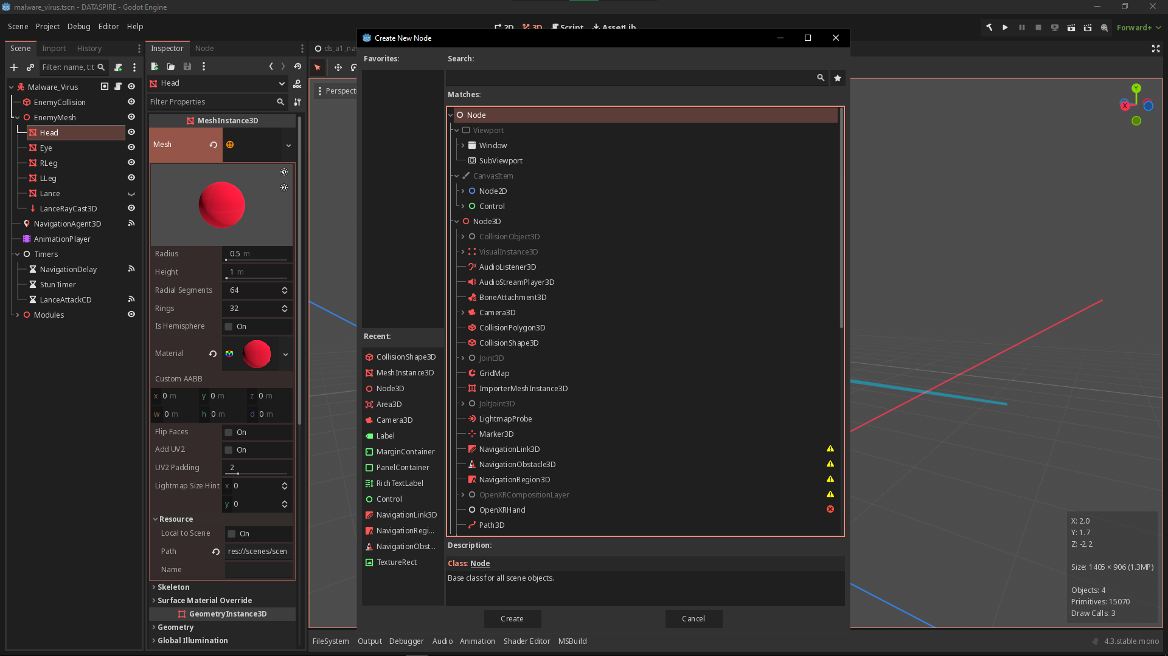
Notes:
In this screenshot, I opened up the Node menu which allows me to add a new Node to the scene.
You can see just how many Nodes there are here, though you rarely use all of them.
There’s 3D Nodes, 2D Nodes, Control Nodes, and some more specialized ones near the bottom.

Slide 8
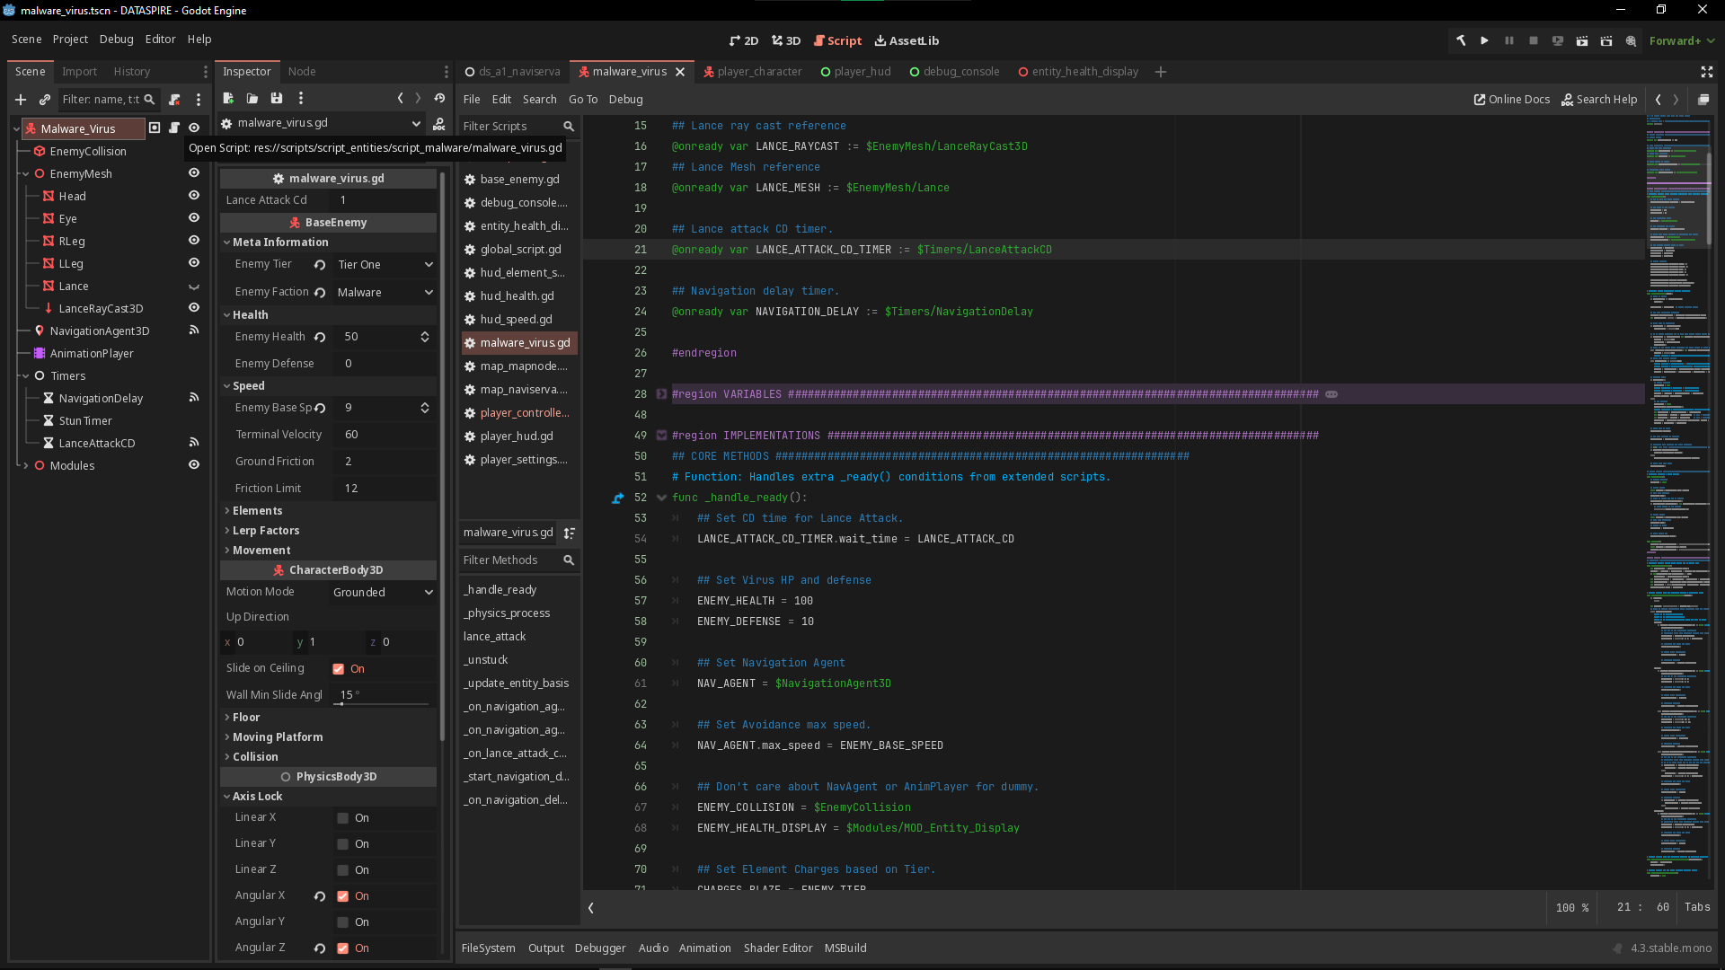
Notes:
In this screenshot I opened the Virus’s script, which is attached to the Root Node called “Malware_Virus”.
One of the things I’d like to point out is that up here is a variable that defines a reference to a Node.
This is what allows you to define Node functionality programmatically.

Slide 9
KEY FEATURES: SUPPORT
Godot has an asset library where users can submit addons for the rest of the community to use.
Submissions and updates are put under review by moderators before being pushed to the site.
Godot also has an active documentation site (also embedded within the engine itself) that you can use as reference.
Notes:
The last, and probably most important, key feature is support.
By this I mean documentation, tutorials, community-made addons, et cetera.
Godot has an official asset library where users can upload addons for other users to use.
There’s also an official documentation site, though its already embedded into the engine itself.
Its still useful to open it in a browser if you don’t want to clutter your Godot window.

Slide 10
GAMES IN GODOT: INDIE
Why do Indie developers use Godot?
Subjective:
Indie developers hate Unity!
The other engines are fine I guess?
Objective:
September 12, 2023, Unity announced a runtime fee for all Unity games.
Unity fully retracted this decision… two weeks ago.
Trust broken between Indie developers and Unity management.
Notes:
Now, it’s time for a little rant.
Why do Indie developers use Godot? Well we hate Unity.
More seriously, Vance and I almost decided on using Unity last September for DATASPIRE.
In an act of what I can only call Divine Intervention, Unity announced the runtime fee, and the game development community detonated.
This runtime fee would charge developers a royalty every time a game is installed and run once a game reaches a certain revenue threshold.
No, Unity did not elaborate on what “installing” and “running” a game meant, so people rightly lost their minds.
Safe to say, I believe Godot was the right choice for DATASPIRE.
Unity runtime fee: charge developers a royalty every time a game is installed and run, once the game reaches a certain revenue threshold.
Unity also removed a GitHub repository responsible for keeping track of changes to Unity Engine’s Terms of Service…
They fully retracted the runtime fee model a year later (Sep. 2024) and instead announced that they would annually increase the price of existing subscription plans.
Other Engines:
Unreal is more suited to AAA game development, still has problems with upper management.
Gamemaker Studio is popular, but limited to 2D games.

Slide 11
GAMES IN GODOT: AAA
Why aren’t AAA developers using Godot?
Newer engine, still maturing.
Open-source, no “official” support service.
Existing game engines are sufficient.
“If it ain’t broke…”
Lack of time and resources to switch.
Notes:
I can hear you asking though: “But why aren’t AAA studios using Godot???”
It’s the same reason why Walt Disney doesn’t use Blender: there’s no official support line.
If you’re a studio and you’re on a deadline, the last thing you want to do is debug something yourself.
Unity and Unreal are both businesses at their core, they offer support services to studios that pay up.
Godot is an open-source project and doesn’t have that advantage, there’s no business model backing it up.
Of course, there’s other reasons too: It’s still a new tool, existing tools are sufficient, we don’t have the time or money to switch…
If you hate C and love Rust, it’s all the same arguments.

Slide 12
GAMES IN GODOT: SHOWCASE
There is an official game showcase on Godot’s site.
The “Is it made with Godot” Curator on Steam lists all games made with Godot.
Not all Godot games are on Steam!
You can also check Itch.io
Notes:
Lastly, If you want to see some games made in Godot, there’s an official game showcase on Godot’s website.
There’s also a curator on steam that you can follow, they tag all games made with Godot on steam.

Slide 13
QUESTIONS?

