Slide 1
Carry Look-Ahead Adder
Jheel Makhijani
Drashti Khatri

Slide 2
Why CLA?
In RCA, if number of bits increases, propagation delay increases. There is carry dependency in RCA.
Hence, CLA is used to eliminate propagation delay.

Slide 3
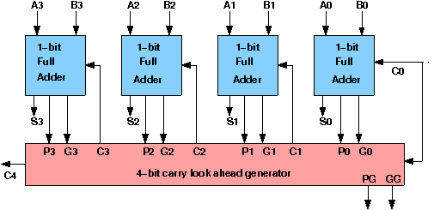
P_{i} = A_{i} ⊕ B_{i}
G_{i} = A_{i} · B_{i}
Carry Propagator
Carry Generator

Slide 4
How it Works
Sum_{i} = P_{i} ⊕ C_{i}
C_{i+1} = G_{i} + ( P_{i} · C_{i})
C₁ = G₀ + P₀ · C₀
C₂ = G₁ + P₁ · C₁ = G₁ + P₁ · G₀ + P₁ · P₀ · C₀
C₃ = G₂ + P₂ · C₂ = G₂ P₂ · G₁ + P₂ · P₁ · G₀ + P₂ · P₁ · P₀ · C₀
C₄ = G₃ + P₃ · C₃ = G₃ P₃ · G₂ P₃ · P₂ · G₁ + P₃ · P₂ · P₁ · G₀ + P₃ · P₂ · P₁ · P₀ · C₀

Slide 5
Advantage
Drawback
It does not need to wait till the previous stage generates the carry. It can generate carry for each full adder simultaneously, hence it is faster as compared to the ripple carry adder.
Requires complex hardware to generate the carry based on input signals and the complexity grows with an increasing number of bits.

Slide 6
module CarryLookAheadAdder(A,B,Cin,S,Cout);
input [3:0]A, B,;
input Cin;
output [3:0] S;
output Cout;
wire [3:0] Ci;
assign Ci[0] = Cin;
assign Ci[1] = (A[0] & B[0]) | ((A[0]^B[0]) & Ci[0]);
assign Ci[2] = (A[1] & B[1]) | ((A[1]^B[1]) & ((A[0] & B[0]) | ((A[0]^B[0]) & Ci[0])));
assign Ci[3] = (A[2] & B[2]) | ((A[2]^B[2]) & ((A[1] & B[1]) | ((A[1]^B[1]) & ((A[0] & B[0]) | ((A[0]^B[0]) & Ci[0])))));
assign Cout = (A[3] & B[3]) | ((A[3]^B[3]) & ((A[2] & B[2]) | ((A[2]^B[2]) & ((A[1] & B[1]) | ((A[1]^B[1]) & ((A[0] & B[0]) | ((A[0]^B[0]) & Ci[0])))))));
assign S = A^B^Ci;
endmodule

Slide 7
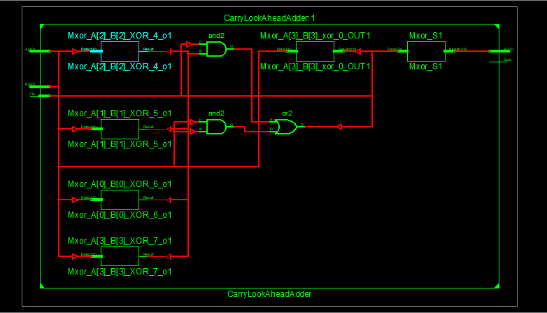
RTL Schematic

Slide 8
`timescale 1ns / 1ps
module CLA_tb;
reg [3:0] A,B;
reg Cin;
wire [3:0] S;
wire Cout;
integer i,j;
CarryLookAheadAdder uut (.A(A), .B(B), .Cin(Cin), .S(S), .Cout(Cout));
initial begin
A = 0; B = 0; Cin = 1;
#100;
for(i=0;i<=15;i=i+1)
begin
A=i; #5;
for(j=0;j<=15;j=j+1)
begin
B=j; #5;
$display("A=%b, B=%b, Cin=%b, S=%b, Cout=%b",A,B,Cin,S,Cout);
end
end
#5 $finish;
end
endmodule

Slide 9
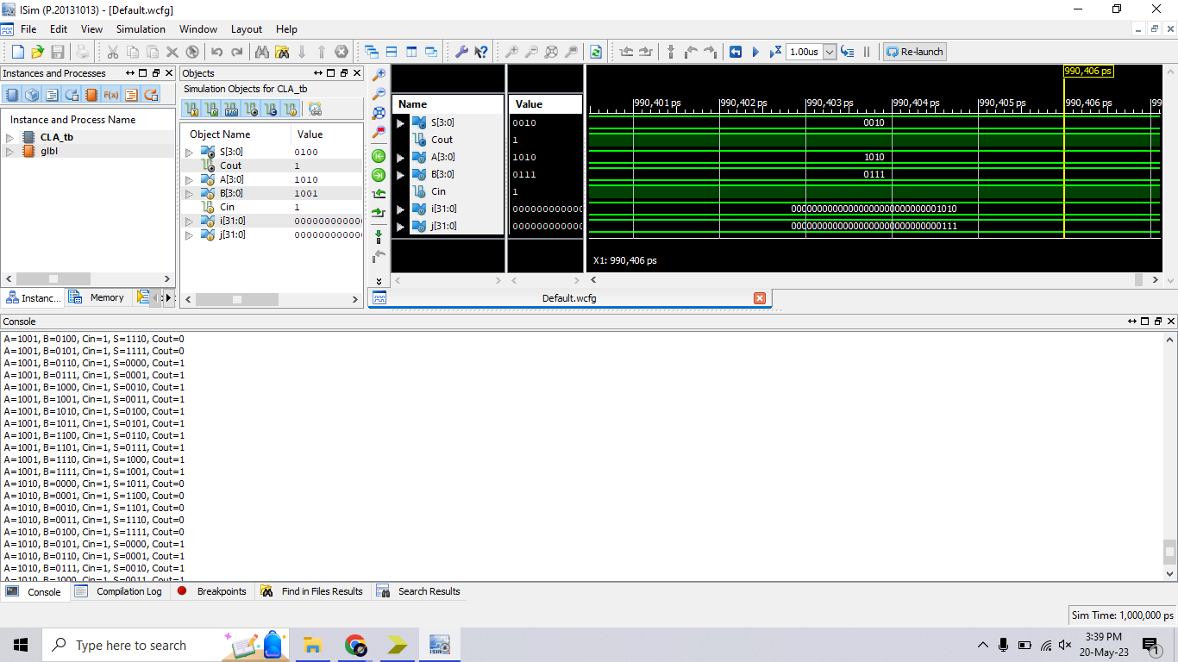
Simulation

