Slide 1


Secure Remote Access VPN using WireGuard
Project By:
Jheel Girish Bhandia
CONFIDENTIAL: The information in this document belongs to Boston Institute of Analytics LLC. Any unauthorized sharing of this material is prohibited and subject to legal action under breach of IP and confidentiality clauses.

Slide 2
Agenda
Introduction
Project Objectives
Remote Access Solution Design Document
Encryption and Authentication Plan
Endpoint Security Plan
Network Access Control Strategy
Secure Remote Access Tools Configuration
Monitoring and Logging Plan
User Training Materials
Policy and Compliance Documentation
Mitigation
Conclusion

Slide 3
INTRODUCTION
In today’s digital workplace, employees frequently access company systems while working remotely or traveling. This creates the need for a secure and reliable method to connect to corporate resources. Without proper security, remote access can expose the organization to cyber threats, data breaches, and unauthorized access.
The purpose of this project is to design and implement a secure remote access solution that ensures confidentiality, integrity, and authentication of all remote connections. This includes using VPN technology, strong encryption, multi-factor authentication, and endpoint security to protect sensitive corporate data from potential cyber risks.
This project focuses on evaluating the existing remote access infrastructure, identifying security gaps, and deploying a comprehensive secure access solution. The solution includes VPN implementation, MFA integration, Zero Trust principles, secure remote tools, and centralized monitoring. The final outcome enables employees to safely access company resources from any location while maintaining strong security controls.

Slide 4
OBJECTIVES
To provide employees a safe and secure way to connect to company systems from home or while traveling.
To protect company data from unauthorized access using VPN and strong encryption.
To improve security by adding Multi-Factor Authentication (MFA) for all remote logins.
To ensure only safe and updated devices can connect to the network using endpoint security checks.
To follow the Zero Trust approach where every user and device is verified before giving access.
To monitor remote access activities and quickly detect suspicious behavior.
To create clear security policies and train employees on safe remote working practices.

Slide 5
Remote Access Solution Design Document
Provide secure remote access for employees/administrators with encryption, MFA, and controlled access.
Key Technologies :
VPN (fast, modern, secure)
Identity Provider (Azure AD / Okta) with MFA
Reverse Proxy / App Gateway for web apps
SIEM for centralized monitoring
Firewall + Micro-segmentation

Slide 6
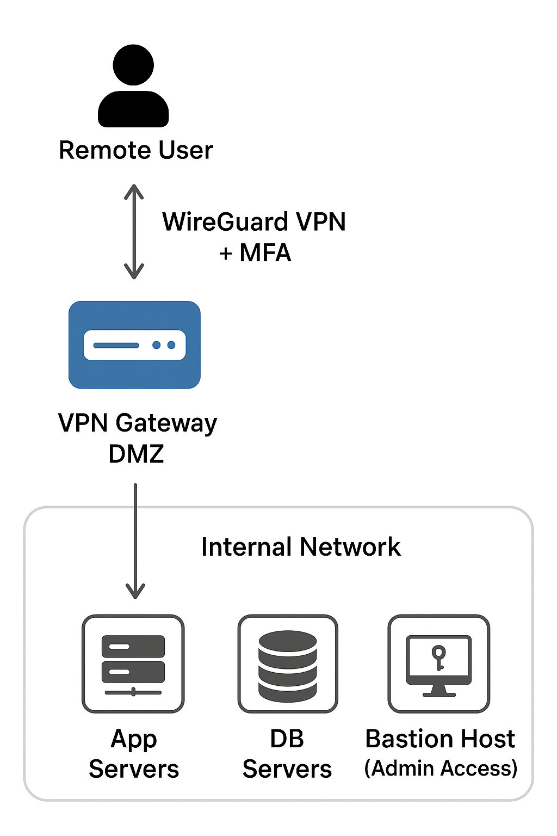
High-Level Architecture

Slide 7
Network Design & Security Controls
VPN Subnet: 10.200.0.0/22
Internal Segments:
  Mgmt: 10.10.0.0/24
  Apps: 10.10.1.0/24
  DB: 10.10.2.0/24
Split DNS for internal resolution
Routing: Allow only required subnets via AllowedIPs
Firewall Rules
Default deny-all
Allow UDP 51820 (WireGuard)
VPN subnet → only approved internal services
Admin access via bastion host only
Security Enhancements
Mandatory MFA
Endpoint posture check (EDR/MDM)
Full logging to SIEM (VPN, auth, firewall)

Slide 8
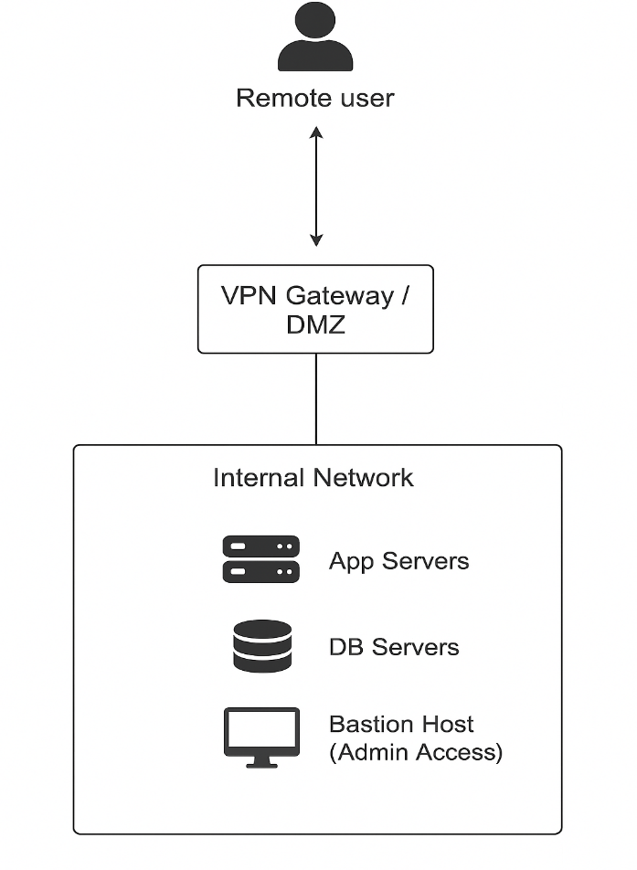
Encryption and Authentication Plan
An enterprise encryption strategy ensures confidentiality, integrity, authenticity, and non-repudiation of data across the organisation. It standardizes how data is encrypted in transit, at rest, and during processing, including key management and compliance enforcement.
Chosen Protocols
WireGuard VPN – ChaCha20 & Poly1305
  High-speed, modern encryption
  Perfect forward secrecy (PFS)
TLS 1.3 for Applications
  Strong cipher suites only (AES-256-GCM / ChaCha20)
  Enforced HSTS, certificate pinning
Database Encryption
  AES-256 at rest (Transparent Data Encryption – TDE)
  Encrypted backups + key rotation policy
Key Management
Centralized KMS (AWS KMS / HashiCorp Vault)
Rotate keys every 90 days
Disable weak ciphers and deprecated protocols (SSL, TLS 1.0/1.1)

Slide 9
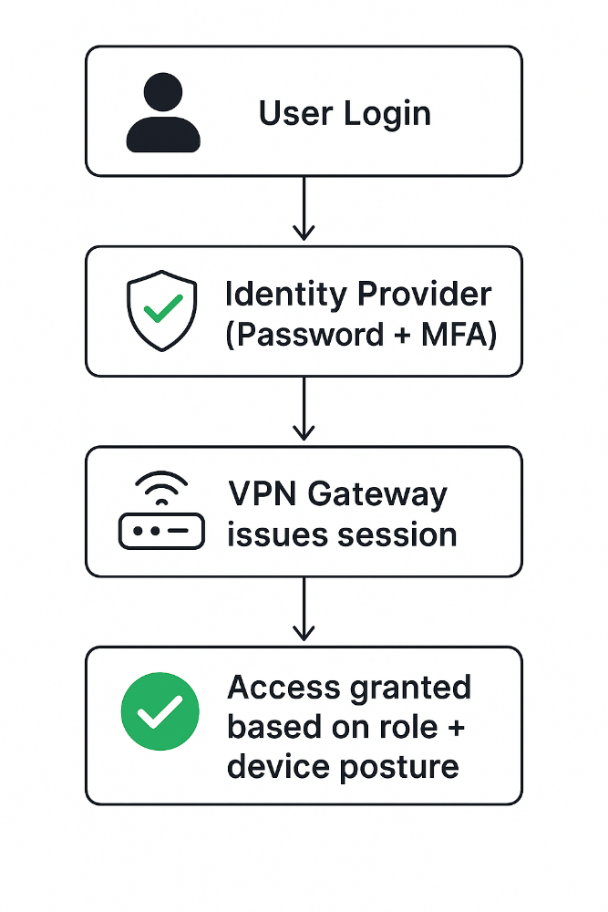
Authentication Plan (MFA + Access Control)
Authentication Mechanisms MFA Enforcement Flow
Primary Authentication: Identity Provider (Azure AD / Okta)
Multi-Factor Authentication:
  TOTP (Google Authenticator / Authy)
  Push-based MFA (Microsoft Authenticator / Okta Verify)
  Hardware Keys FIDO2 / YubiKey
Optional: Device Posture Check (EDR/MDM)
MFA / Authentication Configuration Guidelines
Enforce MFA for all VPN connections.
Enable Conditional Access:
  Block unknown geolocations
  Allow only compliant devices
Use short-lived access tokens (max 8–12 hours).
Map IdP groups → VPN access roles (e.g., vpn-user, vpn-admin).

Slide 10
Endpoint Security Plan
Endpoint Protection Requirements
Mandatory EDR/Antivirus (Defender, CrowdStrike, SentinelOne)
Full Disk Encryption (BitLocker / FileVault)
Auto Patch Management for OS & apps
Enforced device firewall, strong password, screen lock
Compliance Checks (Before VPN Access)
EDR active + real-time protection ON
Disk encryption enabled
OS fully updated (no critical patches pending)
No malware or suspicious activity detected
Deployment Guidelines
Install EDR agent before enabling remote access
Auto-enroll devices in MDM/Intune
Non-compliant devices → blocked or quarantined VLAN

Slide 11
Network Access Control Strategy
Zero Trust Security
Never trust, always verify
Identity + device posture–based access
Continuous authentication & authorization
Least-privilege access enforced across network
Network Segmentation
Separate zones: Mgmt, Apps, DB, Guest/IoT
Strict ACLs between segments
East-West traffic allowed only through inspected paths
Micro-segmentation using firewall/SDN/service mesh

Slide 12
Access Control (NAC)
802.1X for wired/wireless
NAC tools: Cisco ISE / FortiNAC / Aruba ClearPass
Non-compliant devices → quarantine VLAN
Policies based on user + device + compliance state
Monitoring
SIEM logging of all access attempts
Real-time alerts for posture failures
ZTNA gateways for continuous session validation

Slide 13
Secure Remote Access Tools Configuration
Remote Desktop Services
Use hardened RDP or equivalent
Enforce MFA + Network Level Authentication (NLA)
Restrict access via VPN + firewall rules
Enable session logging & clipboard/device redirection control
Secure File Sharing
Use encrypted file-sharing platforms (e.g., SharePoint, OneDrive, Nextcloud)
Apply role-based access control (RBAC)
Enforce DLP policies to prevent data leakage
Enable audit logs and version control

Slide 14
Monitoring and Logging Plan
Monitoring Setup
Deploy continuous monitoring for VPN, RDP, and endpoint activity
Enable real-time alerts for suspicious login attempts, unusual access, or failed authentications
Configure behavior analytics to detect anomalies
Integrate monitoring output with SOC dashboards
Logging Configuration
Centralize logs from:
  VPN Gateway
  Authentication Server (AD/IdP)
  Endpoint Security Tools (EDR)
  Firewalls & Network Devices
Use a SIEM platform: ELK / Splunk / QRadar / Azure Sentinel

Slide 15
Security & Compliance
Configure log retention: 90–365 days
Enable timestamping & integrity checks
Restrict access to logs (RBAC)
Schedule weekly log reviews & automated reports
Response Workflow
Alerts → SIEM → SOC Analyst Review
Incident ticket creation for high-severity events
Automated response for common threats (e.g., lock account, block IP)

Slide 16
User Training Materials
Training Topics
Safe remote access usage (VPN, MFA, secure passwords)
Identifying phishing, social engineering & suspicious emails
Secure file sharing and data handling practices
Device security basics (updates, EDR alerts, encryption)
Reporting security incidents quickly
Training Materials Provided
Step-by-step guides (PDF)
Short video tutorials
Do’s & Don’ts cheat sheet
Monthly awareness posters & email tips
Hands-on demo sessions for VPN & MFA
Training Schedule
Initial onboarding training for all new employees
Quarterly security awareness sessions
Annual compliance certification

Slide 17
Policy and Compliance Documentation
Core Remote Access Policies
Approved remote access methods (VPN, MFA, secure RDP)
Device security requirements (EDR, patching, encryption)
Acceptable use rules for remote work
Data handling & classification guidelines
Compliance Requirements
Adherence to internal security standards
Compliance with frameworks: ISO 27001, NIST, GDPR (if applicable)
Regular access reviews and least-privilege enforcement
Mandatory log retention (90–365 days)
Documented incident response & escalation process
Documentation Package Includes
Remote Access Policy
VPN & MFA Configuration Standards
Endpoint Security Requirements
Change Management & Audit Procedures

Slide 18
Mitigation
MFA + RBAC to block unauthorized access.
EDR, encryption, patching to secure endpoints.
Zero Trust + segmentation to limit lateral movement.
Secure VPN setup with restricted subnet access.
Continuous monitoring & SIEM logging for threat detection.
User training to reduce phishing and credential attacks.
Hardened RDP & secure file sharing to prevent misuse.

Slide 19
Conclusion
Secure remote access is fully strengthened using VPN, MFA, and encryption.
Zero Trust principles ensure continuous verification and least-privilege access.
Network segmentation reduces lateral movement and protects critical systems.
Endpoint security controls ensure only compliant devices can connect.
Centralized monitoring & logging improve threat detection and incident response.
User awareness training reduces human-based security risks.
The solution enhances overall security posture while enabling safe remote work.

Slide 20
Questions ?

Slide 21
Thank You!
CONFIDENTIAL: The information in this document belongs to Boston Institute of Analytics LLC. Any unauthorized sharing of this material is prohibited and subject to legal action under breach of IP and confidentiality clauses.

