Slide 1
Data Science Course
Introduction
IFT6758, Fall 2020

Slide 2
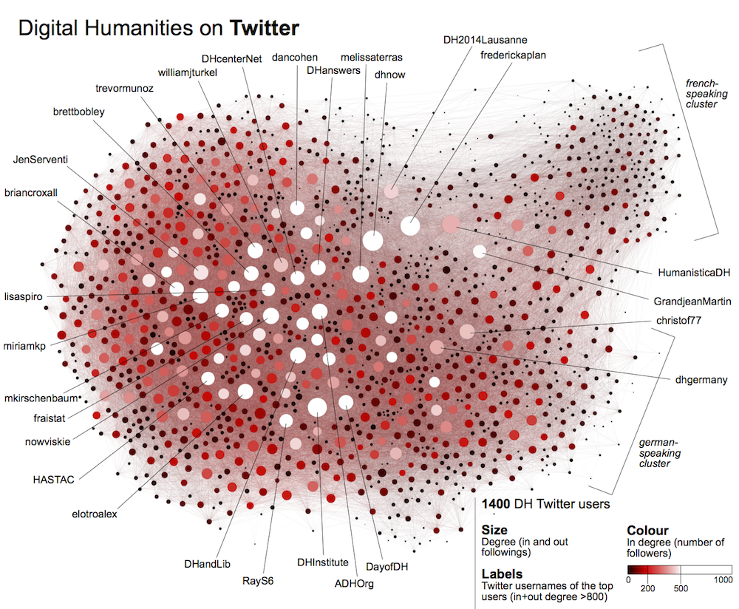


Introduction: the era of big data
Billions of sensors have been collecting data for decades
Data is routinely collected and employed for
Scientific discovery
Commercial purposes
Data driven society
Huge resource of public datasets
https://github.com/awesomedata/awesome-public-datasets
It’s important that data scientists work responsibly and for greater good

Slide 3
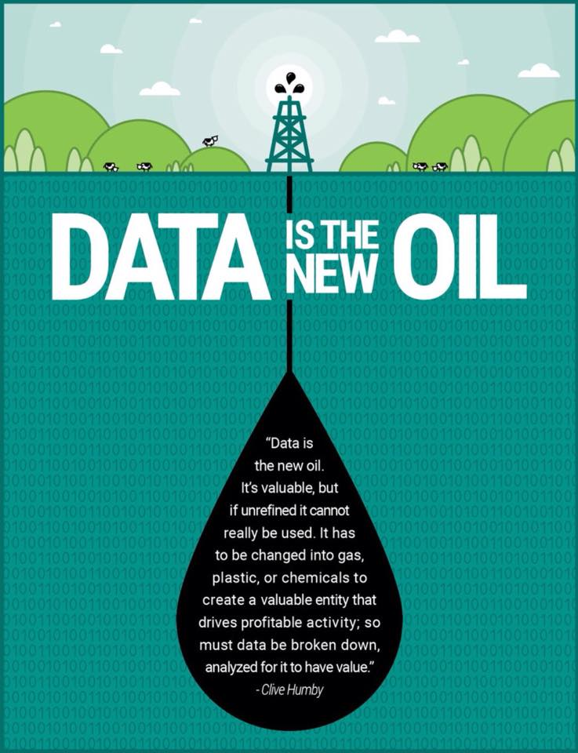
Data is the new oil
Or, is it?
Unlike oil, when dealing with data, it is far from clear how exactly to turn that data into profits.
Why data is not new oil

Slide 4
Know the data
Be comfortable with data
Build competence working with multimodal data sets
Exposure to the full data science workflow
Become a data detective
Learn to ask good questions
Reason about uncertainty, think critically
Learn responsible data science
Understand risks at all stages of data science workflow

Slide 5
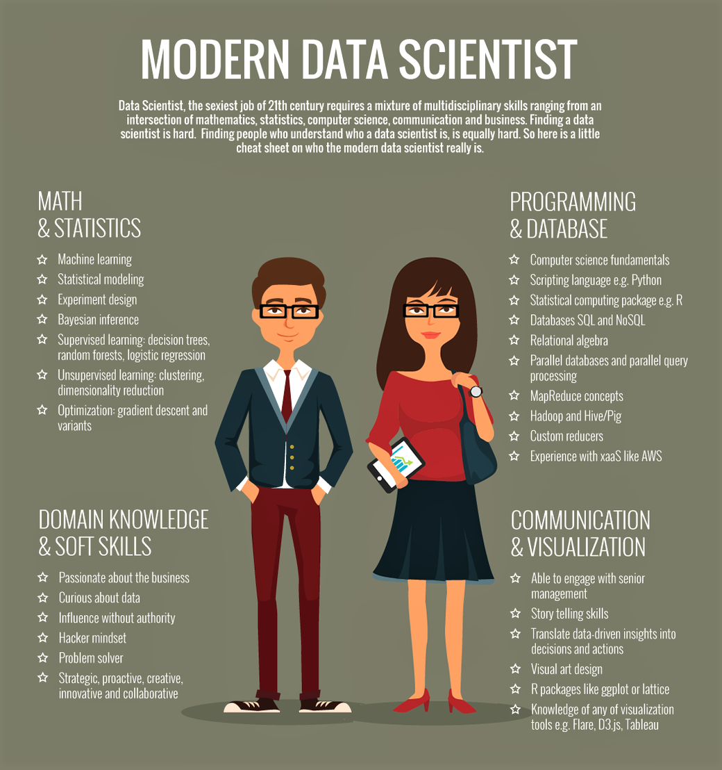
Takeaway from this course
Prepare you to be responsible and competent data scientists
Learn how to…
Apply data science in your own field
Work in industry or research
Understand data’s role in society

Slide 6
Course outline (subject to minor changes)
Part 1: Summaries and Inferences
Data visualization and transformation
Supervised and unsupervised learning from data
Inference and model comparison
Part 2: Nontabular data
Text and Image
Graph mining
Special topics: Reinforcement Learning and Deep Learning
Part 3: Frontiers
Advanced inference
Ensembling
Privacy and explainability

Slide 7
Logistics
Course website: https://jhelum-ch.github.io/DataScience_IFT6758/
Fill Survey for access to discussion forum
Grading: 25% Final project, 30% HW, 30% Midterm, 15% Kaggle competition
Instructor & TA Office Hours: TBA
Use StudiUM Forum to reach out to the instructor
In case of emergency:
Instructor: Jhelum – chakravj@mila.quebec
Head TA: Pravish – pravishsainath@gmail.com
TAs: Yutong Yan, Alexander Peplowski, Harmanpreet Singh, Akshay Singh Rana

Slide 8
Resources
Books: Statistical Learning, Python Handbook, Introduction to Data Science
Online courses: freeCodeCamp , Harvard CS109
Harvard’s Data Science Review

