Slide 1
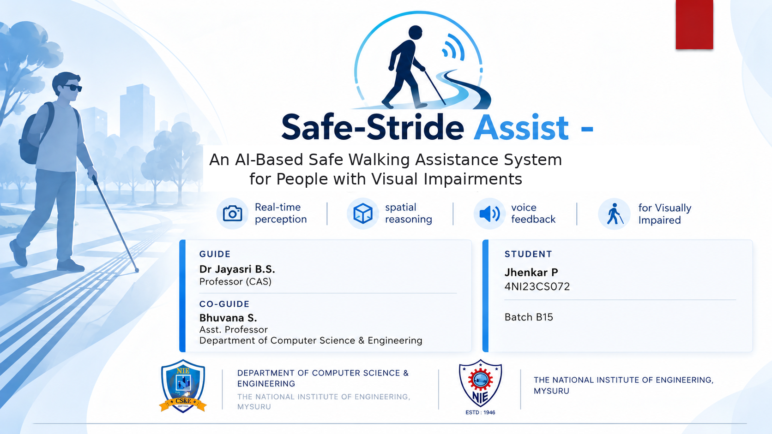

Slide 2
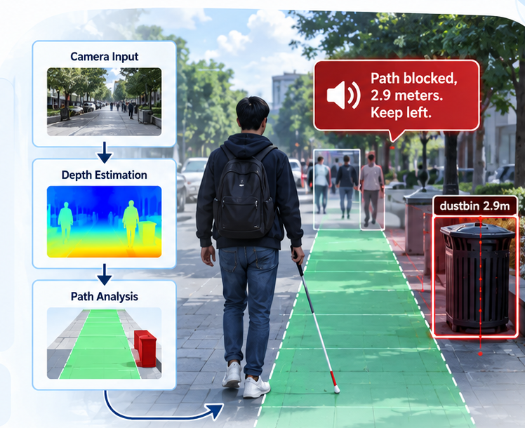
SAFESTRIDE ASSIST
PROJECT OVERVIEW
Abstract
AI walking support for people with visual impairment
LOCAL CAMERA PROCESSING
Camera and video are analyzed locally.
AI OBSTACLE DETECTION
YOLO11s detects objects; ByteTrack tracks them.
DEPTH & WALKING PATH
Depth estimation checks a 3 m forward corridor.
VOICE GUIDANCE
Highlights blockers and suggests a clearer side.
KEYWORDS
Safe Walking Assistant • Computer Vision • YOLO • Monocular Depth • Distance Estimation • Obstacle & Blocker Detection • Voice Alerts • Spatial Reasoning
B15 | 02

Slide 3
SAFESTRIDE ASSIST
PRESENTATION ROADMAP
Presentation Roadmap
A clear path from the problem and prior work to our system, results and takeaways.
04
Introduction
09
Proposed system
CONTEXT
OUR APPROACH
05
Problem statement
10
System architecture
THE CHALLENGE
DESIGN
06
Literature review
11
Mathematical formulation & algorithms
RELATED WORK
CORE METHODS
07
Research gaps
12
Implementation & live results
WHAT IS MISSING
DEMONSTRATION
08
Existing systems & limitations
13–14
Conclusion & research references
BASELINE
OUTCOMES
PROBLEM → RESEARCH → DESIGN → IMPLEMENTATION → CONCLUSION
B15 | 03

Slide 4
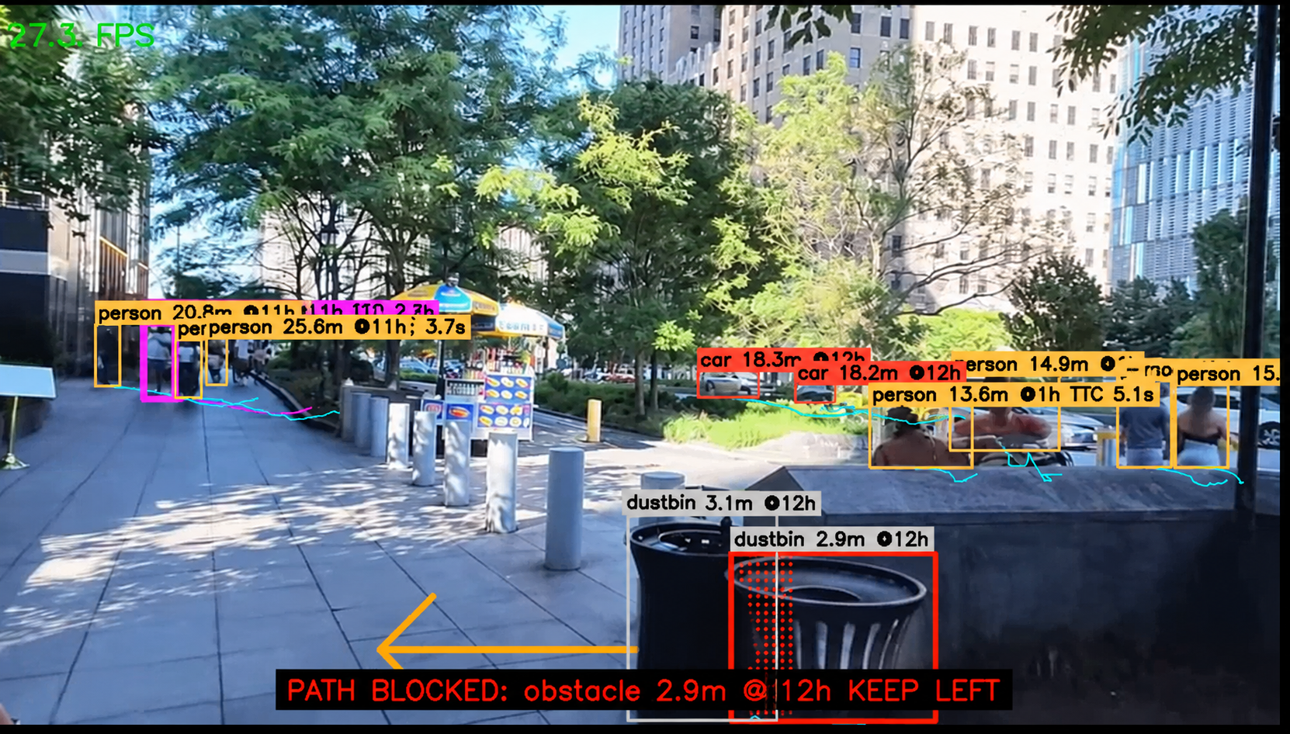
SAFESTRIDE ASSIST
MOTIVATION
Introduction
An extra layer of awareness for safer walking.
Designed to support—not replace—established mobility aids.
1 SPOT WHAT MATTERS
People, poles, vehicles, steps, and unfamiliar blockers can obstruct the path.
2 UNDERSTAND THE PATH
Estimate distance and check whether an obstacle lies inside the forward corridor.
3 GIVE CLEAR FEEDBACK
Use concise voice alerts with distance and a suggested clear side when possible.
LIVE SCENE • OBSTACLE DETECTION + PATH ALERT
Actual Safe-Stride Assist prototype output
Prototype only • Continue using a cane, guide dog, or human support.
B15 | 04

Slide 5
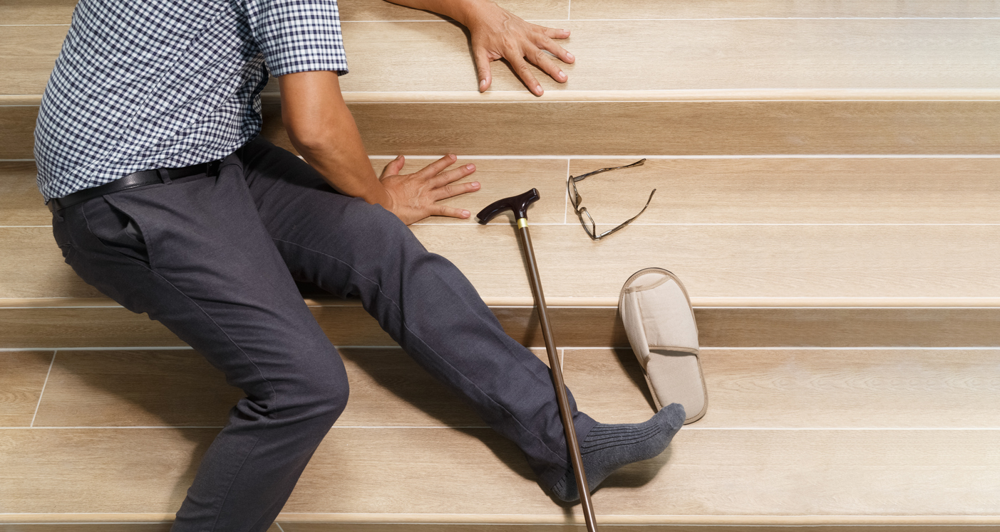
SAFESTRIDE ASSIST
THE NEED
B15 | 05
Problem Statement
When hazards are missed, everyday movement can become dangerous.
PATH IS UNCLEAR
01
A person or object may be visible yet sit outside the usable walking corridor.
DISTANCE IS UNKNOWN
02
A bounding box cannot tell the user whether a hazard is 0.5 m or 3 m away.
UNFAMILIAR BLOCKERS
03
Poles, bins, branches, and temporary barriers may not fit known object classes.
REAL-WORLD RISK • A MISSED HAZARD CAN CAUSE A FALL
ALERTS CAN OVERWHELM
04
Repeated warnings need prioritisation by path relevance and approach risk.
Safe walking support must do more than label objects: it must identify hazards and judge whether they threaten the walking path.
THE CORE GAP
Detect → Estimate distance → Judge path risk → Give concise guidance
Safe-Stride focuses on what is in the walking corridor and what action may help.
Illustrative image supplied for the presentation.

Slide 6






SAFESTRIDE ASSIST
RESEARCH FOUNDATION
Literature review
SIX RESEARCH PILLARS • HOW PRIOR WORK INFORMS SAFE-STRIDE ASSIST
Real-time perception
Temporal tracking
Monocular depth
Redmon et al. [1] • Ultralytics [5]
Zhang et al. [2]
Yang et al. [3] • Ranftl et al. [4]
OPEN SOURCE ↗
YOLO detects relevant objects in each frame.
OPEN SOURCE ↗
ByteTrack links detections across frames to stabilise identity and motion.
OPEN SOURCE ↗
Depth maps reveal scene structure; metric distance still needs assumptions.
Navigation & obstacles
Audio & haptics
User agency & access
Khan et al. [7] • Xu et al. [8] • Eltaher et al. [10]
Katzschmann et al. [9] • Johannesson et al. [11] • Shull & Damian [12]
Ranganeni et al. [13] • Zhang et al. [14] • WHO [6]
OPEN SOURCE ↗
Reviews motivate context-aware obstacle avoidance and route guidance.
OPEN SOURCE ↗
Spatial audio and haptics can communicate direction and proximity.
OPEN SOURCE ↗
Guidance should preserve user control and complement established aids.
RESEARCH GAP → Combine detection + tracking + approximate geometry + path risk + concise, user-controlled feedback.
Select a pictogram or cloud to open a related paper, project, or official resource.
B15 | 06

Slide 7



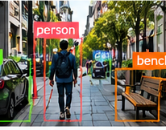


7
Research Gaps to Address
The system must move beyond “what is in the image?” to “what could affect the next few steps?”
01
No collision / approach reasoning
02
No walking-corridor reasoning
Frame-by-frame detections do not establish whether an object is approaching or likely to intersect the walking path.
Objects off to the side may trigger noise, while a relevant blocker inside the forward corridor may need priority.
03
Unfamiliar blockers can be missed
04
Distance is not urgency
Temporary structures, low-contrast objects, and hazards outside trained classes may not be recognised.
A label alone does not say how close a hazard is, how quickly the user should respond, or which side is clearer.
05
Ground changes remain difficult
06
Repeated alerts increase cognitive load
Steps, curbs, and changes in level need dedicated evaluation; they are a limitation, not a solved feature of the current prototype.
Speech should be prioritised using persistence, distance, path relevance, and risk—not every detection in every frame.
SAFE-STRIDE
DIRECTION
Detect
Track
Estimate
Reason
Guide
YOLO11s
ByteTrack
Depth + scale
3 m corridor
Prioritised voice
SAFESTRIDE ASSIST • RESEARCH & DESIGN
B15 | 07

Slide 8
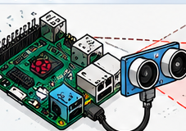
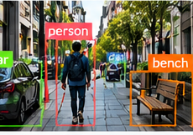
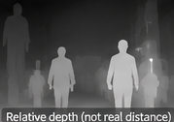
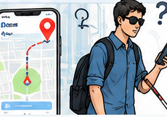
8
Existing Systems & Their Limitations
Different tools provide pieces of assistance, but often stop short of a complete walking-path decision.
Raspberry Pi / sensor-based aids
Camera object detection
Short sensing range
Labels are not safe guidance
May detect a nearby object, but often cannot identify it, track motion, or reason about the walking path.
Bounding boxes identify visible classes; they do not reliably estimate distance or decide whether an object blocks the route.
Monocular depth systems
Navigation / map apps
Relative depth has uncertainty
Route is not hazard awareness
Depth varies with lighting, camera motion, and scene structure; it is not automatically a dependable distance measurement.
A route may guide a user between places but may not describe a branch, step, temporary barrier, or blocked section ahead.
THE CORE ISSUE
Perception, distance, movement, and route context are often handled separately—not as one timely decision about the person’s forward path.
SAFESTRIDE ASSIST • RESEARCH & DESIGN
B15 | 08

Slide 9
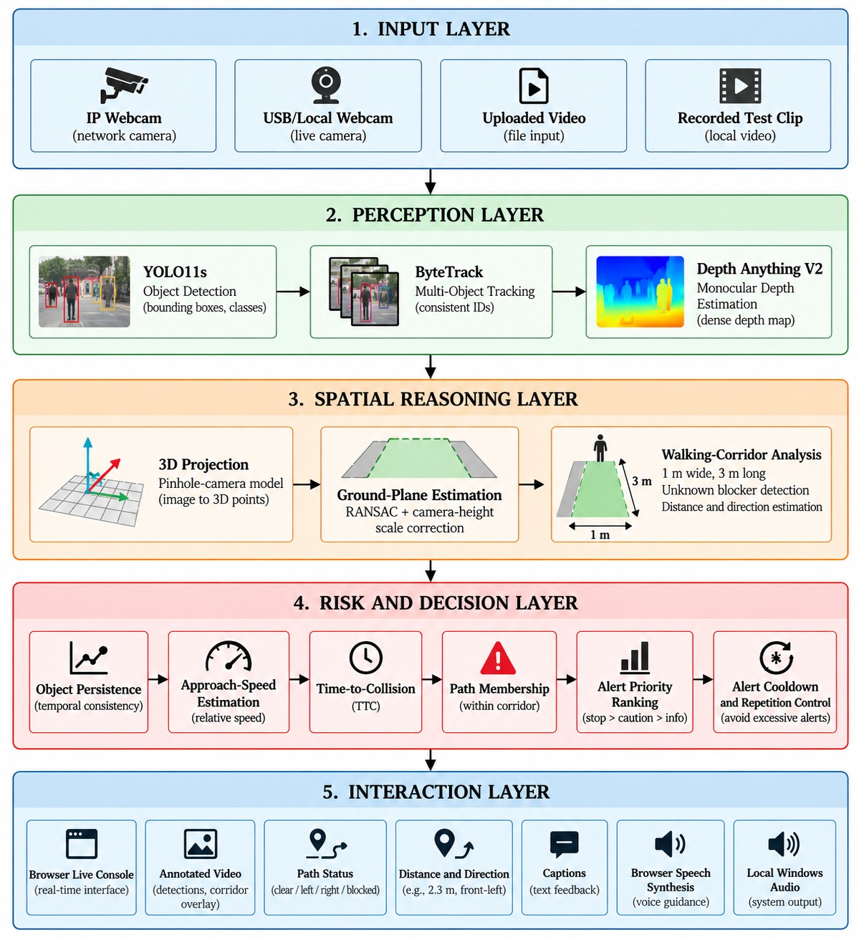
SAFESTRIDE ASSIST • PROPOSED DESIGN
Proposed System
HOW THE PIPELINE WORKS
1 INPUT LAYER
IP/USB webcam, uploaded video or recorded clips feed the browser console.
2 PERCEPTION
YOLO11s detects objects; ByteTrack maintains identities; Depth Anything V2 estimates scene depth.
3 SPATIAL REASONING
3D projection and ground-plane scale correction support approximate distance and a 1 m × 3 m walking corridor.
4 RISK & DECISION
Persistence, approach speed, time-to-collision and corridor membership help prioritise hazards and limit repeated alerts.
5 INTERACTION
Live console, annotated video, path status, distance/direction, captions and browser speech provide concise guidance.
Goal: turn detections into path-aware, prioritised guidance—not just boxes.

Slide 10
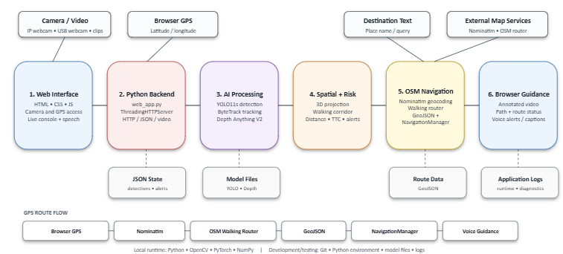
SAFESTRIDE ASSIST • SYSTEM DESIGN
System Architecture
B15 | 10

Slide 11
SAFESTRIDE ASSIST • ALGORITHM & MATHEMATICAL MODEL
Mathematical Formulation & Core Algorithms
Selected equations and algorithm steps from the perception, collision-risk, and navigation pipeline.
1 CAMERA GEOMETRY & GROUND PLANE
2 CORRIDOR & COLLISION RISK
3 GPS DISTANCE & HEADING
Pinhole projection
|X| ≤ W/2; 0 < Z ≤ L
a = sin²(Δφ/2) + cosφ₁ cosφ₂
· sin²(Δλ/2)
u = fₓ(X/Z) + cₓ; v = fᵧ(Y/Z) + cᵧ
Back-projection
Prototype corridor: W = 1 m, L = 3 m.
Pₓ = D(u,v)(u−cₓ)/fₓ
Pᵧ = D(u,v)(v−cᵧ)/fᵧ; Pz = D(u,v)
vₜ = (pₜ − pₜ₋ₖ)/(k Δt)
d = 2Rₑ atan2(√a, √(1−a))
p: tracked position; k: frame gap; Δt: time step.
φ₁,λ₁: current location; φ₂,λ₂: destination; radians; Rₑ: Earth radius.
nᵀP + d = 0
TTC = −d/ḋ if ḋ < 0; otherwise ∞
θ = atan2(sinΔλ cosφ₂,
cosφ₁ sinφ₂ − sinφ₁ cosφ₂ cosΔλ)
Eplane = Σᵢ∈I |nᵀPᵢ + d|²
R = w_dR_d + w_vR_v + w_cR_c + w_pR_p
(X,Y,Z): camera coordinates; (u,v): pixel; fx,fy,cx,cy: intrinsics; D: estimated depth; n,d: ground-plane parameters. RANSAC fits the plane while rejecting outliers.
Risk combines distance, motion, collision timing and corridor membership. Weights must be calibrated on representative test data.
Haversine gives straight-line distance; bearing gives initial direction. OpenStreetMap routing supplies route geometry.
4 CORE ALGORITHM — FRAME TO PRIORITISED ALERT
5 URGENCY SCORE & VARIABLE KEY
for each frame I_t:
detections ← YOLO11s(I_t); tracks ← ByteTrack(detections)
depth ← DepthAnythingV2(I_t); plane ← RANSAC(ground_points)
for each track: estimate 3D position, distance and velocity
if inside corridor (|X| ≤ W/2 and 0 < Z ≤ L):
compute TTC, persistence and risk score
speak the highest-priority actionable warning
U = α/(TTC+ε) + β/(D+ε) + γρ
D: estimated distance; ρ: persistence/confidence; α, β, γ: weights; ε > 0 prevents division by zero. Higher U prioritises close, approaching, persistent hazards. Weights and thresholds require empirical calibration; this is not a certified safety guarantee.
Limitations: monocular depth and ground-plane scaling yield approximate distances; camera calibration, pitch, lighting, motion blur and ground visibility affect accuracy.
B15 | 11

Slide 12
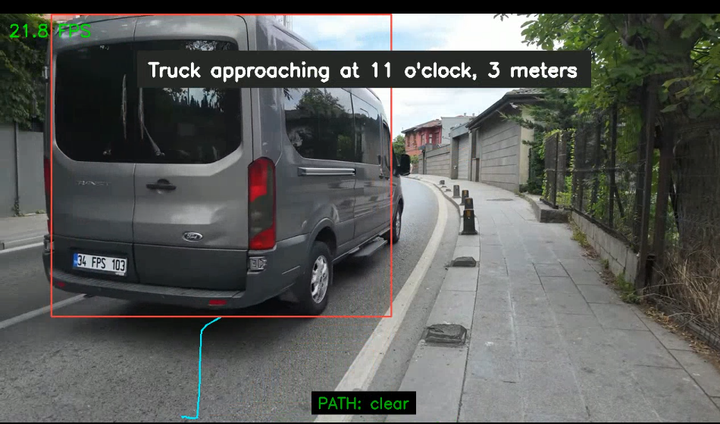
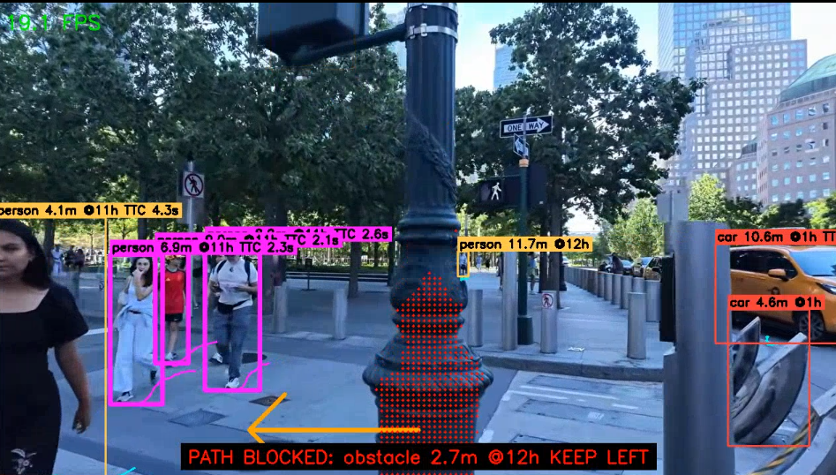
SAFESTRIDE ASSIST • IMPLEMENTATION
Implementation — Live Prototype Results
Three real prototype snapshots show how detection, path relevance, and spoken guidance work together.
01 BLOCKED CORRIDOR
02 PATH CLEAR
03 OBSTRUCTION WARNING
A dustbin blocks the walking corridor. The overlay estimates about 2.9 m and recommends keeping left.
A truck is detected, but it is not treated as a path blocker; the walking path remains clear.
A foreground obstruction falls inside the corridor and triggers a keep-left warning.
Distance + side guidance
Context-aware filtering
Prioritised voice alert
Prototype demonstration only: estimated distances and guidance can be wrong; use alongside established mobility aids.
B15 | 12

Slide 13
SAFESTRIDE ASSIST • CONCLUSION
From Visual Detection to Actionable Guidance
Safe-Stride Assist connects perception, spatial context, risk reasoning, and concise feedback.
01
DETECT
02
TRACK & ESTIMATE
03
ASSESS RISK
04
GUIDE
YOLO11s identifies walking-relevant objects.
ByteTrack stabilises identities; monocular depth and ground-plane reasoning estimate approximate range.
Corridor membership, persistence, distance, and TTC help prioritise relevant hazards.
Browser voice feedback communicates a short, actionable warning.
CORE CONTRIBUTION
A detected object becomes a useful warning only when the system considers where it is, how close it is, and whether it affects the walking path.
WHAT THE PROTOTYPE DEMONSTRATES
LIMITATIONS & NEXT STEPS
• Live camera input and object tracking
• Approximate depth-aware corridor reasoning
• Prioritised, spoken guidance with route context
• Monocular distance is approximate and scene-dependent
• Unseen/unknown hazards and ground changes may be missed
• Evaluate with users; calibrate risk thresholds; add haptic feedback
Safety boundary: a research prototype—not a certified mobility device. It supplements, never replaces, a white cane, guide dog, or human assistance.
B15 | 13

Slide 14
SAFESTRIDE ASSIST • REFERENCES
References & Research Sources
Selected papers and official documentation supporting the methods and assistive-navigation context.
[1] Redmon et al. (2016) — You Only Look Once: Unified, Real-Time Object Detection.
[8] Xu et al. — Wearable Electronic Travel Aids for Obstacle Avoidance (review).
CVPR 2016 · YOLO • Open source ↗
Obstacle avoidance · verify exact article metadata • Open source ↗
[2] Zhang et al. (2022) — ByteTrack: Multi-Object Tracking by Associating Every Detection Box.
[9] Katzschmann et al. (2018) — Safe Local Navigation for Visually Impaired Users with ToF Sensing and Haptic Feedback.
ECCV 2022 · Tracking • Open source ↗
Distance sensing · haptics • Open source ↗
[3] Yang et al. (2024) — Depth Anything V2.
[10] Eltaher et al. — Urban Navigation Systems for Visually Impaired People (review).
Monocular depth • Open source ↗
Urban navigation · verify exact article metadata • Open source ↗
[4] Ranftl et al. (2021) — Vision Transformers for Dense Prediction.
[11] Johannesson et al. (2016) — The Sound of Vision.
Dense prediction • Open source ↗
Audio scene representation • Open source ↗
[5] Ultralytics — YOLO Documentation.
[12] Shull & Damian (2015) — Haptic Wearables as Sensory Replacement and Augmentation.
Official documentation • Open source ↗
Haptic feedback • Open source ↗
[6] World Health Organization (2019) — World Report on Vision.
[13] Ranganeni et al. — Levels of Control in a Navigation Assistant for Blind Travelers.
Vision impairment • Open source ↗
Human control · verify exact article metadata • Open source ↗
[7] Khan et al. — Navigation Assistants for Blind and Visually Impaired People (review).
[14] Zhang et al. (2019) — ARCore-Based User-Centric Assistive Navigation System.
Review · verify exact article metadata • Open source ↗
AR navigation · verify exact article metadata • Open source ↗
Click a reference title to open its source. Verify the full bibliographic metadata for entries explicitly marked for verification before final submission.
B15 | 14

