Slide 1




1. Research Output Overview
Bisaya Post-Class Speech and Affect Recognition
Group members
Completed outputs
[Member names]
30 recordings with coded metadata
Audio feature dataset (67 features)
Assigned CS section
Spectrogram and waveform figures
[CS section] · Group 1, 1st Year
Six trained models, LOPO-evaluated
Prototype: WAV in, affect out
Participants
30 first-year CS students (40 required)
Group research report
Notes:
Introduce the group, our assigned section, and the study. We recorded 30 first-year CS students saying one Bisaya word right after class, against a required minimum of 40. Completed outputs: the coded dataset, a 67-feature acoustic dataset, spectrogram and waveform figures, six evaluated models, a prototype that predicts affect from a new WAV file, and the written report. (About 1 minute.)

Slide 2
2. Data Collection
Procedure
1
Consent obtained before any recording
2
Right after class: say one Bisaya word
3
Rate own valence and arousal (1–5)
4
Log activity, session, feeling; anonymous code
Session: Morning 13 · Afternoon–Evening 17 Year: all 1st Year *off-protocol word
Consent
Recorded variables
Voluntary; no academic penalty
Forms stored apart from data
Codes only (Y1-001), no names
Participant Code
Year Level
Class Activity
Session
Spoken Word
Feeling (free text)
Valence 1–5
Arousal 1–5
Notes:
Each participant gave consent first, then, immediately after class, said one word from the Bisaya list and rated their own valence and arousal from 1 to 5. We also logged the class activity, session, and a free-text feeling under an anonymous code. Quizzes and exams make up two thirds of the sessions, and Kapoy is 13 of the 30 words. Libog was used twice although it is not on the protocol list. Video was also recorded alongside the audio.

Slide 3
3. Dataset Establishment
Audio dataset (analysed)
Facial dataset
Target affect labels
Group1_audio_feature_dataset.csv: 30 × 78
11 metadata and label columns
67 acoustic feature columns
30 spectrogram images → 512-d embeddings
30 MP4 videos recorded
Not analysed: audio-only scope
Raw video kept private
Valence (positive = 4–5)
positive 12
non-positive 18
Arousal (high = 4–5)
high 10
low-mod 20
Sample records (3 of 30, selected columns)
Code | Word | Activity | V | A | Valence class | Arousal class | Duration (s) | f0 mean (Hz) | RMS mean
Y1-001 | Kapoy | Examination | 4 | 4 | positive | high | 1.58 | 362.5 | 0.072
Y1-013 | Lingaw | Presentation | 4 | 5 | positive | high | 0.82 | 165.5 | 0.095
Y1-030 | Kapoy | Lecture | 2 | 2 | non-positive | low-mod | 0.74 | 141.6 | 0.134
V, A = self-reported valence and arousal (1–5). Classes are derived labels; the other 64 features are in the CSV.
Notes:
The analysed dataset has one row per recording: 11 metadata and label columns, then 67 acoustic features. The spectrogram images are a second feature set for the CNN. Video was recorded but, because our scope is audio only, no facial features were analysed. The target labels are binary: valence positive if 4 or 5, otherwise non-positive (12 vs 18), and arousal high if 4 or 5, otherwise low-to-moderate (10 vs 20). Context columns such as word and activity are never used as predictors.

Slide 4

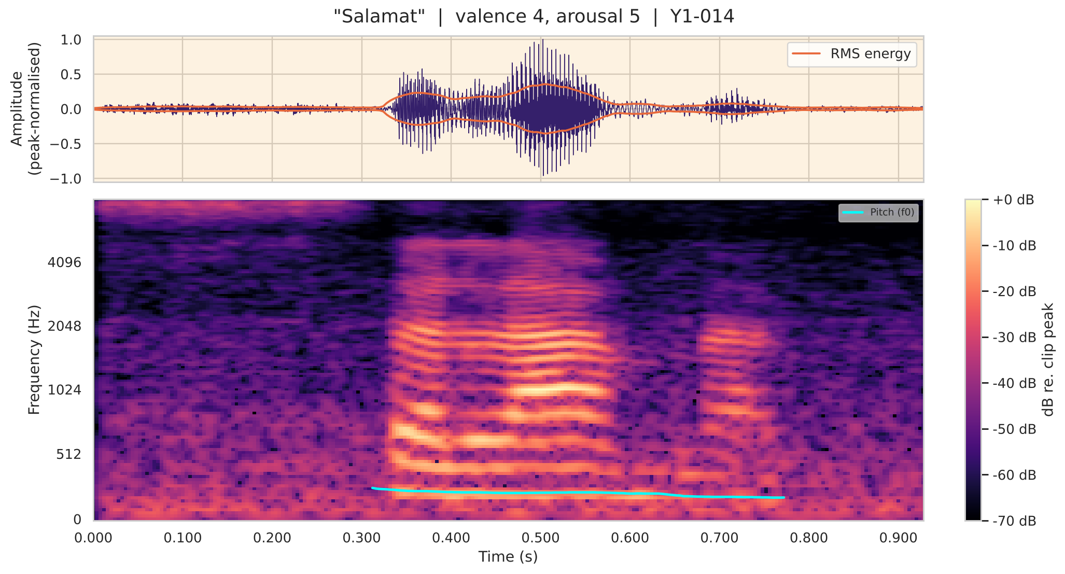

4. Preprocessing and Feature Extraction
Raw WAV 192 kHz stereo
Resample 16 kHz mono
Trim silence (25 dB)
Peak-normalise
Extract features
MFCC
52
Pitch (f0)
4
13 coefficients: mean, SD, Δ and ΔΔ SD
pYIN 65–500 Hz: mean, SD, range, voicing
Energy (RMS)
4
ZCR
2
Mean, SD, max, peak position
Zero-crossing rate: mean, SD
Spectral + timing
5
Spectrogram CNN
512
Y1-014 “Salamat”: waveform with RMS (top); spectrogram with pitch (bottom)
Centroid; duration, segments, active ratio
128-band mel image → ResNet18
Facial processing: not applied (audio-only scope)
Notes:
Every recording goes through the same steps: resample from 192 kHz stereo to 16 kHz mono, trim leading and trailing silence, and peak-normalise. Then we extract 67 handcrafted features: 52 MFCC statistics, 4 pitch features from pYIN, 4 energy features, 2 zero-crossing-rate features, and 5 spectral and timing features. Separately, each clip becomes a mel-spectrogram image and a frozen ResNet18 turns it into 512 numbers. The figure shows one real recording: the waveform with its energy envelope, and the spectrogram with the pitch line. Because peak normalisation is applied, absolute loudness is not kept.

Slide 5
5. Machine Learning Implementation
Algorithms
Model parameters
Logistic Regression
SVM (RBF kernel)
Random Forest
Majority baseline
Component | Setting
Logistic Regression | C = 0.5, balanced, max_iter 2000
SVM | RBF, C = 1.0, balanced
Random Forest | 100 trees, depth 4, min leaf 2, balanced
Preprocessing | StandardScaler → PCA (5)
Evaluation | 30 LOPO folds; 1000 permutations
Seed | 42
2 feature sets (handcrafted, spectrogram CNN) × 3 models = 6 configurations
Training and testing: leave-one-participant-out
Train
Fit scaler + PCA
Classifier
Test
29 participants
training fold only
fit on 5 components
1 held-out participant
Repeated 30 times, once per participant
Binary targets: valence class, arousal class
Word, activity, session never used as predictors
Notes:
We compared logistic regression, an RBF support vector machine and a random forest, each on two feature sets, against a majority-class baseline. Testing is leave-one-participant-out: train on 29 participants, test on the one left out, and repeat 30 times. Standardisation and PCA to 5 components are fitted inside each training fold only, so the test participant never leaks into training. All models use balanced class weights because the classes are uneven. The permutation test reruns the whole evaluation 1000 times with shuffled labels.

Slide 6
6. Model Evaluation
Valence: handcrafted + LogReg
Model comparison (accuracy / macro-F1)
Predicted →
Configuration | Val. acc | Val. F1 | Aro. acc | Aro. F1
Handcrafted + LogReg | 0.73 | 0.72 | 0.50 | 0.47
Handcrafted + SVM | 0.70 | 0.68 | 0.53 | 0.48
CNN + LogReg | 0.63 | 0.61 | 0.60 | 0.55
CNN + SVM | 0.53 | 0.51 | 0.47 | 0.40
Handcrafted + RF | 0.50 | 0.49 | 0.43 | 0.35
CNN + RF | 0.43 | 0.38 | 0.57 | 0.47
Majority baseline | 0.60 | 0.38 | 0.67 | 0.40
non-pos
14
4
Class | Prec. | Recall | F1
non-positive | 0.78 | 0.78 | 0.78
positive | 0.67 | 0.67 | 0.67
macro avg | 0.72 | 0.72 | 0.72
positive
4
8
non-pos
positive
Arousal: spectrogram CNN + LogReg
Predicted →
high
4
6
Class | Prec. | Recall | F1
high | 0.40 | 0.40 | 0.40
low-mod | 0.70 | 0.70 | 0.70
macro avg | 0.55 | 0.55 | 0.55
low-mod
6
14
Valence: p = 0.018 (B = 1000); 95% CI 55.6–85.8% includes 60%
high
low-mod
Arousal: p = 0.30 60% accuracy, below the 66.7% baseline
Notes:
Left: the highest-scoring configuration for each target. For valence, handcrafted features with logistic regression got 22 of 30 right: 73.3% accuracy and macro-F1 0.72, against a 60% majority baseline; precision and recall are 0.78 for non-positive and 0.67 for positive. For arousal, the best was spectrogram CNN with logistic regression at 60%, which is below the 66.7% from always guessing low-to-moderate; only 4 of 10 high-arousal participants were detected. Right: all six configurations. The valence permutation p is 0.018 with 1000 shuffles, but the confidence interval still includes the baseline and we picked the best of six, so we call it suggestive, not conclusive.

Slide 7



7. Findings and Limitations
Findings
Limitations
Recommendations
Valence: 73.3% vs 60% (p = 0.018)
CI includes baseline: suggestive only
Arousal: no signal above baseline
Word-centring drops valence F1 to 0.58
Heavy acoustic overlap; no single marker
Only 30 of 40 required observations
First-year only; one recording each
Kapoy is 43%; “Libog” off-protocol
Best of six chosen on test data
Some clips include extra non-word sound
Pool class dataset (≥ 280 recordings)
Balance words across affect levels
Hold out data for model selection
Fixed microphone and recording setup
Trim clips; recheck duration effect
Notes:
Findings: valence shows a suggestive signal, but the interval includes the baseline and we chose the best of six models, so it is not conclusive. Arousal shows no signal. When we hold the word constant, valence macro-F1 drops from 0.72 to 0.58, close to chance, so part of the result reflects which word was said. Limitations: 30 instead of 40 observations, first-year students only, Kapoy dominates the words, model selection used the same data, and some clips contain extra sound around the word, which inflates duration. Recommendations: pool the class datasets, balance the words, keep a separate validation set, standardise the recording setup, and trim clips before re-running.

