Slide 1


CE245 : Data Structure and Algorithms Topic: Stack Data Structure
Accredited with Grade A by NAAC
Accredited with Grade A by KCG
Prepared By,
Dr. Nikita Bhatt

Slide 2

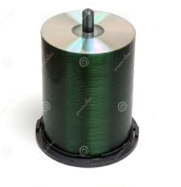


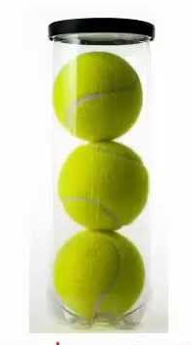
Stack: Data Structure
Described as a "Last In First Out" (LIFO) OR First In Last Out (FILO) data structure.
Operations
push (add item to stack)
pop (remove top item from stack)
Linear Data Structure

Slide 3
Stack Operations
Push(Element) - Insertion
int st[5];
Top=-1
Max=5
Step 1: If Top=Max-1
Print “Overflow : Stack is full” and Exit
End If
Step 2: Top=Top+1
Step 3: Stack[TOP]=Element
Step 4: End
Top=-1
Element | Index
 | 0
 | 1
 | 2
 | 3
 | 4
Push(20)
Top=0
20
Top=1
Push(30)
30
Push(40)
40
Top=2
Push(50)
50
Top=3
Push(60)
60
Top=4
Push(70)
Top=Max-1=4(5-1)
“OverFlow”

Slide 4
Stack Operations
Pop() – remove element from stack
Pop()
“Underflow”
Top=-1
1. [Check for the stack Underflow]
If Top == -1 then
Print “Stack Underflow” and Exit
else
[Remove the top element]
item=Stack [Top]
[Decrement Top by 1]
Top=Top-1
Return item
2. Exit
Element | Index
 | 0
 | 1
 | 2
 | 3
 | 4
Pop()
Top=0
20
Top=1
Pop()
30
Pop()
40
Top=2
Pop()
50
Top=3
Pop()
60
Top=4

Slide 5
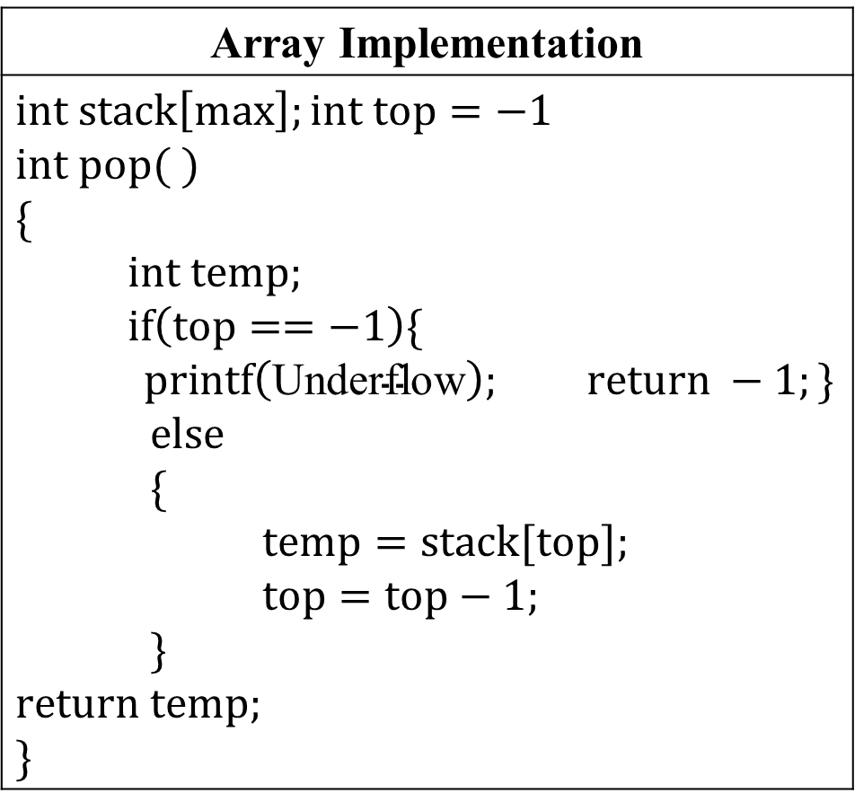
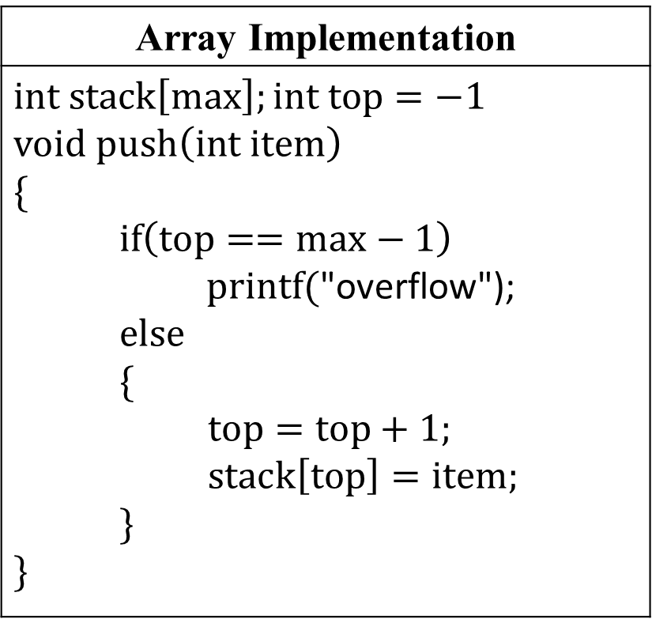
Approaches to Implement Stack Data Structure
Array Implementation
$$int stack\left[max\right];int top=−1$$ $$void push\left(int item\right)$$ $$\{$$ $if\left(top==max−1\right)$ $printf(\text{"}\text{overflow}\text{");}$ $else$ $\{$ $top=top+1;$ $stack\left[top\right]=item;$ $\}$ $$\}$$
Array Implementation
$$int stack\left[max\right];int top=−1$$ $$int pop( )$$ $$\{$$ $int temp;$ $if\left(top==−1\right)\{$ $printf\left(\text{Underflow}\right);$ $return −1;\}$ $else$ $\{$ $temp=stack[top];$ $top=top−1;$ $\}$ $$return temp;$$ $$\}$$

Slide 6
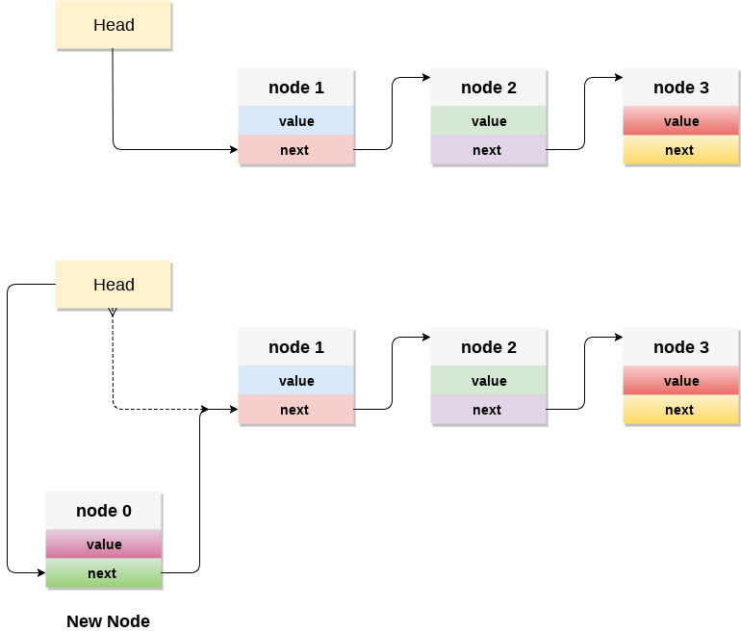
Approaches to Implement Stack Data Structure(Continue)

Slide 7
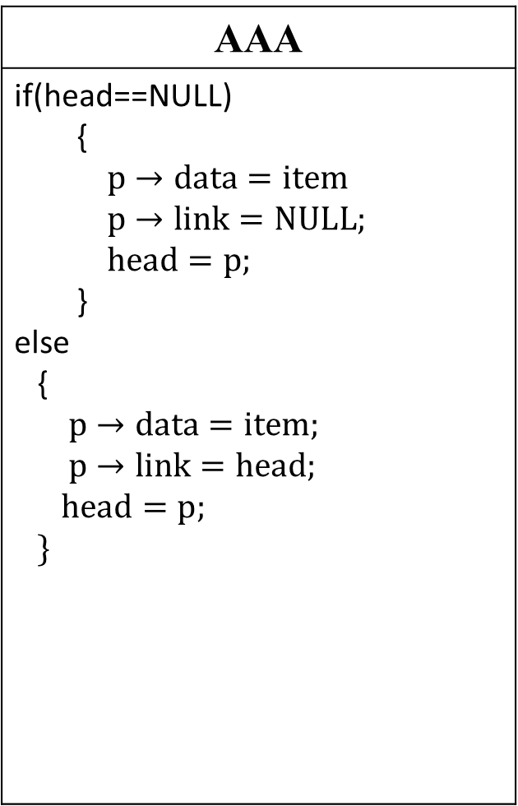
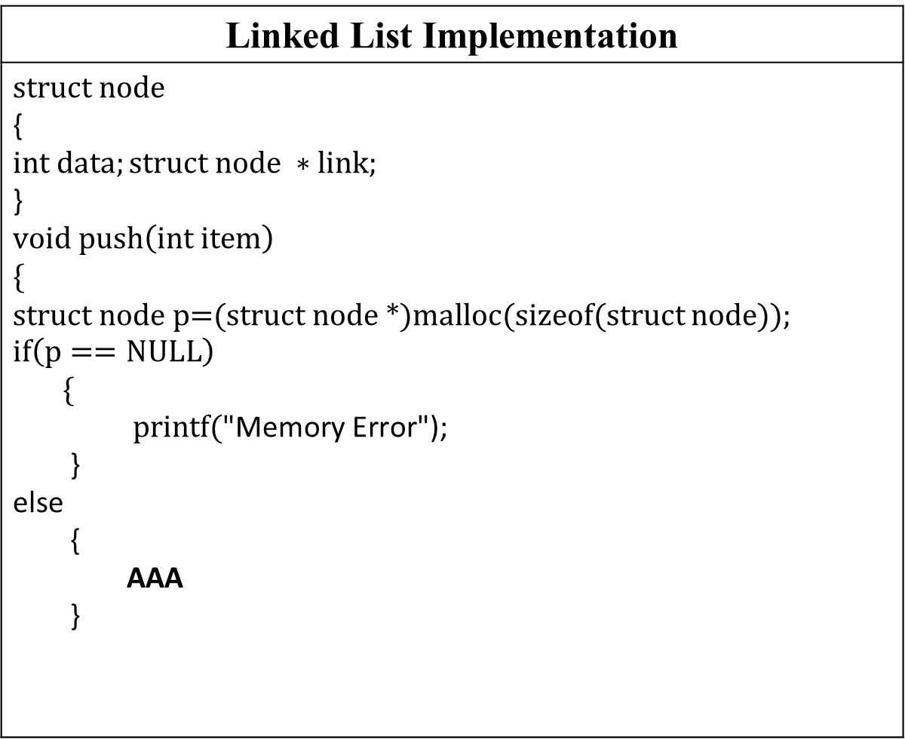
Approaches to Implement Stack Data Structure(Continue)
Linked List Implementation
$$struct node$$ { $$int data;struct node ∗link;$$ } $$void push\left(int item\right)$$ $$\{$$ struct node p=(struct node *)malloc(sizeof(struct node)); $$if\left(p==NULL\right)$$ $\{$ $printf(\text{"}\text{Memory} \text{Error}\text{");}$ } else { AAA }
AAA
if(head==NULL) { $p→data=item$ $p→link=NULL;$ $head=p;$ } else { $p→data=item;$ $p→link=head;$ $head=p;$ $\}$

Slide 8
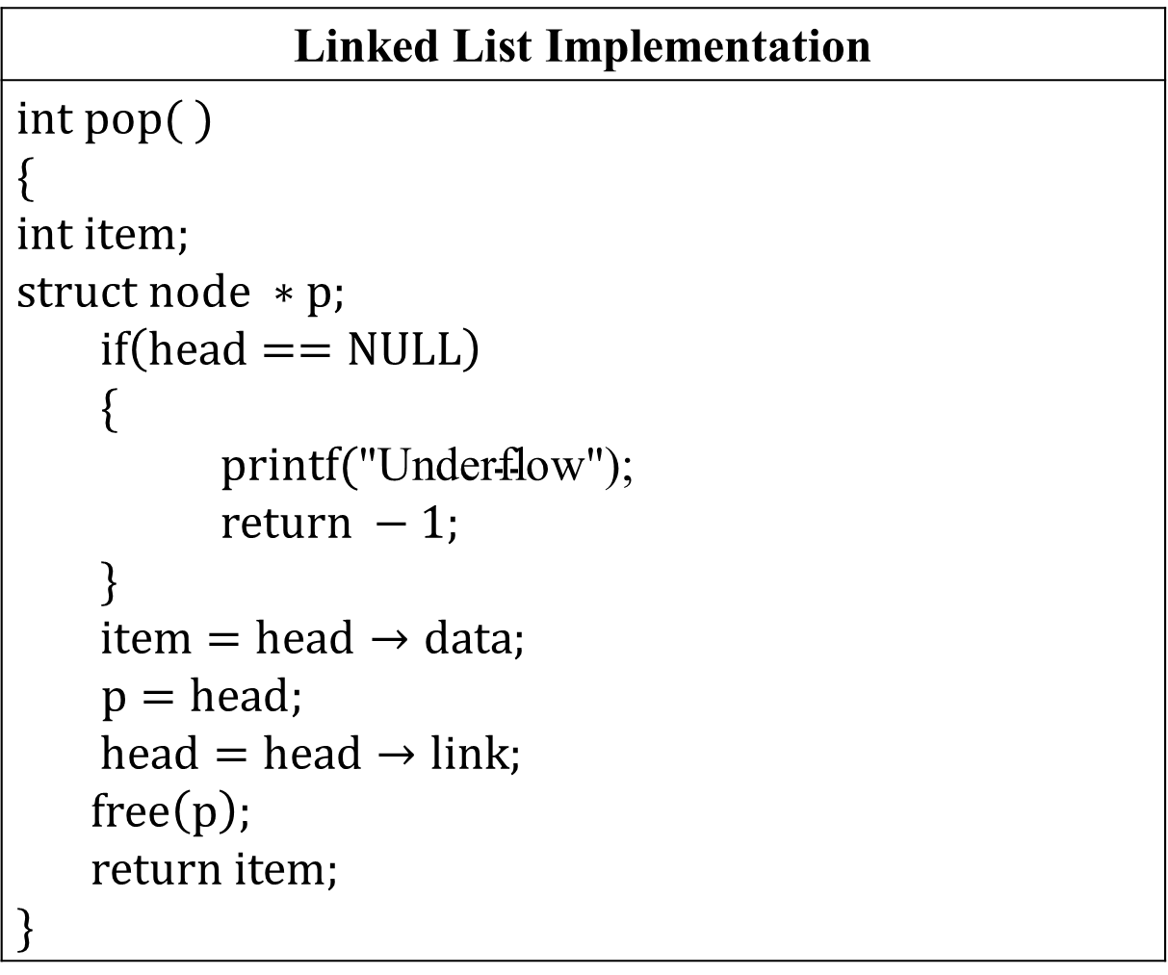
Approaches to Implement Stack Data Structure(Continue)
Linked List Implementation
$$int pop( )$$ $$\{$$ $$int item;$$ $$struct node ∗p;$$ $if\left(head==NULL\right)$ $\{$ $printf(\text{"}\text{Underflow}\text{");}$ $return −1;$ $\}$ $item=head→data;$ $$p=head;$$ $head=head→link;$ $$free\left(p\right);$$ $$return item;$$ $$\}$$

Slide 9
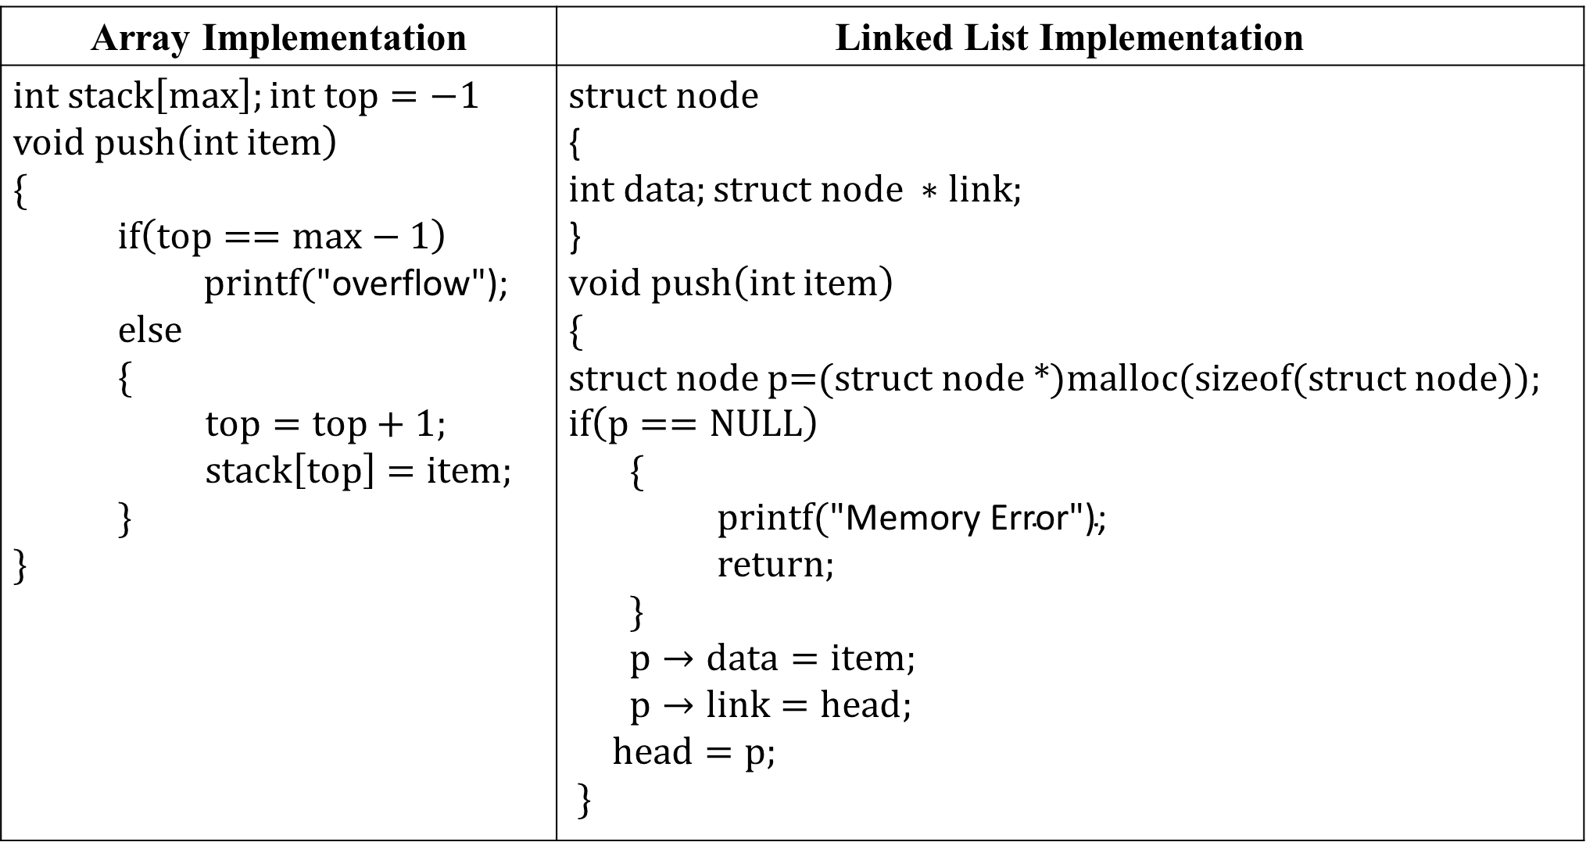
Approaches to Implement Stack Data Structure
Array Implementation | Linked List Implementation
$$int stack\left[max\right];int top=−1$$ $$void push\left(int item\right)$$ $$\{$$ $if\left(top==max−1\right)$ $printf(\text{"}\text{overflow}\text{");}$ $else$ $\{$ $top=top+1;$ $stack\left[top\right]=item;$ $\}$ $$\}$$ | $$struct node$$ { $$int data;struct node ∗link;$$ } $$void push\left(int item\right)$$ $$\{$$ struct node p=(struct node *)malloc(sizeof(struct node)); $$if\left(p==NULL\right)$$ $\{$ $printf(\text{"}\text{Memory} \text{Error}\text{");}$ $return;$ $\}$ $p→data=item;$ $p→link=head;$ $head=p;$ $\}$

Slide 10
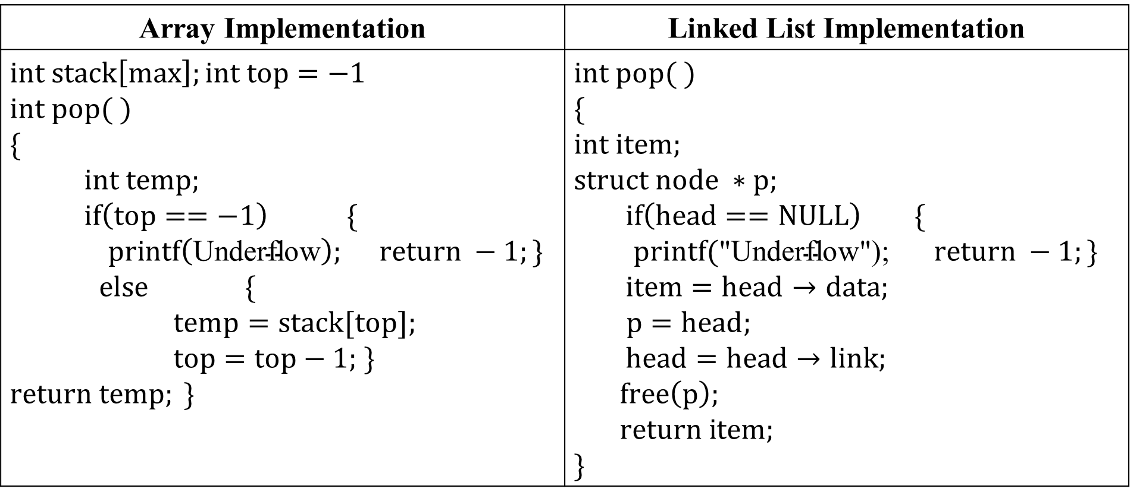
Approaches to Implement Stack Data Structure(Continue)
Array Implementation | Linked List Implementation
$$int stack\left[max\right];int top=−1$$ $$int pop( )$$ $$\{$$ $int temp;$ $if\left(top==−1\right) \{$ $$printf\left(\text{Underflow}\right); return −1;\}$$ $else$ $\{$ $temp=stack[top];$ $top=top−1;$ $\}$ $$return temp; \}$$ | $$int pop( )$$ $$\{$$ $$int item;$$ $$struct node ∗p;$$ $if\left(head==NULL\right)$ $\{$ $printf(\text{"}\text{Underflow}\text{"); }$ $return −1;\}$ $item=head→data;$ $$p=head;$$ $head=head→link;$ $$free\left(p\right);$$ $$return item;$$ $$\}$$

Slide 11
Approaches to Implement Stack Data Structure(Continue)
Display the content of stack
void display() { struct node *ptr; ptr=head; if(ptr == NULL) { printf("Stack is empty\n"); } else { printf("Printing Stack elements \n"); while(ptr!=NULL) { printf("%d\n",ptr->data); ptr = ptr->link; } } }

Slide 12
Algebraic Expression
INFIX Expression : x + y, x + y * z
POSTFIX Expression: Also Known as Reverse Polish Notation (RPN). Examples are xy+, xyz*+.
PREFIX: Also Known as Polish notation. Examples are +xy, *+xyz.
To our surprise INFIX notations are not as simple as they seem specially while evaluating them. To evaluate an infix expression we need to consider Operators’ Priority and Associative property.
For example expression 3+5*4 evaluate to
(a)32 i.e. (3+5)*4
(b)23 i.e. 3+(5*4).
Postfix and prefix expression forms do not rely on operator priorities, a tie breaker, or delimiters. So, it is easier to evaluate expressions that are in these forms.

Slide 13
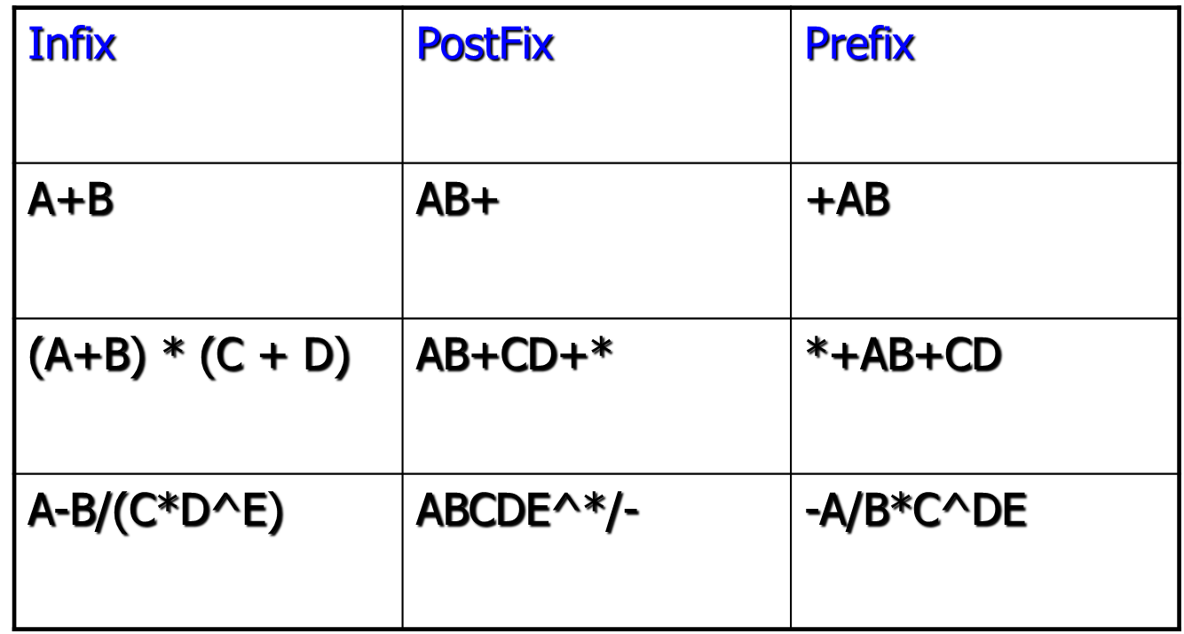
Algebraic Expression(Continue)

Slide 14
Infix to Postfix Conversion(Continue)
Scan all the symbols one by one from left to right in the given Infix Expression.
If the reading symbol is an operand, then immediately append it to the Postfix Expression.
If the reading symbol is left parenthesis ‘( ‘, then Push it onto the Stack.
If the reading symbol is right parenthesis ‘)’, then Pop all the contents of the stack until the respective left parenthesis is popped and append each popped symbol to Postfix Expression.
If the reading symbol is an operator (+, –, *, /), then Push it onto the Stack. However, first, pop the operators which are already on the stack that have higher or equal precedence than the current operator and append them to the postfix. If an open parenthesis is there on top of the stack then push the operator into the stack.
If the input is over, pop all the remaining symbols from the stack and append them to the postfix.
Do it for a*(b+c+d) and A+(B*C+D)/E

Slide 15
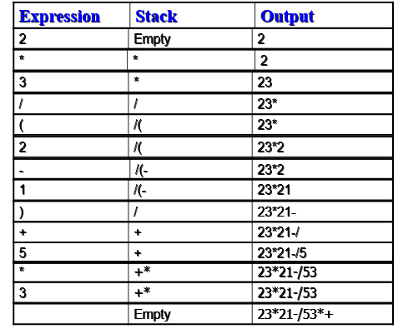
Application 1 of Stack: Infix to Postfix Conversion(Continue)
Infix Expression: 2*3/(2-1)+5*3

Slide 16
Self Assessment-III

Slide 17
Algorithm to convert infix to postfix

Slide 18
Conversion of Expression- a*b+c#
Character Scanned | Stack | Output | Rank
Symbol | Precedence (f) | Rank(r)
+,- | 1 | -1
*,/ | 2 | -1
variables | 3 | 1
# | 0 | -
 | #
a | #a
* | # | a | 1
 | #* | a | 1
b | #*b | a | 1
+ | #*b | a | 1
+ | #* | ab | 2
 | #+ | ab* | 1
c | #+c | ab* | 1
# | #+c | ab* | 1
# |  | ab*c+ | 1

Slide 19
Conversion of Expression- With Parenthesis
Step 1: Add '')" to the end of the infix expression
Step 2: Push ( onto the stack
Step 3: Repeat until each character in the infix notation is scanned
IF ‘(‘ is encountered, push it on the stack
IF an operand (whether a digit or a character) is encountered, add it postfix expression.
IF a ")" is encountered, then a. Repeatedly pop from stack and add it to the postfix expression until a "(" is encountered. b. Discard the "(". That is, remove the(from stack and do not add it to the postfix expression
IF an operator is encountered, then
Repeatedly pop from stack and add each operator ( popped from the stack) to the postfix expression which has the same precedence or a higher precedence than Operator in case of left to right associative and Push the operator to the stack
push the current token to the stack if it has the same precedence as the operator on the top of the stack, but the operator on top of the stack is right-to-left associative
[END OF IF]
Step 4: Repeatedly pop from the stack and add it to the postfix expression until the stack is empty
Step 5: EXIT
Operator | Symbol | Precedence | Associativity
Exponent | ^ | 4 | Right to Left
Multiplication | * | 3 | Left to Right
Division | / | 3 | Left to Right
Addition | + | 2 | Left to Right
Subtraction | - | 2 | Left to Right

Slide 20
Precedence and Associativity of operators
Precedence | Type | Operators | Associativity
1 | Postfix | () [] -> . ++ — | Left to Right
2 | Unary | + – ! ~ ++ — (type)* & sizeof | Right to Left
3 | Multiplicative | * / % | Left to Right
4 | Additive | + – | Left to Right
5 | Shift | <<, >> | Left to Right
6 | Relational | < <= > >= | Left to Right
7 | Equality | == != | Left to Right
8 | Bitwise AND | & | Left to Right
9 | Bitwise XOR | ^ | Left to Right
10 | Bitwise OR | | | Left to Right
11 | Logical AND | && | Left to Right
12 | Logical OR | || | Left to Right
13 | Conditional | ?: | Right to Left
14 | Assignment | = += -+ *= /= %= >>= <<= &= ^= |= | Right to Left
15 | Comma | , | Left to Right

Slide 21
Example : (a+b) * (c+d)
Character Scanned | Stack | Output | Rank
 | (
( | ((
a | (( | a | 1
+ | ((+ | a | 1
b | ((+ | ab | 2
) | ( | ab+ | 1
* | (* | ab+ | 1
( | (*( | ab+ | 1
c | (*( | ab+c | 2
+ | (*(+ | ab+c | 2
d | (*(+ | ab+cd | 3
) | (*(+ | ab+cd+ | 2
 | (* | ab+cd+* | 1

Slide 22
Application 2 of Stack: Evaluation of Expression
2 3 * 2 1 - / 5 4 1 - * +

Slide 23
Application 2 of Stack: Evaluation of Expression (continue)
+ / * 2 3 - 2 1 * 5 - 4 1

Slide 24
Application 2 of Stack: Evaluation of Expression (continue)
Algorithm
WHILE more input items exist
{
If symb is an operand
then push (S, Top, symb)
else //symbol is an operator
{
Opnd2=pop(S, Top);
Opnd1=pop(S, Top);
Value = opnd1 operator opnd2 // perform operation as per theoperator
Push(S, Top, value);
} //End of else
} // end while
Result = pop (S, Top);

Slide 25
Infix to Prefix Expression
Step 1: Reverse the infix string. Note that while reversing the string you must interchange left and right parentheses.
Step 2: Obtain the postfix expression of the infix expression Step 1.
Step 3: Reverse the postfix expression to get the prefix expression
Infix : ((a/b+c)-(d+(e*f))
String after reversal – ))f*e(+d(-)c+)b/a((
String after interchanging right and left parenthesis – ((f*e)+d)-(c+(b/a))
Apply postfix –
Reverse Postfix Expression

Slide 26
Application 3 of Stack: Function Call
public int f(int a){
if (a==1)
return(1);
else
return(a * f( a-1));
}

Slide 27
Application 4 of Stack: Tower of Hanoi
The problem is as follows:
- N discs of decreasing size stacked on one needle & two empty needles are given.
- It is required to arrange all the discs onto a second needle in decreasing order of size.
- The Third needle may be used as temporary storage.

Slide 28
Application 4 of Stack: Tower of Hanoi (Continue)
The movement of the discs is restricted by the following rules:
Only one disc may be moved at a time.
A disc may be moved from any needle to any other.
At no time may a larger disc rest upon a smaller disc.

Slide 29
Solution of the problem (N=2)
Initial position
Move-1
Move-2
Move-3

Slide 30
N = 3

Slide 31
Solution
The solution of this problem is:
To move one disc, move it from AC.
To move two discs, move the first disc AB, move the second from AC, then move the disc from BC.
In general, the solution of the problem moving N discs from A to C has three steps:
Move N – 1 discs from AB. (sourceinterm)
Move N^{th} disc from AC. (sourcedestination)
Move N – 1 discs from BC. (intermdest)

Slide 32
Solution of the problem (N=2)
Initial position
Move-1
Move-2
Move-3

Slide 33
N = 3

Slide 34
Graphical solution of the problem (N=2)

Slide 36
Algorithm
S I D
ToH(source, intermediate, destination, no.of disc)
ToH (A, B, C, N)
if ( N==1 )
Write (Move Disc N from SD);
else
{
ToH (A, C, B, N-1);
Write (Move Disc N from SD);
ToH (B, A, C, N-1);
}
S I D
S I D
S I D

Slide 37
Sr. no. | Expression | Stack | Prefix
0 | ( | ((
1 | ( | (((
2 | f | ((( | f
3 | * | (((* | f
4 | e | (((* | fe
5 | ) | (( | fe*
6 | + | ((+ | fe*
7 | d | ((+ | fe*d
8 | ) | ( | fe*d+
9 | – | (- | fe*d+
10 | ( | (-( | fe*d+
11 | c | (-( | fe*d+c
12 | + | (-(+ | fe*d+c
13 | ( | (-(+( | fe*d+c
14 | b | (-(+( | fe*d+cb
15 | / | (-(+(/ | fe*d+cb
16 | a | (-(+(/ | fe*d+cba
17 | ) | (-(+ | fe*d+cba/
18 | ) | (- | fe*d+cba/+
19 | ) |  | fe*d+cba/+-
fe*d+cba/+- ➔ -+/abc+d*ef

Slide 38
Stack: Example of Operations
The following sequence of operations is performed on a stack:
push(10),push(20),pop(),push(10),push(20),pop(),pop(),pop(),push(20), pop(). The sequence of values popped out is:
(a) 20,10,20,10,20
(b) 20,20,10,10,20
(c) 10,20,20,10,20
(d) 20,20,10,20,10
Answer : (b)

Slide 39
Gate 1994
Which of the following permutations can be obtained in the output (in the same order) using a stack assuming that the input is the sequence 1, 2, 3, 4, 5 in that order?
3, 4, 5, 1, 2
3, 4, 5, 2, 1
1, 5, 2, 3, 4
5, 4, 3, 1, 2
Answer : (b)

Slide 40
Self Assessment-I
Consider the following pseudocode that uses a stack
declare a stack of characters
while ( there are more characters in the word to read)
{
read a character
push the character on the stack
}
while ( the stack is not empty )
{
pop a character off the stack
write the character to the screen
}
What is output for input "geeksquiz"?
(a) geeksquizgeeksquiz (b) ziuqskeeg (c) geeksquiz (d) ziuqskeegziuqskeeg
Answer : (b)

Slide 41
Self Assessment-IV (Continue)
2. The prefix form of an infix expression p + q - r * t is
3. Consider the following operation performed on a stack of size 5. Push(1); Pop(); Push(2); Push(3); Pop(); Push(4); Pop(); Pop(); Push(5); After the completion of all operation, the no of element present on stack are :

Slide 42
Self Assessment-II
Consider a empty stack of integers. Let the numbers 1,2,3,4,5,6 be pushed on to this stack only in the order they appeared from left to right. Let S indicates a push and X indicate a pop operation. Can they be permuted in to the order 325641(output) and order 154623?
If a permutation is possible give the order string of operations.
(Hint: SSSSSSXXXXXX outputs 654321)
Solution:
SSSXXSSXSXXX outputs 325641.
154623 cannot be output as 2 is pushed much before 3 so can appear only after 3 in output.

Slide 43
Self Assessment-IV (Continue)
4. Consider the usual implementation of parentheses balancing program using stack. What is the maximum number of parentheses that will appear on stack at any instance of time during the analysis of ( ( ) ( ( ) ) ( ( ) ) )?
5. The following postfix expression with single digit operands in evaluated using a stack 8 2 3 ^ / 2 3 * 5 1 * -. The top two elements of the stack after the first * is evaluated are

Slide 44
Self Assessment-IV (Continue)
6. The following postfix expression, containing single digit operands and arithmetic operators + and *, is evaluated using a stack. 5 2 * 3 4 + 5 2 * * + Show the contents of the stack.
(i) After evaluating 5 2 * 3 4 +
(ii) After evaluating 5 2 * 3 4 + 5 2
(iii) At the end of evaluation

Slide 45
Self Assessment-IV (Continue)
7. The postfix expression for the infix expression a + b * ( c + d ) / f + d * e is

Slide 46
Self Assessment-IV (Continue)
8. Perform Postfix Conversion for following expression:
((((4^1^6)-(3^2-8)/(7-5)*2)+9)-3)

Slide 47
Self Assessment-IV (Continue)
9. Evaluation for following expression:
((((4^1^6)-(3^2-8)/(7-5)*2)+9)-3)

Slide 48
Gate 2004
The best data structure to check whether an arithmetic expression has balanced parentheses is a
(A) queue
(B) stack
(C) tree
(D) list
Answer: (B)

Slide 49
Gate 2004
A single array A[1..MAXSIZE] is used to implement two stacks. The two stacks grow from opposite ends of the array. Variables top1 and top2 (topl< top 2) point to the location of the topmost element in each of the stacks. If the space is to be used efficiently, the condition for “stack full” is
(A) (top1 = MAXSIZE/2) and (top2 = MAXSIZE/2+1)
(B) top1 + top2 = MAXSIZE
(C) (top1= MAXSIZE/2) or (top2 = MAXSIZE)
(D) top1= top2 -1
Answer : (D)

Slide 50
Self Assessment-IV
Following is C like pseudo code of a function that takes a number as an argument, and uses a stack S to do processing.
void fun(int n)
{
Stack S; // Say it creates an empty stack S
while (n >0)
{
push(&S, n%2);
n = n/2;
}
while (!isEmpty(&S))
printf("%d ", pop(&S)); // pop an element from S and print it
}

Slide 51
Self Assessment-IV (Continue)
What does the above function do in general? (A) Prints binary representation of n in reverse order (B) Prints binary representation of n (C) Prints the value of Logn (D) Prints the value of Logn in reverse order
Answer : (B)

Slide 52
Applications of Stack
To convert Infix expression to postfix and prefix notation.
To evaluate postfix and prefix expressions.
To perform undo and redo operations in Editors.
To check the syntax in programing language.
Matching Parenthesis, Match in HTML tags < >, Matching if else
To perform Forward – backward surfing in browser- check the history of visited websites.
To use in virtual machines like JVM.
Real life examples:
Message logs
Call logs
E-mails
Google photos’ [any gallery]
YouTube downloads and Notifications ( latest appears first )
Scratch card’s earned after Google pay transaction

