Slide 1


유생찾기
Finding friends for the same purpose
at close distance
Team 7

Slide 2
CONTENTS
PART 1
PART 2
PART 3
PART 4
1. Overview
2. Goals & Methods
3. Team & Strategy
4. Plan & Effect

Slide 3
1
Background
PART 1
Overview
2
Market Status

Slide 4


01
Overview
Background
Who do I do with my team project?
How can I make my group?
I need friends to eat lunch together.
How can I find my lunch mate?
In college, we don’t have a lot of opportunities to make new friends.

Slide 5

01
Overview
Background
1
Double major students
2
Military matters
3
Senior year
There are a lot of double major students in SKKU. Therefore, there is not enough opportunity to make new departments, and even new campus friends.
In the case of most of the male students, friends are scattered when they come back from the army because the timing is different.
As students go up to the senior year, they have a significantly lower chance of making friends than they did in your freshman year.
There are many reasons why there is not enough opportunity to make friends.

Slide 6
01
Overview
Background
I don't have many chances to make friends because I'm in the senior year. I need a friend to share career concerns, and work on a project together.
26, Male
Computer Science
The department changed and the campus changed as I majored in double major. I need a friend to take classes together and share information. A friend who can eat with me, too.
23, Female
Economics & Software
When I was a freshman, I didn't do much in my department or club activities, so I hardly made friends. I need a friend to meet on campus and eat together.
22, Female
Mathematics
Students want to interact with friends for various reasons.

Slide 7

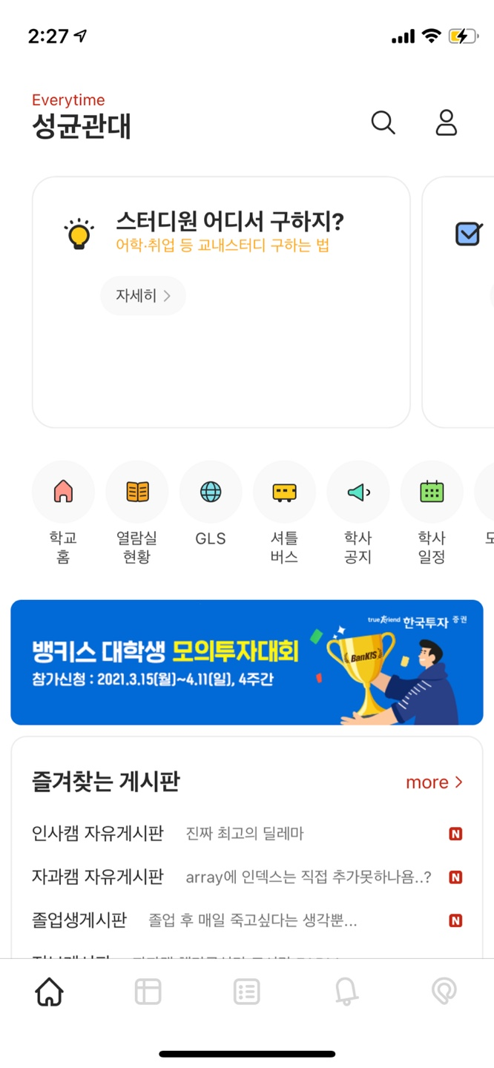
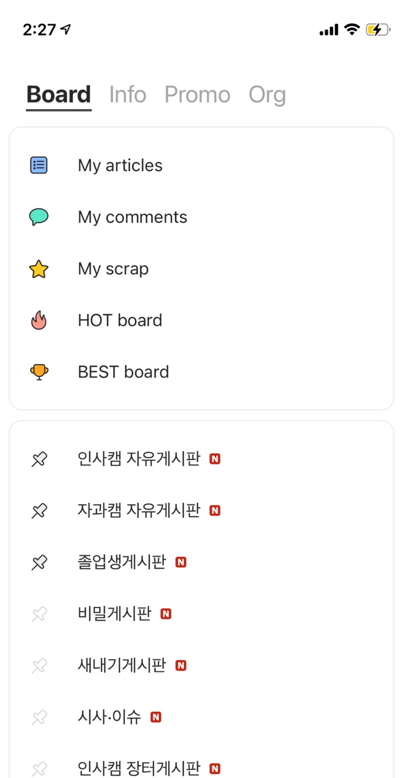
01
Overview
Market status
There are three kinds of communities to connect with students in SKKU.
Analysis
Basic description: Community accessible to the
entire students, Multiple bulletins formed. - Information Sharing: O 1. CAN find information about school life
2. But there is a limit to getting the answers
you want because there are so many users
and so many articles are posted in real time,
so the posting is pushed back to new posting - Promoting friendship with friends with the
same purpose: X
1. NOT easy to form friendship freely
2. Anonymity and various topics are posted.
1. Everytime

Slide 8
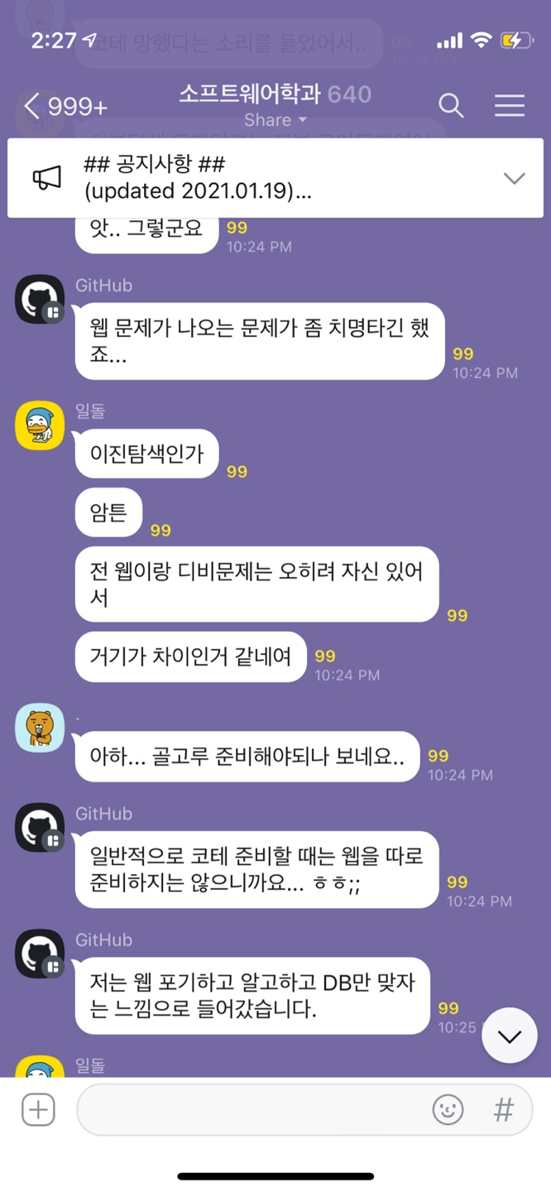
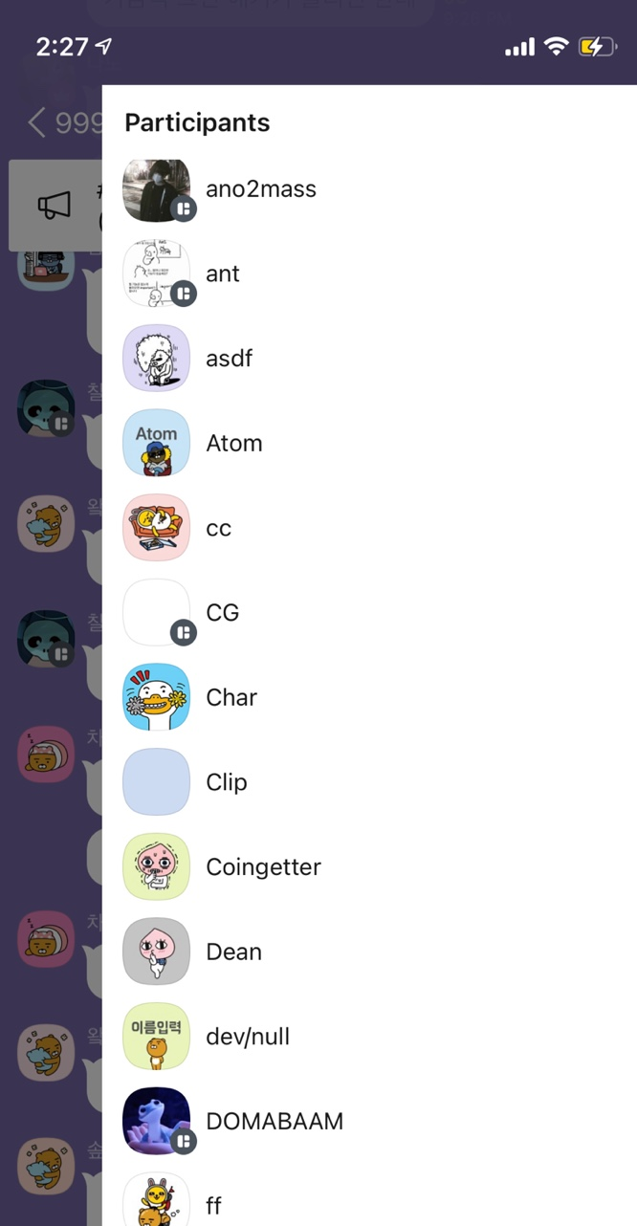
01
Overview
Market status
There are three kinds of communities to connect with students in SKKU.
Analysis
Analysis
Basic Description: Group chat composed of
the same department or club. - Information Sharing: O 1. Compared to Everytime, it is easier to share
specific information among the same groups
- Promoting friendship with friends with the
same purpose: X
1. Usually anonymous
2. Short-answer Q&A form rather than
long-term conversation Realistically, it is difficult to form a friendship.
2. Kakao open-chatting room

Slide 9
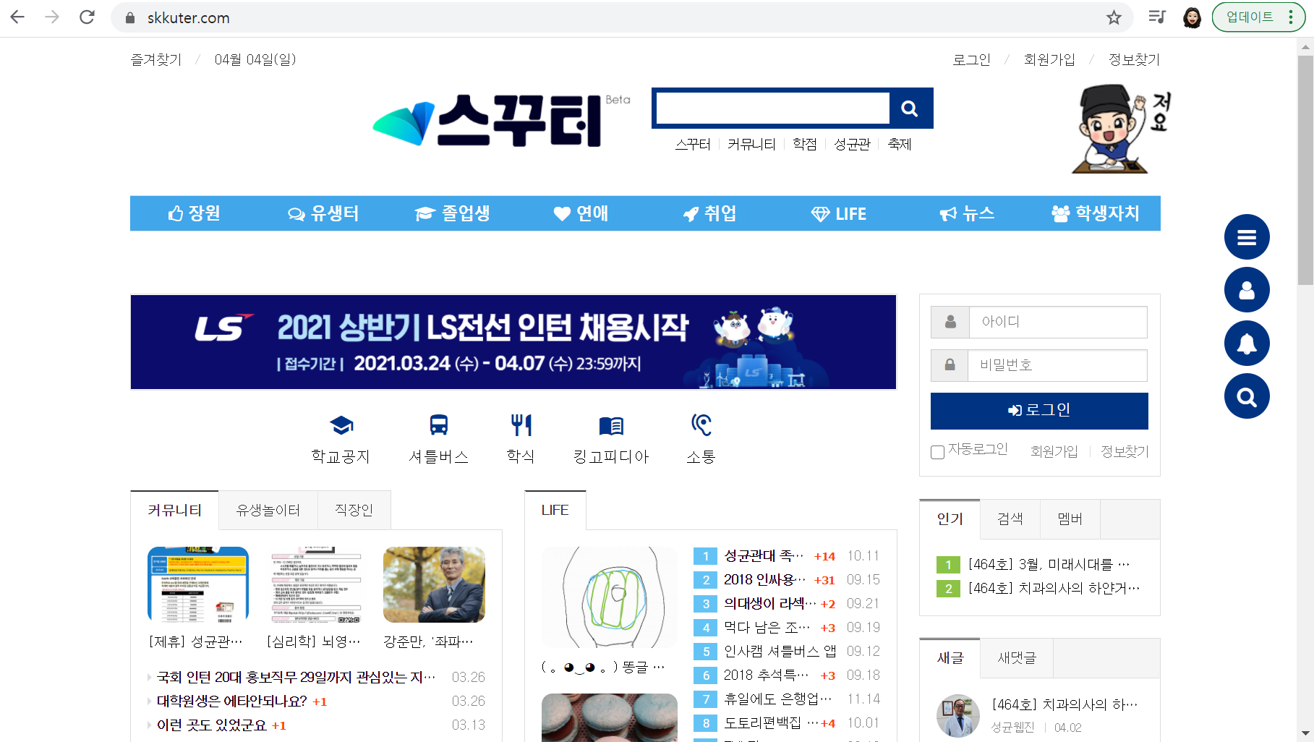
01
Overview
Market status
There are three kinds of communities to connect with students in SKKU.
Analysis
Analysis
Basic description: Communities accessible to current students and graduates - Information Sharing: O 1. low accessibility due to web page access required, consequently activation failed - Promoting friendship with friends with the
same purpose: X
1. It is practically difficult for current students, not graduates, to find friends
3. SKKUTER

Slide 10
01
Overview
Market status
“ Everytime “
There was no community in SKKU that could actually make friends by doing social work.
“ Kakao open-chatting room ”
“ SKKUTER”

Slide 11
1
Goals
PART 2
Goals & Methods
2
Methods
1
System structure
Development tools
2

Slide 12

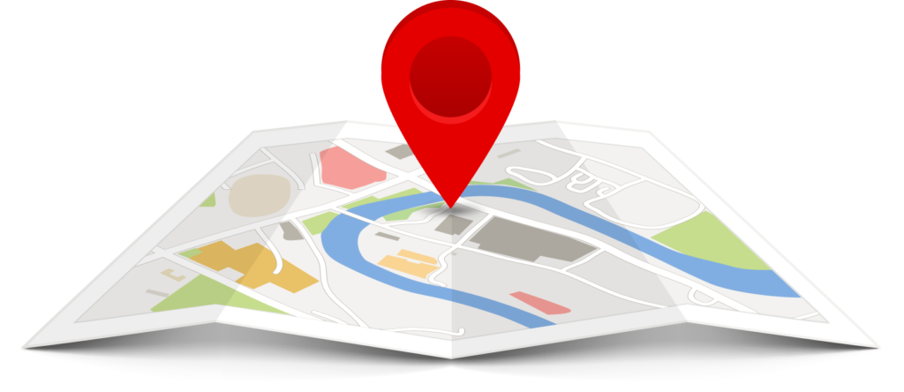
02
Goals & Methods
Goals
It recommends a friend who is close to you
It is easier and more enjoyable to make friends with same purpose in SKKU.
Example
Lunch at 1 o’clock
Find study member
Looking for team members in SE class
You can ask for help.
Who can lend me a calculator?

Slide 13
02
Goals & Methods
Goals – Detailed goals
It is easier and more enjoyable to make friends with same purpose in SKKU.
Map-based application
You can look at friends who are looking for friends in close proximity.
It recommends a friend who is close to you and suits your purpose.
You can set your own profile.
You can manage your friends list by requesting, accepting, blocking friends.
You can chat with your added friends.
You can share your location with your friends.
You can easily know the location of the school building.

Slide 14
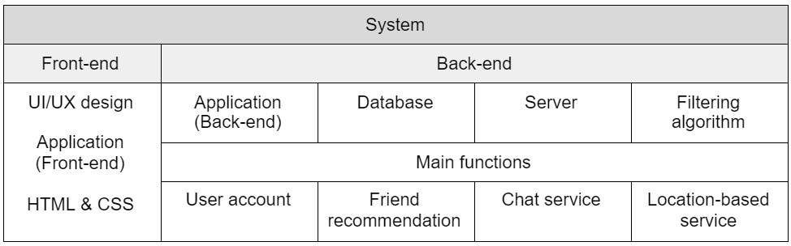
02
Goals & Methods
Methods – System structure

Slide 15
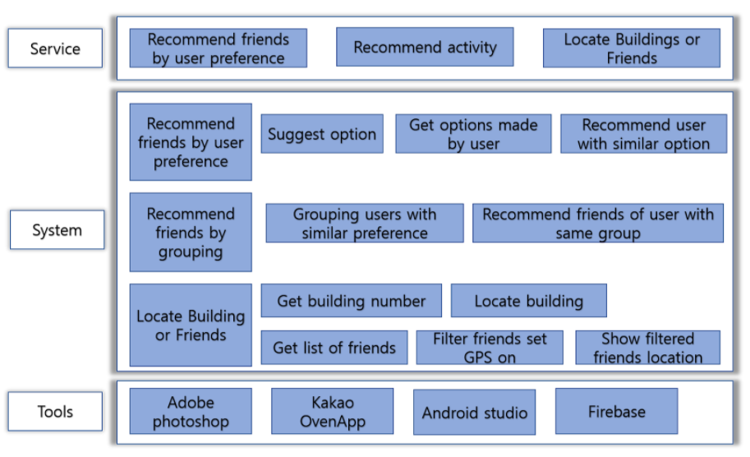
02
Goals & Methods
Methods – System structure

Slide 16




02
Goals & Methods
Methods – Frontend tools
UI/UX design
Frontend Tools
For our APP
Adobe Photoshop
Adobe Xd
Kakao OvenApp
Application
Android Studio(XML)

Slide 17





02
Goals & Methods
Methods – Backend tools
Backend Tools
For our APP
Android Studio(Java)
Application
Firebase
DBMS
SQLite Database
Github
Open source
Node.js
Server
AWS

Slide 18
1
Team formation
PART 3
Team & Strategy
Planning strategy - Schedule
2
3
Quantative evaluation of goals

Slide 19



03
Team & Strategy
Team formation
Team 7
Designer
UX/UI Designer
길은지
UX/UI Designer
Design our application
김혜영
UX/UI Designer
HTML/CSS Expert
Developer
Application Developer
박거량
Develop app about GPS service
서지원
Develop whole part of app
Server Developer
석은주
Control and manage our server
Connect server and app
Team leader
Database Developer
장혜준
Manage our database
Connect database and app

Slide 20
03
Team & Strategy
Planning strategy – Schedule
Contents | Time Line
 | 4/5 ~4/11 | 4/12 ~ 4/18 | 4/19 ~ 4/25 | 4/26 ~ 5/2 | 5/3 ~ 5/9 | 5/10 ~ 5/16 | 5/17 ~ 5/23 | 5/24 ~ 5/30 | 5/31 ~ 6/6 | 6/7 ~ 6/13
Requirement Specification
UX / UI Design
Implement - Component
Implement - Integration
Making a test plan
Code Review
Testing

Slide 21


03
Team & Strategy
Planning strategy - Schedule
Requirement
Specification
Unit Model
Specification
Unit Model
Development
~4/25
~5/16
~5/23
Test Plan
Integration
Verification/
Validation
~5/30
~5/30
~6/13

Slide 22
03
Team & Strategy
Planning strategy - Demonstration Process
User
Acceptance
Testing
Integration
Testing
System
Testing
Unit Testing

Slide 23
03
Team & Strategy
Planning strategy – Quantative evaluation of goals
Quantative evaluation of goals
Goal achievement rate
Evaluation indicator
Importance
30%
Over 90%
Easy to understand document
Location service accuracy
Over 95%
30%
20%
User-friendly UI/UX
Over 80%
20%
Over 85%
Expert verification/review

Slide 24


03
Team & Strategy
Planning strategy - Acheivements
1. Detailed and easy to understand document
2. Application with market competitiveness

Slide 25
1
Application Plan
PART 4
Plan & Effect
2
Benefit

Slide 26




04
Plan & Effect
Application Plan
It can be extended to a platform that receives advertising fees.
Examples include nearby restaurants, and
dormitory refrigerator providers.
Beyond making friends, it can be extended to a community app.
Such as finding team project members,
finding people to eat together.
Advertisement
Community
It can be extended to a platform that can
promote events in the school.
The school can increase the rate of student
participation in events.
You can easily find your destination by
displaying the building number.
Expandable to platform that guides restaurants and nearby trail.
School
Maps

Slide 27


04
Plan & Effect
Benefit
It provides an opportunity to meet new people for various purposes.
Starting with a chat, you can make new friends relatively easily, and you can even meet face-to-face with them.
Social
Has a friend recommendation algorithm that can match people with similar purposes.
Business can be expanded to various fields based on the user database in the school.
Technical
You start by chatting first, so you can easily start to talk to people without going out.
It saves time to find opportunities in various ways to make friends and various interactions can arise
from new relationship building. It also can delvelop into a team member of a valuable project.
Economical

Slide 28
Thank you
Team 7

