Slide 1

Go, change the
world.
MACHINE LEARNING.
-By Intershala.
Name : Chetan K.M
USN : 1RV18ME038
SEC : 7A

Slide 2
Introduction :
ML is a branch of artificial intelligence:
Uses computing based systems to make sense out of data
Extracting patterns, fitting data to functions, classifying data, etc
ML systems can learn and improve with historical data, time and experience
Bridges theoretical computer science and real noise data.

Slide 3

ML in real life :
Algorithm of our feed will be based on our interest in particular topics.

Slide 4
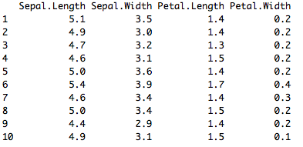
Supervised and Unsupervised Learning :
Unsupervised Learning
There are not predefined and known set of outcomes
Look for hidden patterns and relations in the data
A typical example: Clustering

Slide 5
Supervised Learning :
Classification
Predicts which class a given sample of data (sample of descriptive features) is part of (discrete value).
Regression
Predicts continuous values

Slide 6
Machine Learning as a Process :
Define Objectives
Data Preparation
Model Building
Model Deployment
Model Evaluation

Slide 7
ML as a Process: Data Preparation:
Needed for several reasons
Some Models have strict data requirements
Scale of the data, data point intervals, etc
Some characteristics of the data may impact dramatically on the model performance
Time on data preparation should not be underestimated
Raw Data ->Data Transformation->Data Ready

Slide 8
ML as a Process: Feature engineering :
Determine the predictors (features) to be used is one of the most critical questions
Some times we need to add predictors
Reduce Number:
Fewer predictors more interpretable model and less costly
Most of the models are affected by high dimensionality, specially for non-informative predictors
Binning predictors
Wrappers
Multiple models adding and removing parameter
Filters
Evaluate the relevance of the predictor
Based normally on correlations
Algorithms that use models as input and performance as output
Genetics Algorithms

Slide 9
ML as a Process: Model Building
Data Splitting
Allocate data to different tasks
model training
performance evaluation
Define Training, Validation and Test sets
Feature Selection (Review the decision made previously)
Estimating Performance
Visualization of results – discovery interesting areas of the problem space
Statistics and performance measures
Evaluation and Model selection
The ‘no free lunch’ theorem no a priory assumptions can be made
Avoid use of favorite models if NEEDED

Slide 10
Linear Regression :
Linear regression is a linear model, e.g. a model that assumes a linear relationship between the input variables (x) and the single output variable (y). More specifically, that y can be calculated from a linear combination of the input variables (x).
For example, in a simple regression problem (a single x and a single y), the form of the model would be:
y = B0 + B1*x

Slide 11
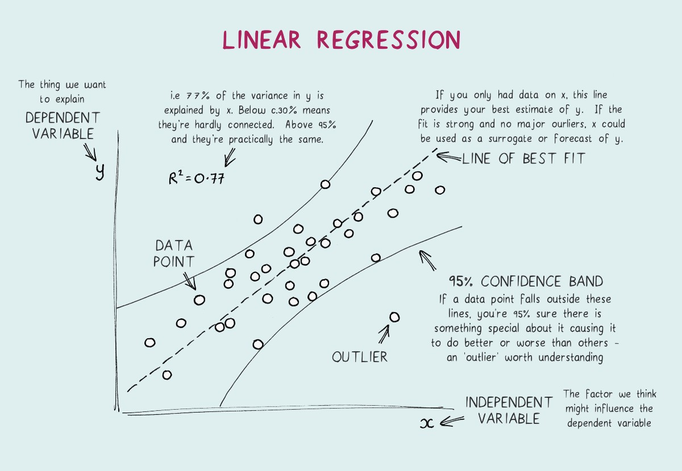

Slide 12
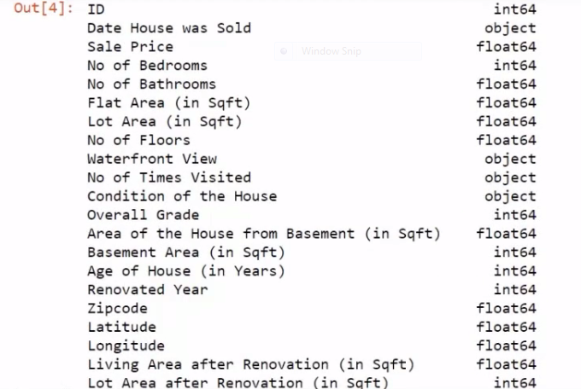
Project : Raw_housing_data

Slide 13
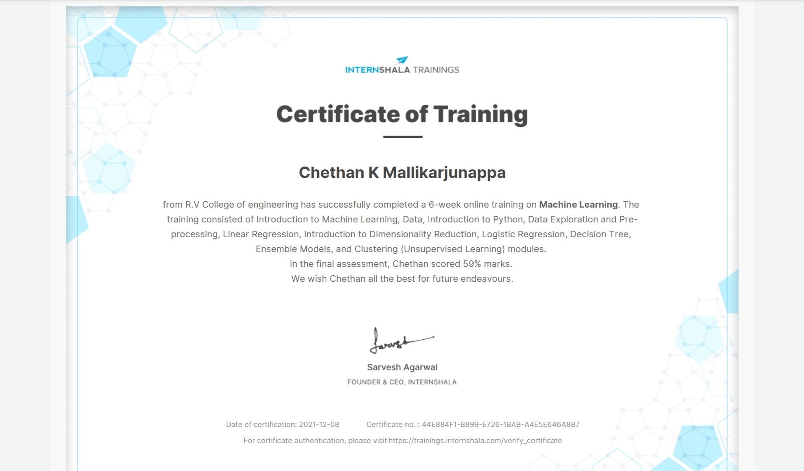

Slide 14
THANK YOU.

