Slide 1



Introduction to Foreign Direct Investment (FDI)
Foreign Direct Investment (FDI) is an investment made by a firm or individual in one country into business interests located in another country. It typically involves acquiring a lasting interest in or gaining significant influence over a company in the foreign country. FDI can take various forms, such as establishing new operations, acquiring existing businesses, or entering into joint ventures with local firms. FDI is a crucial driver of globalization, facilitating the flow of capital, technology, and expertise across borders. It plays a vital role in the economic development of both the investing and host countries, promoting integration into the global economy. However, it also involves challenges and risks that require careful management to ensure mutual benefits. Foreign Direct Investment (FDI) lies at the heart of globalization and serves as an important conduit for the transfer of capital, goods, services, and information across economies. Measuring FDI helps us better understand how countries are interconnected and integrated into today’s global economy.
CK
by Chethan Km

Slide 2


Benefits of FDI
1
Economic growth and development
2
Technology transfer and innovation
FDI can stimulate economic growth and development by providing access to new markets, technologies, and capital.
FDI can facilitate the transfer of technology and innovation from developed to developing countries, leading to increased productivity and competitiveness.
3
Infrastructure development
4
Access to international markets
FDI can contribute to the development of infrastructure, such as transportation, energy, and telecommunications, which are essential for economic growth.
FDI can provide companies with access to new international markets, expanding their customer base and sales opportunities.

Slide 3


Insights
Sector
FDI Share (%)
Reason for FDI
Services
18%
Outsourcing, urbanization, government regulations, thriving startup ecosystem
Computer Software and Hardware
7%
Interlinking with telecommunications and service sector
Construction Development
6%
Infrastructure development, urbanization
Telecommunications
7%
Growing demand for mobile and internet services
Automobiles
5%
Growing middle class, increasing demand for vehicles

Slide 4
Insights (Continued)
FDI Trends
Low Interest Sectors
Significant Sectors
Total FDI over the 17 years amounts to approximately 3.3 lakh million dollars. FDI in India increased gradually until 2008 but declined afterward, possibly due to the global financial crisis of 2007–2008. FDI further declined in 2012–2013, potentially due to scandals such as the 2G spectrum scam, coal allocation scam, retrospective taxation, declining GDP growth, high inflation, and interest rates.
The Mathematical Surveying and Drawing Instruments sector has recorded zero FDI over the 17 years. There is very low interest in sectors like Coir, Defense Industries, Mathematical Surveying and Drawing Instruments, and Coal Production. Around 28 to 30 sectors receive 1% or less of total FDI.
The second-largest recipient of FDI is the Computer Software and Hardware sector, which accounts for 7% of total FDI. Other significant sectors include Telecommunications (7%), Construction Development (6%), Automobiles (5%), Trade (4.7%), Drugs and Pharmaceuticals (4%), Chemicals (other than Fertilizers) (4%), Power (3%), Construction (3%), and Hotel and Tourism (3%).

Slide 5
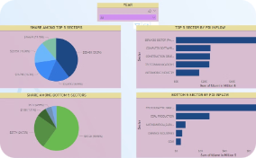
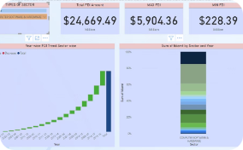
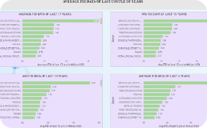
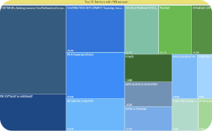
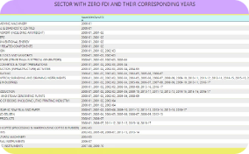
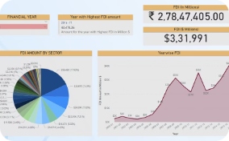
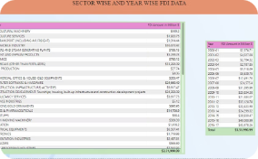
Reports
Report 1
Report 2
Report 3
Report 4
This report provides a comprehensive overview of FDI trends in India over the past 17 years.
This report analyzes the factors driving FDI in specific sectors, such as services, software, and telecommunications.
This report examines the impact of FDI on the Indian economy, including its contribution to growth, employment, and technological advancement.
This report explores the challenges and opportunities associated with FDI in India, such as regulatory frameworks, infrastructure development, and competition.
Report 5
Report 6
Report 7
This report provides recommendations for policymakers to attract and leverage FDI for sustainable economic growth and development in India.
This report provides the data on how much FDI is invested in india for last 17 years and also shows the yearly trends of FDI investmnet.
This report shows the Year wise and Sector wise FDI in india.

