Slide 1

UNIVERSIDAD NACIONAL DE INGENIERÍA
FACULTAD DE CIENCIAS
Implementation and Evaluation of a Distributed Agent System for Concurrent Task Management
ELABORADO POR:
Joel Chavez Chico
Cleber Aguado Gutierrez
Franklin Espinoza Pari
Julio - 2024

Slide 2
Introduction
Authorization checks are central to preserving privacy
This presentation details the development and implementation of a distributed agent system designed to process tasks concurrently, in parallel, and in both homogeneous and heterogeneous distributed environments.

Slide 3
Objectives
Zanzibar stores access control lists (ACLs)
Develop distributed agents capable of processing tasks in a parallel and concurrent manner.
Implement a worker node system that can include both desktop and mobile devices.
Ensure fault tolerance by automatically redistributing tasks if a node fails.
Deploy and evaluate the system in LAN and Wi-Fi network environments.
Measure the system's performance by executing large-scale tasks.

Slide 4
System Arquitecture
Worker Nodes: Desktop Workers and Mobile Workers
Agent Tasks: Word Counter, Keyword Finder, Repeated Keyword Finder
Task Distribution Mechanism: Clients send tasks to worker nodes, which process tasks and return results.

Slide 5
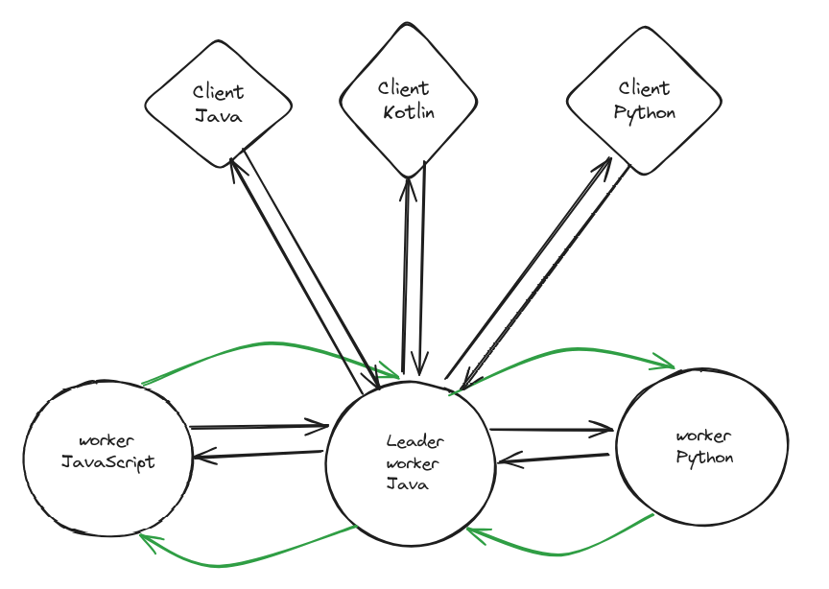
Diagram Arquitecture
and performs authorization checks based on stored ACLs

Slide 6
Task Processing Flo
1. Server Initialization: The leader worker server (Java-based) is initiated.
2. Client Task Submission: Clients load tasks and send them to the leader worker.
3. Task Handling: The leader worker creates a new thread for each client task.
4. Task Processing: Worker nodes process the tasks and return results.
5. Result Handling: Results are displayed on worker nodes' consoles and the client's interface.

Slide 7
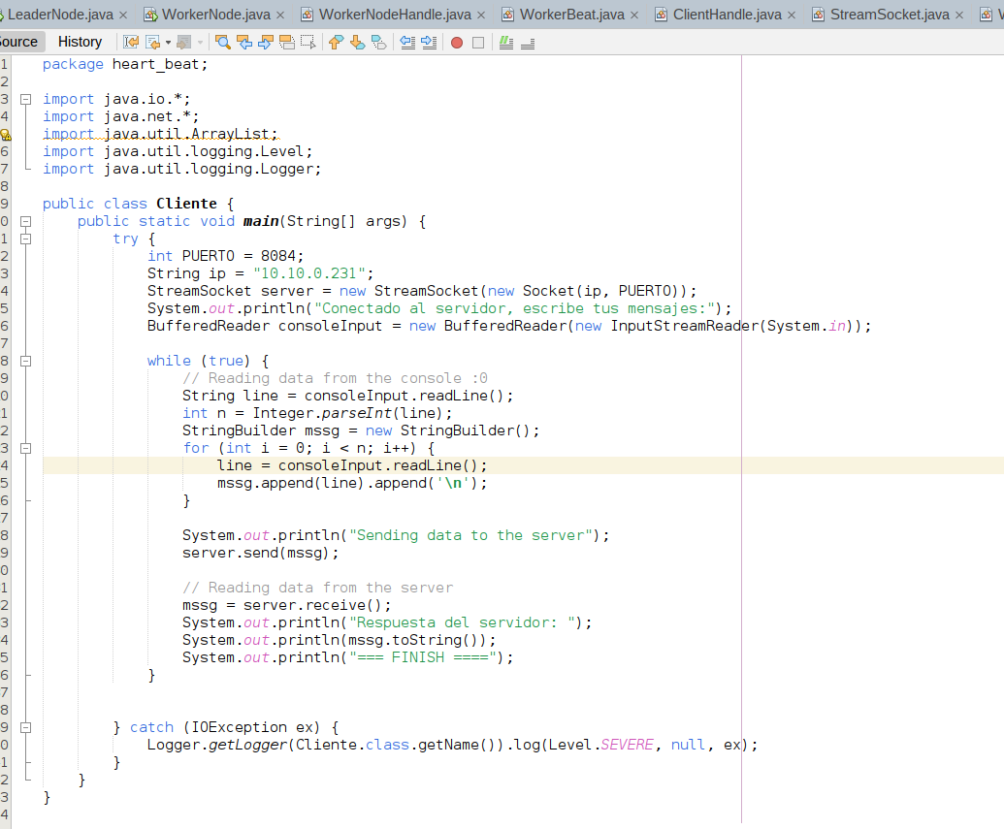
Java Client

Slide 8
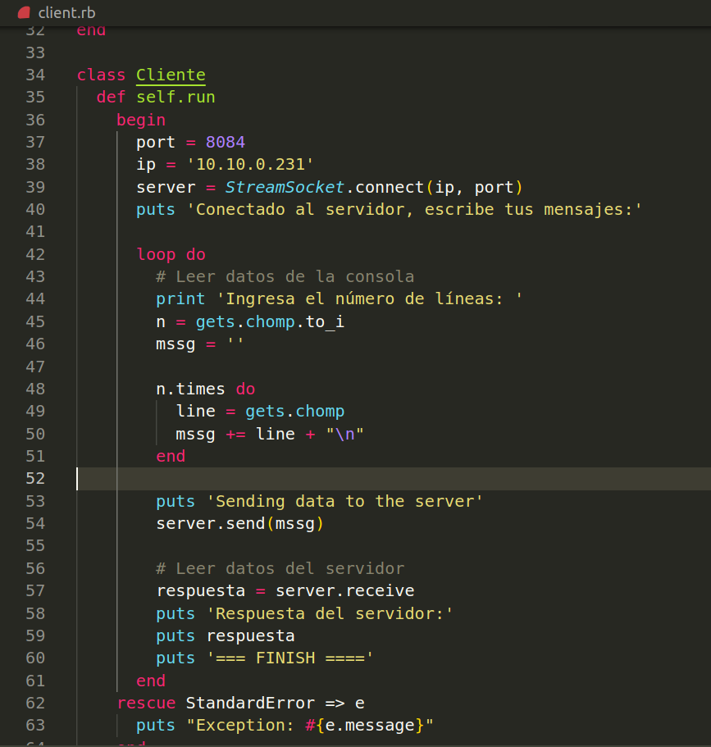
Ruby Client

Slide 9
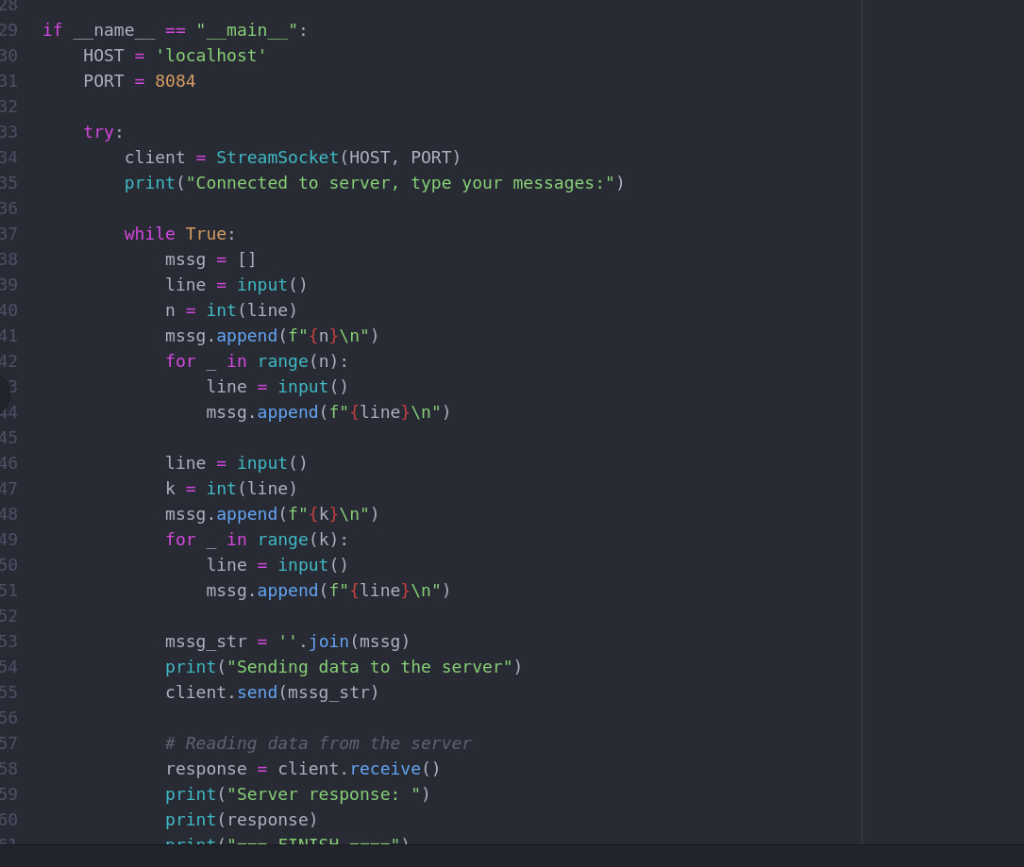
Python Client

Slide 10
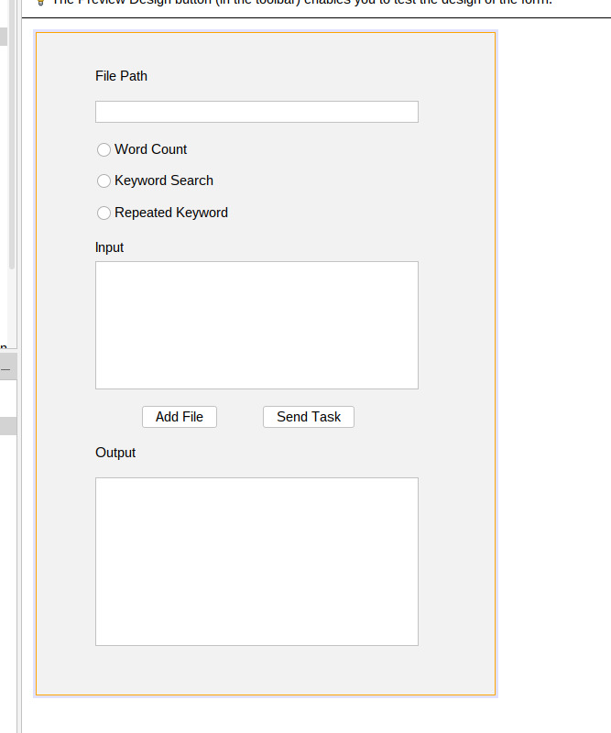
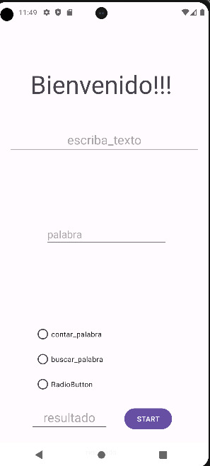
Deployment

Slide 11
Conclusions
Effective concurrent and parallel task processing.
Robust fault tolerance mechanisms.
Scalable and flexible system design.

Slide 12
Thanks You

