Slide 1

Information Encoding Standards Final Project Part 1
By:
Jhoana Romero and Kernel Prieto

Slide 2

Authentication-Summary
Basics To create an authorization
IdentityExample To create an Identity
Server To create the server and authorization
Client The server response
Api Client and server connection-Refresh the token

Slide 3
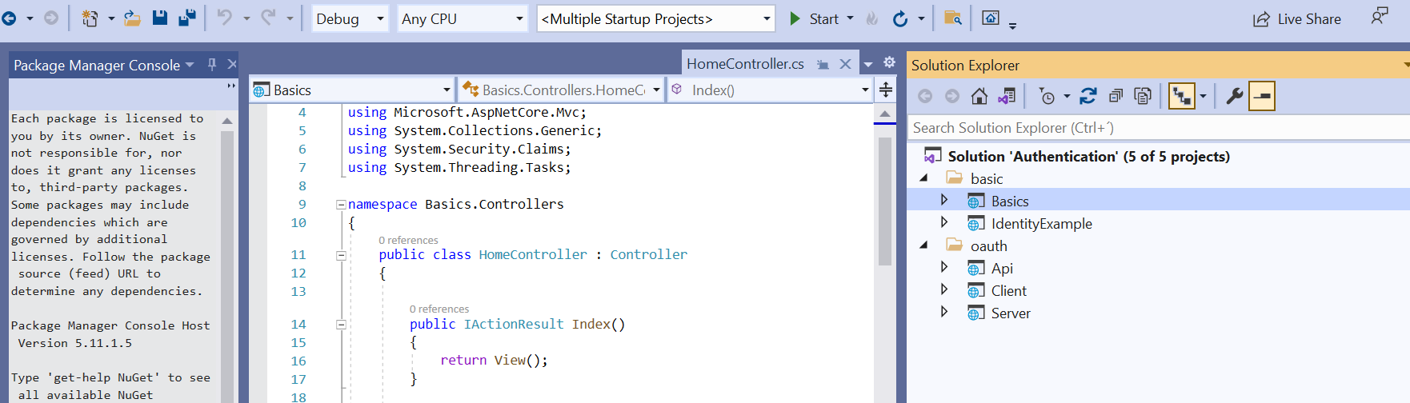
Authentication Project

Slide 4
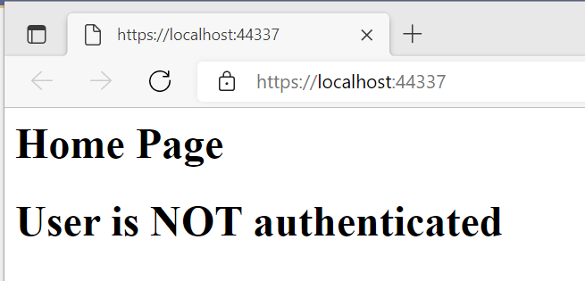
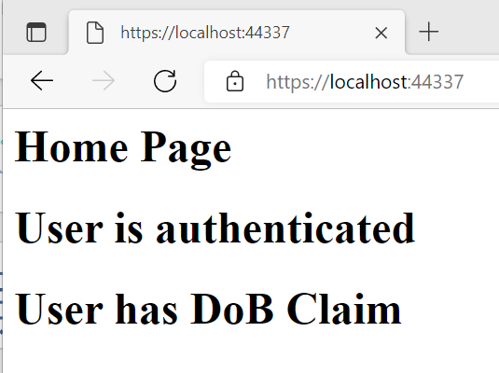
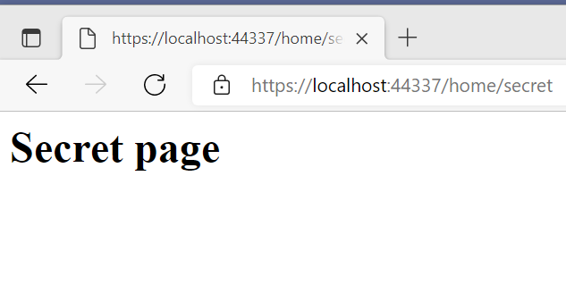
1. Basics
In this step we create a user object that .NetCore can store into cookies and essentially provide authentication and authorization based on it. Once you are authenticated, you will reach the “secret page”.

Slide 5
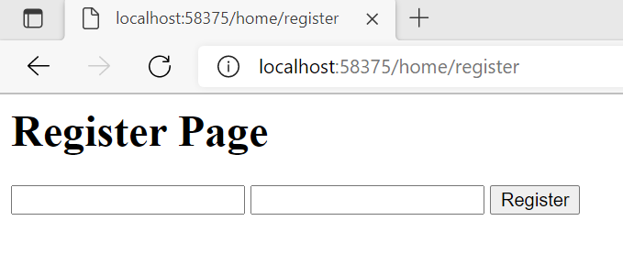
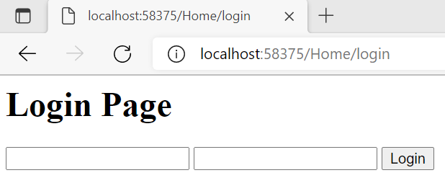
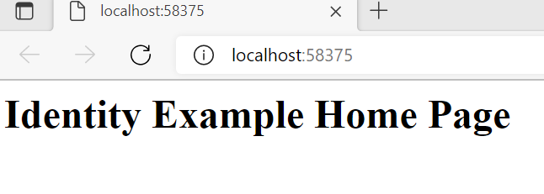
2. IdentityExample
In this step we are going to look at identity and what it provides in terms of infrastructure around some claims. This allows you to roll own authentication.

Slide 6
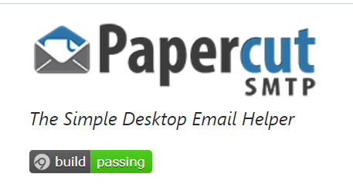
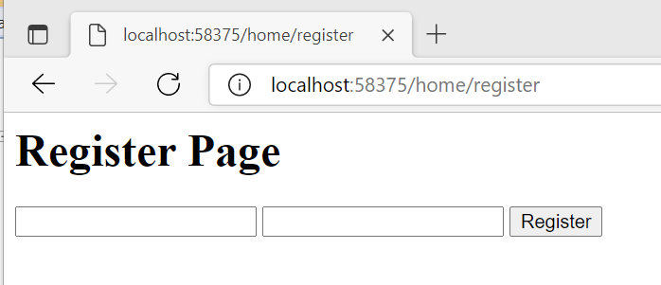
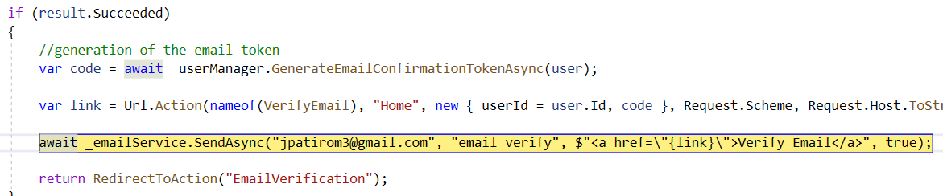
Email verification
We used Papercut as the server to send emails. We use identity to set up infrastructure regarding our authentication process. We store users, claims and the database and how identity provide us with easy to access methods regarding sign in and creating users.
Register Email:

Slide 7
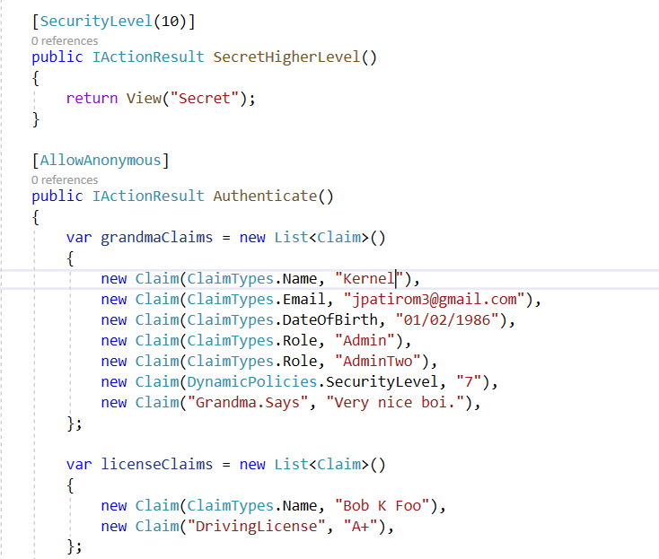
We can use to create some interesting authorization scenarios.
Three main budlings blocks:
Authorization requirements
Authorization policies
Authorization handlers

Slide 8
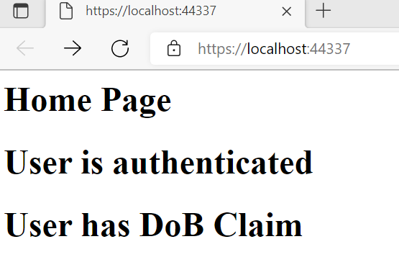
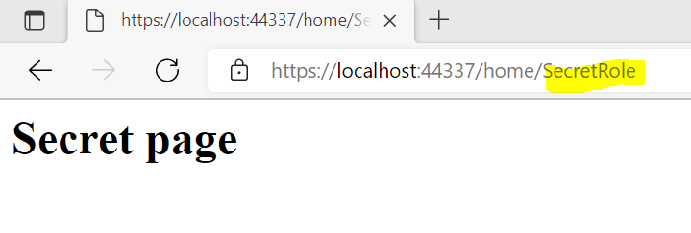

Slide 9
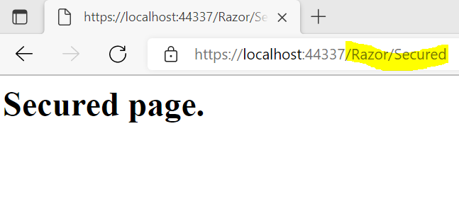
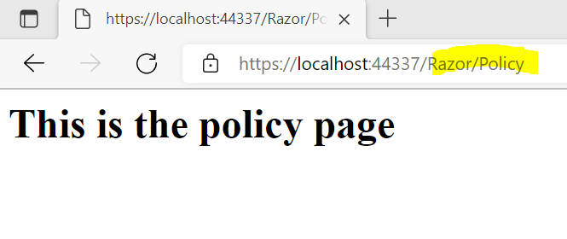
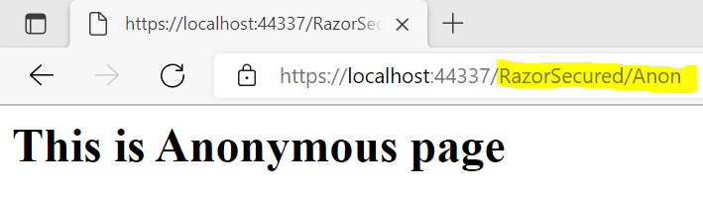
Authorizing Razor pages
Razor Pages is the recommended framework for cross-platform server-side HTML generation. With razor pages we cannot use authorization attributes.

Slide 10
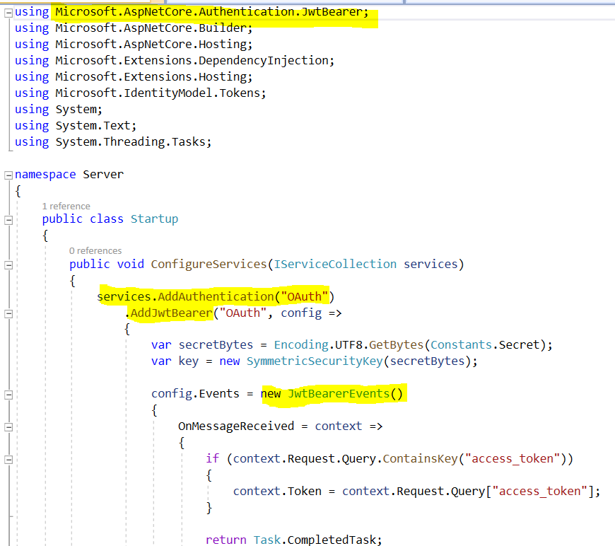
3. Server
How JWT is used in API security?
Here we create our own JWT token, we access such that when we access the page we got our access token and then we set up the service.

Slide 11
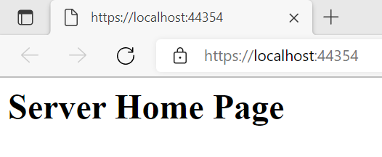
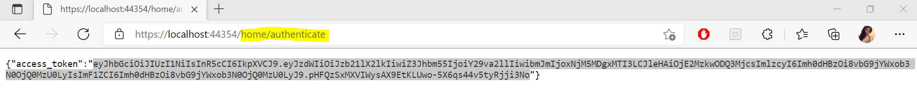

Slide 12
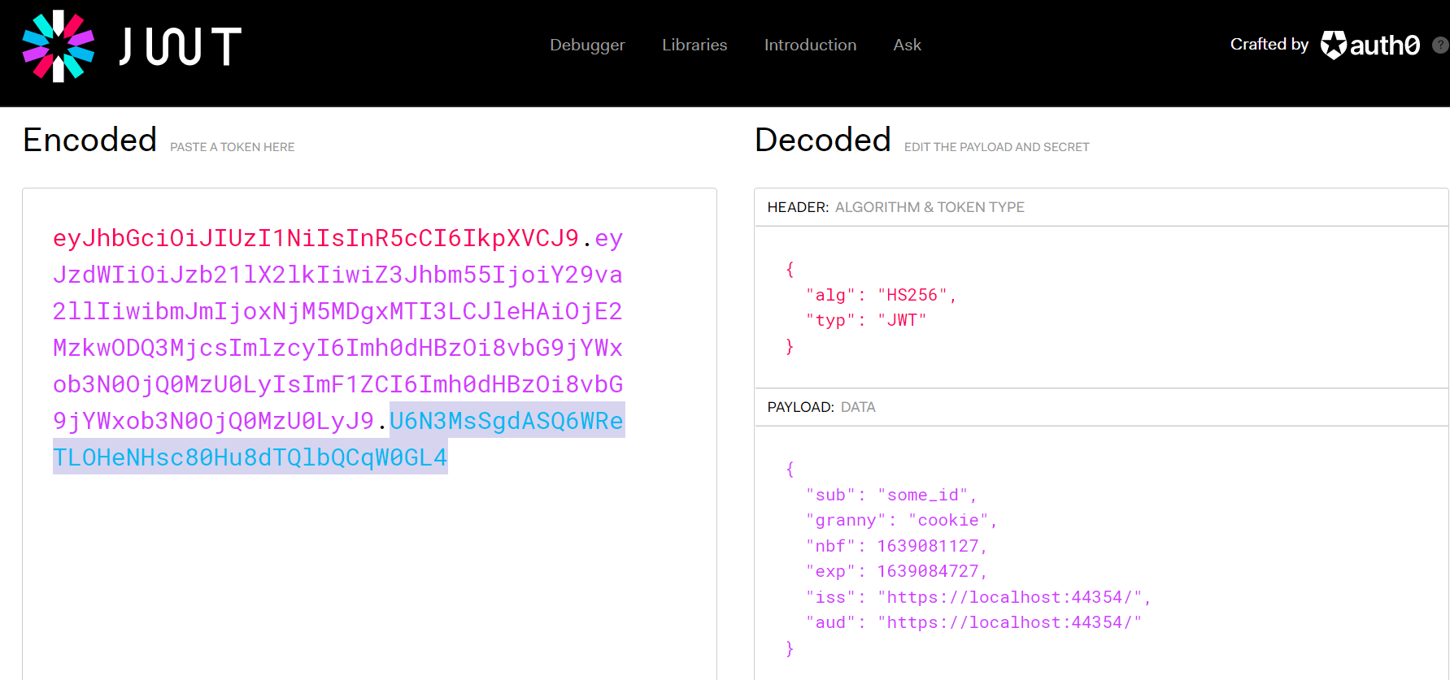
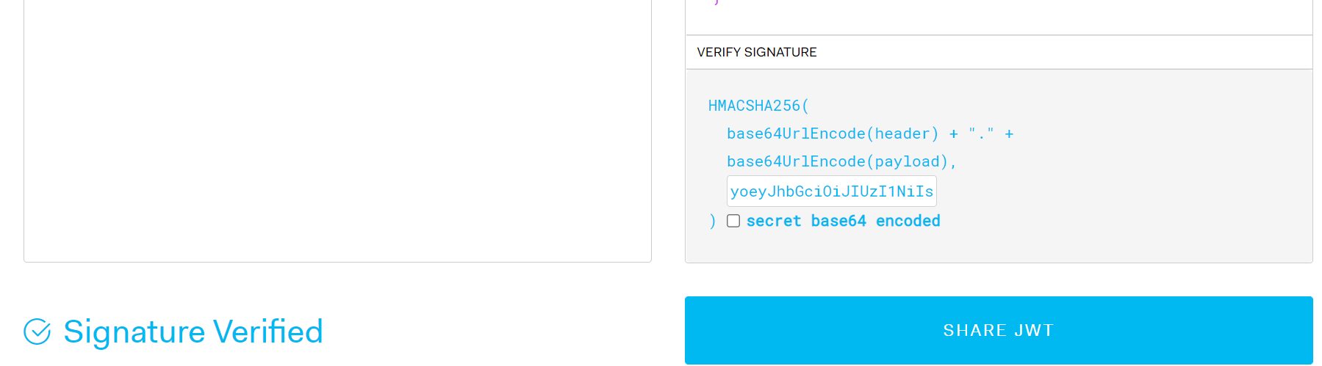

Slide 13

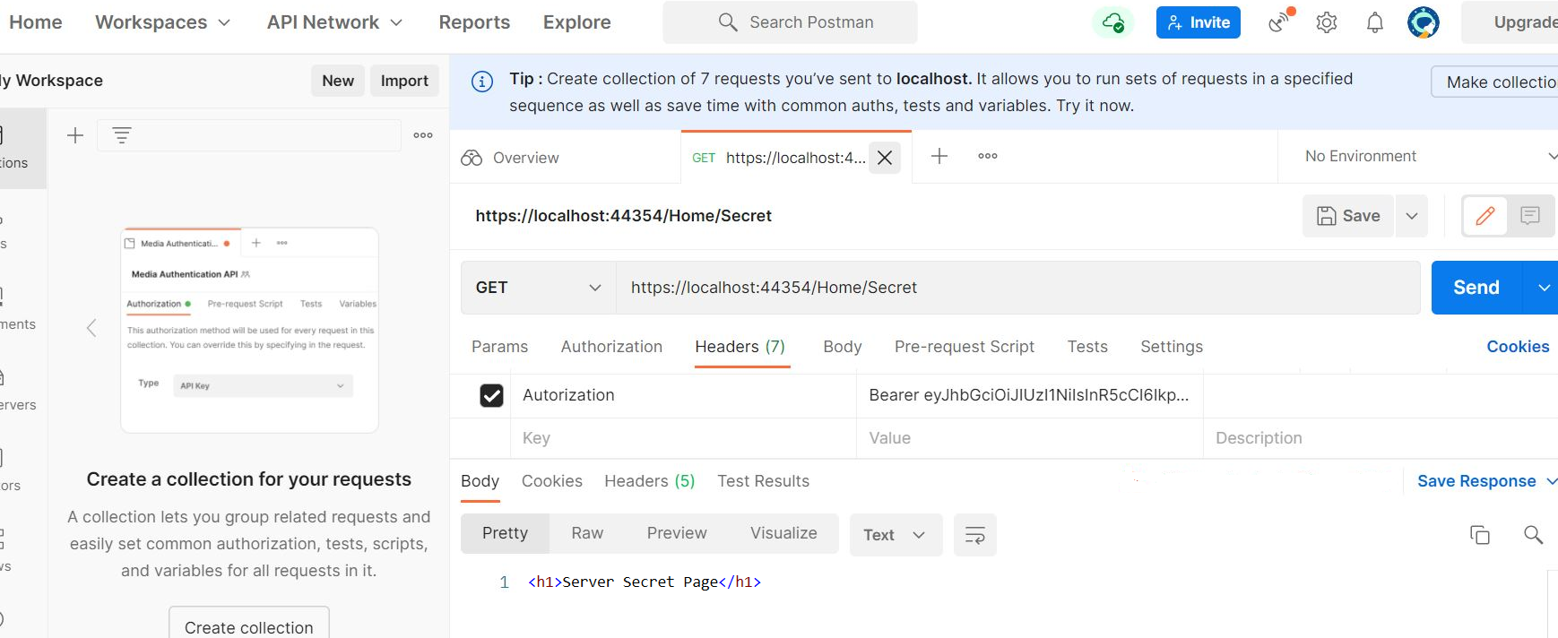
Acquire data from PostMan

Slide 14
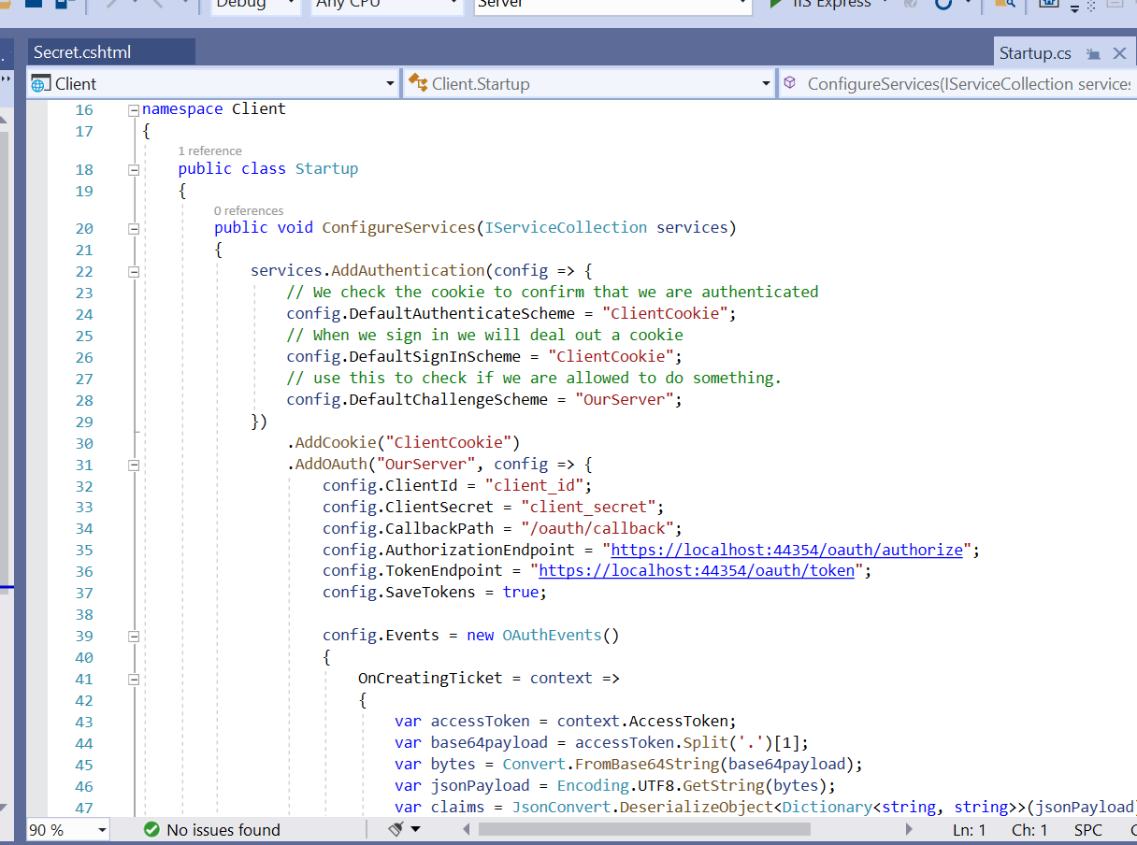
4. Client
Here, we create a client which will be able to store the token, which can later be used for authorization with an API

Slide 15
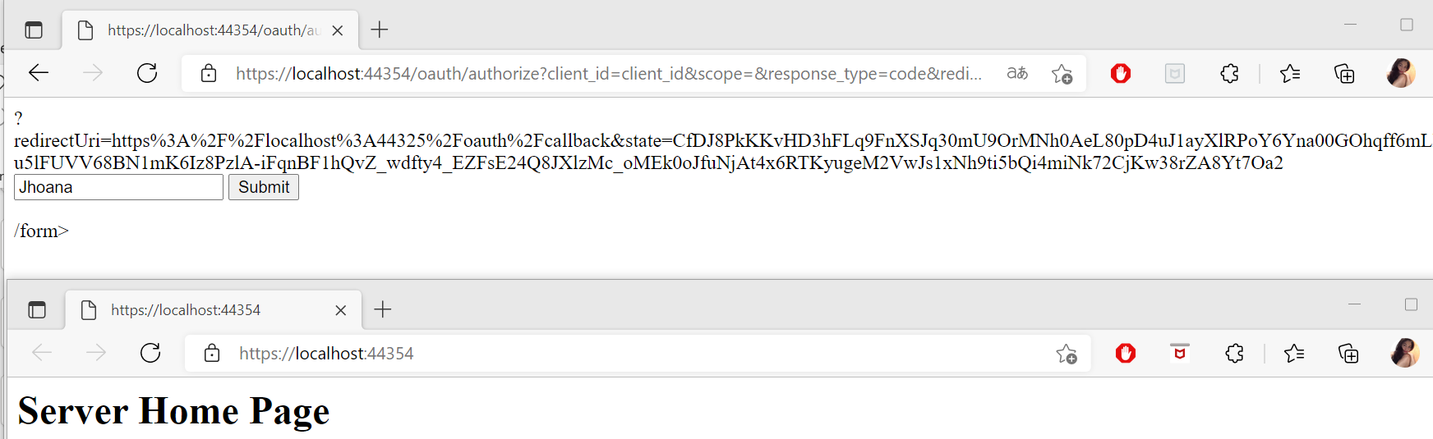

Slide 16
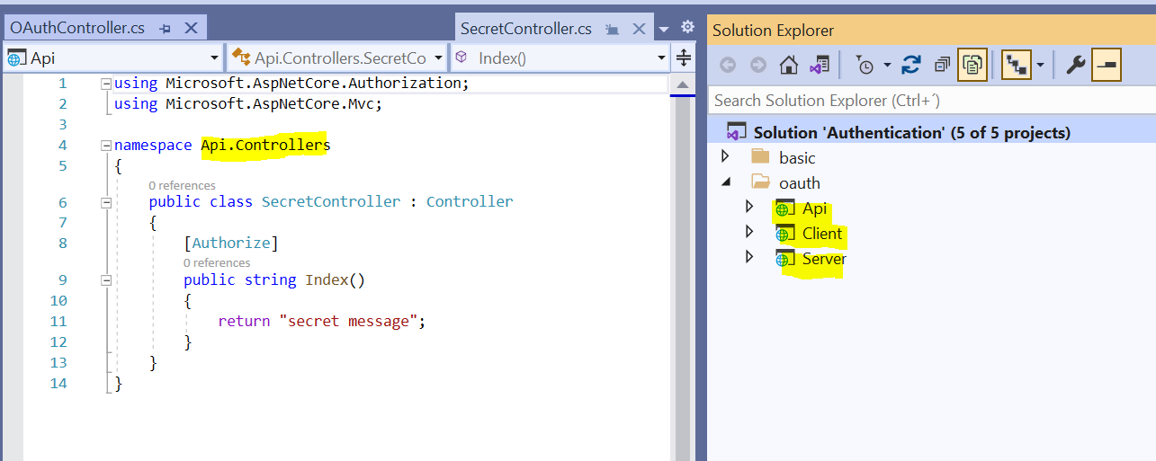
5. Api
We can use the access token to access some secured resources.
We have a client that is requesting to an access token from the server, its going to make a call to some kind of authorized endpoint on our API and our API validates the token with the server

Slide 17
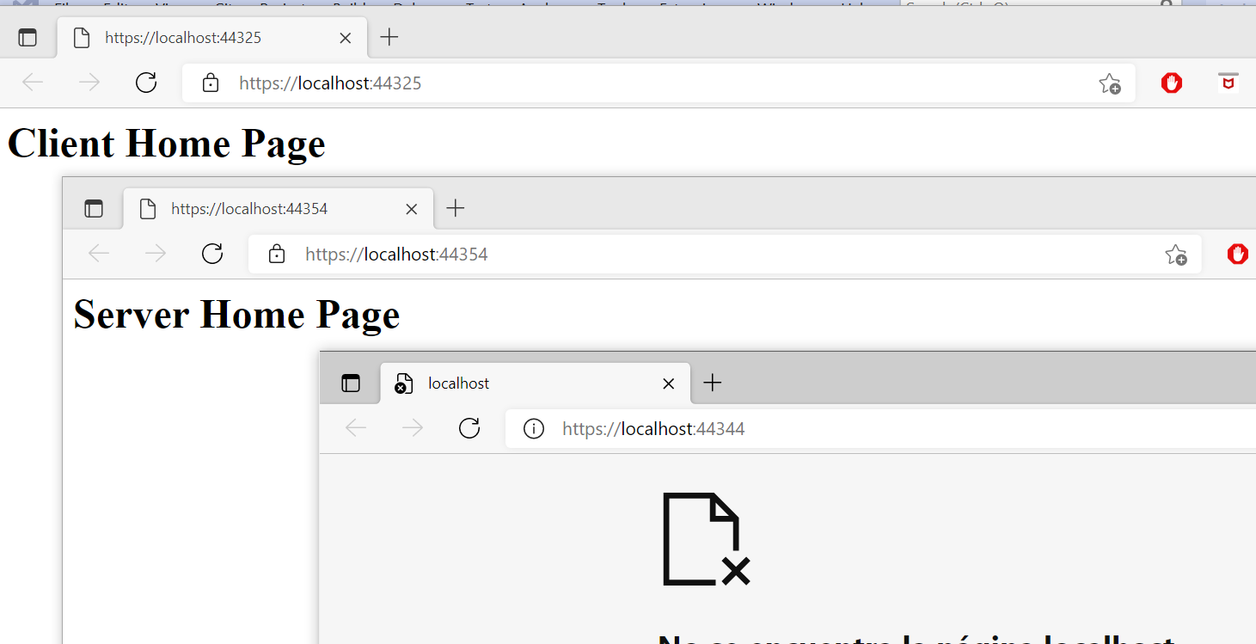
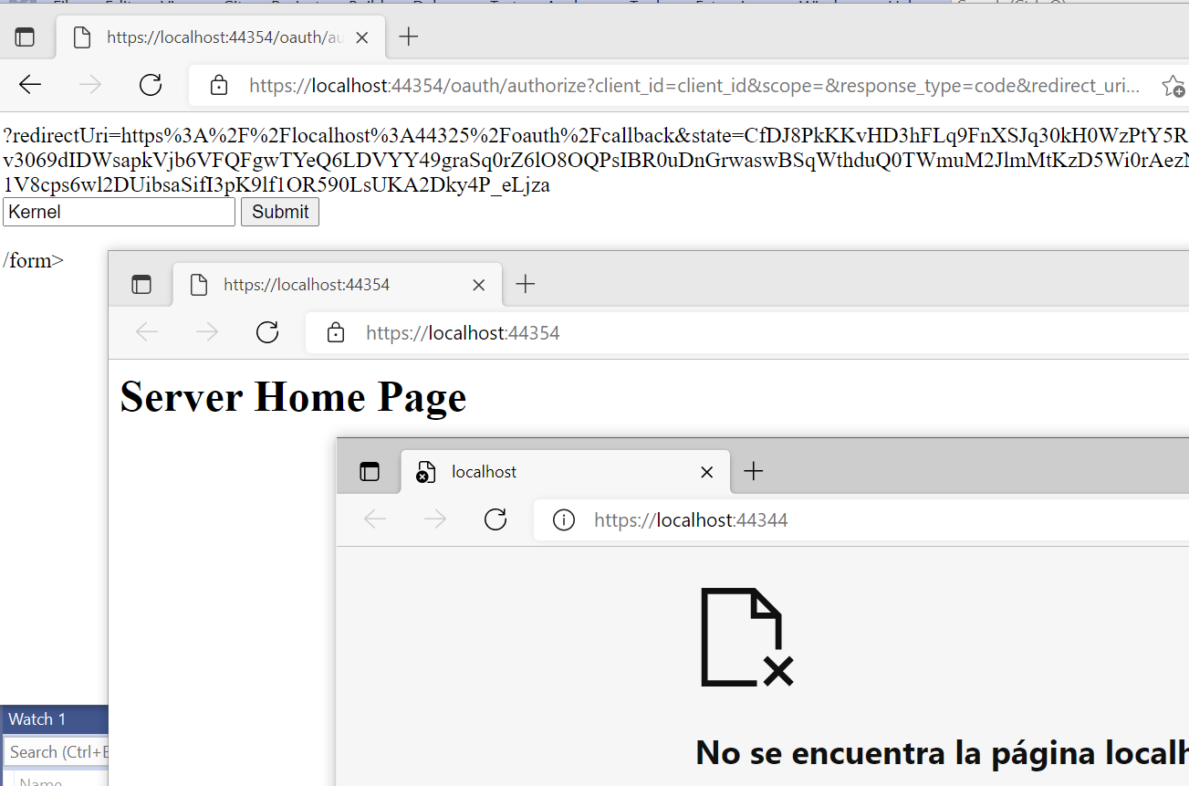
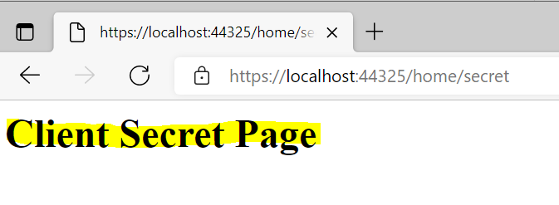
Demonstrate your API

Slide 18
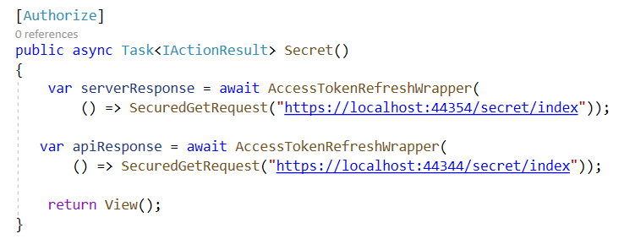
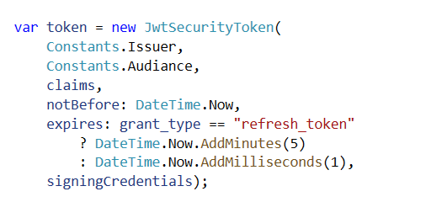
Refresh the token
Step 1: To expire our access token
Token can be used to retrieve new access tokens.
Server, Client and API communicate to retrieve the token to access to authorized resources and to refresh the access token.
Step 2 To generate a new token

Slide 19
API authentication methods and Recommendations
OAuth for Accessing User Data
API Keys
OpenID Connect
OAuth is the best choice for identifying personal user accounts and granting proper permissions. In this method, the user logs into a system. That system will then request authentication, usually in the form of a token. The user will then forward this request to an authentication server, which will either reject or allow this authentication. From here, the token is provided to the use, and then to the requester.

Slide 20


Task 2: Security Technologies Recommendations
.PPTS link: IES_FinalProject_JRomeroKPrieto_P2.pptx
https://github.com/JhoanaGeorgian/JRomero.KPrieto.BDAT1001.FinalProject
Recording link: https://georgiancollege.webex.com/recordingservice/sites/georgiancollege/recording/0a9b5a993ff8103a979f0050568cc44f/playback
Password: RkpK6ZmH

