Slide 1

Information Encoding Standards Final Project Part 2 Security Technologies Recommendations
By:
Kernel Prieto and Jhoana Romero

Slide 2

Question 1: How can we transfer personal data securely within their network?
Email Encryption
Website Encryption
File Transfer Protocol (FTP) and Secure File Transfer Protocol (SFTP)
Secure HyperText Transfer Protocol
Off the Record Messaging
Cloud Services
Peer to Peer (P2P) Communication
Near Field Communication
The Bottom Line

Slide 3

Question 2: What Privacy Policies should we be aware of before we get started? Can you give us a checklist to follow?
1. Configuration
Use of https
Avoid cloud use
Disable the use of JavaScript in the browser
Program the internet browser so that it does not accept cookies
2. Keys and conditions of use
Good passwords
3. Encrypt
-Chats and emails (Gnu Privacy Guard (GPG), Pretty Good Privacy (PGP) y Thunderbird)
-HDD
4. Effort for the personal

Slide 4
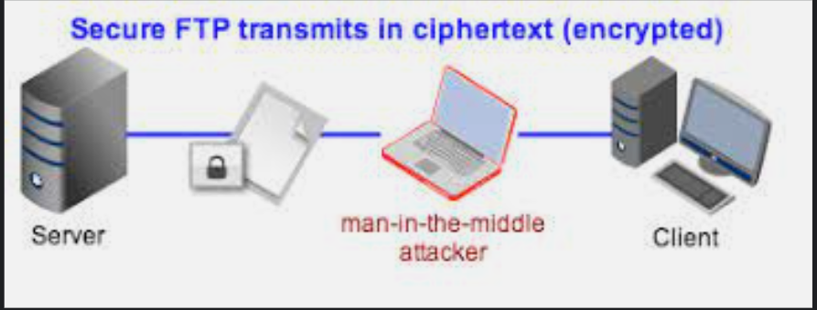

Q3: What security policy is best for transferring personal information?
The best way is with FTP client
FileZila
All browsers are by default configured to work in passive mode when are used as FTP clients
Users can use the client to connect to any number of FTP server

Slide 5

Q4: Can we encode and encrypt images?
Encryption of images is proven a successful method to communicate confidential information for which countless procedures are unearthed. Still, it continues attracting researchers as usage of images in every means of digital communication has phenomenally increased.

Slide 6
Q5: Our database cannot be moved from the site and we need to be able to access it externally using a secure API. Can you explain the architecture of a secure API?
Step 1: Control requests into the agency’s trusted network
Step 2: Establish filtering rules and alerts
Step 3: Implement protective caching
Step 4: Operationalize cyber threat information

Slide 7
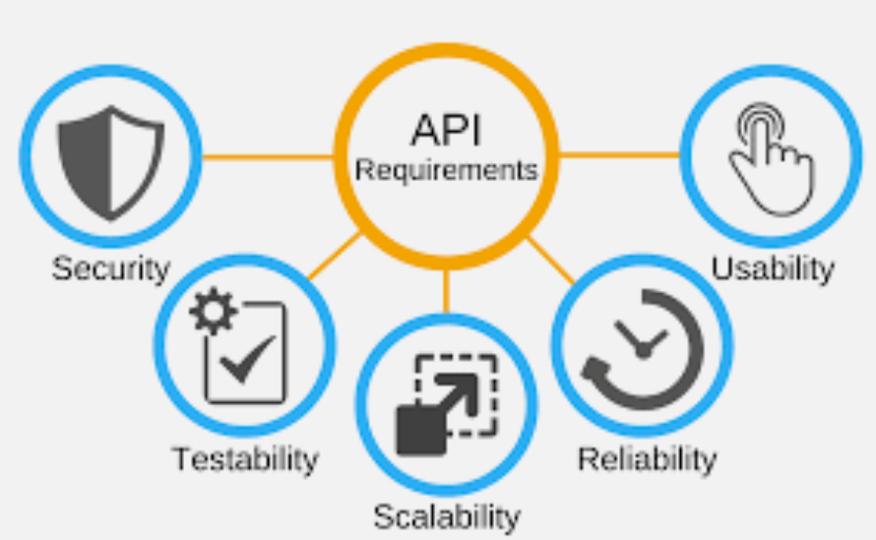
Step 5:Manage identity and access
Step 6: . Protect against payload threats
Step 7: Deploy SQL injection filters

Slide 8

Q6: Can you recommend a secure framework for coding an API?
ASP.NET Web API is a framework for building HTTP services that can be accessed from any client including browsers and mobile devices. It is an ideal platform for building RESTful applications on the . NET Framework.

Slide 9

Q7: What data interchange format should we use while transferring data between locations?
JSON has eclipsed XML as the preferred data interchange format for web applications and web services.
Over the last 15 years, JSON has become ubiquitous on the web. Today it is the format of choice for almost every publicly available web service, and it is frequently used for private web services as well.

Slide 10
Q8: How should we store our data in our many locations?
They provide massive storage for any kind of data, great processing power and the ability to handle virtual limitless concurrent tasks or jobs.
When data is written to Hadoop it is automatically encrypted and assigned to an encryption zone.

Slide 11

References
Kritzinger, E., & Smith, E. (2008). Information security management: An information security retrieval and awareness model for industry. Computers & security, 27(5-6), 224-231.
Lin, B., Chen, Y., Chen, X., & Yu, Y. (2012, August). Comparison between JSON and XML in Applications Based on AJAX. In 2012 International Conference on Computer Science and Service System (pp. 1174-1177).
Security.org: https://www.security.org/resources/securely-storing-data/

