Slide 1

The JADE Platform

Slide 2
JADE AND THE AGENTS PARADIGM

Slide 3
An Agent is Autonomous and Proactive: An agent cannot provide call-backs or its own object
reference to other agents in order to mitigate any chance of other entities coopting control of its services. An agent must have its own thread of execution, using it to control its life cycle and
decide autonomously when to perform which actions.

Slide 4
Agents Can Say ‘No’, and They are Loosely Coupled: Message-based asynchronous communication is the basic form of communication between agents in JADE; an agent wishing to communicate must send a message to an identified destination (or set of destinations). There is no temporal depen-
dency between the sender and receivers: a receiver might not be available when the sender issues the message

Slide 5
The System is Peer-to-Peer: Each agent is identified by a globally unique name (the AgentIdentifier, or AID, as defined by FIPA). It can join and leave a host platform at any time and can discover other agents through both white-page and yellow-page services (provided in JADE by AMS and the DF agents as defined also by the FIPA specifications). An agent can initiate communication with any other agent at any time it wishes and can equally be the object of an incoming communication at any time.

Slide 6
JADE ARCHITECTURE

Slide 7
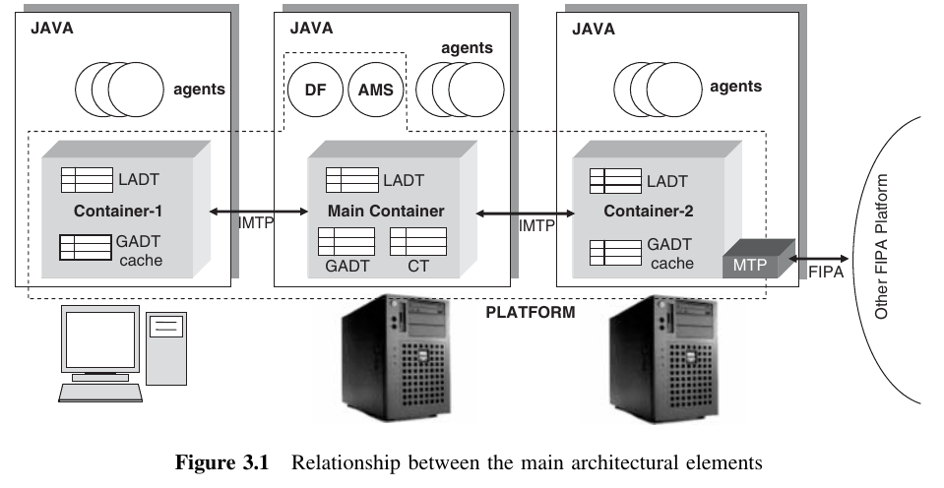

Slide 8
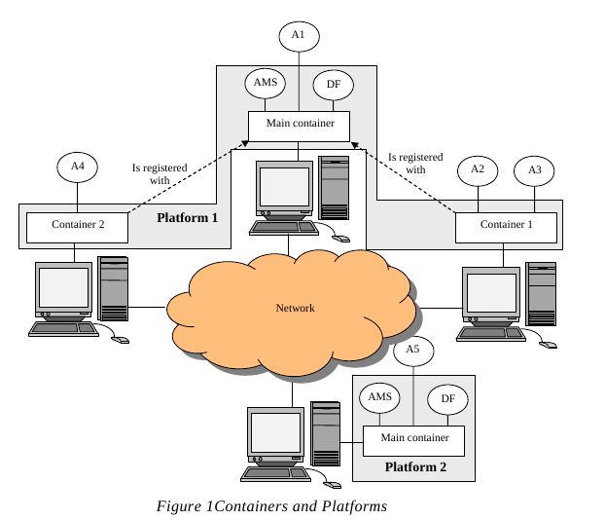

Slide 9
Containers and Platforms
Each running instance of the JADE runtime environment is called a Container as it can contain several agents. The set of active containers is called a Platform. A single special Main container must always be active in a platform and all other containers register with it as soon as they start. It follows that the first container to start in a platform must be a main container while all other containers must be “normal” (i.e. non-main) containers and must “be told” where to find (host and port) their main container (i.e. the main
container to register with).

Slide 10
AMS and DF
The AMS (Agent Management System) that provides the naming service (i.e. ensures that each agent in the platform has a unique name) and represents the authority in the platform (for instance it is possible to create/kill agents on remote containers by requesting that to the AMS). This tutorial does not illustrate how to interact with the AMS as this is part of the advanced JADE programming.

Slide 11
The DF (Directory Facilitator) that provides a Yellow Pages service by means of which an agent can find other agents providing the services he requires in order to achieve his goals.

