Slide 1
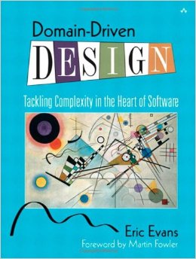
Domain-Driven Design

Slide 2

What is a Model for you?

Slide 3
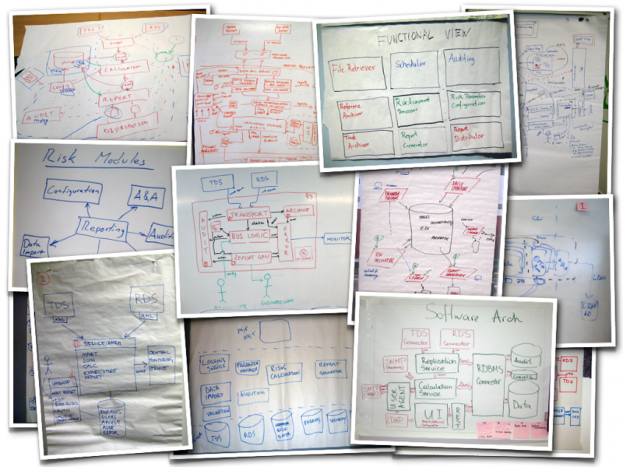

Slide 4
A model is a simplification. It is an interpretation of reality that abstracts the aspects relevant to solving the problem at hand and ignores extraneous detail.
A model is a selectively simplified and consciously structured form of knowledge. An appropriate model makes sense of information and focuses it on a problem.

Slide 5

What is a Domain for you?

Slide 6
Every software program relates to some activity or interest of its user. That subject area to which the user applies the program is the domain of the software.
A domain model is not a particular diagram; it is the idea that the diagram is intended to convey. It is not just the knowledge in a domain expert's head; it is a rigorously organized and selective abstraction of that knowledge.

Slide 7
A diagram can represent and communicate a model, as can carefully written code

Slide 8
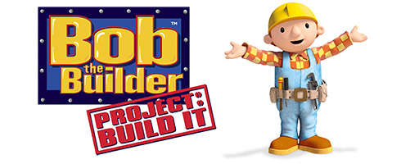
The Utility of a Model in Domain-Driven Design

Slide 9
In domain-driven design, three basic uses determine the choice of a model:

Slide 10
The model and the heart of the design shape each other

Slide 11
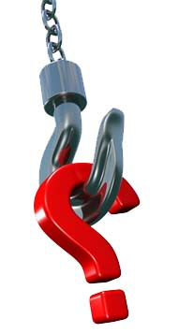
It is the intimate link between the model and the implementation that makes the model relevant and ensures that the analysis that went into it applies to the final product, a running program.
Why do you think there is a bound between the model and the implementation?

Slide 12
This binding of model and implementation also helps during maintenance and continuing development, because the code can be interpreted based on understanding the model.

Slide 13
The model is the backbone of a language used by all team members.

Slide 14

Because of the binding of model and implementation, developers can talk about the program in this language. They can communicate with domain experts without translation.
This affirmation what it means for you?Show an example of that

Slide 15
And because the language is based on the model, our natural linguistic abilities can be turned to refining the model itself.

Slide 16
The model is distilled knowledge

Slide 17
The model is the team's agreed-upon way of structuring domain knowledge and distinguishing the elements of most interest. A model captures how we choose to think about the domain as we select terms, break down concepts, and relate them.

Slide 18
The shared language allows developers and domain experts to collaborate effectively as they wrestle information into this form.

Slide 19
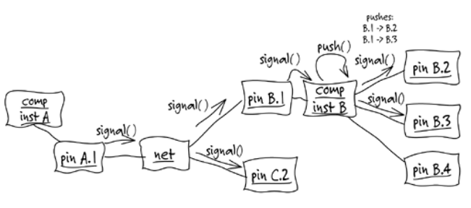
Crunching Knowledge

Slide 20
A few years ago, I set out to design a specialized software tool for printed-circuit board (PCB) design. One catch: I didn't know anything about electronic hardware. I had access to some PCB
designers, of course, but they typically got my head spinning in three minutes. How was I going to understand enough to write this software? I certainly wasn't going to become an electrical engineer before the delivery deadline!
We tried having the PCB designers tell me exactly what the software should do. Bad idea. They were great circuit designers, but their software ideas usually involved reading in an ASCII file,
sorting it, writing it back out with some annotation, and producing a report. This was clearly not going to lead to the leap forward in productivity that they were looking for.
The first few meetings were discouraging, but there was a glimmer of hope in the reports they asked for. They always involved "nets" and various details about them. A net, in this domain, is essentially a wire conductor that can connect any number of components on a PCB and carry an electrical signal to everything it is connected to. We had the first element of the domain model.

Slide 21
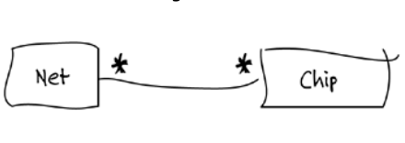

Slide 22
I started drawing diagrams for them as we discussed the things they wanted the software to do. I used an informal variant of object interaction diagrams to walk through scenarios.

Slide 23
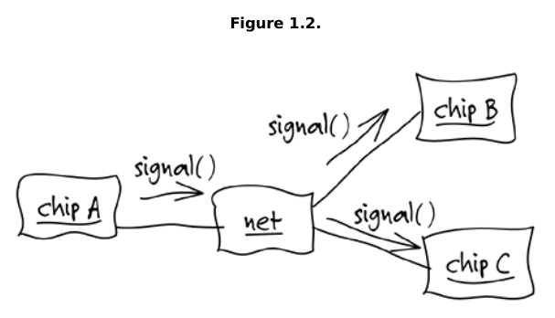
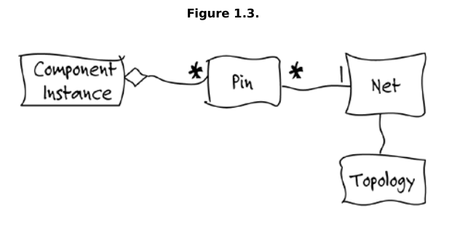

Slide 24
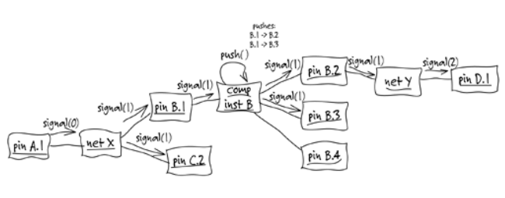

Slide 25
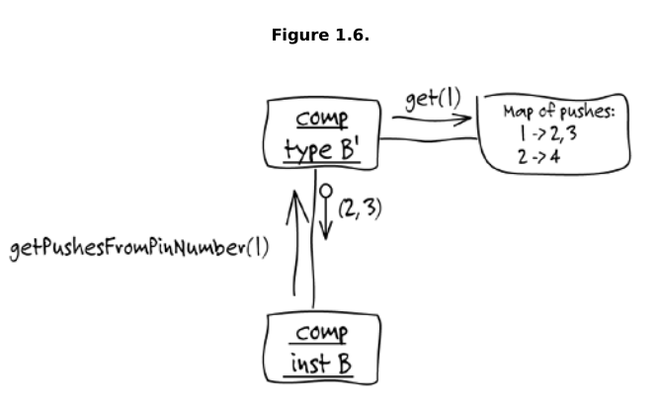

Slide 26
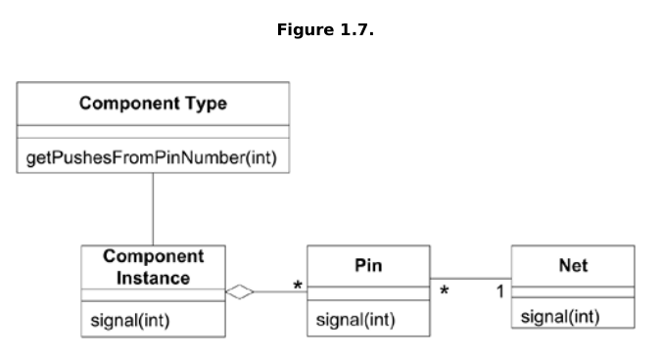
Final Model

Slide 27

Ingredients of Effective Modeling

Slide 28
Binding the model and the implementation
That crude prototype forged the essential link
early, and it was maintained through all subsequent iterations

Slide 29
Cultivating a language based on the model.
At first, the engineers had to explain elementary
PCB issues to me, and I had to explain what a class diagram meant. But as the project
proceeded, any of us could take terms straight out of the model, organize them into
sentences consistent with the structure of the model, and be un-ambiguously understood
without translation.

Slide 30
Developing a knowledge-rich model.
The model
wasn't just a data schema; it was integral to solving a complex problem. It captured
knowledge of various kinds.

Slide 31
Distilling the model.
Important concepts were added to the model as it became more complete, but equally important, concepts were dropped when they didn't prove useful or central.

Slide 32
Brainstorming and experimenting
The language, combined with sketches and a
brainstorming attitude, turned our discussions into laboratories of the model, in which
hundreds of experimental variations could be exercised, tried, and judged.

Slide 33
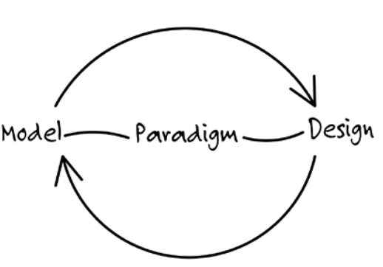
Modeling Paradigms and Tool Support

Slide 34
To make such a close correspondence of model and design possible, it is almost essential to work within a modeling paradigm supported by software tools that allow you to create direct analogs to the concepts in the model.
The paradigm is logic, and the model is a set of logical rules and facts they operate on.

Slide 35
The Building Blocks of a Model-
Driven Design

Slide 36
To keep a software implementation crisp and in lockstep with a model, in spite of messy
realities, you must apply the best practices of modeling and design.
Certain kinds of decisions keep the model and implementation aligned with each other, each
reinforcing the other's effectiveness.

Slide 37
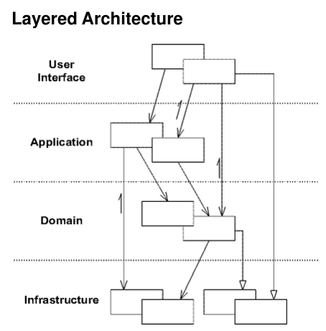

Slide 38

When domain-related code is mixed with the other
layers, it becomes extremely difficult to see and think about. Superficial changes to the UI can actually change business logic. To change a business rule may require meticulous tracing of UI code, database code, or other program elements.

Slide 39
Therefore, partition a complex program into LAYERS. Develop a design within each LAYER that is cohesive and that depends only on the layers below
Concentrate all the code related to the domain model in one layer and isolate it from the user interface, application, and infrastructure code.

Slide 40
Building Domain Knowledge

Slide 41
Let’s consider the example of an airplane flight control system project,and how domain knowledge can be built.
The proposed project is a monitoring system
which tracks every flight over a certain area, determines if the flight follows its supposed route or not, and if there is the
possibility of a collision.

Slide 42
Where do we start from a software development perspective?
we should start by understanding the domain, which in this case is air traffic monitoring

Slide 43
Air traffic controllers are the specialists of this
domain. But the controllers are not system designers or software specialists. You can’t expect them to hand you a complete
description of their problem domain.
The air traffic controllers have vast knowledge about their domain, but in order to be able to build up a model you need to extract essential information and generalize it.

Slide 44
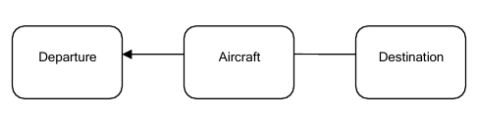
The controller and you agree that each aircraft has a departure and a destination airfield. So we have an aircraft, a departure and a destination, as shown in the figure below.

Slide 45
While hearing about a flight plan, you may think in your mind that this is about the path followed by the plane while in the air. After further discussion, you hear an interesting word: route.
The route contains an important concept of flight travel. That’s what planes do while flying, they follow a route.

Slide 46
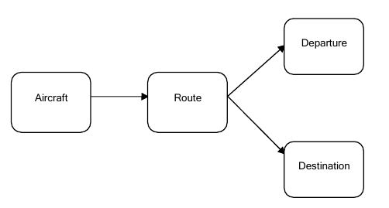
So, instead of associating the aircraft with the departure and destination points, it seems more natural to associate it with a route, which in turn is associated with the corresponding departure and destination.

Slide 47
Talking with the controller about the routes airplanes follow, you discover that actually the route is made up of small segments, which put together constitute some sort of a crooked line from departure to destination. The line is supposed to pass through predetermined fixed points. So, a route can be considered as a series of consecutive fixes.

Slide 48
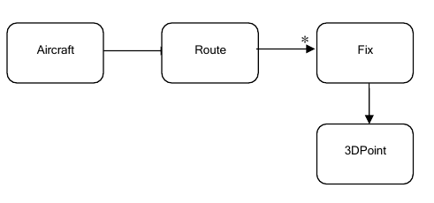

Slide 49
The diagram shows another element, the fact that each fix is a point in space followed by the route, and it is expressed as a three dimensional point. But when you talk to the controller, you will discover that he does not see it that way. Actually he sees the route as the projection on earth of the plane flight. The fixes are just points on Earth surface uniquely determined by their latitude and longitude. So the correct diagram is:

Slide 50
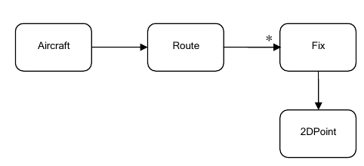

Slide 51
What is actually happening here? You and the domain experts are talking, you are exchanging knowledge. You start asking questions, and they respond. While they do that, they dig essential concepts out of the air traffic domain.
You need to learn as much as possible about the domain from the experts. And by putting the right questions, and processing the information in the right way, you and the experts will start to sketch a view of the domain, a domain model
This is an important part of the design.

