Slide 1
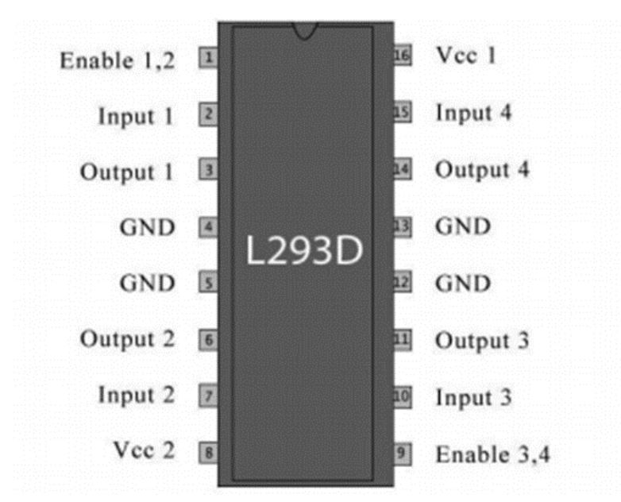
Left-EN1
5V (Vlogic)
Left-PWM
Right-PWM
DC-Left-1
DC-Right-1
DC-Left-2
DC-Right-2
Left-Negated-PWM
Right-Negated-EN2
6V (Vpower)
Right-EN2

Slide 2
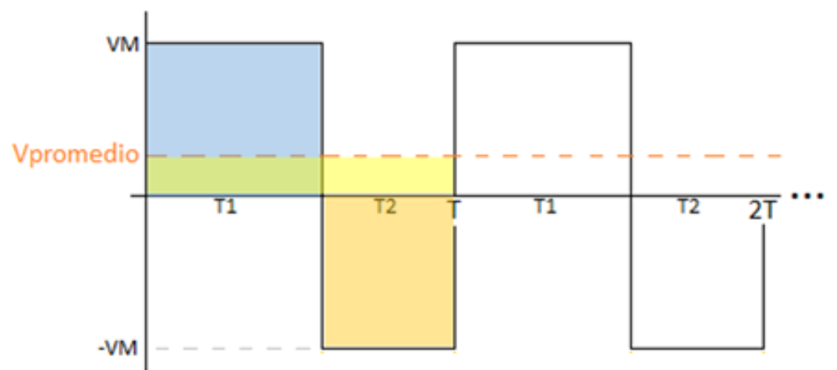
IN1,IN2=1,0(clockwise)
VAVG
IN1,IN2=0,1(anti-clockwise)

