Slide 1
EMBEDED SYSTEMS PROJECT

Slide 2
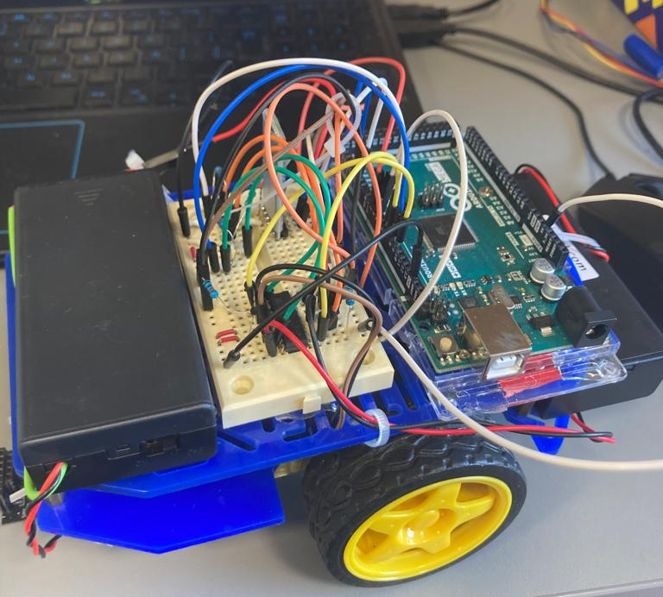
Assembly

Slide 3
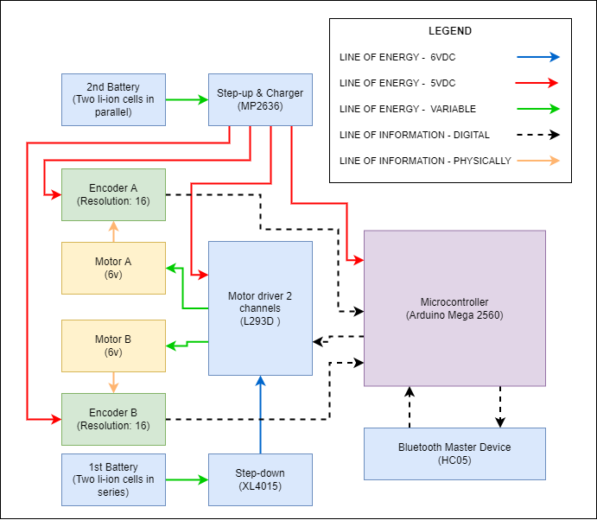
General schematic

Slide 4
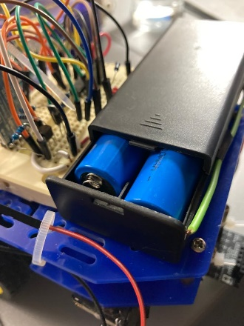
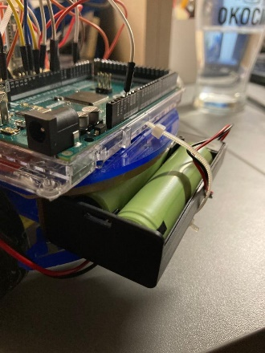
Energy system

Slide 5
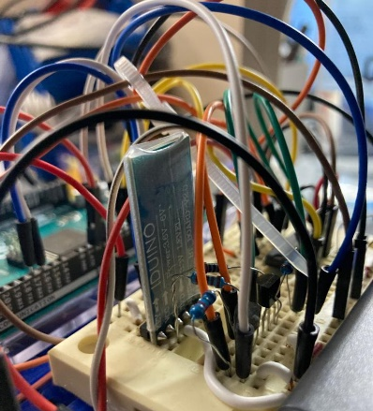
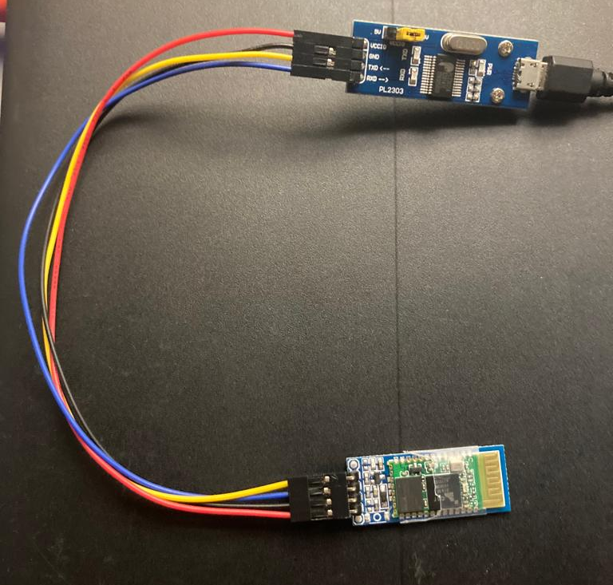
Comunication system

Slide 6
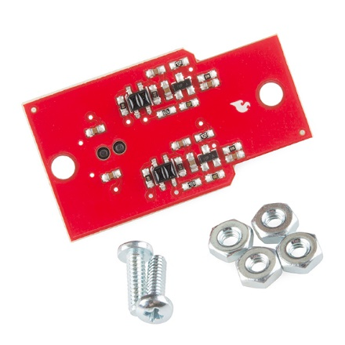
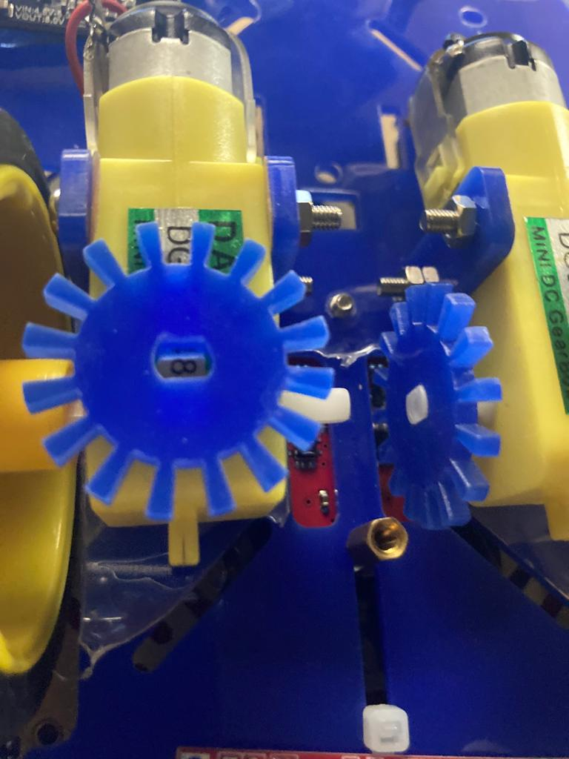
Sensing system

Slide 7
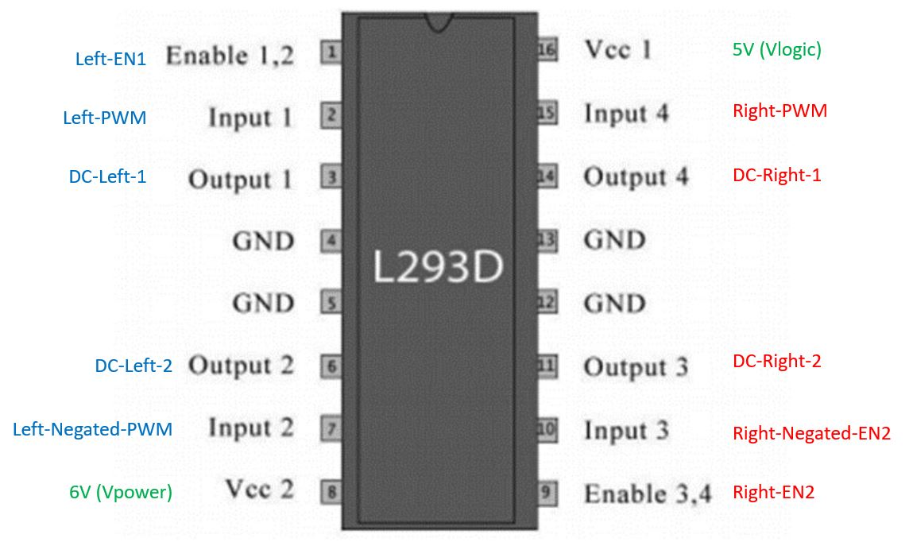
Actuation system

Slide 8
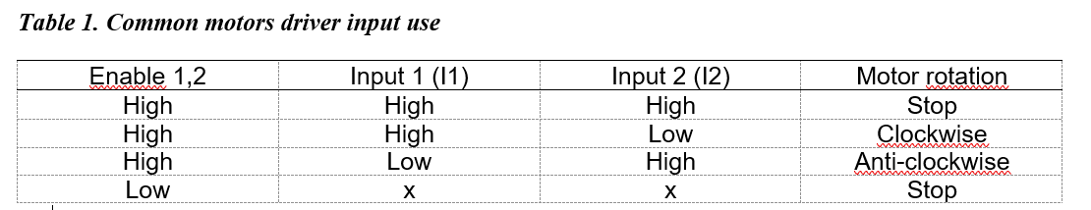
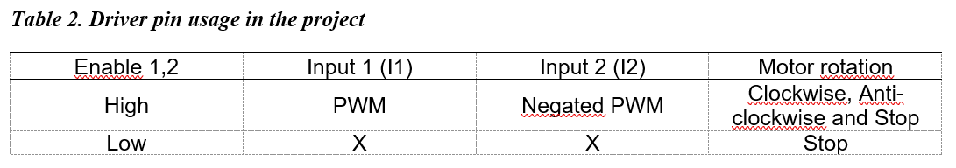
Common use
Use in the current project

Slide 9
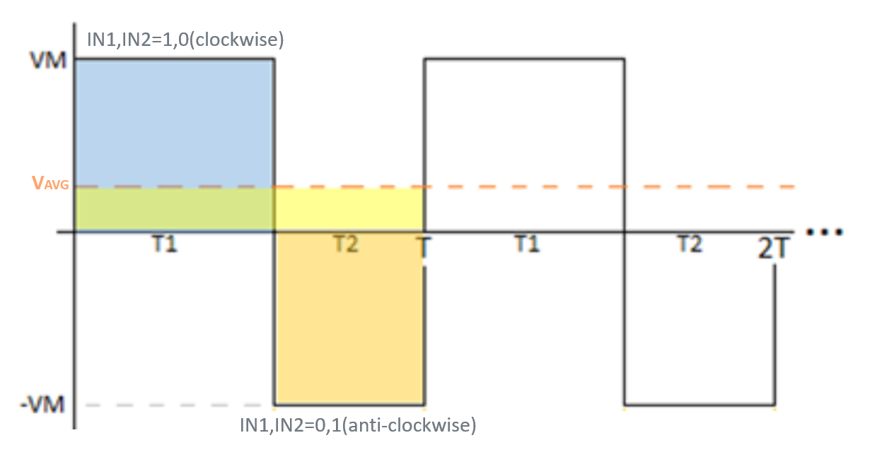
Obtaining an average voltaje through driver inputs

Slide 10
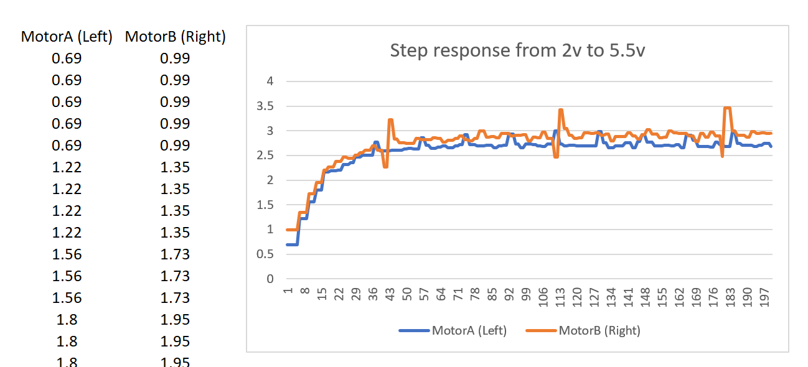
System Identification

Slide 11
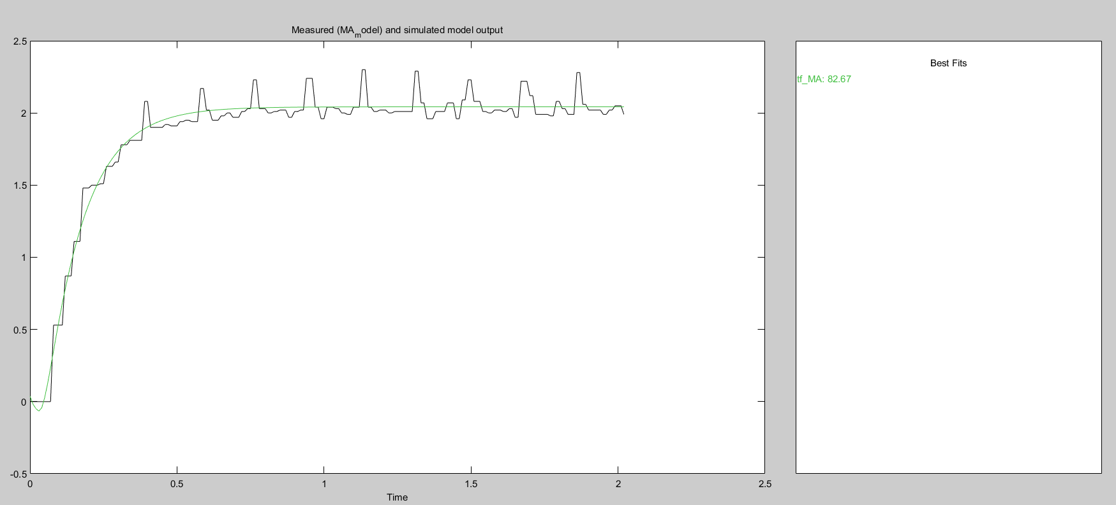
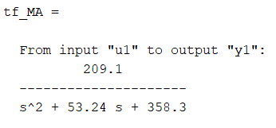
Fitting models

Slide 12
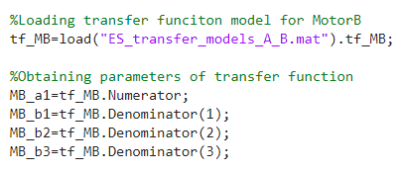
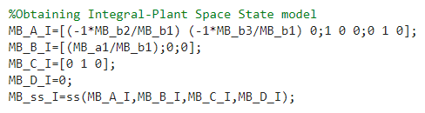
Control design

Slide 13
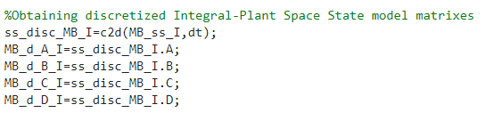
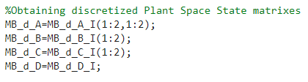
Scripts

Slide 14
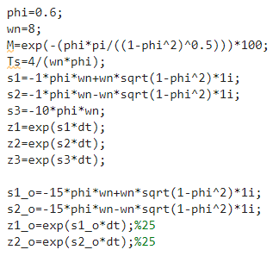

Scripts

Slide 15
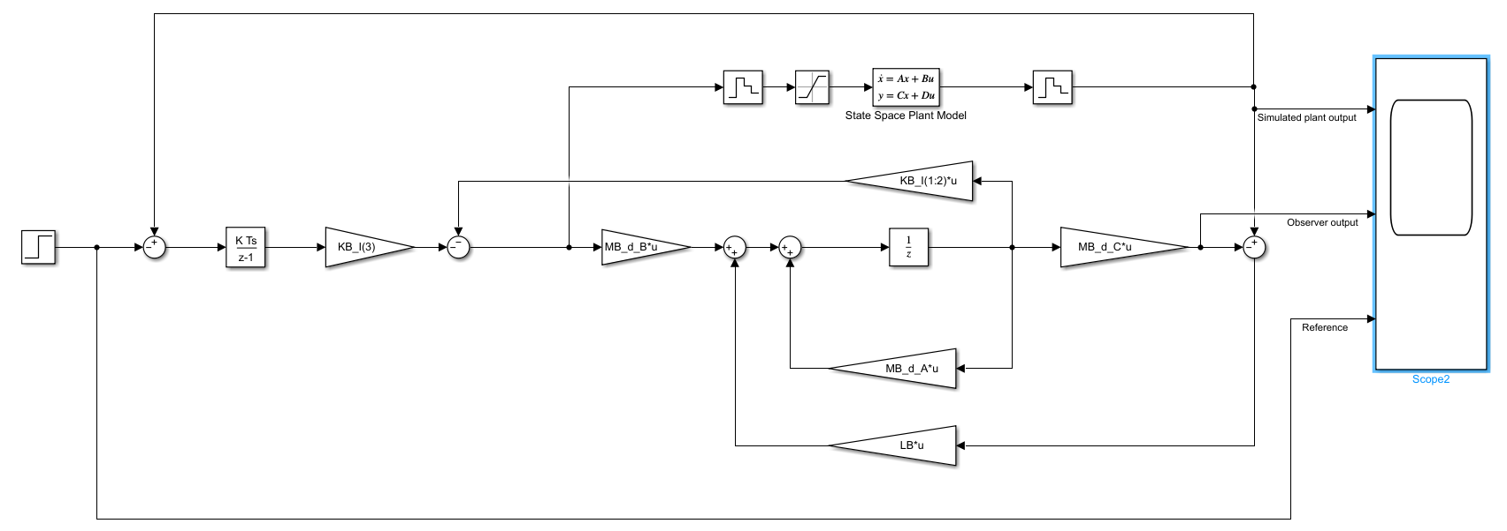
Control design

Slide 16
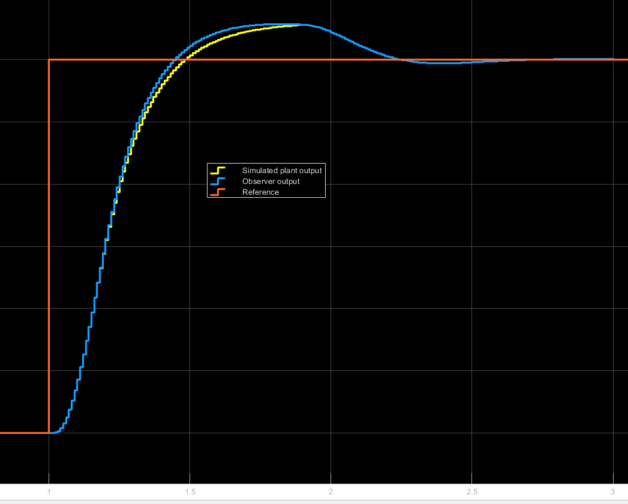

Slide 17
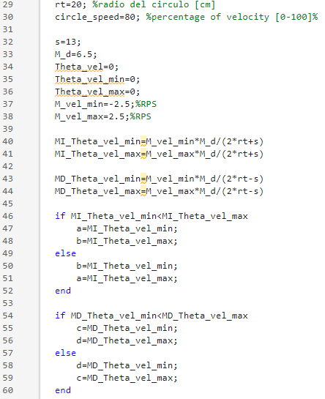
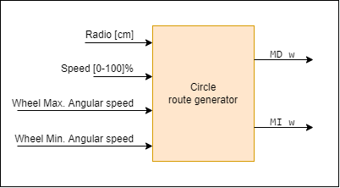
Route generation

Slide 18
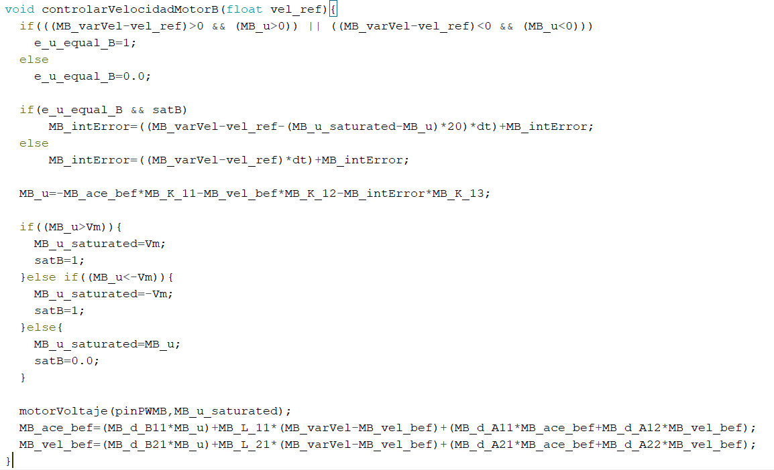
Control implementation

Slide 19
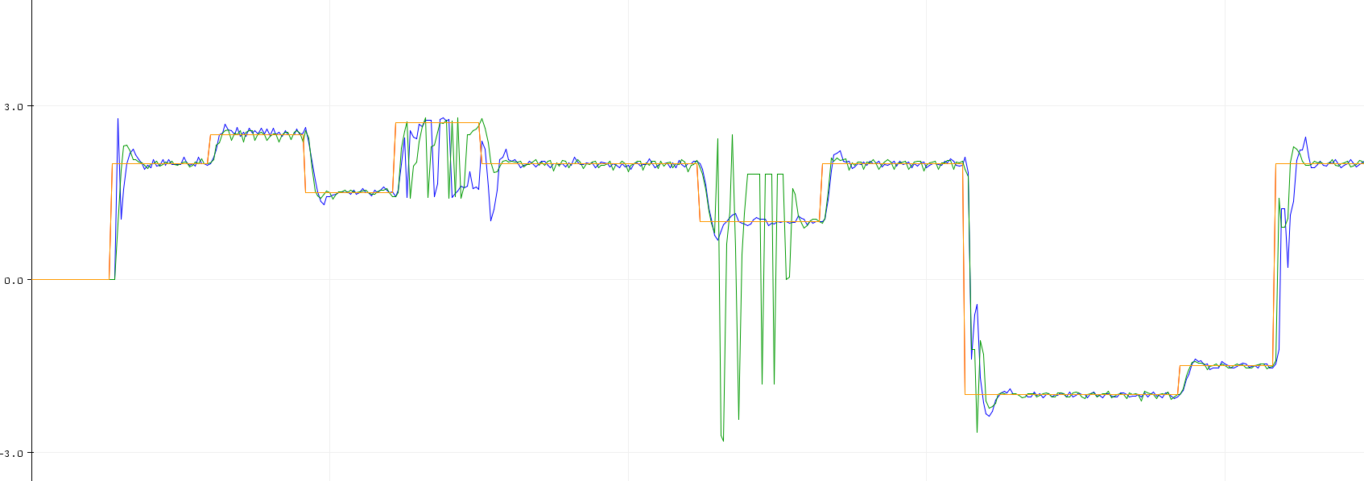
Results

Slide 20
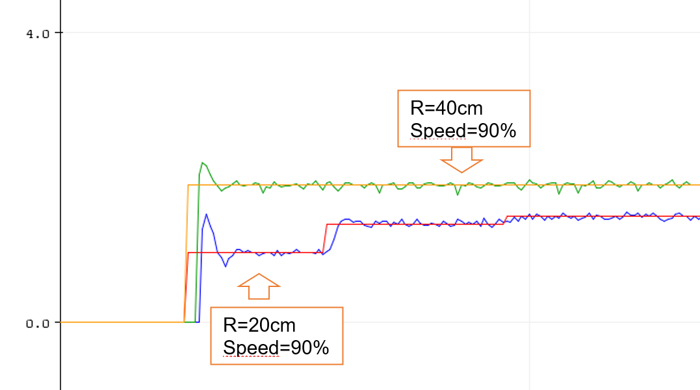
Results

Slide 21
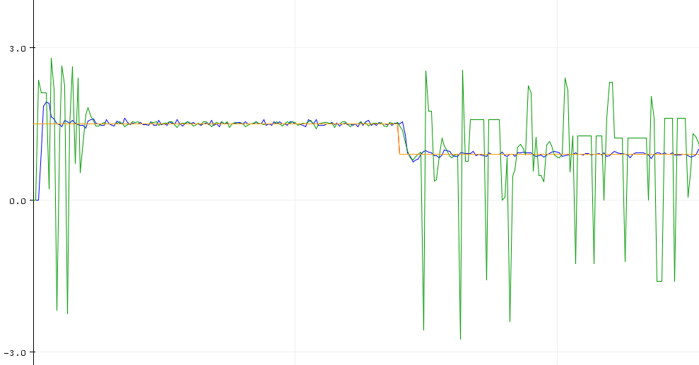
Problems
Negative peaks

Slide 22
Problems
Low resolution of encoder, bad readings below 1.5 RPS or over 41.6ms.
Data trasmision, 9600 bps or 0.8 ms per byte (related to sequential excecution)
Lower velocity reading for the second readed encoder (related to sequential excecution)

Slide 23
Conclusions
Setup of a robot with control velocity has been done.
It is needed a two channel encoder for sensing rotation direction.
Increase resolution of 16.
RTOS is suggested for reducing errors caused by sequential execution.

Slide 24
Thank you.

