Slide 1
N-body memory layout exploration
Bernhard Manfred Gruber CERN, CASUS

Slide 2
N-body simulations
Used to simulate interaction of many bodies
Galaxies, stars, atoms, electrons, proteins, …
Gravity, electromagnetic forces, van der Waals forces, …
https://www.youtube.com/results?search_query=nbody+simulation
N² computational complexity
There are faster methods and acceleration data structures
E.g. using Octrees and approx. groups of bodies
But they still use the N² base algorithm inside

Slide 3
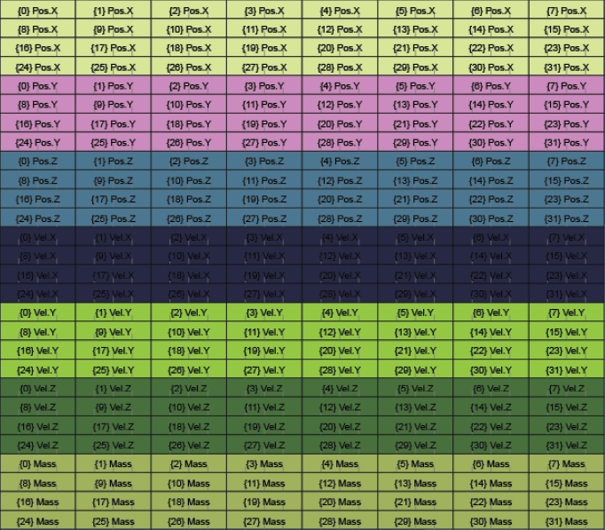
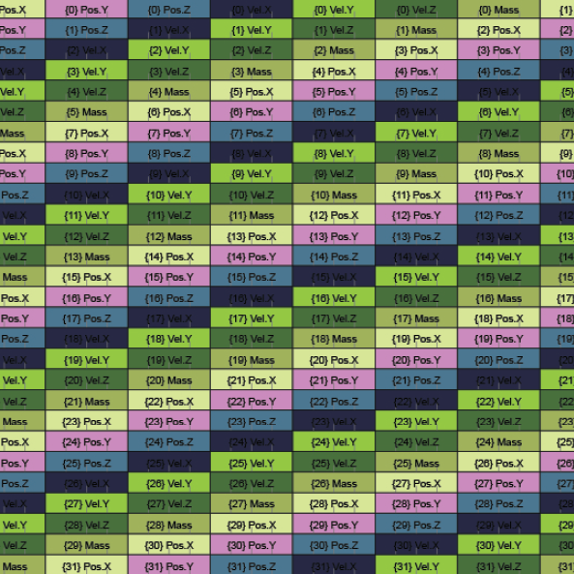
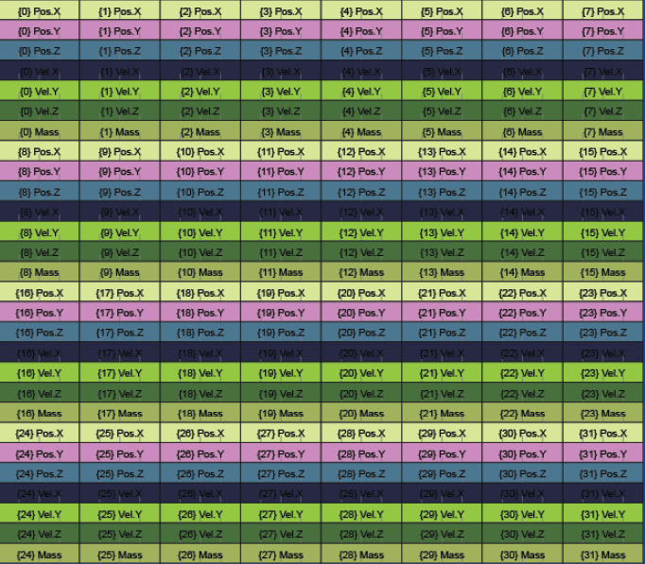
Objective
Given 3 n-body CPU implementations
~430 LOCs C++
with different memory layouts
AoS (Array of Structs)
SoA (Structs of Arrays)
AoSoA (Array of Structs of Arrays)
Find the fastest possible CUDA implementation
by finding the fastest memory layout for global and shared memory
without functional changes

Slide 4
Tasks
Start by cloning: https://github.com/bernhardmgruber/ nbody_memory_layout_student_project
Compile/run sample CPU code. Compare runtime of different memory layouts
Inspect disassembly and understand CPU vectorization and access pattern: https://godbolt.org/z/1jqo3z
Write CUDA versions with various memory layouts in global memory and compare
Use a profiler to find explanations for the runtime differences
Write a faster CUDA variant using shared memory for caching
Find the best memory layout combination for global/shared memory

