Slide 1

COMPUTATIONAL BIOLOGY INTERNSHIP-
CHALLENGE
JHONATAN FELIX

Slide 2
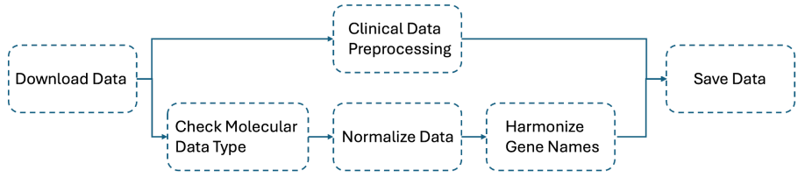
Task 2 : Improve the RNAseq data integration pipeline

Slide 3
FIRST PART:
COMMENT ON THE PIPELINE

Slide 4

UPDATING THE WORKFLOW
Verify the datatype such as raw counts, TPM, TPKM
Identify and flag missing or inconsistent data
Validate the structure of the dataset , avoid duplicates

Slide 5
UPDATING THE WORKFLOW
Normalize the data either to TPM or FPKM
Using appropriate scaling techniques to ensure values are comparable accross datasets
Handle batch effects or technical biases

Slide 6
UPDATING THE WORKFLOW
Standardize gene identifiers across datasets (Ensembl)
Remove or flag genes with mismatched or missing identifiers
Map aliases or outdated gene names to the latest standards using reference database (optional)

Slide 7
UPDATING THE WORKFLOW
Map molecular data to clinical features with patient metadata for instance
Ensure a one-to-one relationship between molecular samples and clinical entries
Perform QC to verify consistent sample annotations

Slide 8

UPDATING THE WORKFLOW
Ensure formats are consistent for downstream analysis

Slide 9
ENHANCING THE PIPELINE TO ENSURE CONSISTENCY OF DATA
Automated QC
Verify data completennes, formating and scaling consistency
Use External Gene Databases
Integrating tools like Ensembl API or UniProt to ensure a standard format
Missing data Handling
Specify a uniform strategy for missing values (imputation, exclusion, flagging)
Batch Effect correction
Using tools to correct batch effects when integrating datasets from different experiments
Document each steps
Generate logs for each step

Slide 10

POSSIBLE CHALLENGES
Data Heterogeneity
Harmonizing diverse data types into a unified
Normalization methods accross datasets
Difference in file formats
Naming conventions
Clinical Data Integration
Missing data
Gene Name Ambiguity
Batch effects

Slide 11
SECOND PART:
COMMENT ON THE DIFFERENT OUTPUT FILES

Slide 12
WHY DO WE HAVE DIFFERENT FILES FOR ONE DATASET?
Because each output serves a specific analytical purpose
Raw Counts
The unprocessed data from sequencing typically used for DEA
Transcripts per million (TPM
Used for cross-sample comparisons since it accounts for both sequencing depth and gene length
Fragments Per Kilobase Per Million (FPKM)
Used for within-dataset comparisons or visualization
And also we need flexibility for Downstream Analysis and to preserve biological information

Slide 13
DIFFERENT FILES FOR DOWNSTREAM ANALYSIS
Raw Counts
Differential expression analysis
Transcripts per million (TPM)
Cross-sample comparison, clustering and visualization (e.g., heatmaps and PCA )
Fragments Per Kilobase Per Million (FPKM)
Within-dataset comparison, exploratory analysis and visualizations
Preprocessed Data
Machine learning, pathway analysis, and integration with clinical data

Slide 14

Task 1 : Single-cell RNAseq data integration
Dimensional reduction/ Clustering and Visualization
Quality Control
Filter and Normalize
Input Data
Save file

Slide 15
INPUT DATA AND UNIFYING FILES
GSM7109167
GSM7109168
Barcodes
unified
Matrix
unified
Same features
Annotation file

Slide 16
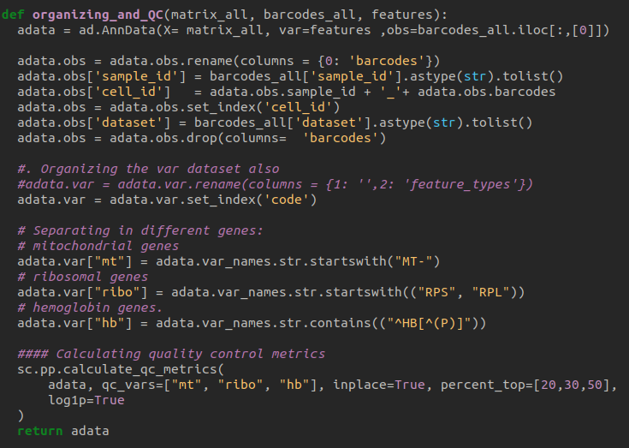
INPUT DATA AND UNIFYING FILES
Annotation file
Organization of columns
Separating genes
Quality Control

Slide 17
INPUT DATA AND UNIFYING FILES
Annotation file
Organization of columns
Separating genes
Quality Control

Slide 18
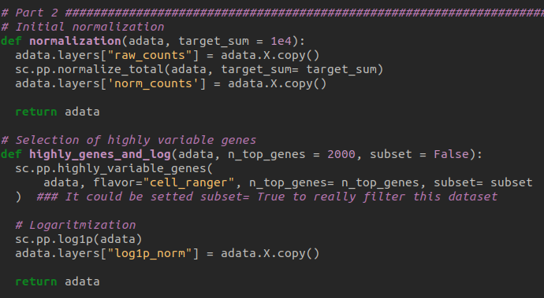
INPUT DATA AND UNIFYING FILES
Normalization
Log transform
highly genes

Slide 19
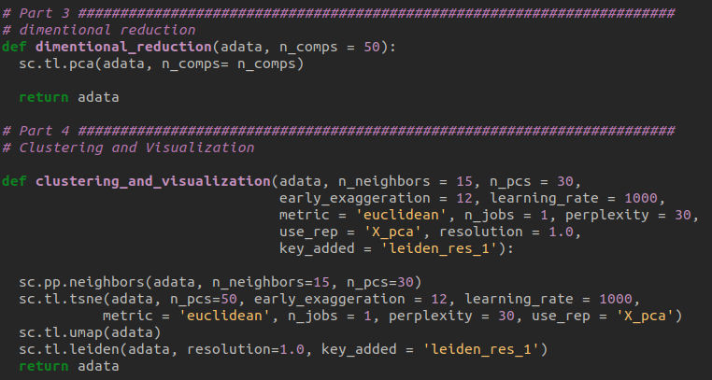
INPUT DATA AND UNIFYING FILES
Dimensional reduction
Clustering
Visualization

Slide 20
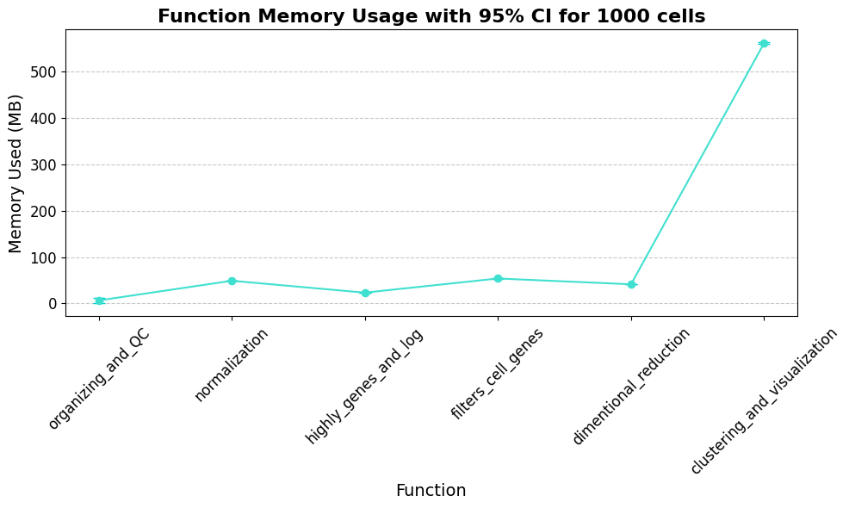
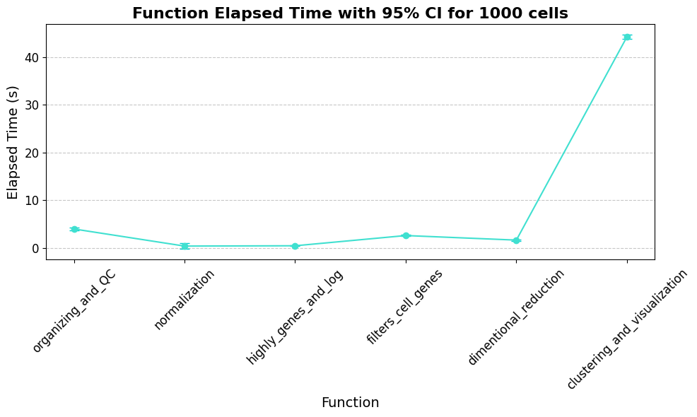
BENCHMARKS AND EFFICIENCY

Slide 21
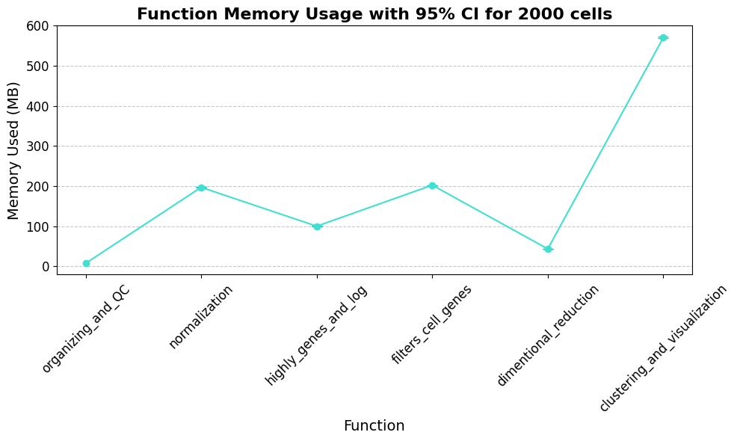
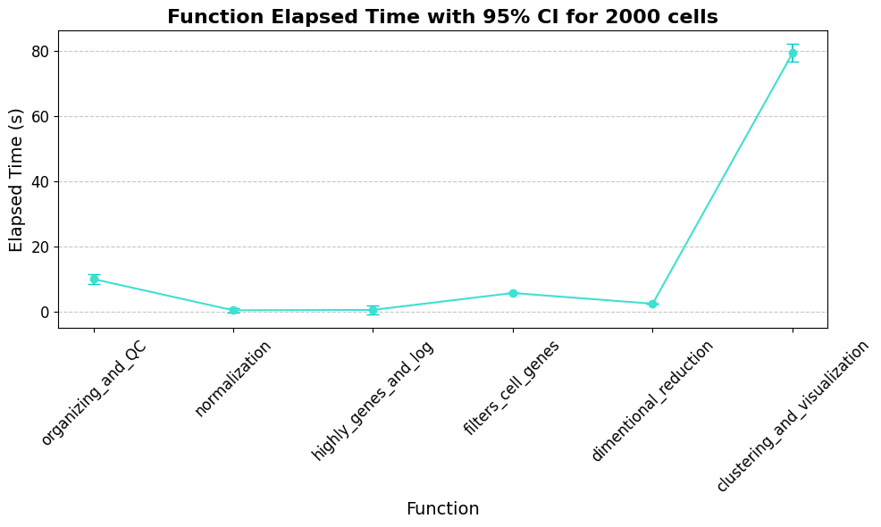
BENCHMARKS AND EFFICIENCY

Slide 22
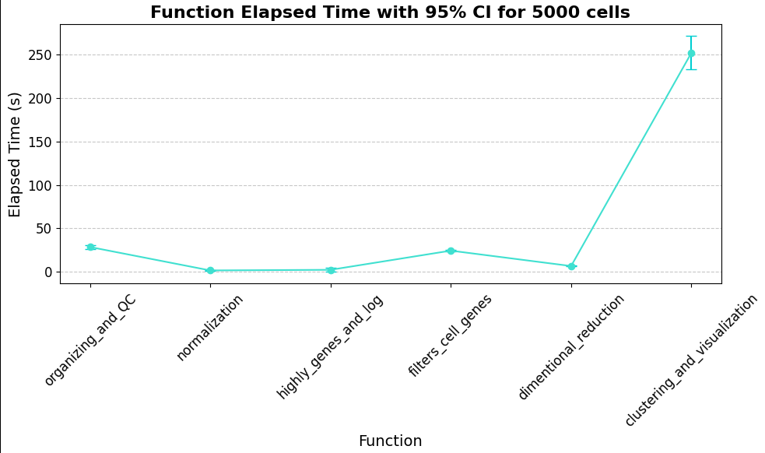
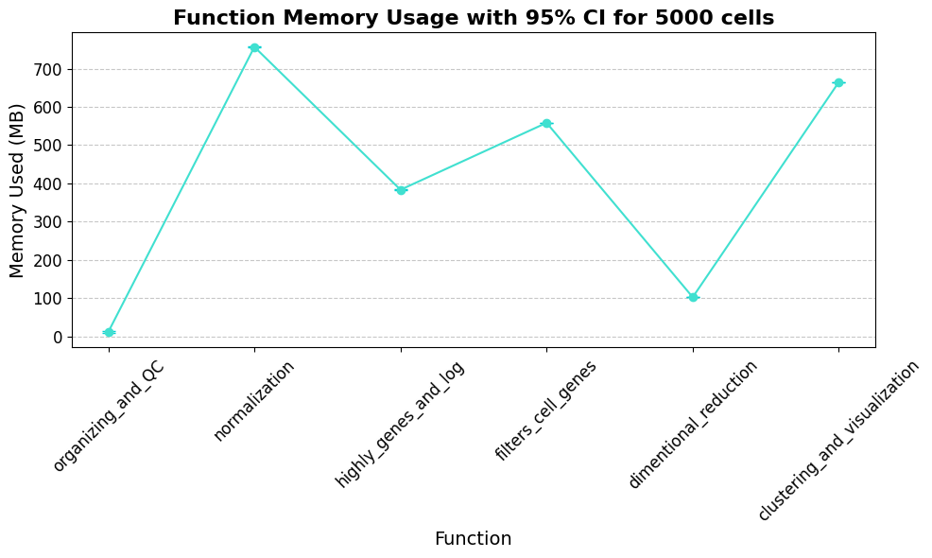
BENCHMARKS AND EFFICIENCY

Slide 23
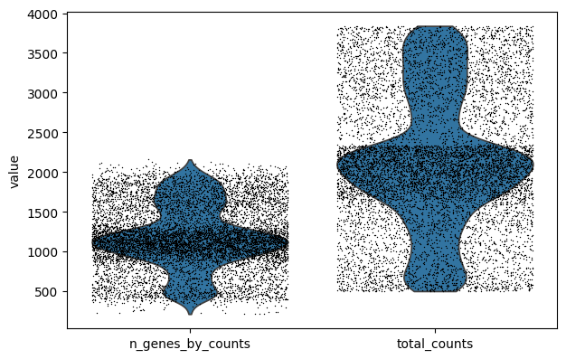
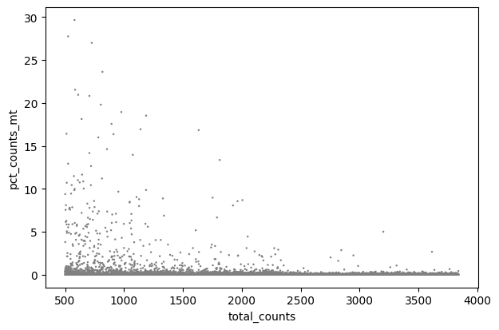
RESULTS OF THE PIPELINE

Slide 24
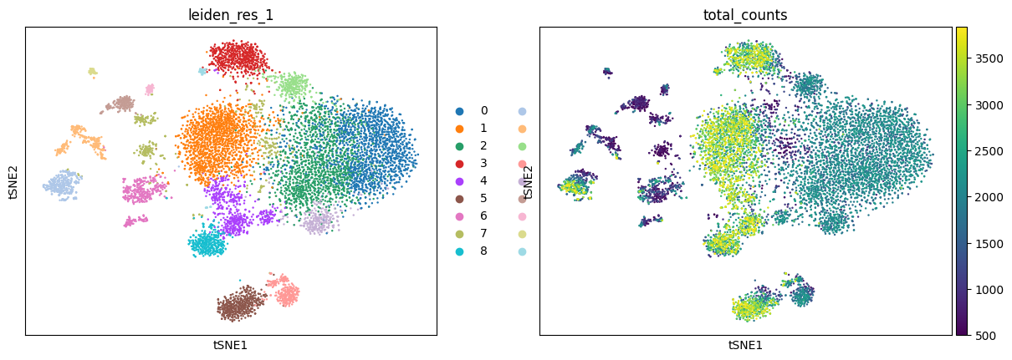
RESULTS OF THE PIPELINE

Slide 25
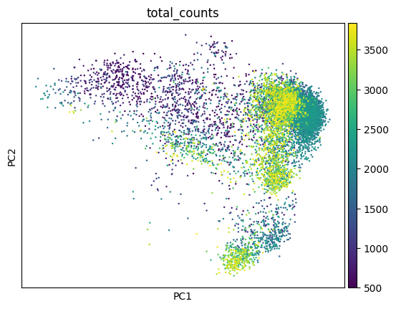
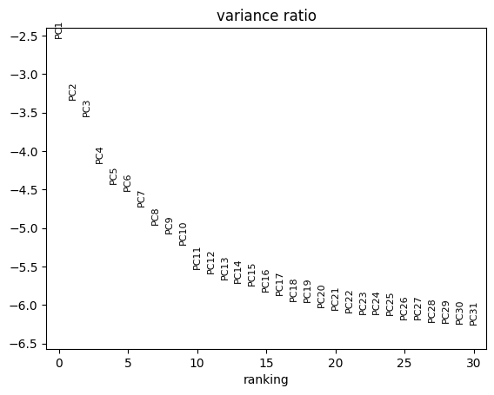
RESULTS OF THE PIPELINE

Slide 26
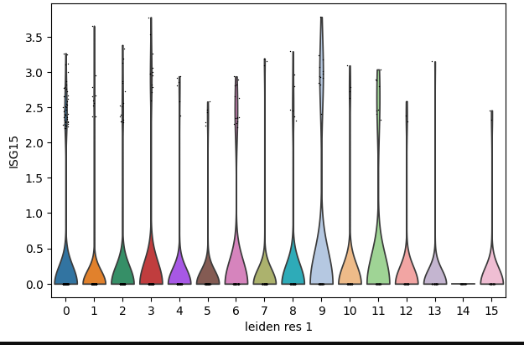
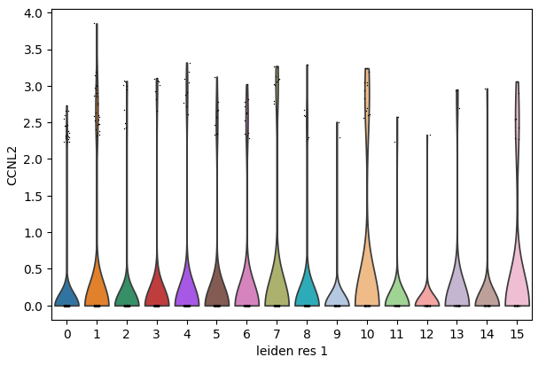
RESULTS OF THE PIPELINE

Slide 27
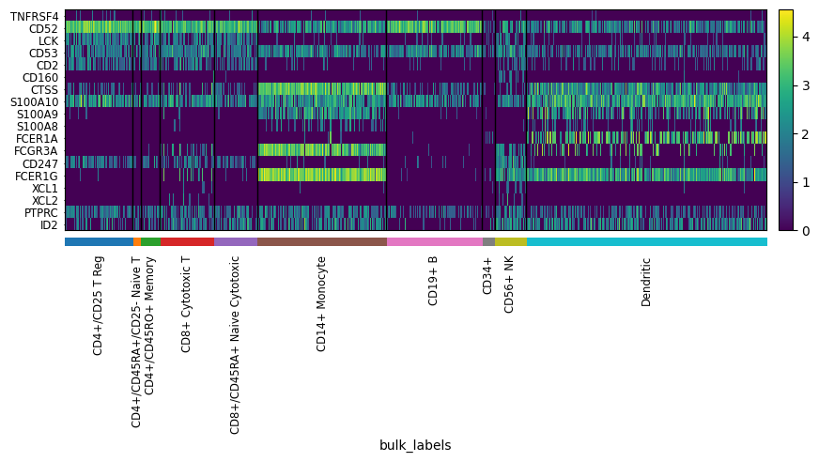
RESULTS OF THE PIPELINE

Slide 28
?
ANY QUESTIONS

Slide 29
THANK YOU!

