Slide 1
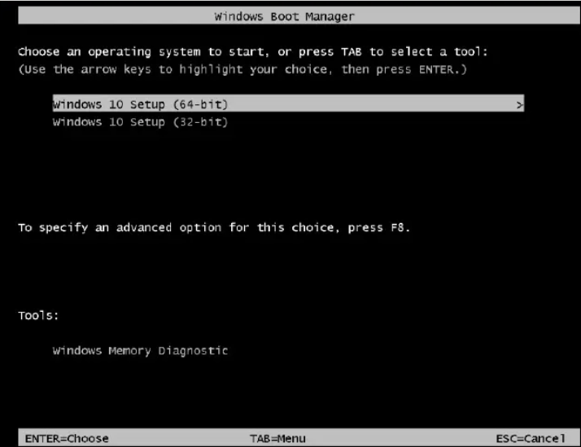
Choose Windows 10 setup (64-bit) or Windows 10 setup(32-bit). Press ENTER

Slide 2
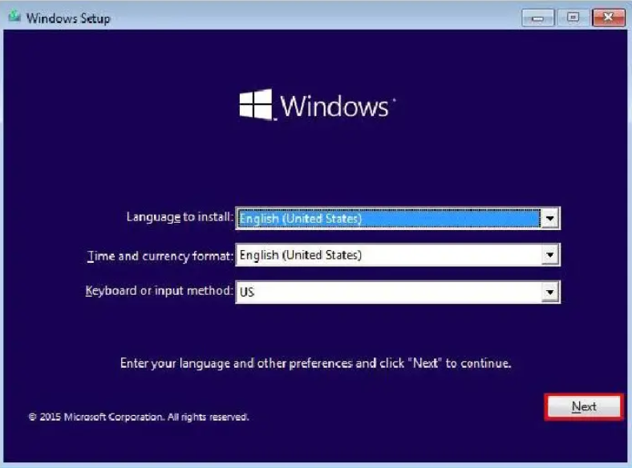

Slide 3
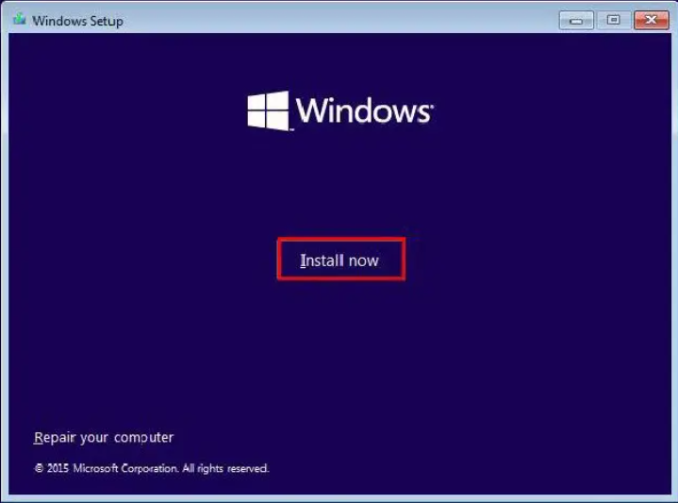
-Install Now: this option must be selected to continue the installation process.

Slide 4
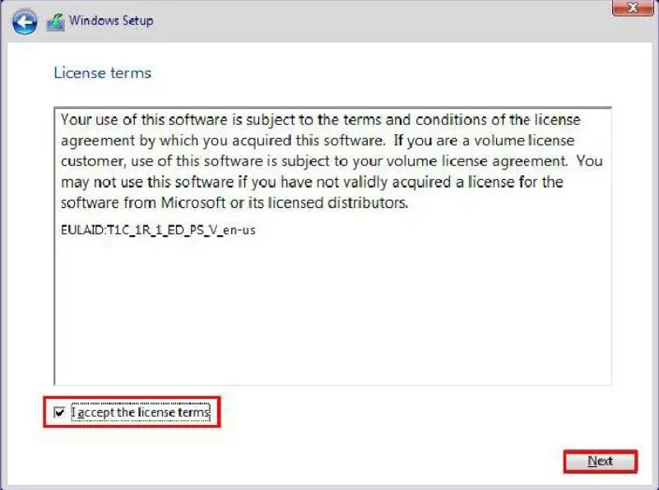
Select “I accept the license term” and click on the “Next” button.

Slide 5
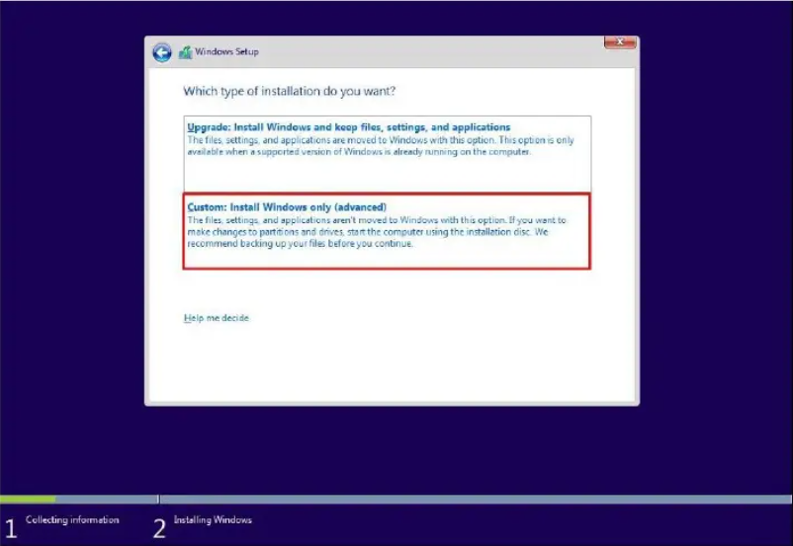
At this point, you can choose the installation type. Click on the “Custom Install Windows Only” option. To begin the installation process(ENTER)

Slide 6
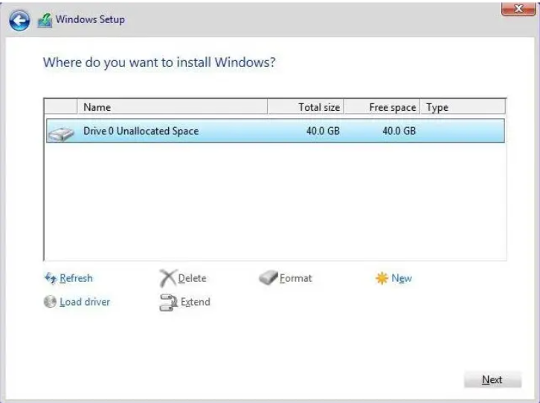
Select the location and drive you want Windows to install on it

Slide 7
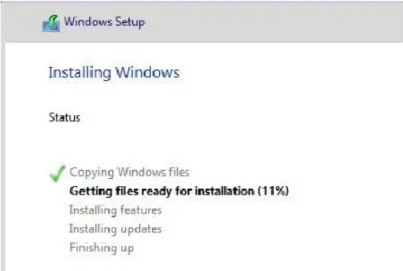
Windows installation started and you have wait for the step to be completed.

Slide 8
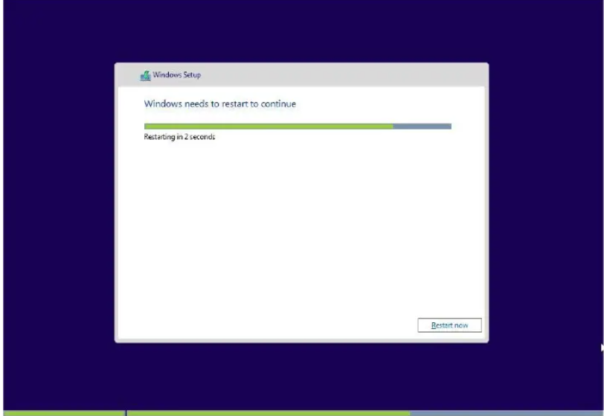
After finishing the first part of the installation process when all the files have been copied, restart system

Slide 9
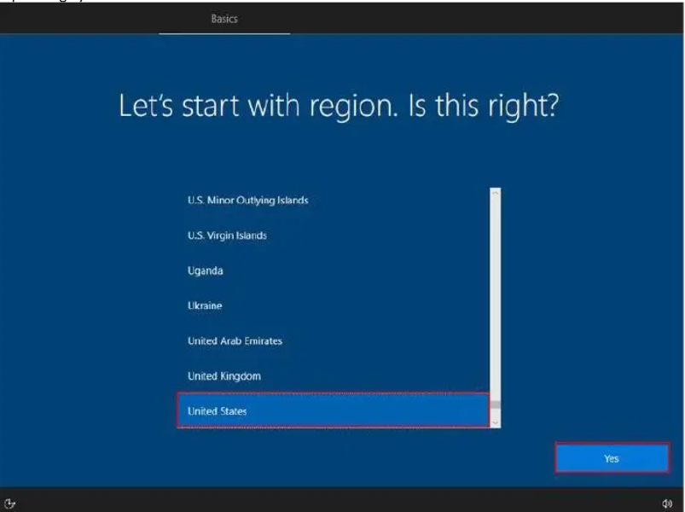
As show below, select the country you want and tap Yes.

Slide 10
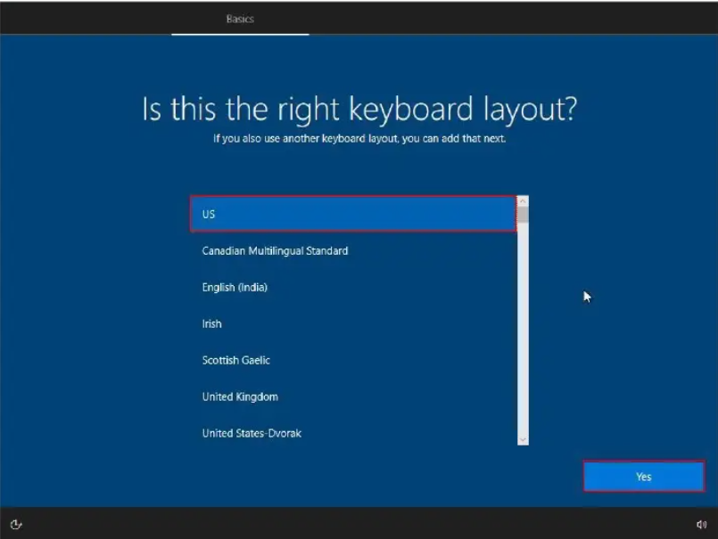
In the Keyboard section, Select the language in the list below and tap YES

Slide 11
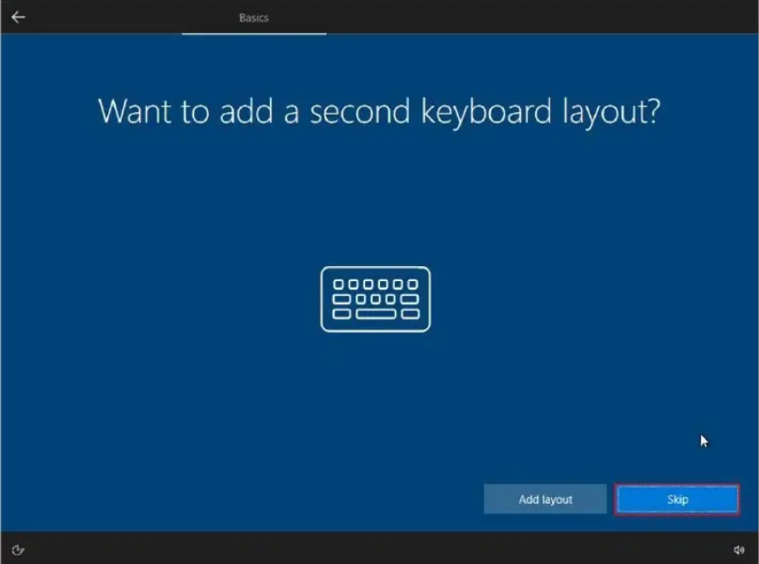
In the Keyboard layout section, select ‘Skip’

Slide 12
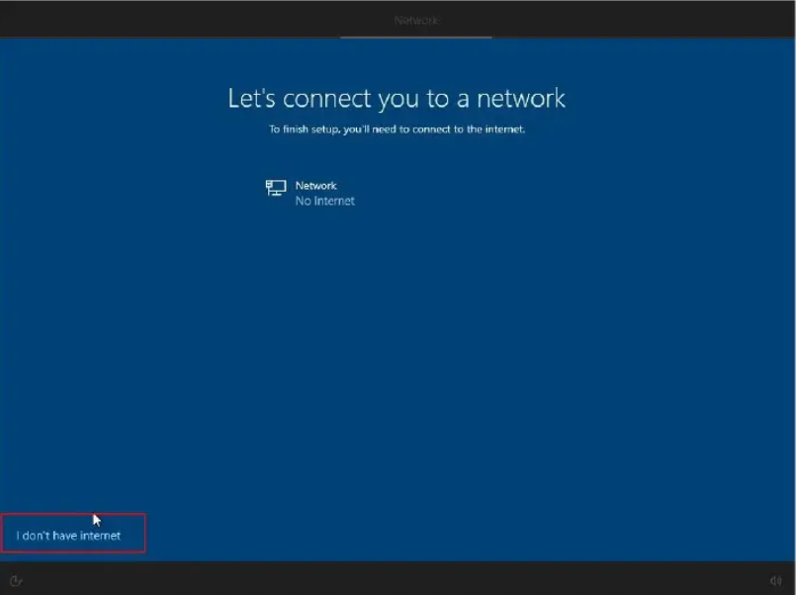
In the Network section, select “I Don’t have internet ”

Slide 13
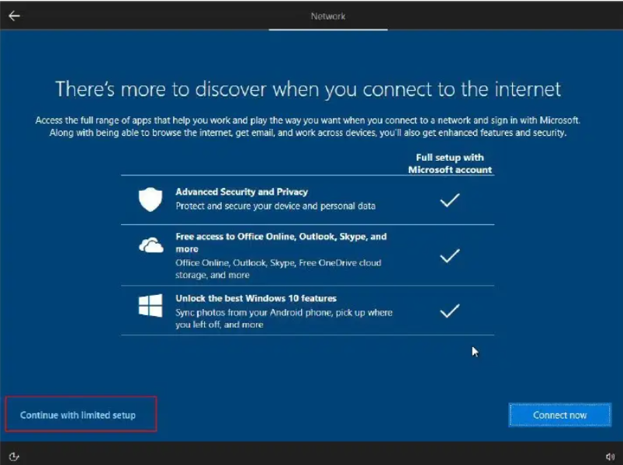
At this point, select Continue with limited setup

Slide 14
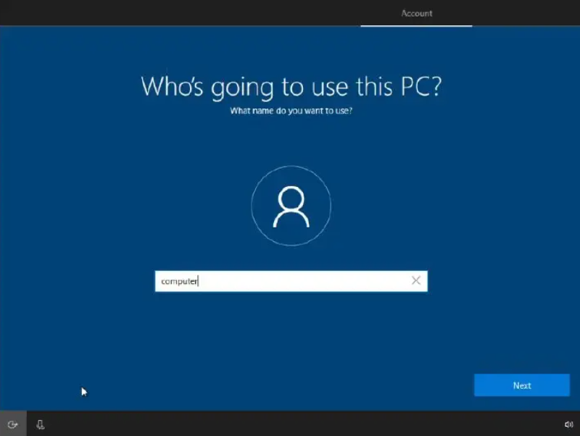
In the Account section, enter the name and press NEXT

Slide 15
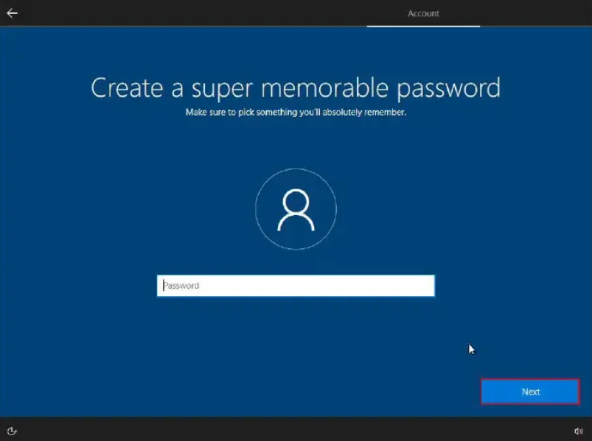
In this section, you can choose a Password for windows as you wish

Slide 16
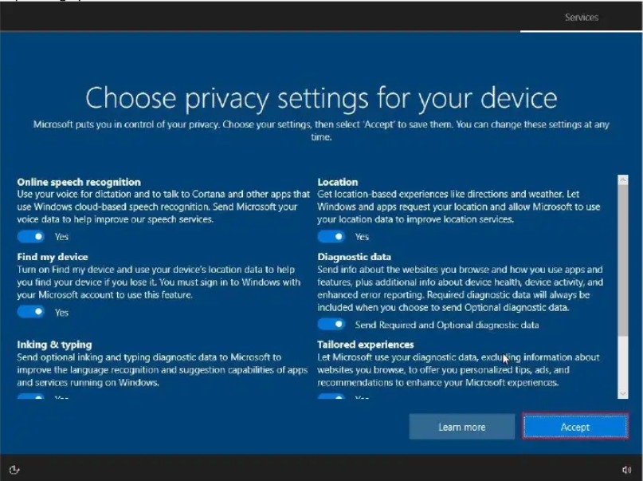
Tap the accept button in the Services section

Slide 17
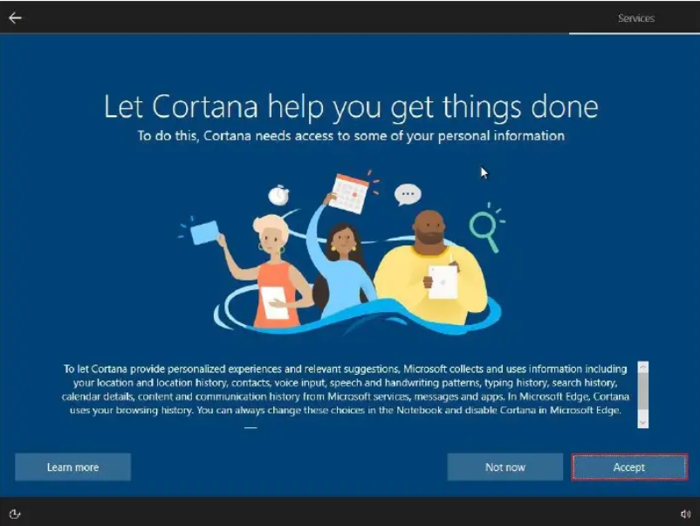
Click the Accept again

Slide 18
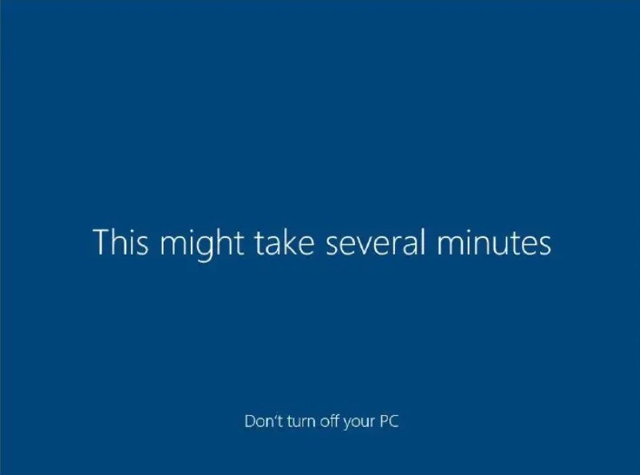
Wait a fer minutes for your windows to load

Slide 19
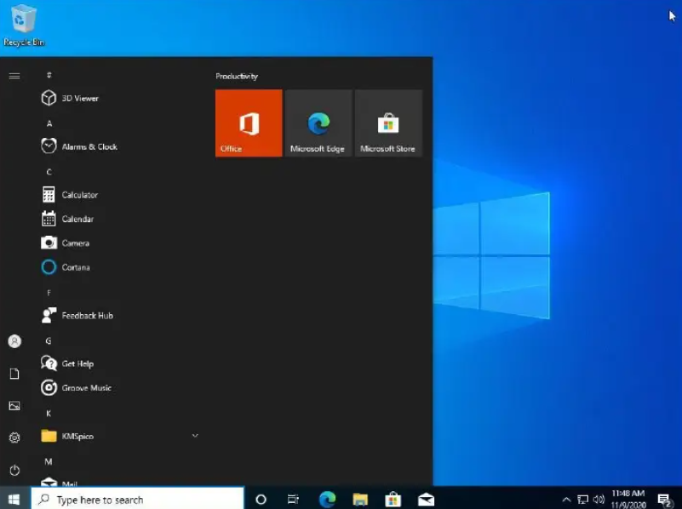
The installation process is finished and windows 10 is loaded for the first time.

