Slide 1

Open Edu.
By: Karl Gadong
Lester Pablo
Jhonnie Palaganas
Mary Joy Agustin

Slide 2
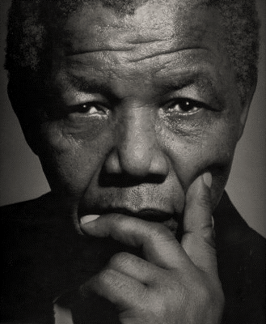
“
Education is the most powerful weapon which you can use to change the world
- Nelson Mandela
”

Slide 3

Who can use it?
What’s the purpose?
Usability
Anyone who is capable of using it. Kids, teens, adults and the elderly
But limited only to people who can see and hear.
Anyone who is capable of using it. Kids, teens, adults and the elderly
But limited only to people who can see and hear.
Open Edu. gives access to education without having to go to school, focusing on people who has special needs.
3
2
1

