Slide 1
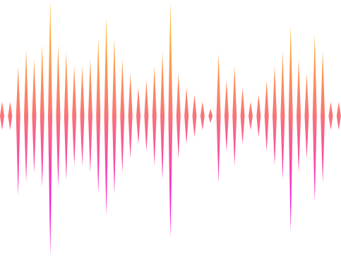
SPEECH EMOTION RECOGNITION PROJECT
Group 3

Slide 2
TABLE OF CONTENT
1
Introduction
6
Metrics
2
Dataset
7
Evaluation &
Error Analysis
3
Model architecture
8
System Demo
4
Experiments
9
Future Work

Slide 3
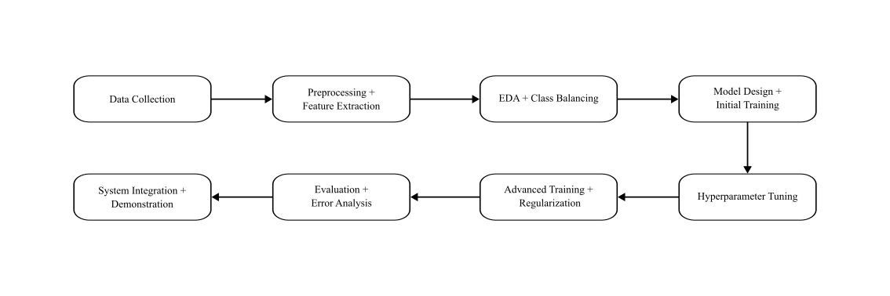

PROJECT PIPELINE

Slide 4
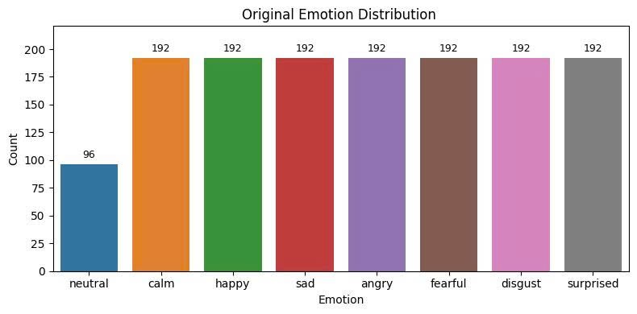
DATASET
Training dataset: RAVDESS
Data description:
Files: 1440 audio files
Language: English
Emotions: Neutral, Calm, Happy, Sad, Angry, Fearful, Disgust, Surprised

Slide 5
PREPROCESSING
Oversampling with Pitch-Shifted Audio (only Neutral Class):
Each new sample was randomly pitch-shifted by ±2 semitones.
Additive Gaussian Noise:
Duplicate all original samples.
Gaussian noise (0.005–0.007) was randomly added to each copy samples.

Slide 6
FEATURES
Mel-spectrogram: power spectral density projected onto the Mel scale over time.
MFCC (Mel-Frequency Cepstral Coefficients): Cepstral features derived from the DCT (Discrete Cosine Transform) of log-Mel spectrograms.

Slide 7
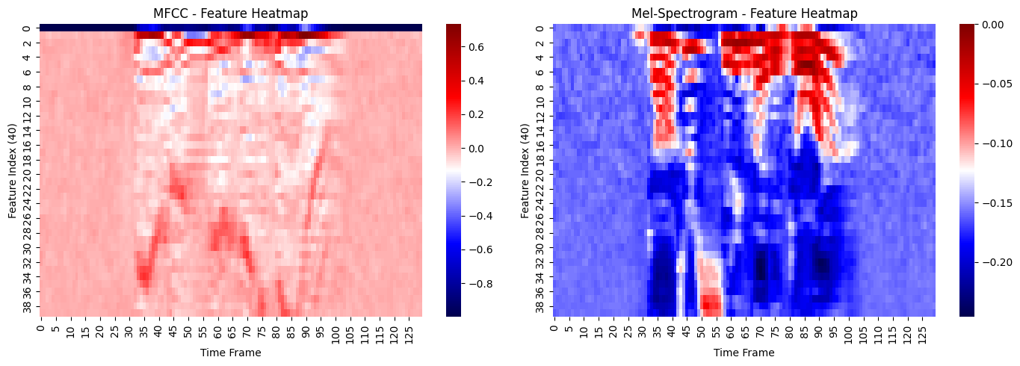
FEATURES
(n_mels=40)
(n_mfcc=40)

Slide 8
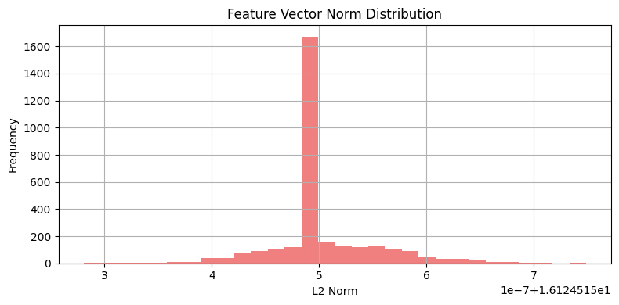
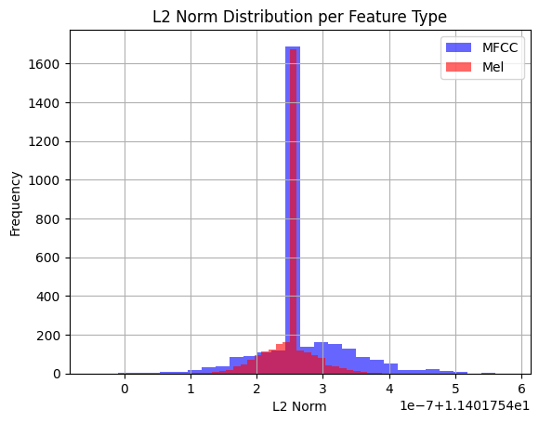
FEATURES

Slide 9
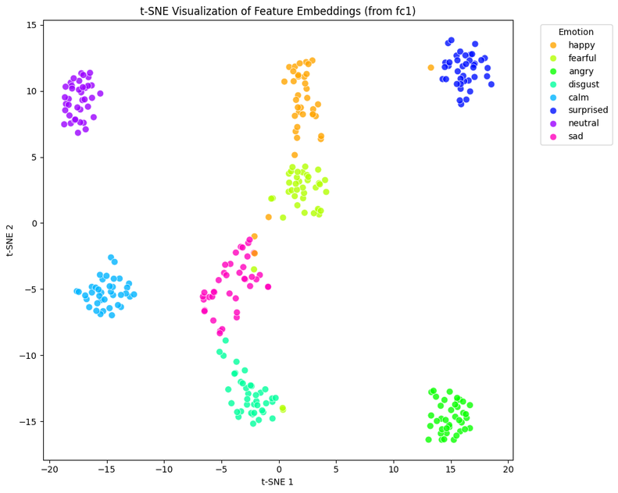
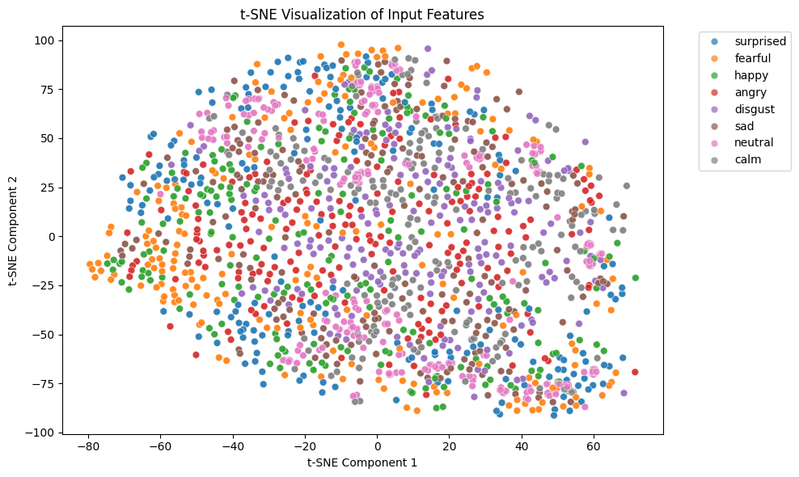
FEATURES
Before:
Raw input features – classes are mixed.
After:
Learned feature embeddings – emotions are well-separated.

Slide 10
MODEL ARCHITECTURE

Slide 11
MODEL ARCHITECTURE
🔹 3DCNN:
Input shape: (Batch, Channel=1, Depth=2, Time=130, Freq=40)
5 Conv3D blocks, each consisting of:
Conv3D(kernel=3x3x3, padding=1)
GroupNorm(num_groups=4)
ReLU
Dropout3D(p=0.1)
MaxPool3D(kernel=(1,2,2))
Global Average Pooling 3D to extract a fixed-size feature vector.
2 Fully Connected layers:
FC(Flattened → 128) → ReLU + Dropout
FC(128 → 8) → Outputs 8 emotion classes.

Slide 12
MODEL ARCHITECTURE
Model Pipeline
Input (batch_size,1,2,130,40)
5x [Conv3D → GN → ReLU → Dropout3D → MaxPool3D]
AdaptiveAvgPool3D → Flatten
Output (batch_size, 8)
FC2 (128 → 8) → Softmax
FC1 (128 → 128) + Dropout

Slide 13
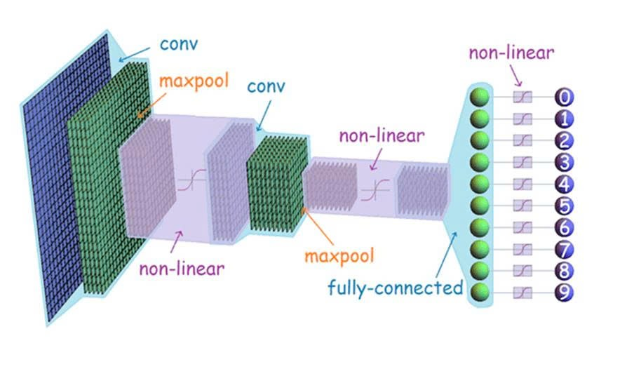
MODEL ARCHITECTURE
3D Convolution
Extracts spatiotemporal features from stacked spectrogram/MFCC sequences.
Captures both:
Local patterns in frequency–time space.
Temporal dynamics across multiple audio frames (depth).

Slide 14
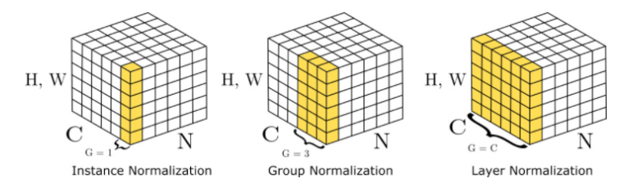
MODEL ARCHITECTURE
GroupNorm
Channel-wise normalization
Divides channels into groups
Works with small batches
Improves stability & convergence
Replaces BatchNorm in 3D CNN

Slide 15

MODEL ARCHITECTURE
ReLu
Activation function:
ReLU(x) = max(0, x)
Introduces non-linearity
Avoids vanishing gradient
Fast & efficient
x : input to a neuron
ReLU: Activation function

Slide 16

MODEL ARCHITECTURE
DropOut3D
Regularization technique:
Drops entire feature maps
Reduces overfitting
Applies spatially in 3D
Randomly disables units during training
h’ : Random Variable
h : Intermediate Activation
p : Dropout Probability

Slide 17
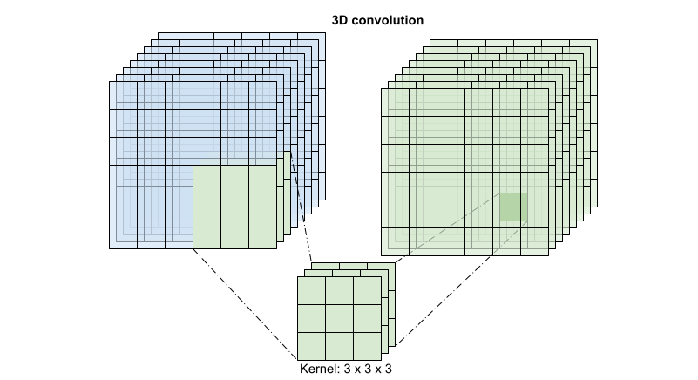
MODEL ARCHITECTURE
MaxPool3D
Downsamples feature maps
Kernel: (1, 2, 2)
→ Keeps depth (D)
→ Reduces time & frequency
Controls spatial dimension growth

Slide 18
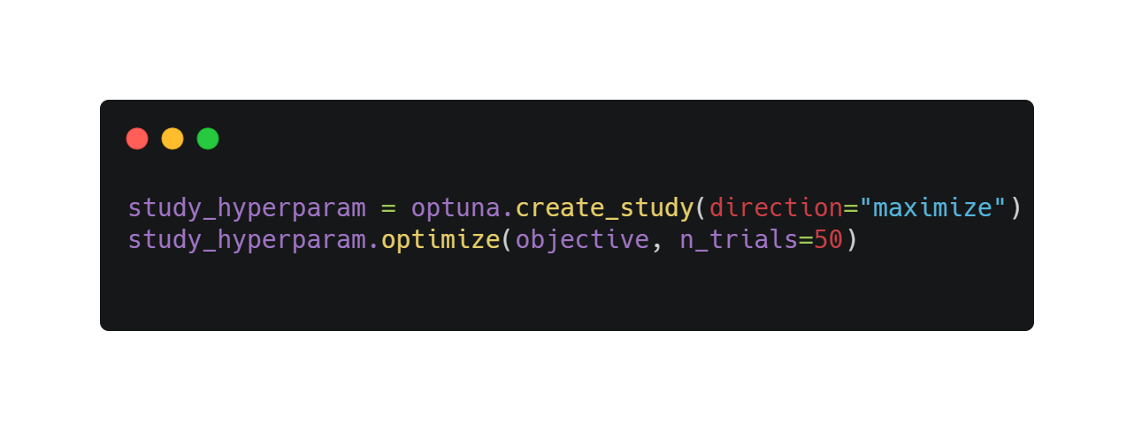
HYPERPARAMETER TUNING
Using Optuna:
Based on Bayesian Optimization algorithm, specifically TPE (Tree-structured Parzen Estimator).
Create a Study to optimize the objective function.
At each Trial, Optuna selects a set of hyperparameters → trains the model → evaluates → repeats.
After many trials, return best_trial with the best set of hyperparameters.

Slide 19
HYPERPARAMETER TUNING
Parameter | Search Space | Best Value Found
conv1 | [16, 32, 64] | 32
conv2 | [32, 64, 128] | 128
conv3 | [64, 128] | 64
conv4 | [128, 256] | 256
conv5 | [128, 256, 384] | 128
dropout | Uniform(0.1, 0.5) | ~0.21
fc_dim | [64, 128, 256] | 128
Tuned Parameters:

Slide 20
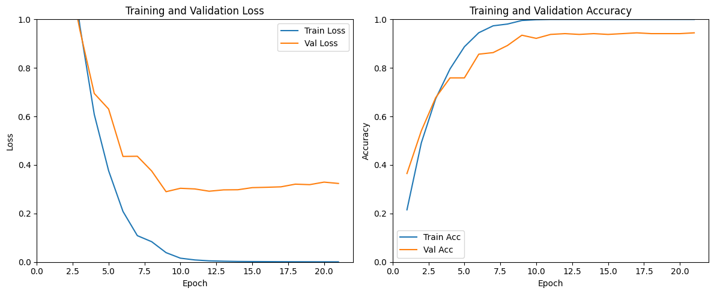
EXPERIMENTS
Initial Model

Slide 21
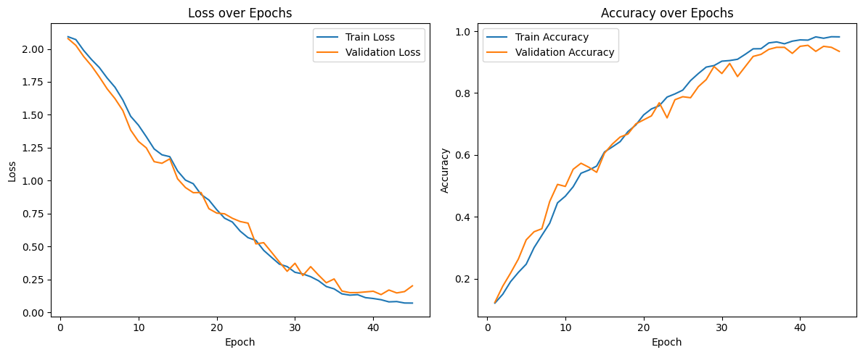
EXPERIMENTS
Advanced Model

Slide 22
METRICS
TP + TN
Precision =
TP
Accuracy =
TP + TN+ FP +FN
TP + FP
F1 =
2 x Precision x Recall
TP
Recall =
Precision + Recall
TP + FN

Slide 23
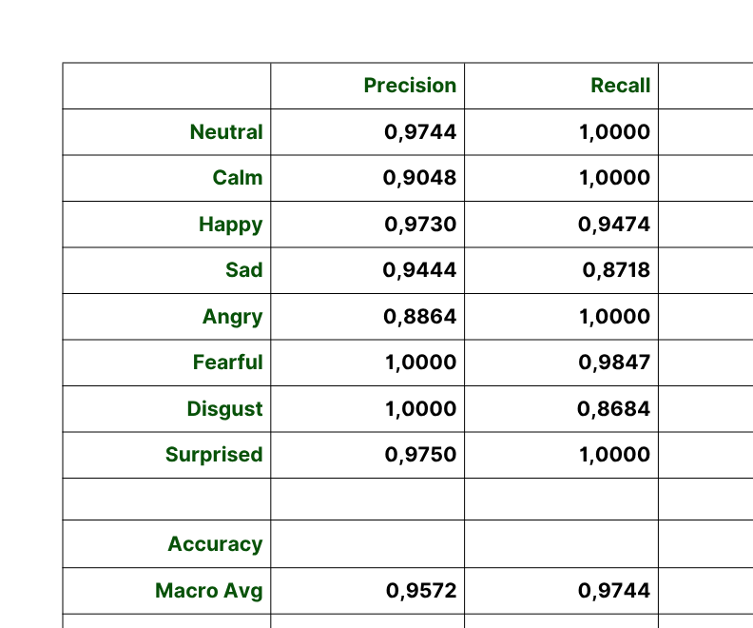
EVALUATION
Classification Report

Slide 24
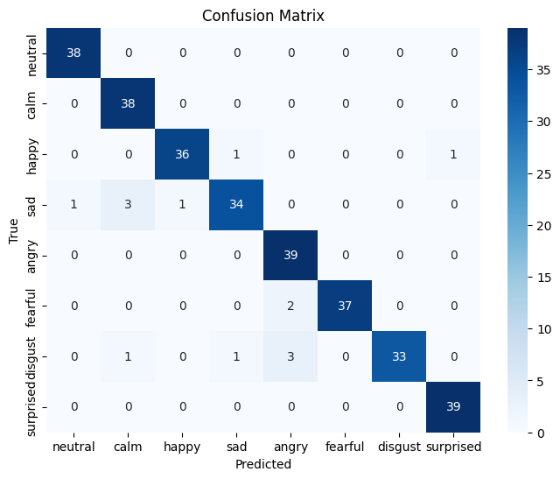
EVALUATION

Slide 25
ERROR ANALYSIS
Confusion between Negative Emotions
"Sad" & "Disgust" have lower F1-scores (0.90-0.92), indicating more errors.
Problem
The model mixes up "disgust" with "fearful" or "sad."
Reason
These emotions share similar speech patterns.

Slide 26
SYSTEM DEMO
Simple chatbot built and developed using C#, .NET, and WPF.
Libraries used including NAudio, Newtonsoft, RestSharp, ...

Slide 27
FUTURE WORK
Further improvement on Model via usage of other techniques and methods.
A more varied dataset.
Distinguishing between similar and/or ambiguous emotions.

Slide 28

THANK YOU

