Slide 1
MICROSOFT ENTRA ID · AUTHENTICATION METHODS
I read an article. I wanted to automate it. Here's what
DevTools found.
System-Preferred Authentication · isSystemDefaultPrimaryAuthEnabled · Graph API
#EntraID
#GraphAPI
#MFA
#M365Security
1 / 7

Slide 2
BACKGROUND · SLIDE 2 OF 7
What is System-Preferred
Authentication?
Automatic method ranking
Entra presents the most secure registered method at sign-in — passkeys & TAP at the top, passwords at rank 9 at the bottom.
The toggle activates device-preferred credential
Setting state to "Microsoft managed" reveals a toggle: "Apply to both primary and multifactor authentication." Turning it On activates device-preferred credential — presenting the strongest method the device supports at every sign-in.
Microsoft-managed is the right default
Set state to "Microsoft managed" and enable the toggle manually. Microsoft handles the system-preferred rollout; device-preferred credential logic is what you're actually activating.
2 / 7

Slide 3
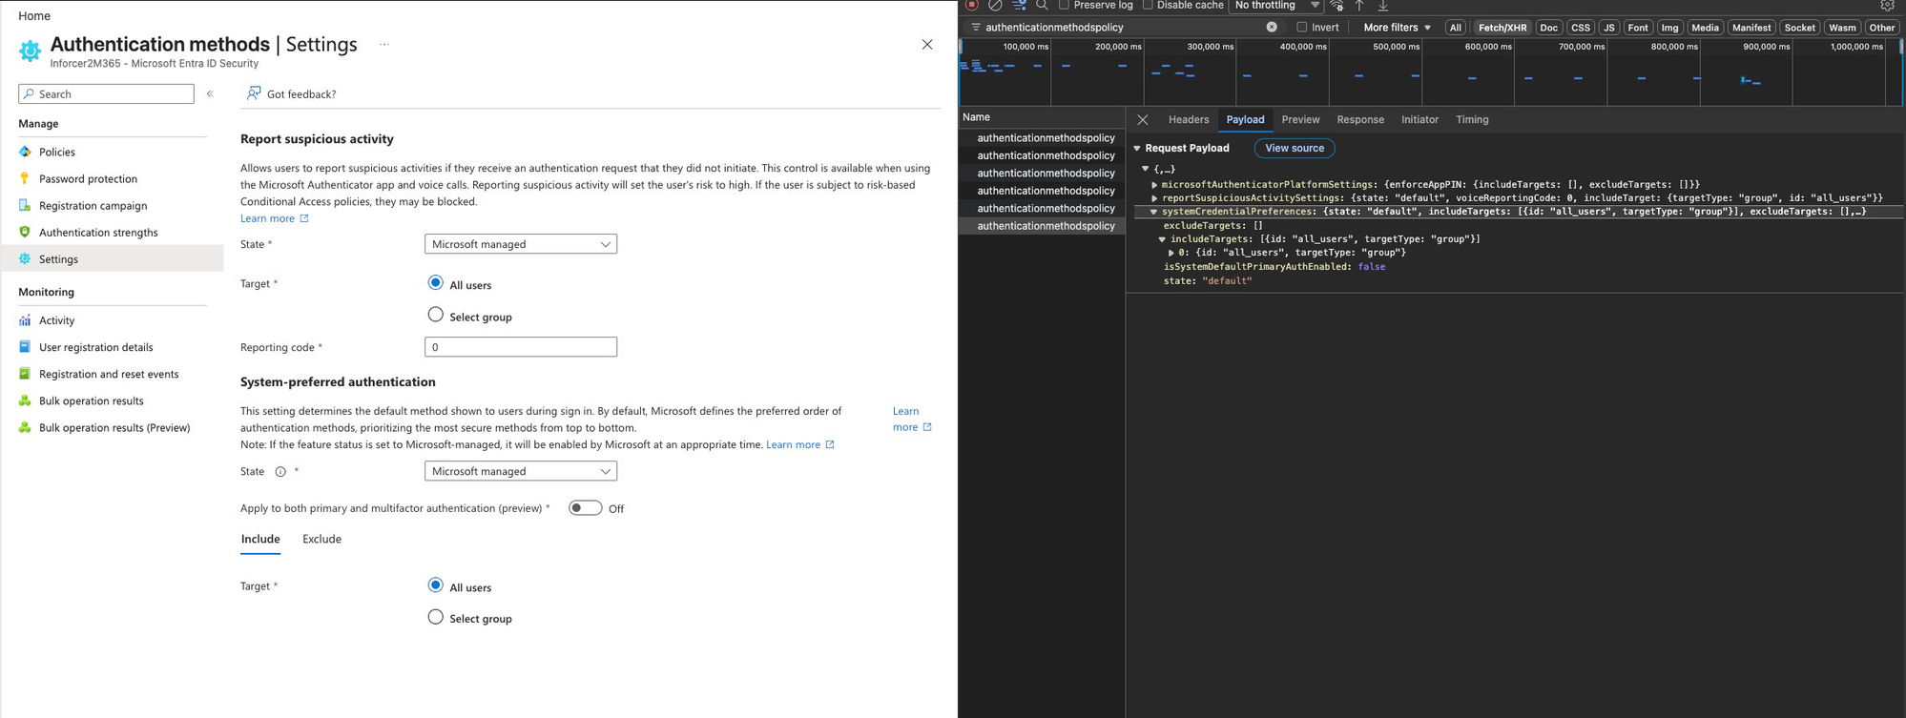
STEP 1 — DEVTOOLS · SLIDE 3 OF 7
I flipped the toggle OFF first.
Network tab captured every PATCH call.
Endpoint: authenticationMethodsPolicy · Property: isSystemDefaultPrimaryAuthEnabled · Value: false
State: OFF | isSystemDefaultPrimaryAuthEnabled: false
PATCH authenticationMethodsPolicy · Request Payload (captured)
systemCredentialPreferences: {
state: "default",
includeTargets: [{ id: "all_users" }],
isSystemDefaultPrimaryAuthEnabled: false
}
3 / 7

Slide 4
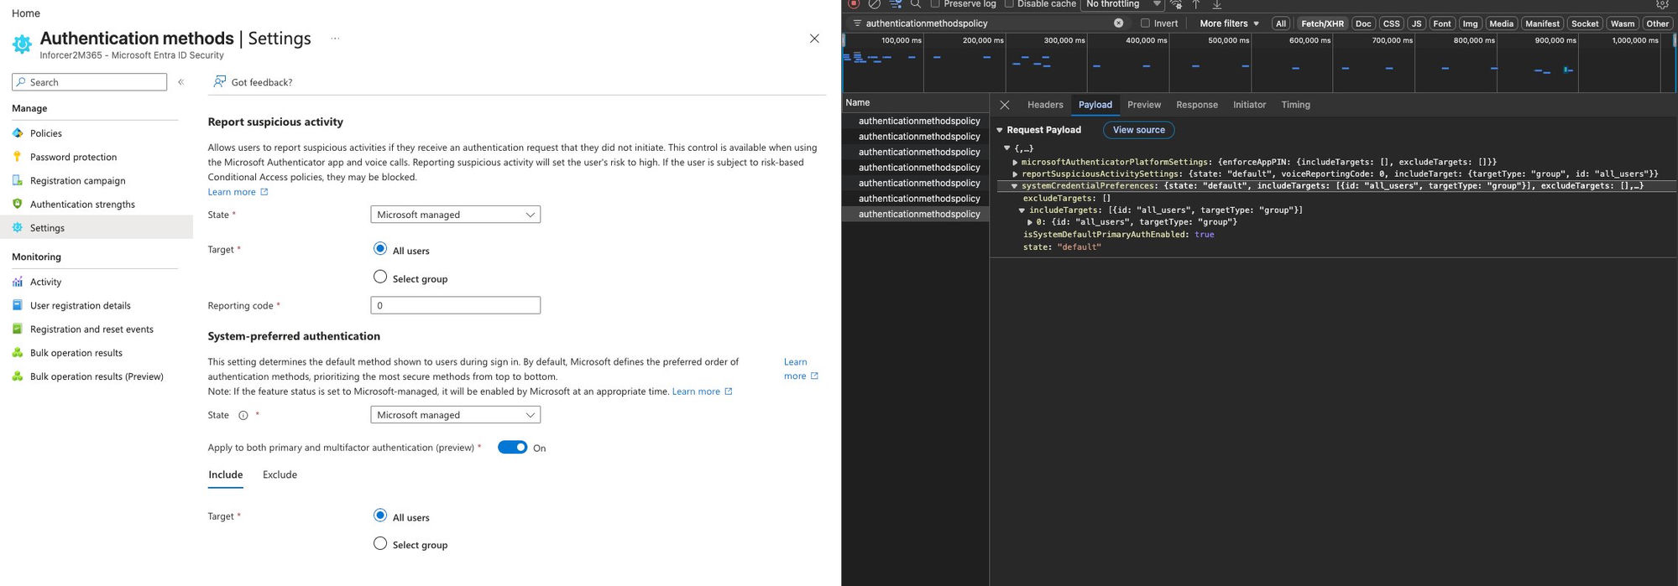
STEP 2 — TOGGLE ON · SLIDE 4 OF 7
Same endpoint, same property.
Now the value is true.
Enabling "Apply to both primary and MFA" fired a PATCH with isSystemDefaultPrimaryAuthEnabled: true — property confirmed.
State: ON | isSystemDefaultPrimaryAuthEnabled: true | Can Graph API do the same?
PATCH authenticationMethodsPolicy · Request Payload (captured)
systemCredentialPreferences: {
state: "default",
includeTargets: [{ id: "all_users" }],
isSystemDefaultPrimaryAuthEnabled: true
}
4 / 7

Slide 5
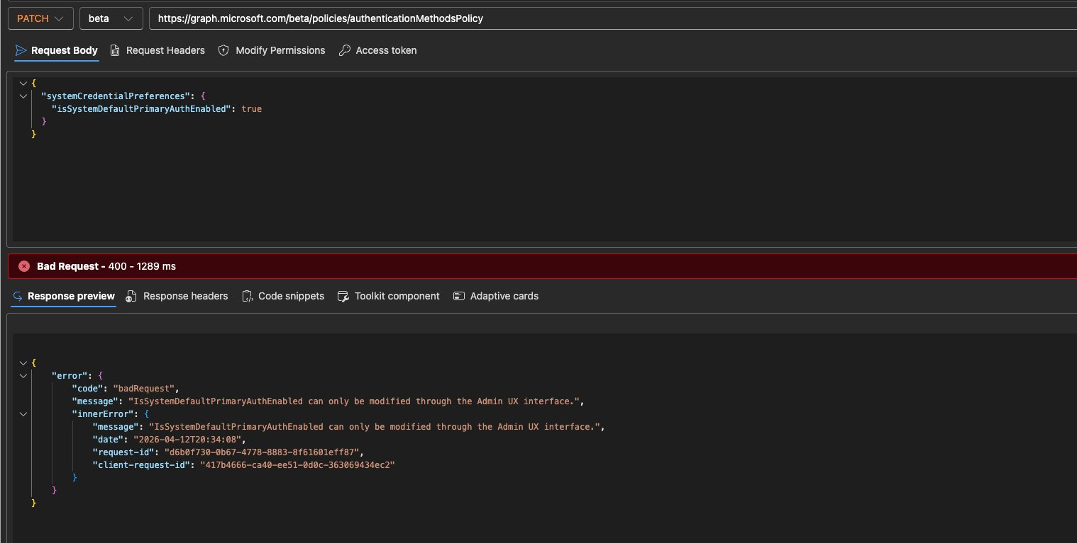
STEP 3 — GRAPH EXPLORER · SLIDE 5 OF 7
Same endpoint. Same property.
Let me PATCH it via Graph Explorer.
PATCH https://graph.microsoft.com/beta/policies/authenticationMethodsPolicy
400 Bad Request — badRequest — 1289ms
5 / 7

Slide 6
THE FINDING · SLIDE 6 OF 7
Microsoft's response was
unambiguous.
400 Bad Request | badRequest | 1289ms
"IsSystemDefaultPrimaryAuthEnabled can only be modified through the Admin UX interface."
— Microsoft Graph API | April 2026
What I did next:
This confirmed the setting can't be managed programmatically. I changed my tenant from Enabled to Microsoft Managed — Microsoft handles the rollout; I still manually enable the device-preferred credential toggle.
If you can't automate it, let Microsoft manage the rollout — that's what Microsoft Managed is for.
6 / 7

Slide 7
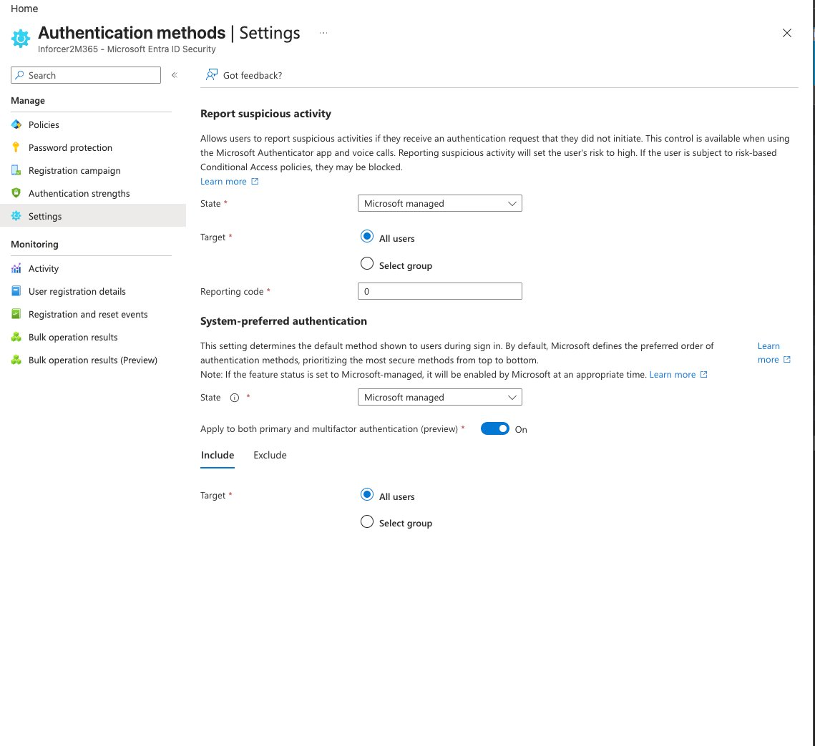
TAKEAWAYS · SLIDE 7 OF 7
Know your tenant.
Know its limits.
Not every portal setting is scriptable
1
DevTools gives you the property name — the Graph API may still hard-block writes to it.
Use Microsoft Managed, not Enabled
2
Lets Microsoft control the phased rollout. You still manually enable the device-preferred credential toggle on top.
Portal final state
Toggle ON ✓
DevTools = your schema reference
3
Even when Graph blocks you, portal traffic documents the exact data model for your compliance evidence.
Timeline note: MC1253746
4
Microsoft has pushed back a related rollout. Features in this space are still evolving — worth tracking in Message Center.
#EntraID #GraphAPI #MicrosoftEntra #M365Security #ZeroTrust #MFA #Passkeys
7 / 7

