Slide 1
DESIGN PATTERNS
* ADAPTER
* BRIDGE
Máryuri Monsalve-1151138
Jhorman Botello-1151454

Slide 2
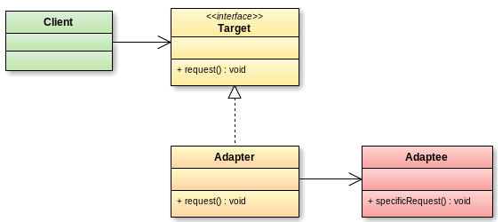
ADAPTER PATTERN
Intent:
Convert the interface of a class into another interface clients expect. Adapter lets
classes work together that could not otherwise because of incompatible interfaces.
Also Known As:
Wrapper

Slide 3
APPLICABILITY USE THE ADAPTER PATTERN
• you want to use an existing class, and its interface does not match the one you need.
• you want to create a reusable class that cooperates with unrelated or unforeseen classes, that is, classes that don't necessarily have compatible interfaces.
• (object adapter only) you need to use several existing subclasses, but it's unpractical to adapt their interface by subclassing every one. An object adapter can adapt the interface of its parent class.

Slide 4
PROBLEM STATEMENT
We have a vehicle sales system (motorcycles, cars) that share similar characteristics, we want to add a new vehicle to the system: the airplane. The airplane has some characteristics different from those of other vehicles. A new class must be adapted without affecting the initial logic of the application.

Slide 5
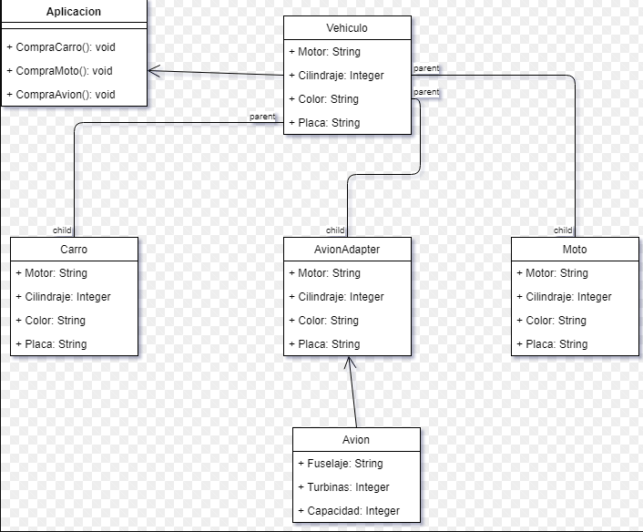
UML

Slide 6
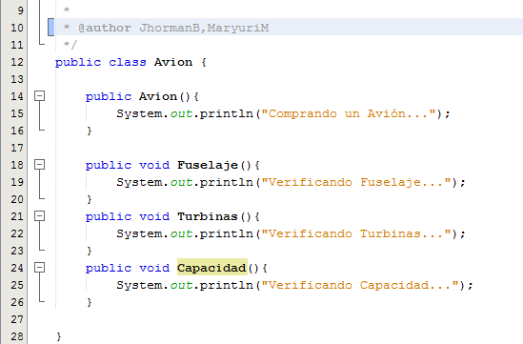
CLASE AVION

Slide 7
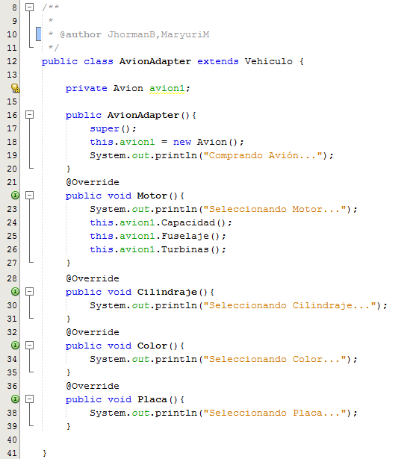
CLASE AVIONADAPTER

Slide 8
RELATED PATTERNS
Bridge has a structure similar to an object adapter, but Bridge has a different
intent: It is meant to separate an interface from its implementation so that they can
be varied easily and independently. An adapter is meant to change the interface
of an existing object

Slide 9
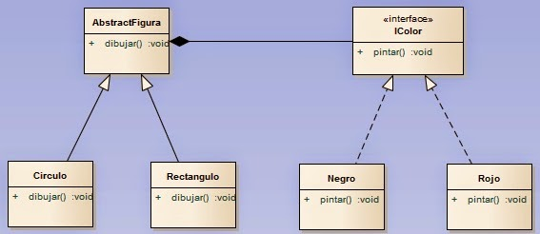
BRIDGE PATTERN
Intent:
Decouple an abstraction from its implementation so that the two can vary independently.
Also Known As:
Handle/Body

Slide 10
APPLICABILITY USE THE BRIDGE PATTERN
• you want to avoid a permanent binding between an abstraction and itsimplementation. This might be the case,for example,when the implementation must be selected or switched at run-time.
• both the abstractions and their implementations should be extensible by subclassing. In this case, the Bridge pattern lets you combine the different abstractions and implementations and extend them independently.
• changes in the implementation of an abstraction should have no impact on clients; that is, their code should not have to be recompiled.
• (C++) youwant tohide theimplementation ofanabstraction completely from clients. In C++ the representation of a class is visible in the class interface.

Slide 11
• you have a proliferation of classes as shown earlier in the first Motivation diagram. Such a class hierarchy indicates the need for splitting an object into two parts. Rumbaugh uses the term "nested generalizations" [RBP+91] to refer to such class hierarchies.
• you want to share an implementation among multiple objects(perhaps using reference counting), and this fact should be hidden from the client. A simple example is Coplien's String class [Cop92], in w

Slide 12
INTEGRATION

Slide 13
UML

