Slide 1
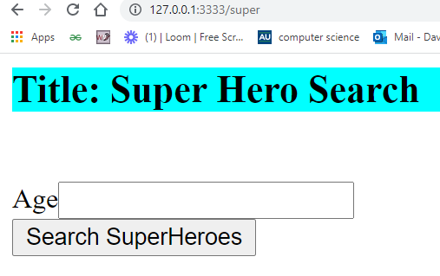
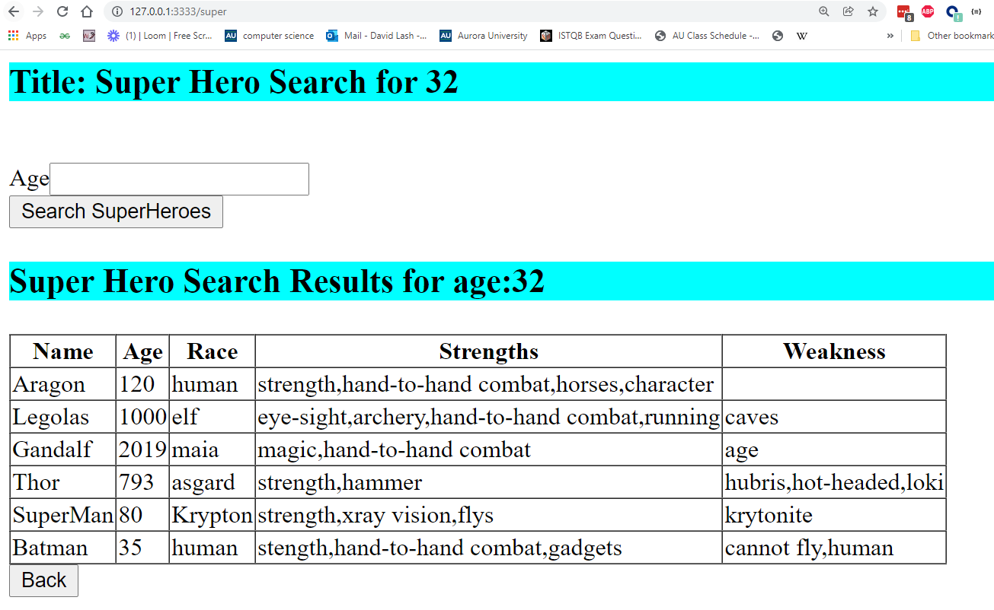
Build a super-hero search node.js/express.js application
R1 -> Use express.js and node.js and pug to create this page when you visit 127.0.0.1:3333/super via a get request
R2 -> Make this a H1 and utilize an external style sheet to make the background color teal that is used from the pug file
R3 -> On submit of the Age input, then output all super heroes with age > the input 127.0.0.1:3333/super via a post request
Here the user submitted 32 so showing all superheros > 32 age.
R4-> Support a Back button that links back to 127.0.0.1:3333/super via a get request

Slide 2
let heros = [ { "id": "01", "name": "Aragon", "race": "human", "age": 120, "strengths": [ "strength", "hand-to-hand combat", "horses", "character" ], "weakness": [ ] }, { "id": "02", "name": "Black Widow", "race": "human", "age": 32, "strengths": [ "agility", "hand-to-hand combat", "knives" ], "weakness": [ "brainwashing" ] }, { "id": "03", "name": "Legolas", "race": "elf", "age": 1000, "strengths": [ "eye-sight", "archery", "hand-to-hand combat", "running" ], "weakness": [ "caves" ] }, { "id": "04", "name": "Gandalf", "race": "maia", "age": 2019, "strengths": [ "magic", "hand-to-hand combat", ], "weakness": [ "age" ] }, { "id": "05", "name": "Thor", "race": "asgard", "age": 793, "strengths": [ "strength", "hammer" ], "weakness": [ "hubris", "hot-headed", "loki" ] }, { "id": "06", "name": "SuperMan", "race": "Krypton", "age": 80, "strengths": [ "strength", "xray vision", "flys" ], "weakness": [ "krytonite" ] }, { "id": "07", "name": "SpiderMan", "race": "human", "age": 17, "strengths": [ "stength", "webs", "jumping" ], "weakness": [ "experience", "Aunt May" ] }, { "id": "08", "name": "Batman", "race": "human", "age": "35", "strengths": [ "stength", "hand-to-hand combat", "gadgets", ], "weakness": [ "cannot fly", "human" ] } ];
R5 -> Utilize the following JSON code at the top of your main express.js file
(Partial code is available on moodle)
R6 -> You need to support these routes
app.get('/super', function(req, res) { let title = "Super Hero Search"; .
.
. }); app.post('/super', function(req, res) {
.
.
.
});

Slide 3
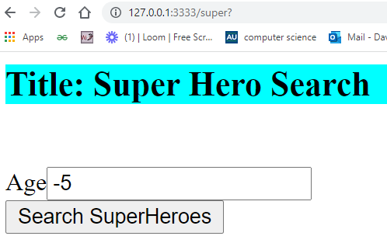
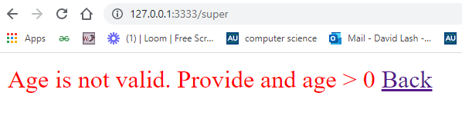
R7 -> If user submits no value or a value 0 or less, then show the following screen and provide a working back button
The UI should come from .pug files.

Slide 4
What to hand in …
Your all of your code. Including pug files, express files and css
Screen shots of the following
2.a Your initial screen
2.b Screen Results when submit age: 33
2.c Screen Results when submit age: 120
2.d Screen Results when submit age: -7

Slide 5
Final Problem Rubric
Item | Points | Points Earned | Comments
R1 -> Use express.js and node.js and pug to create this page when you visit 127.0.0.1:3333/super via a get request | 20
R2 -> Make this a H1 and utilize an external style sheet to make the background color teal | 10
R3 -> On submit of the Age input, then output all super heroes with age > the input 127.0.0.1:3333/super via a post request | 35
R4-> Support a Back button that links back to 127.0.0.1:3333/super via a get request | 10
R5 -> Utilize the following JSON code at the top of your main express.js file | 15
R6 -> You need to support these routes | 10
 | 100

