Slide 1


GenViz Module 1: Introduction to genomic data visualization and interpretation
Malachi Griffith, Obi Griffith, Zachary Skidmore
Genomic Data Visualization and Interpretation
September 11-15, 2017
Berlin

Slide 2
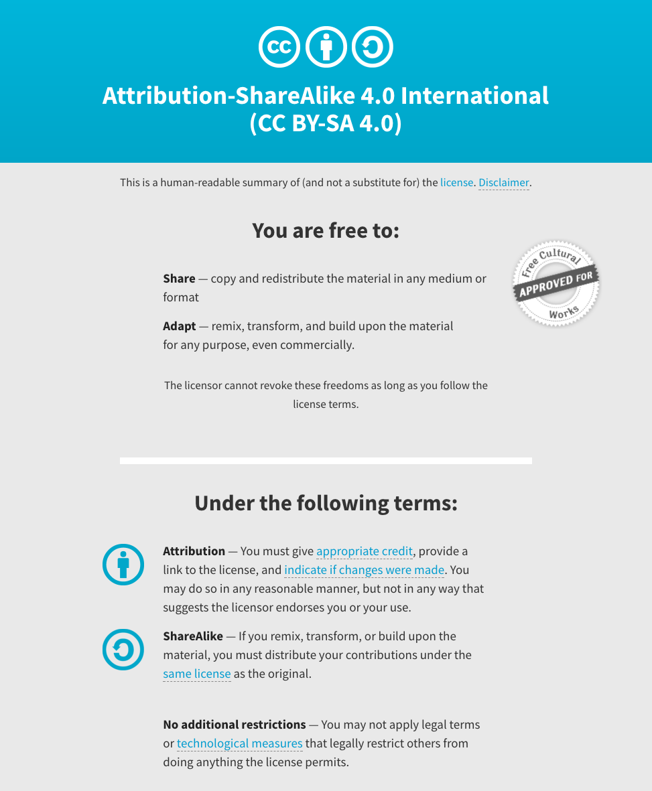
Notes:
Note there are two licenses if effect for this course.
All *content* (lectures, written materials, etc.) are made available under the Creative Commons Attribution-ShareAlike 4.0 International (CC BY-SA 4.0). (https://creativecommons.org/licenses/by-sa/4.0/).
All *code* (R scripts the website code itself) are made available under the MIT License (https://opensource.org/licenses/MIT).

Slide 3
Ideas for introductory content
Intro slide for three of us
Background on MGI
History of genomics, cancer genomics, etc
Anecdotes illustrating key analyses, methods, papers
Other workshops
Plug CSHL and CBW
Review of lab-developed tools
DGIdb
DoCM
CIViC
pVAC-seq
GenVisR
Slide acknowledging lab members

Slide 4
Learning objectives of the course
Module 1: Introduction to genomic data visualization and interpretation
Module 2: Using R for genomic data visualization and interpretation
Module 3: Introduction to GenVisR
Module 4: Expression profiling, visualization, and interpretation
Module 5: Variant annotation and interpretation
Module 6: Q & A, discussion, integrated assignments, and working with your own data
Tutorials
Provide working examples of data visualization and interpretation
Self contained, self explanatory, portable

Slide 5
Learning objectives of module 1
Introduction to genomic data visualization and interpretation
…

