Slide 1


GenViz Module 6: Q & A, discussion, integrated assignments, and working with your own data
Malachi Griffith, Obi Griffith, Zachary Skidmore
Genomic Data Visualization and Interpretation
September 11-15, 2017
Berlin

Slide 2
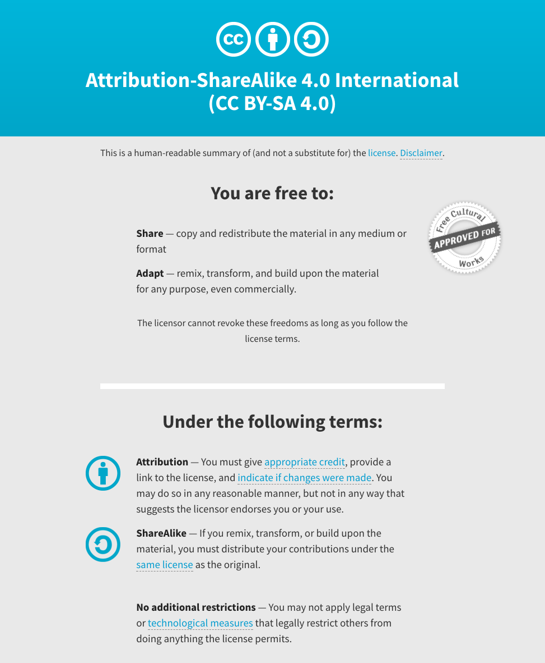
Notes:
Note there are two licenses if effect for this course.
All *content* (lectures, written materials, etc.) are made available under the Creative Commons Attribution-ShareAlike 4.0 International (CC BY-SA 4.0). (https://creativecommons.org/licenses/by-sa/4.0/).
All *code* (R scripts the website code itself) are made available under the MIT License (https://opensource.org/licenses/MIT).

Slide 3
Learning objectives of the course
Module 1: Introduction to genomic data visualization and interpretation
Module 2: Using R for genomic data visualization and interpretation
Module 3: Introduction to GenVisR
Module 4: Expression profiling, visualization, and interpretation
Module 5: Variant annotation and interpretation
Module 6: Q & A, discussion, integrated assignments, and working with your own data
Tutorials
Provide working examples of data visualization and interpretation
Self contained, self explanatory, portable

Slide 4
Learning objectives of module 6
Q & A, discussion, integrated assignments, and working with your own data
…

