Slide 1
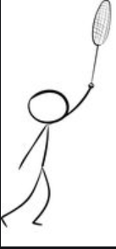
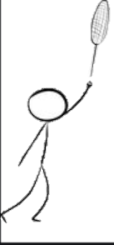
3d tracklet points P_{3d} can be obtained by calculating the intersections of the optical rays and tracklet plane
Tracklet plane
Image plane
Optical rays of 2d tracklet V_{i} = ρP_{2d_i}, where ρ is scaling factor
P_{2d}
Focal
P_{3d}
P_{3d}
P_{3d}
2d tracklet points in CCW space can be describe as P_{2d_i} = (x_{i}, y_{i}, f), where x_{i}, y_{i} is the 2d coordinate of points in image and f is the focal length of camera
P_{proj}
V_{proj}
N_{tracklet}
P_{proj}
The normal vector N_{tracklet} of tracklet plane is orthogonal to V_{proj} and lie on the ground (z = 0)
The projection point of hit position P_{proj} from 3d space to the ground can be described as (x, y, 0) in WCS space. And the projection line of 3d tracklet from 3d space to the ground can be described as V_{proj} = P_{proj_i} - P_{proj_j}

Slide 2
Tracklet plane
Image plane
P_{2d}
Focal
P_{3d}
P_{3d}
P_{3d}
P_{proj}
N_{tracklet}
P_{proj}

Slide 3
