Slide 1
Pseudo3D
2D Information
Camera Pose
Boundary constrain
Video
Camera parameters
Scene Information
Hardware

Slide 2
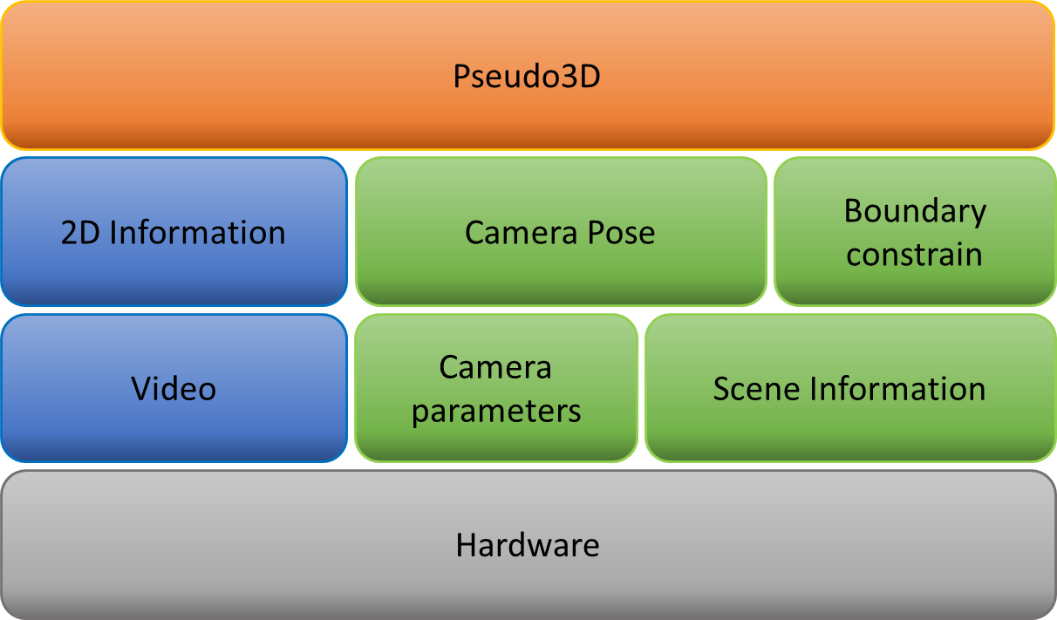

Slide 3
