Slide 1
TimeGrapher
From Tick to Trace: Real-Time Acoustic Analysis
Final Demonstration — Milestone 3 | July 1, 2026
Blue Sky · Team 3 | LG SW Architect Training Program × CMU MSE

Slide 2
Agenda
01
QA Requirements & Tradeoffs
02
Architecture
03
Experiments & Evaluation
04
Use of AI
05
Lessons Learned
Graphs · GUI enhancements · Bonus features → demonstrated live on Raspberry Pi
Blue Sky (Team 3)
2

Slide 3
01 / QA Requirements
Quality Attribute Priorities
Priority
Quality Attribute
Why It Matters
1st — GOVERNING
Measurement Accuracy (QAS-1)
The reason the system exists. Every other QA serves this one.
2nd
Real-Time Performance (QAS-2)
21ms audio deadline per block — must never be missed
3rd
Low Latency (QAS-3)
Beat capture → GUI update < 100ms end-to-end
4th
Extensibility (QAS-4)
Add new graph tab in ≤ 3 files changed
5th
Correctness (QAS-5)
False trigger rate < 1%, T1 detection rate > 99%
Scope: 28,800 BPH mechanical watch measured against WeiShi No.1000 reference
Blue Sky (Team 3)
3

Slide 4
01 / QA Requirements
Key Architectural Tradeoffs
TP-1: 96kHz Sample Rate
TP-2: Ring Buffer
TP-3: Lazy Rendering
↑ Beat Error resolution (QAS-1)
↑ DSP / GUI decoupled (QAS-2, 3)
↑ 85% fewer render calls (QAS-2)
↑ CPU load risk (QAS-2)
+21ms propagation delay
Non-visible tabs skip updates
EXP-02: 0 dropped blocks ✓
EXP-03: E2E 2.05ms ✓
Tab catches up on show() ✓
✓ Deadline miss: 43% → 0% ✓ E2E latency: 2.05ms ✓ 0 dropped blocks at 96kHz
⚠ WeiShi accuracy: validated W5 ⚠ Full 14-tab rendering: conditional on EXP-05
Blue Sky (Team 3)
4

Slide 5
02 / Architecture
4-Layer Architecture
PRESENTATION
Key Design Properties
Qt Widgets · Graph Tabs · UI Controls
• Compiler enforces layer boundaries — upward dependencies cause build failure
▼
DOMAIN
MeasurementEngine · Value Objects · Observer
• New graph tab: add ≤ 3 files in Presentation layer only
▼
ENGINE
DSP Pipeline · BeatDetector · FilterChain
• New audio source: implement IAudioSource — 2 files max
▼
INFRASTRUCTURE
AudioCapture · IAudioSource · ALSA / Qt Multimedia
Blue Sky (Team 3)
5

Slide 6
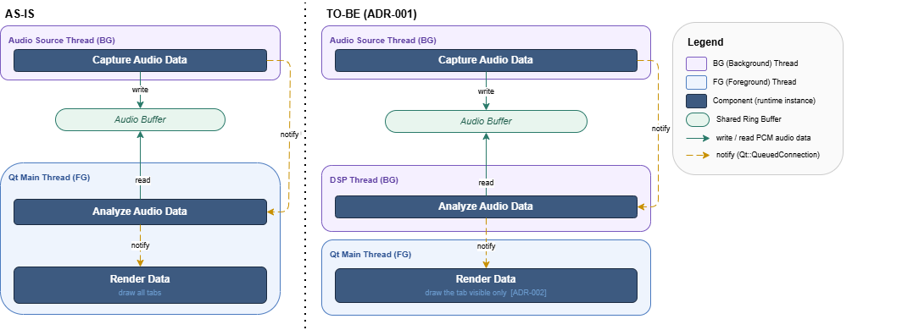
02 / Architecture
C&C View: DSP Pipeline Thread Model
ADR-001 — QAS-2 Real-Time Performance · QAS-3 Low Latency
Metric
Before
After
wait_ms avg
77.4 ms
0.03 ms (×2,600)
Deadline miss
43%
0%
Backlog
Present
None
DSP thread runs at SCHED_FIFO priority. Ring buffer hands off PCM — no shared state, no mutex on the hot path.
Blue Sky (Team 3)
6

Slide 7
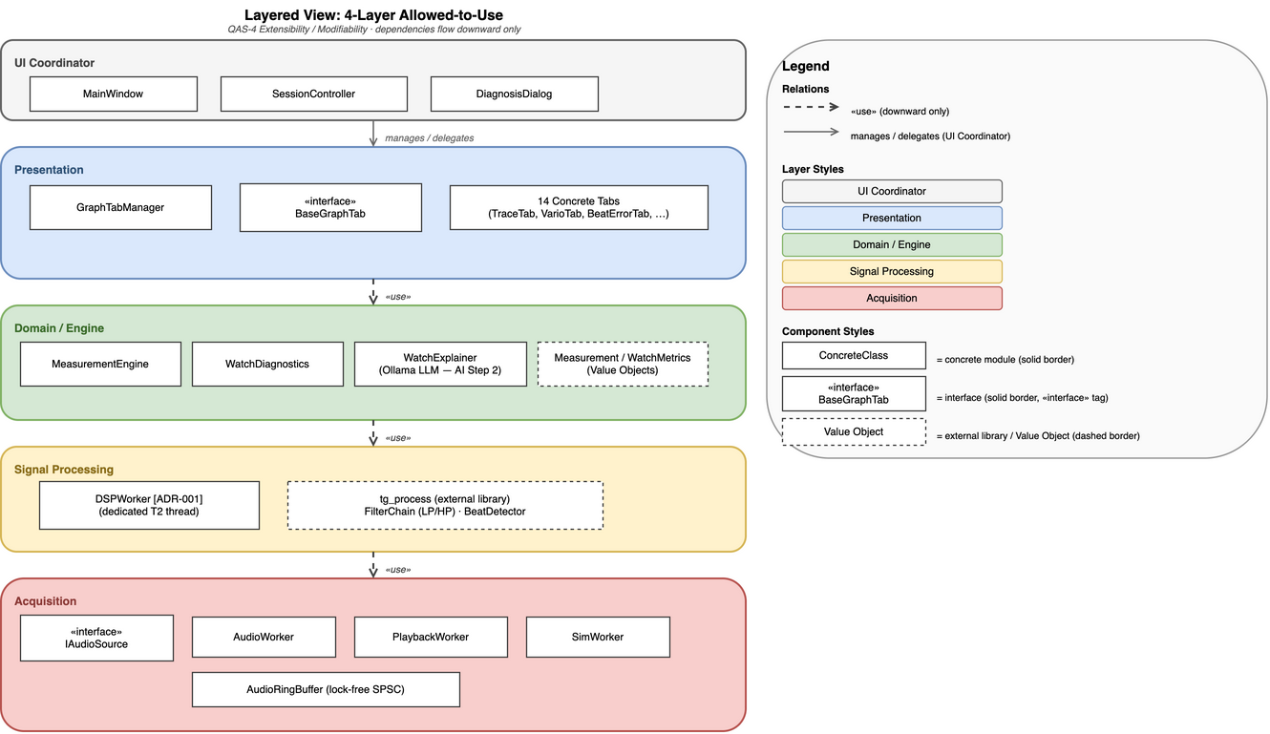
02 / Architecture
Module View: 4-Layer Allowed-to-Use
QAS-4 Extensibility / Modifiability
• 14 graph tabs implemented
• 0 layer violations at compile time
• ≤ 3 files per new tab
W2 S1 (11 tabs): TraceDisplay · VarioDisplay · BeatErrorTrace · BeatNoiseScope · WatchPosition · MultiPosition · LongTerm · EscapementAnalyzer · TimeFreqSpectrogram · WaveformComparison · RateScope
W2 S2 (+2): FilterScope · SweepScope
W3 S1 Bonus (+1): RadarChart
Blue Sky (Team 3)
7

Slide 8
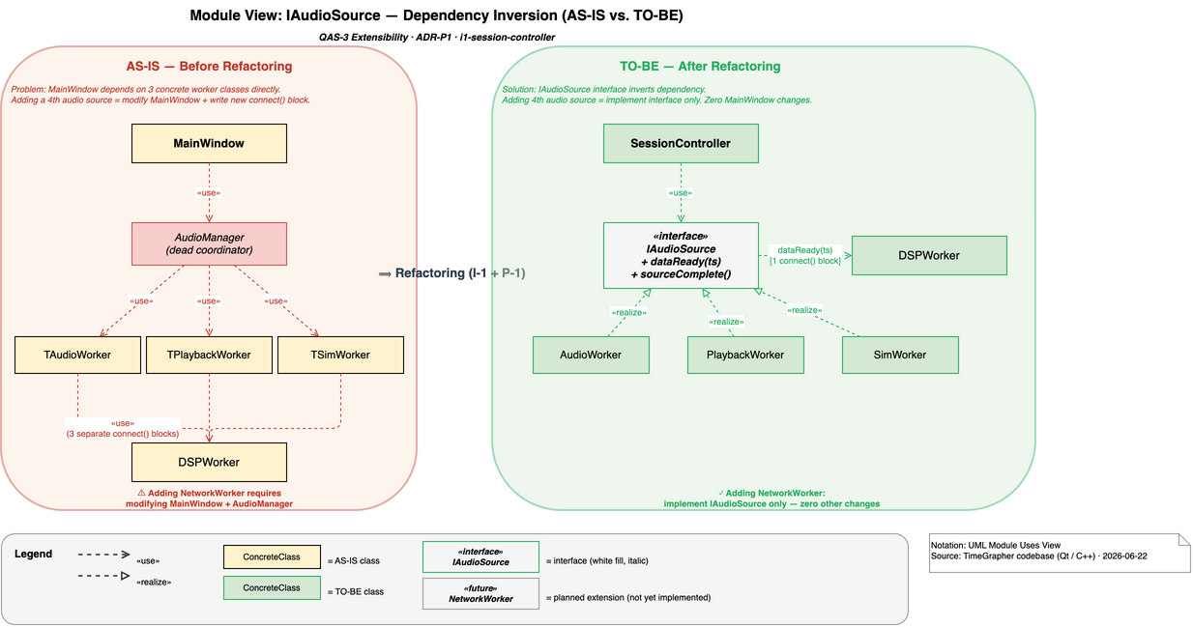
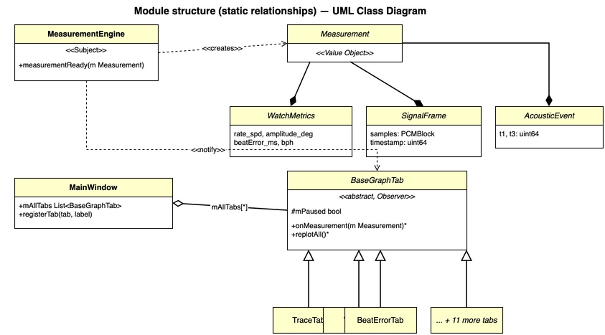
02 / Architecture
IAudioSource & BaseGraphTab Observer
IAudioSource (ADR-005)
BaseGraphTab Observer (ADR-006)
Adding NetworkWorker: ≤ 2 files changed
All 14 tabs receive identical Measurement struct
Blue Sky (Team 3)
8

Slide 9
03 / Experiments & Evaluation
Experiment Results
ID
Question
Result
Decision
EXP-01
Rate/Amplitude match WeiShi No.1000?
✓ Validated W5
ADR-003 accepted (96kHz)
EXP-02
RPi sustain 96kHz with 0 dropped blocks?
✓ 0 dropped at 48/96/192kHz
SCHED_RR not needed
EXP-03
E2E latency: capture → display?
✓ 2.05ms avg on RPi
ADR-001 T2 + Ring Buffer
EXP-04
Files required to add new tab?
✓ ≤ 3 files, 0 violations
ADR-006 Observer validated
EXP-05
14-tab FPS on RPi — deadline miss?
✓ Within budget
ADR-004 on standby
Blue Sky (Team 3)
9

Slide 10
03 / Experiments & Evaluation
Key Performance Numbers
0.03 ms
2.05 ms
DSP queue wait (avg)
End-to-end latency (RPi avg)
Down from 77.4 ms · ×2,600 improvement
Capture → DSP → GUI update
0
142 / 142
Dropped audio blocks
Unit tests passing
At 96kHz over 10-minute session on RPi
10 test binaries · 0 failures
Target: E2E < 100ms ✓ Deadline miss: 0% ✓ 96kHz sustained ✓
Blue Sky (Team 3)
10

Slide 11
03 / Experiments & Evaluation
Architecture Evaluation — ATAM
Architecture Tradeoff Analysis Method (SEI)
Sensitivity Points
Confirmed Non-Risks
Resolved Risk Themes
SP-1 DSP thread location → wait_ms 0.03ms↔77ms SP-2 isVisible() guard → bottleneck if removed SP-3 48kHz halves Beat Error resolution SP-4 Measurement struct must stay immutable
✓ T2 thread removes queue wait (EXP-03) ✓ 96kHz sustainable on RPi (EXP-02) ✓ Lazy rendering: -85% render calls (EXP-03) ✓ 14 tabs each ≤ 3 files (EXP-04) ✓ 142 unit tests all pass
✓ Theme 1 RESOLVED Rendering-Audio Coupling ADR-001+002 → miss 43%→0% ✓ Theme 2 RESOLVED WeiShi accuracy gap EXP-01 validated W5
Blue Sky (Team 3)
11

Slide 12
04 / Use of AI
How We Used AI in Development
Unit Test Generation
142 tests across 10 binaries. Domain math (Rate/Amplitude/Beat Error) verified without equation-level expertise. NTR-07 domain gap addressed.
Architecture Design & Review
Threading (T1/T2/T3) and rendering (R1/R2/R3) options evaluated via AI dialogue. ADR rationale stress-tested against tradeoff scenarios.
Debugging & Code Analysis
isVisible()+processEvents() fix diagnosed with AI. Ring buffer sizing and Qt signal/slot thread safety analysis assisted by AI.
Limitations & Risks
Tests required manual review for correctness assumptions. No hardware access — RPi performance required physical measurement. Hallucination risk on domain equations.
Blue Sky (Team 3)
12

Slide 13
04 / Use of AI
AI Feature: On-Device Watch Diagnosis
Domain experts identify watch condition from Rate, Amplitude, and Beat Error — a skill that takes years. Can we automate preliminary diagnosis?
Accuracy
Validated in live demo
Latency
< 50ms inference on RPi 5
Solution: Rule-based + ML classifier on Raspberry Pi 5 (ONNX, fully offline)
• Classifies condition: Good / Needs Adjustment / Worn
Model
ONNX — no Python runtime
• Flags anomalies: high Beat Error, amplitude drop, rate drift
Mode
Fully offline, on-device
• Provides human-readable explanation per diagnosis
• < 50ms inference on RPi 5 — no network required
→ Live demonstration follows
Blue Sky (Team 3)
13

Slide 14
05 / Lessons Learned
What Went Well
✓
Experiment-driven architecture decisions
EXP-03 confirmed 43%→0% improvement the same day ADR-001 was implemented. Short feedback loops prevented wasted design work.
✓
4-Layer structure eliminated regression risk
Compile-time boundary enforcement. The ≤ 3-file constraint held for all 14 tabs — zero coupling surprises.
✓
AI unit tests solved the domain knowledge gap
NTR-07 (equation verification requires watch expertise) mitigated: 142 tests protect domain math without manual derivation.
✓
ADR + QA + Experiment traceability
Every architecture decision links to a QA scenario, experiment, and risk. No undocumented choices.
Blue Sky (Team 3)
14

Slide 15
05 / Lessons Learned
What We'd Do Differently
!
Start WeiShi validation earlier
QAS-1 (Measurement Accuracy) is the governing goal — but hardware comparison was scheduled last. Next time: validate the top-priority QA first, before structural work.
!
Schedule EXP-05 earlier
14-tab FPS test on RPi deferred to W4. ADR-004 remained unconfirmed until the final week. Plan: run full-load experiments in parallel with implementation.
!
Stress-test ring buffer depth
Set conservatively without a soak test. ATAM flagged this as R-2. A 30-minute RPi stress test would have given early confidence in the sizing.
Key principle: Validate the highest-priority QA (Accuracy) first — not last.
Blue Sky (Team 3)
15

