Slide 1
About Research on PAC Bayes Bound
Dep. Of Mathematics, AIML@K
Jihun Lim

Slide 2
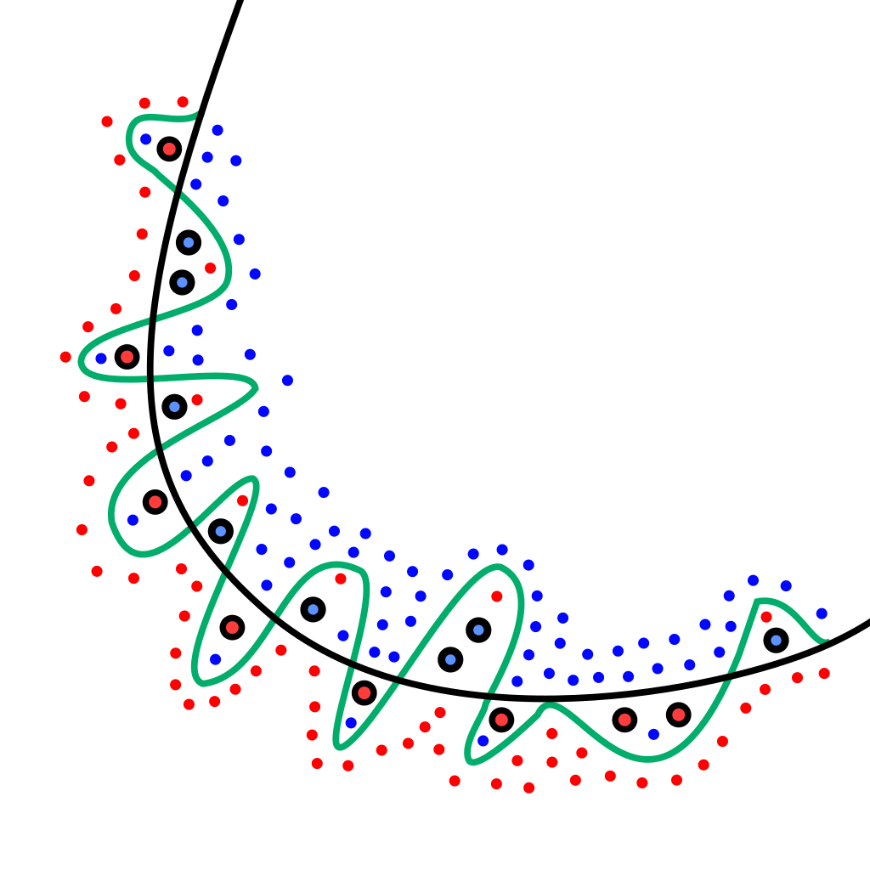
Contents
Motivations
PAC Learning & PAC Bound
PAC Bayes Bound
Current Studies
References

Slide 3
Motivations

Slide 4


Motivations – Rectangle Learning Game
Consider a two-player game where the players are nature and a learner
The nature knows the exact shape of an axis-aligned rectangle
It is willing to reveal tidbits of information about the rectangle
The goal of the learner is to learn the rectangle as accurately as possible
y
$$ℝ^{2}$$
$$ℛ$$
x

Slide 5

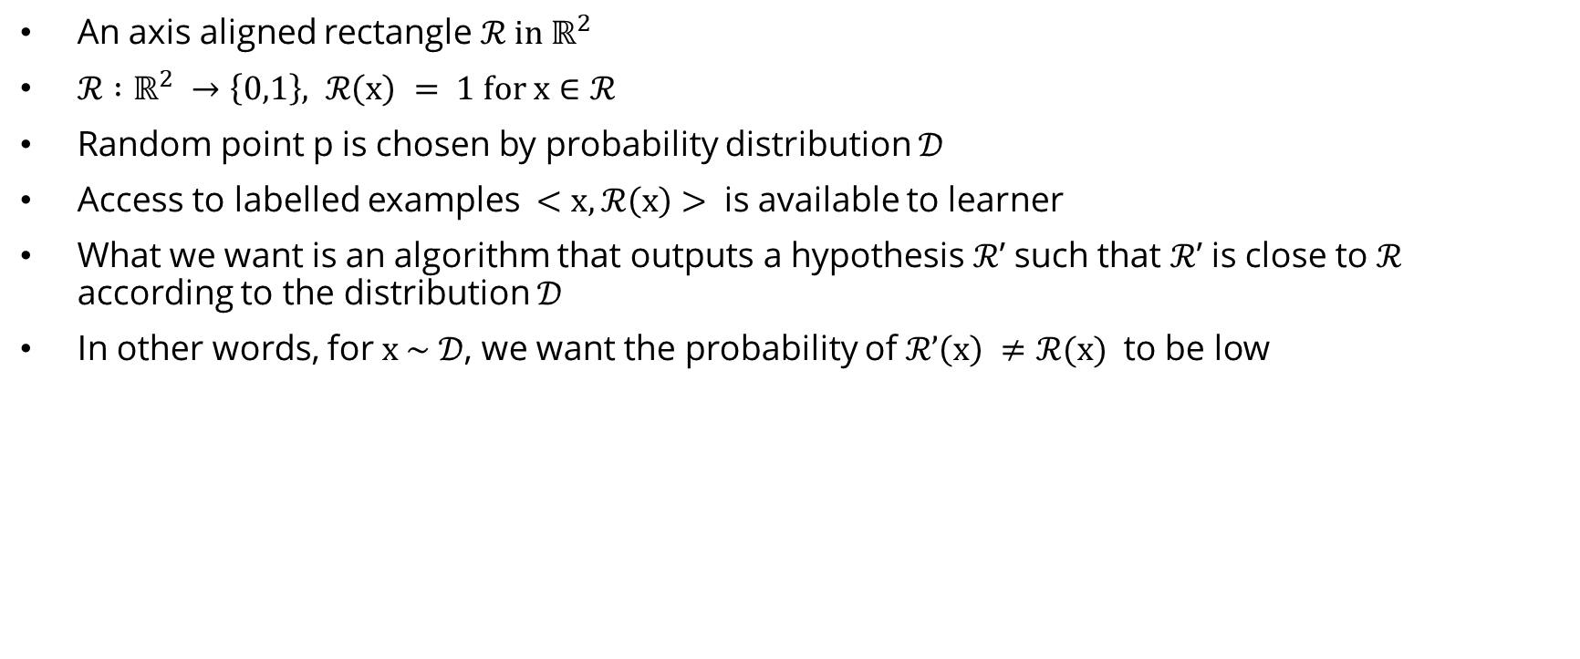


Motivations – Rectangle Learning Game
An axis aligned rectangle ${ℛ in ℝ}^{2}$
$ℛ :ℝ^{2} →\left\{0,1\right\}, ℛ\left(x\right) = 1 for x∈ℛ$
Random point p is chosen by probability distribution $𝒟$
Access to labelled examples $<x,ℛ\left(x\right)>$ is available to learner
What we want is an algorithm that outputs a hypothesis $ℛ$’ such that $ℛ$’ is close to $ℛ$ according to the distribution $𝒟$
In other words, for $x \sim 𝒟$, we want the probability of $ℛ’\left(x\right) ≠ℛ(x)$ to be low
y
$$ℝ^{2}$$
$$ℛ$$
$ℛ$'
x

Slide 6
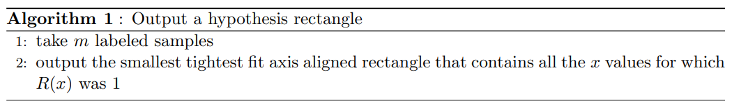

Motivations – Rectangle Learning Game
Algorithm 1 is a simple algorithm that solves the problem.
y
$$ℝ^{2}$$
$$ℛ$$
$ℛ$'
x

Slide 7
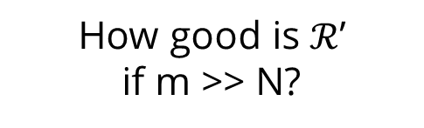
Motivations – Rectangle Learning Game
On the surface, Algorithm 1 appears to be a reasonably good attempt
However, it does not give any indication whatsoever as to what value of m would allow us to get an accurate rectangle
To this end, we introduce a widely embraced notion for studying the efficacy of a learning algorithm, namely Probably-Approximately-Correct (PAC) learning
y
$$ℝ^{2}$$
$$ℛ$$
$ℛ$'
How good is $ℛ$’
if m >> N?
x

Slide 8

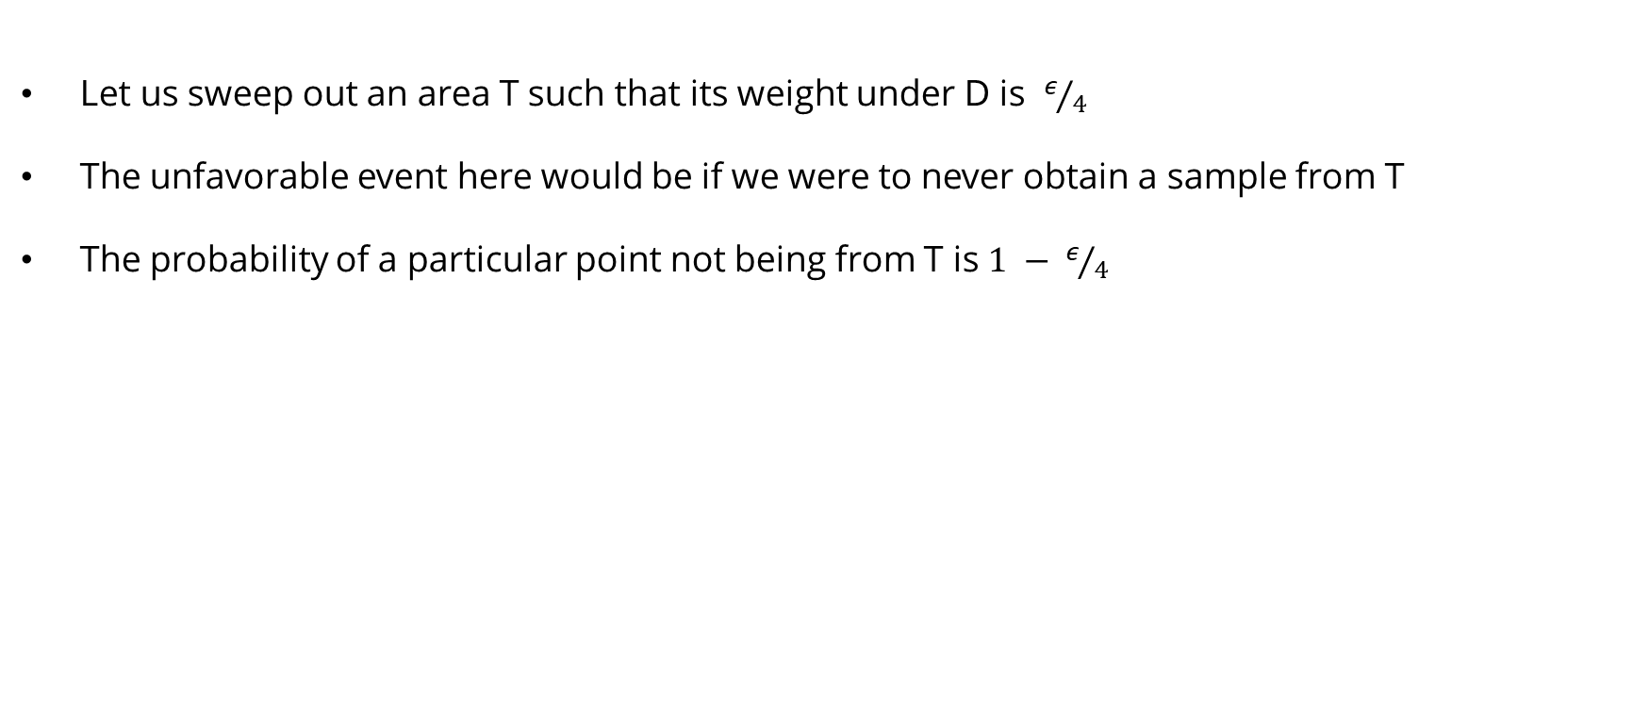

Motivations – Rectangle Learning Game
Let us sweep out an area T such that its weight under D is $ε/4$
The unfavorable event here would be if we were to never obtain a sample from T
The probability of a particular point not being from T is $1 − ε/4$
y
$$ℝ^{2}$$
$$ℛ$$
$$\frac{ε}{4}$$
$$T$$
$ℛ$'
x

Slide 9

Motivations – Rectangle Learning Game
To not have $ℛ$' encroach on T, we would need all our m samples to not be from T
The probability of this event is ${(1 − ε/4)}^{m}$
Thus, we have deduced that
y
$$ℝ^{2}$$
$$ℛ$$
$$\frac{ε}{4}$$
$$T$$
$ℛ$'
x

Slide 10



Motivations – Rectangle Learning Game
By symmetry, if we envision regions similar to T on all sides of R,
we would get the probability of missing each T-like region to be the same
Thus, we have $P\left(error ≥ε\right)≤4{(1−ε/4)}^{m}$
We wish to have $4{(1−ε/4)}^{m} ≤ δ$
y
$$ℝ^{2}$$
$$ℛ$$
$ℛ$'
$$\frac{ε}{4}$$
$$T$$
x

Slide 11

Motivations – Rectangle Learning Game
From Bernoulli’s inequality, it is known that ${1+x≤e}^{x}$
Then$4{(1−ε/4)}^{m} ≤4e^{{−mε}/4}$
We wish $δ$ to be satisfying $4{(1−ε/4)}^{m} ≤ δ$
So, if $m ≥4/εln(4/δ)$, then $P\left(error ≥ε\right)≤4{(1−ε/4)}^{m}$ $≤ δ$
y
$$ℝ^{2}$$
$$ℛ$$
$ℛ$'
$$\frac{ε}{4}$$
$$T$$
x

Slide 12

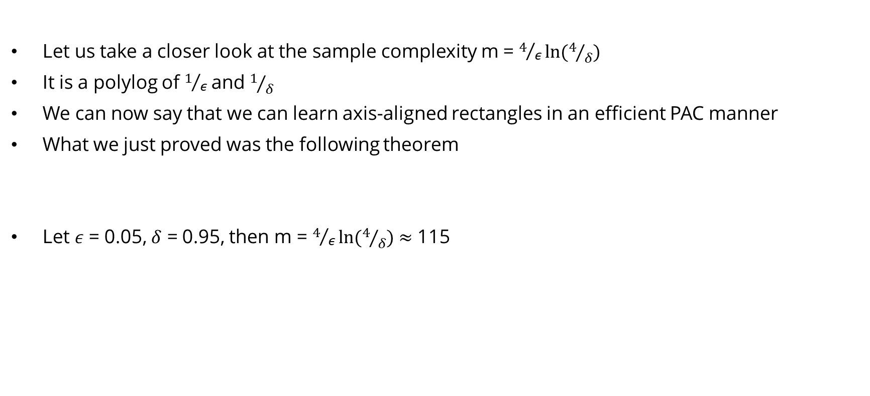



Motivations – Rectangle Learning Game
Let us take a closer look at the sample complexity m = $4/εln(4/δ)$
It is a polylog of $1/ε$and $1/δ$
We can now say that we can learn axis-aligned rectangles in an efficient PAC manner
What we just proved was the following theorem
Let $ε$ = 0.05, $δ$ = 0.95, then m = $4/εln(4/δ)$ $≈$ 115
y
$$ℝ^{2}$$
$$ℛ$$
$ℛ$'
$$\frac{ε}{4}$$
$$T$$
x

Slide 13
PAC Learning & PAC Bound

Slide 14
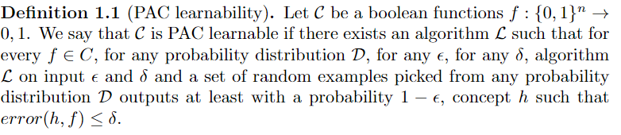
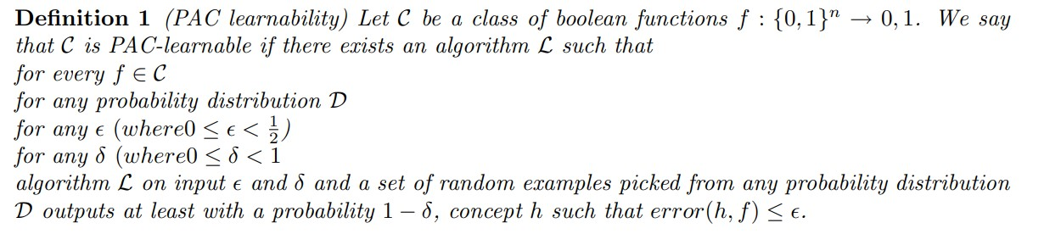
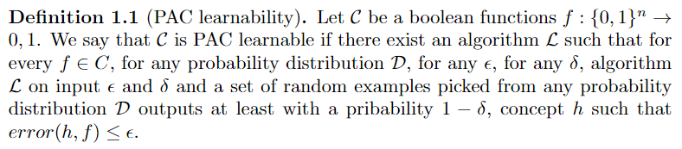
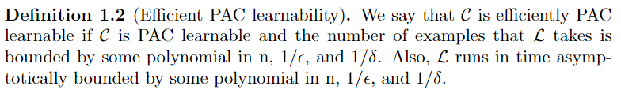
PAC Learning & PAC Bound
PAC Learnability
Efficient PAC Learnability

Slide 15
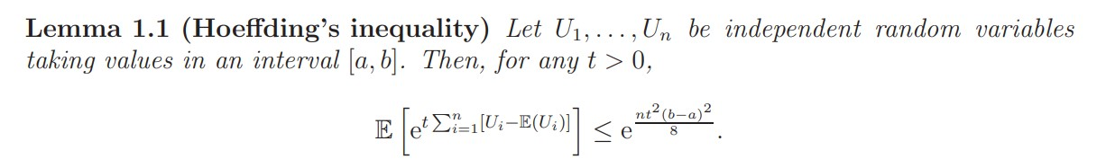
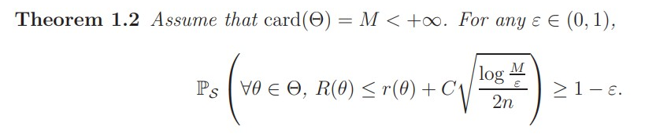
PAC Learning & PAC Bound
Hoeffding’s Inequality
PAC Bound

Slide 16
PAC Bayes Bound

Slide 17
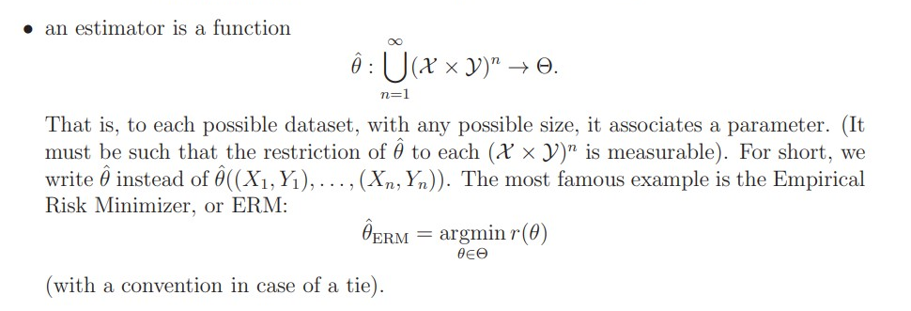
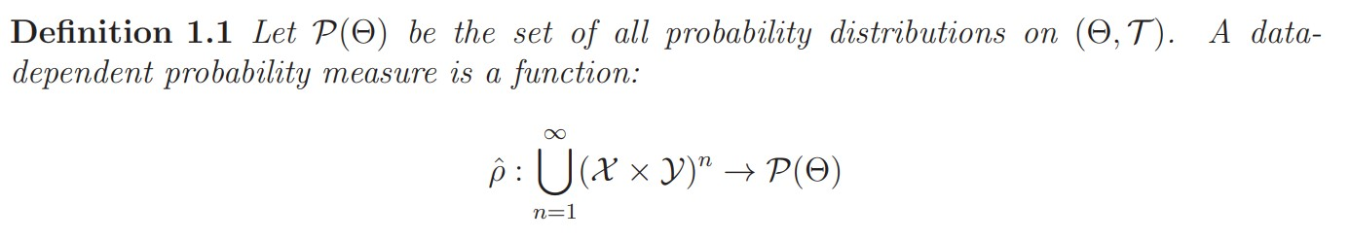
PAC Bayes Bound
Difference between PAC Bound & PAC Bayes Bound
PAC Bound
PAC Bayes
Bound

Slide 18
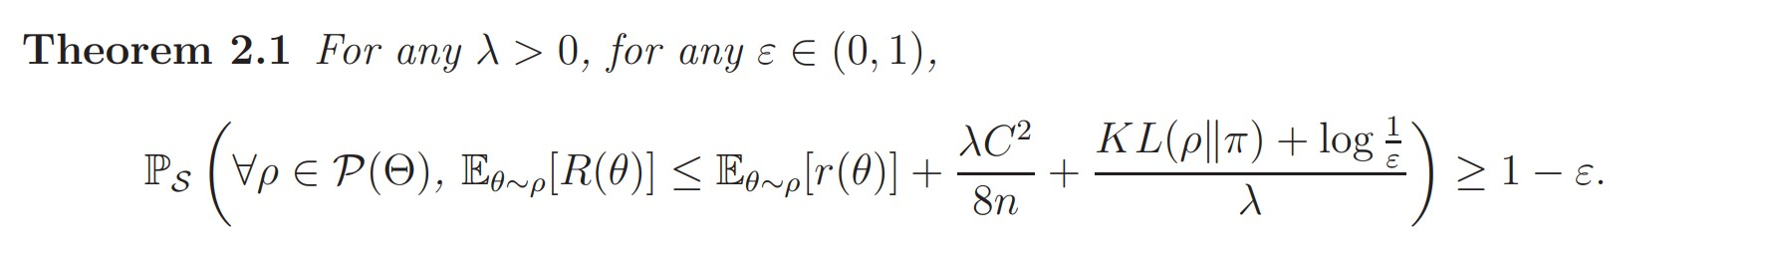
PAC Bayes Bound
Difference between PAC Bound & PAC Bayes Bound
PAC Bound
PAC Bayes
Bound

Slide 19
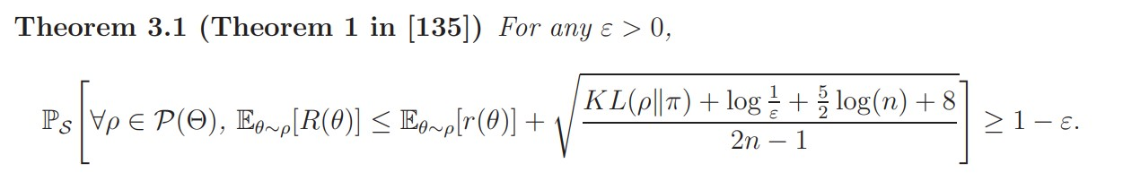
PAC Bayes Bound
Catoni’s Bound
Maurer’s improved bound

Slide 20
Current Studies

Slide 21
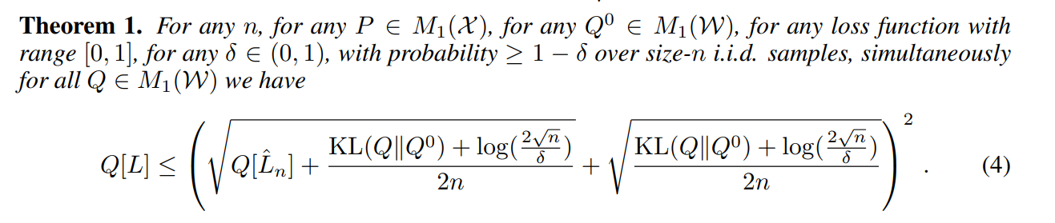
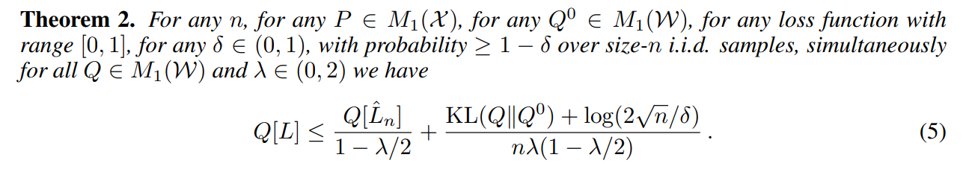
Current Studies
PAC-Bayes with Backprop (2019) : https://github.com/mperezortiz/PBB

Slide 22
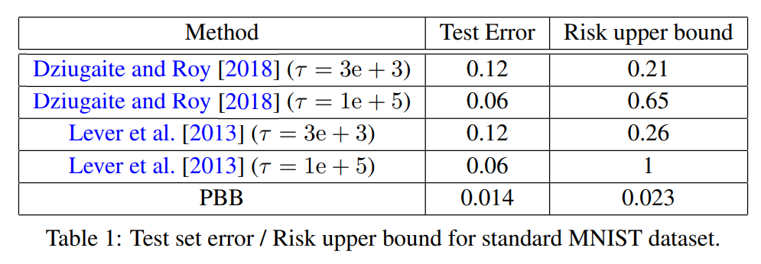
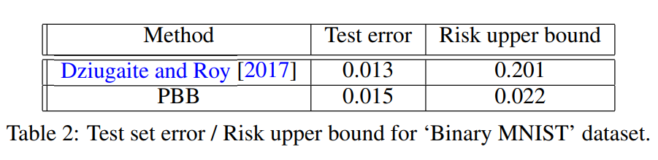
Current Studies
PAC-Bayes with Backprop (2019) : https://github.com/mperezortiz/PBB

Slide 23
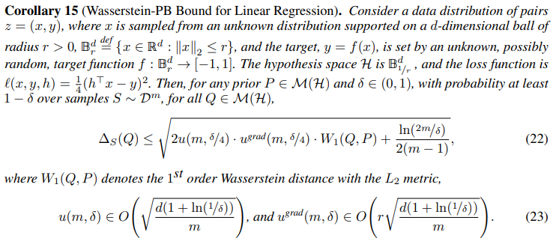
Current Studies
Integral Probability Metrics PAC-Bayes Bounds (2022) :
https://github.com/ron-amit/pac_bayes_reg

Slide 24
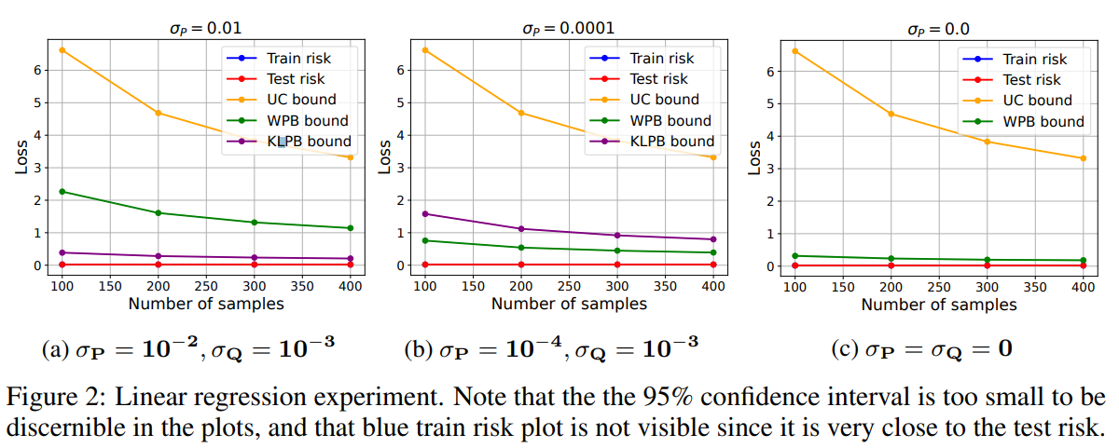
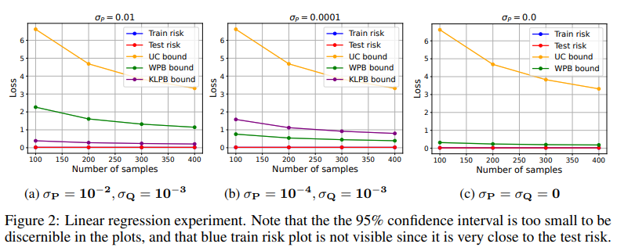
Current Studies
Integral Probability Metrics PAC-Bayes Bounds (2022) :
https://github.com/ron-amit/pac_bayes_reg

Slide 25
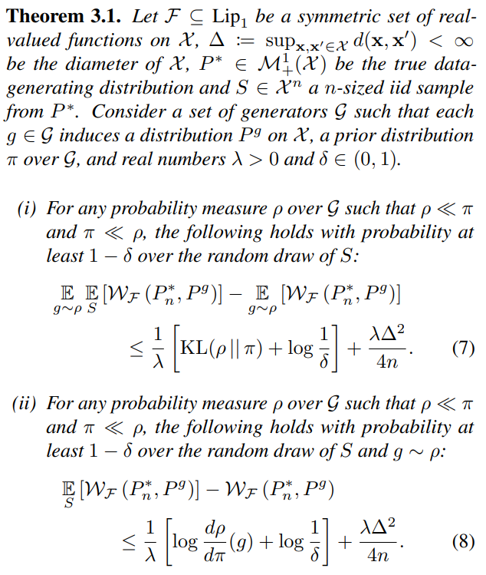
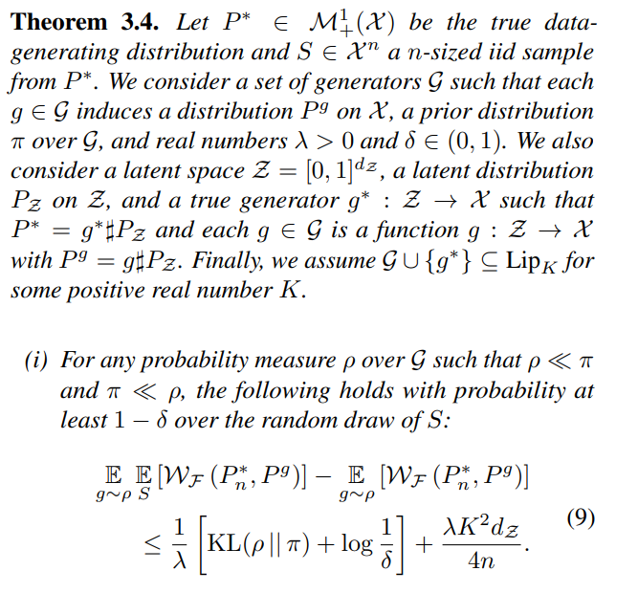
Current Studies
PAC-Bayesian Generalization Bounds for Adversarial Generative Models (2023) :
https://github.com/diarra2339/pac-bayes-wgan

Slide 26
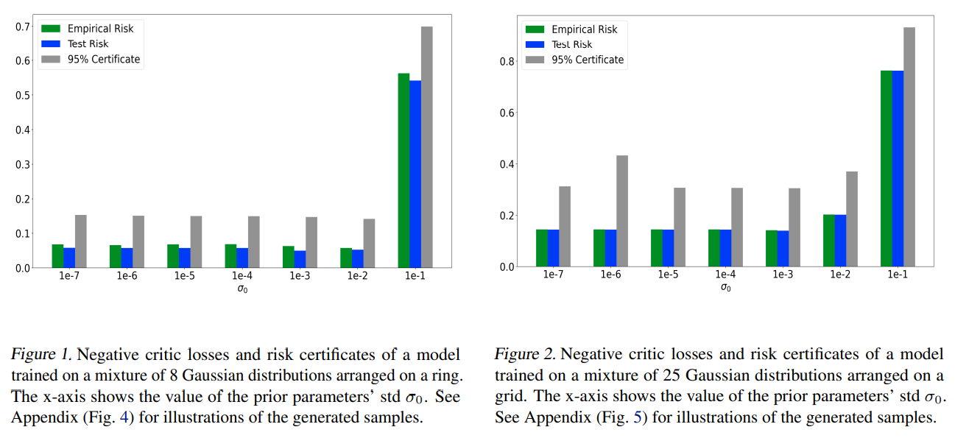
Current Studies
PAC-Bayesian Generalization Bounds for Adversarial Generative Models (2023) :
https://github.com/diarra2339/pac-bayes-wgan

Slide 27
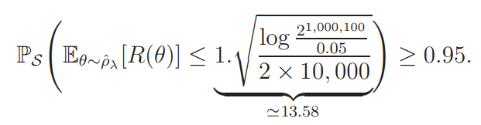
Additionally..
So the classification risk using the Gibbs posterior is smaller than 13.58 with probability at least 95%
Which is not informative at all, because we already know that the classification risk is smaller than 1
Such a bound is usually refered to as a vacuous bound, because it does not bring any information at all
You can try to improve the bound by increasing the dataset
But you can check that even n = 1, 000, 000 still leads to a vacuous bound with this network

Slide 28
Additionally..
Various opinions on these vacuous bounds are possible
“theory is useless. I don’t know why I would care about generalization guarantees, neural networks work in practice.”
This opinion is lazy: it’s just a good excuse not to have to think about generalization guarantees. I will assume that since you are reading this tutorial, this is not your opinion.
“vacuous bounds are certainly better than no bounds at all!”
This opinion is cynical, it can be rephrased as “better have a theory that doesn’t work than no theory at all: at least we can claim we have a theory, and some people might even believe us”. But the theory just says nothing.
“let’s get back to work, and improve the bounds”.
Since the publication of the first PAC-Bayes bounds already mentioned, many variants were proven. One can try to test which one is the best in a given setting, try to improve the priors, try to refine the bound in many ways... In 2017, Dziugaite and Roy obtained non-vacuous (even though not really tight yet) PAC-Bayes bounds for practical neural networks (since then, tighter bounds were obtained by these authors and by others). This is a remarkable achievement, and this also made PAC-Bayes theory immediately more popular than it was ever before.

Slide 29
References
Kearns, Michael J., and Umesh Vazirani. An introduction to computational learning theory. MIT press, 1994.
Alquier, Pierre. "User-friendly introduction to PAC-Bayes bounds." arXiv preprint arXiv:2110.11216 (2021).
Rivasplata, Omar, Vikram M. Tankasali, and Csaba Szepesvari. "PAC-Bayes with backprop." arXiv preprint arXiv:1908.07380 (2019).
Amit, Ron, et al. "Integral probability metrics pac-bayes bounds." Advances in Neural Information Processing Systems 35 (2022): 3123-3136.
Mbacke, Sokhna Diarra, Florence Clerc, and Pascal Germain. "PAC-Bayesian Generalization Bounds for Adversarial Generative Models." arXiv preprint arXiv:2302.08942 (2023).
https://www.cs.purdue.edu/homes/egrigore/590ST15/lec2DensityEstimation.pdf
https://www.cs.utexas.edu/~klivans/f06lec2.pdf
https://www.slideshare.net/ckmarkohchang/pacbayesian-bound-for-deep-learning-197083568

Slide 30
Thank You

