Slide 1

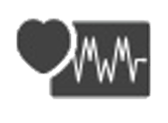



졸업작품 최종 PPT
HoM
Health on Mobile
김한솔 지정한 송치윤 2017. 05. 31

Slide 2

HOM
CONTENTS
01. Introduction
02. Outline
03. Implementation
04. Result & Marketing Plan

Slide 3

01
Introduction

Slide 4
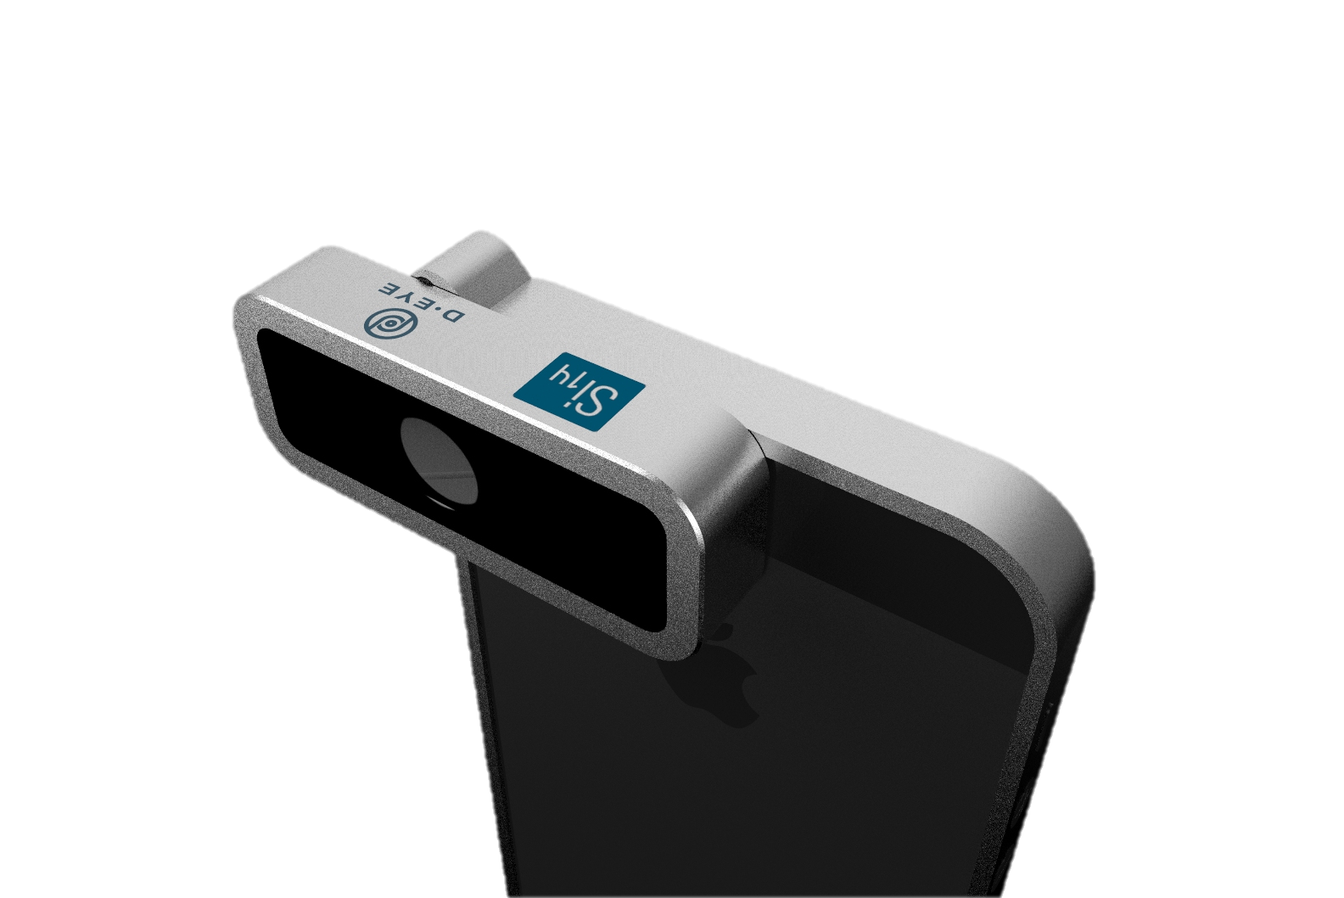
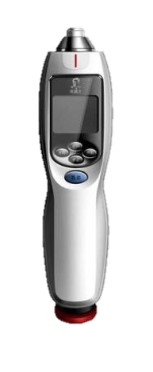
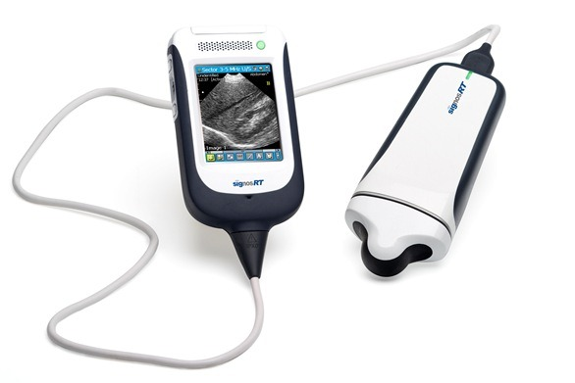
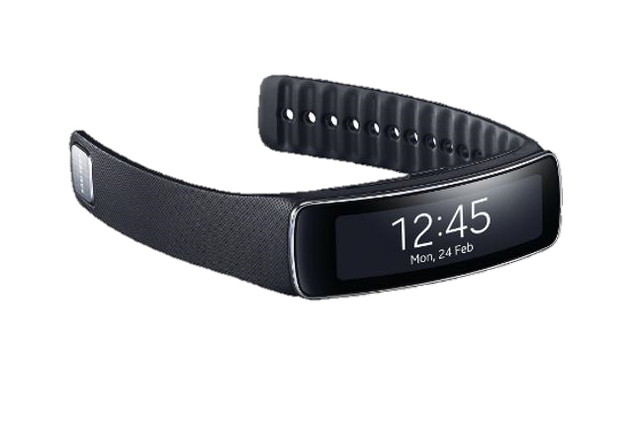
HOM
Introduction
Various kinds of Health related data is monitored

Slide 5

HOM
Introduction
Compare |  | ZephyrLIFE | Health kit
platforms | Microsoft Health App | Medtronic – Android App | IOS
Management Data | EMR, EHR, real time health record | EMR, EHR, real time health record | real time health record
Real-time health record | O | O | O
Integration of Hospital record | O | X | X
Feature | User put information by himself or bring health Info from interlocked device. | Manage EMR, EHR and real time data, but only use data of the hospital | Provide emr data to hospital, But don’t receive emr data from hospital

Slide 6
종류가 다양해서 사용하기 어렵다.
또한 센서 데이터들이 통합되지 않다.
However,
Difficult to use various health related data
Because,
It is not integrated, properly managed, and analyzed appropriately for users and medical experts.

Slide 7
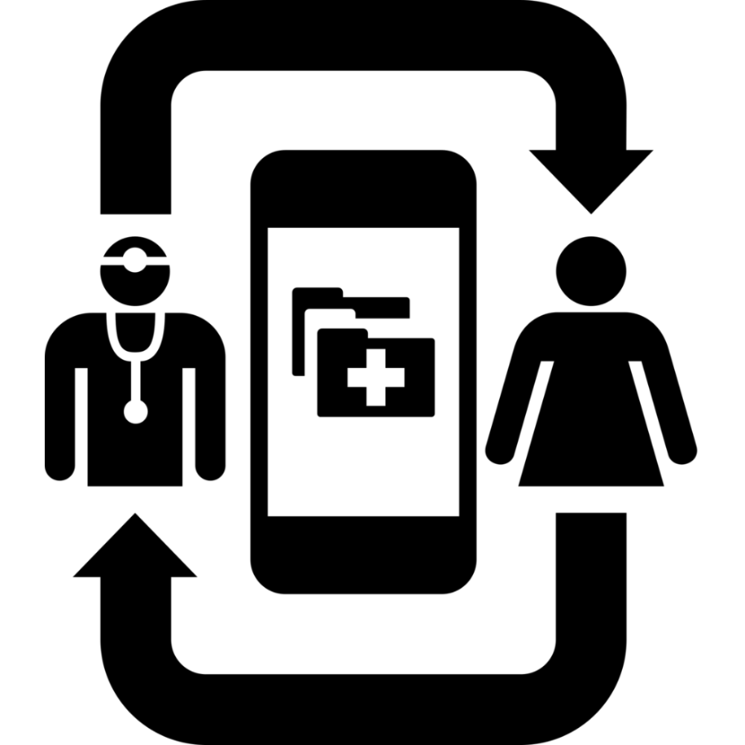
HOM
Introduction
Web-based Health related Data management Platform
Sensor manager which provides functions to manage multiple real-time health related sensory data
Risk analyzer which provides functions to integrate multiple data and analyze risks from real-time and non real-time data

Slide 8
02
Outline

Slide 9

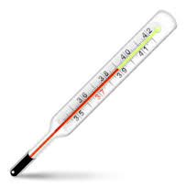
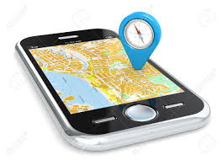
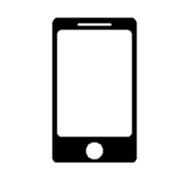


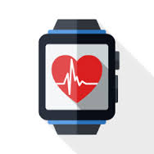





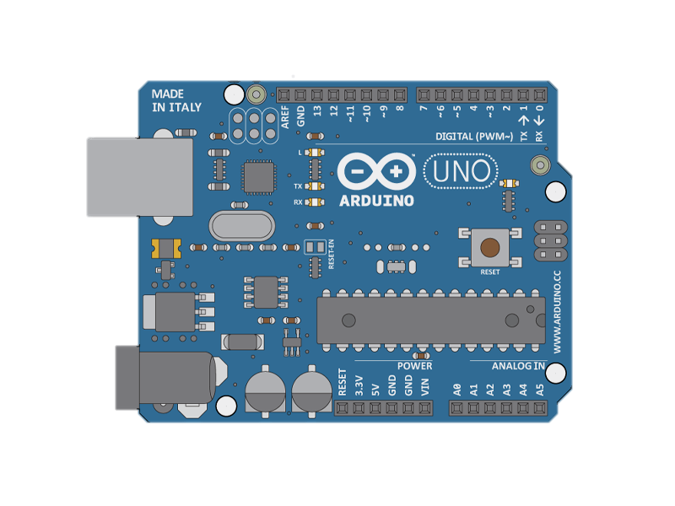
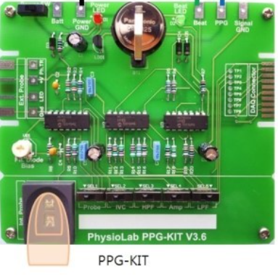
HOM
Outline
Sensors
Sensor Manager
(Mobile station)
Web Server / DB
Web browser
1
2
3
4
Temperature
GPS
Web Server
BLE 4.0
XML
PHP
Web Browser
Exercise
Heart rate
1
XML
Arduino
Uno
Medical records
(XML & Input Form)
PPG sensor

Slide 10
03
Implementation

Slide 11


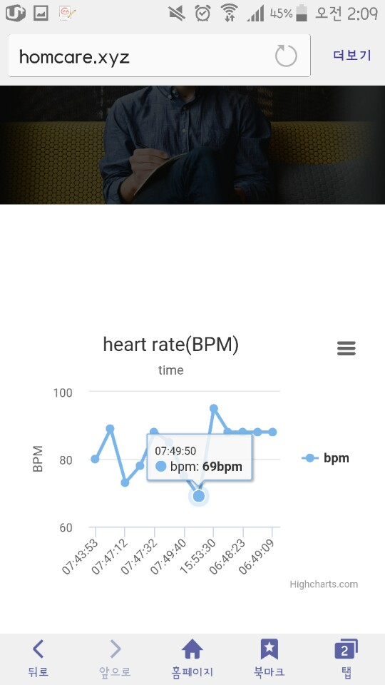
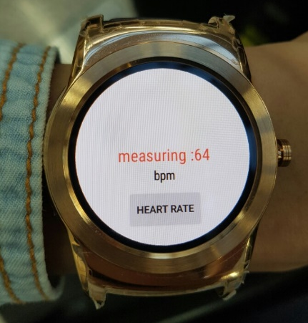
Collect Data : Sensor Data
HOM
Implementation
1
Smart watch (LG G watch)
Heart rate (Sampling 1/60Hz)
GPS (every 1 hour)
Step counter (every 30 minutes)
Bluetooth communication to mobile phone
Arduino
PPG sensor
Serial communication
BLE 4.0
Wearable

Slide 12
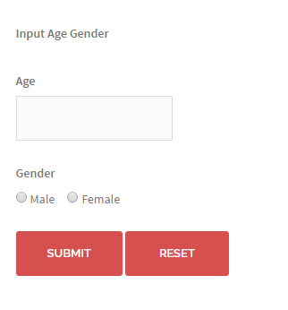
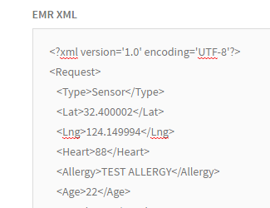
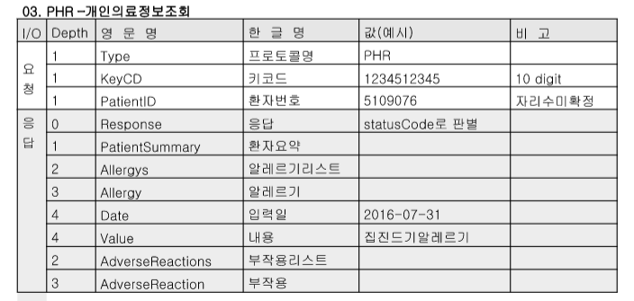
Collect Data : Medical Data
HOM
Implementation
1
Upload EMR(Electronic medical Record) data
Defined by medical standards.
e.g. Demographics, medical history, medication and allergies etc
Upload PHR(Personal Health Record) with Web Input form
Develop XML data parser to store data in DB
UploadXML
InputForm
Typical example of EMR
Our EMR+PHR data

Slide 13





HOM
Implementation
Sensor Manager
2
Main Function
Control data collection interval
Sensor data processing
Send data to server
Heart rate
Heart rate
GPS
GPS
Web Server
Temperature
Temperature
Exercise
Exercise
General Sensor Management Architecture
Our Sensor Manager Architecture

Slide 14
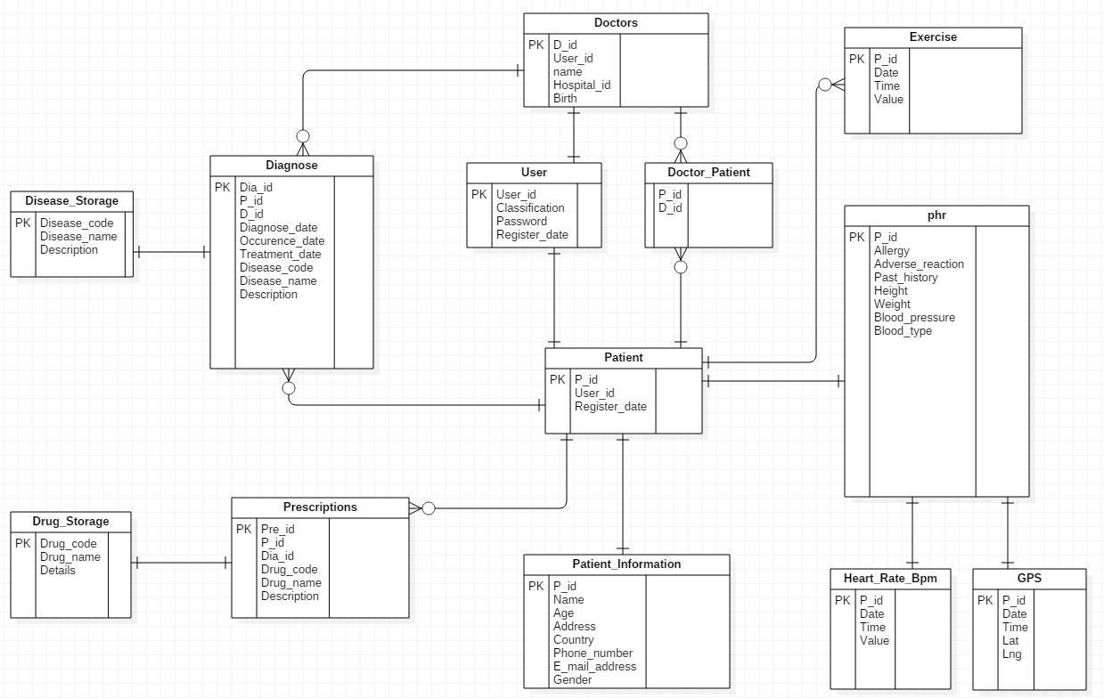
HOM
Implementation
Database Design
3
Patient – Doctor relationship
Personal Health Record(PHR)
Electronic Medical Record(EMR)
Demographics

Slide 15
HOM
Compare
Gender
Implementation
2가지
Risk Analysis
4
7가지
Compare
Age
Blood Pressure
3가지
성별 | 남자 |  | 여자
연령 | 최고 | 최저 | 최고 | 최저
15~19 | 110~134 | 59~79 | 101~123 | 57~75
20대 | 113~137 | 64~84 | 103~125 | 60~78
30대 | 114~142 | 67~89 | 106~134 | 63~83
40대 | 126~150 | 71~95 | 112~146 | 68~90
50대 | 121~159 | 73~97 | 117~159 | 70~94
60대 | 124~166 | 73~95 | 124~166 | 71~93
70대~ | 128~170 | 71~95 | 131~173 | 68~94
BPM
Blood Pressure
각 3가지
정상 (Green)
주의 (Yellow)
위험 (Red)
BPM
성별 | 남자
나이 | 15세~35세 | 36세~55세 | 56세~
정상 | 55~74 | 57~76 | 56~74
주의 | 75~81 | 77~83 | 75~80
위험 | 82+ | 84+ | 81+
여자
15세~35세 | 36세~55세 | 56세~
61~77 | 60~78 | 60~77
78~83 | 79~84 | 78~83
84+ | 85+ | 84+
 | 최고 | 최저
저혈압 | -20 | -30 | 주의
고혈압 전 단계 | +10 | +10
고혈압 1기 | +20 | +20 | 위험
고혈압 2기 | +30 | +30
[출처] Resting Heart Rate Table at "Top End Sports - The Sport Science Reports website"
[출처] 세계보건기구 WHO

Slide 16
HOM
Implementation
Input S value
Risk Analysis
S : Step value
B : Average bpm
R : Risk level (1~3)
4
Server 전송
User is exercising?
Feature Result
 | Risk Level
관심 | 1
주의 | 2
위험 | 3
If B > 100
If B < 100
Exercising
Decrease Risk level 1
Normal
Reference standard table, analysis risk level each feature
Final Result
Visualization R in DB
Visualization R in DB
 | Risk Level
관심 | 3~4
주의 | 5~6
위험 | 7~9
관심 (Green)
주의 (Yellow)
위험 (Red)

Slide 17
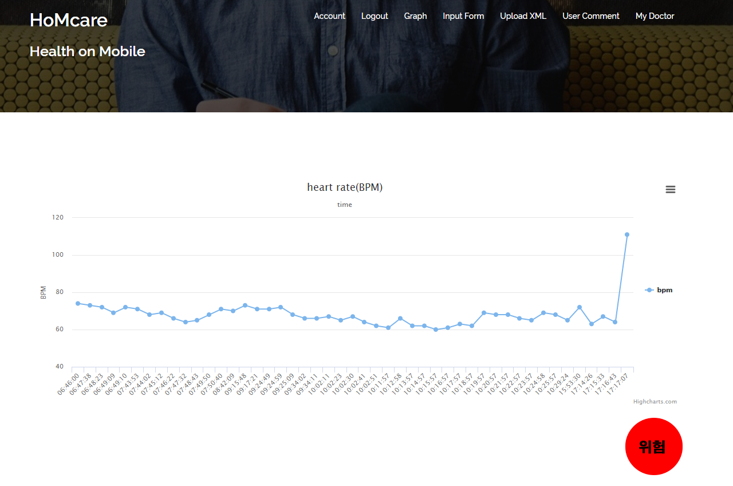
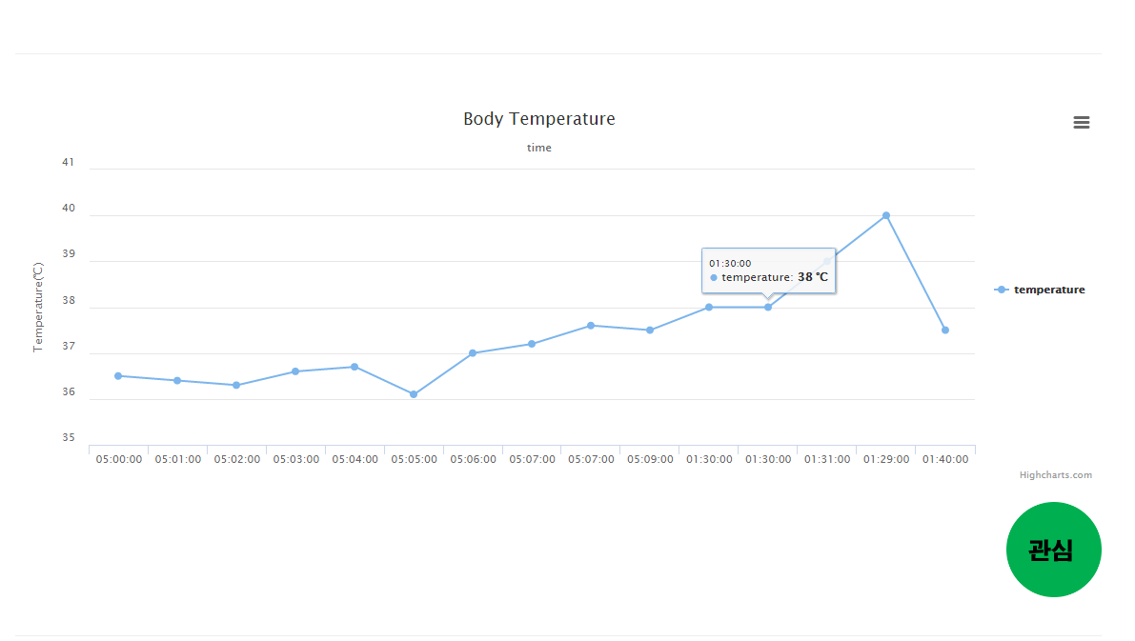
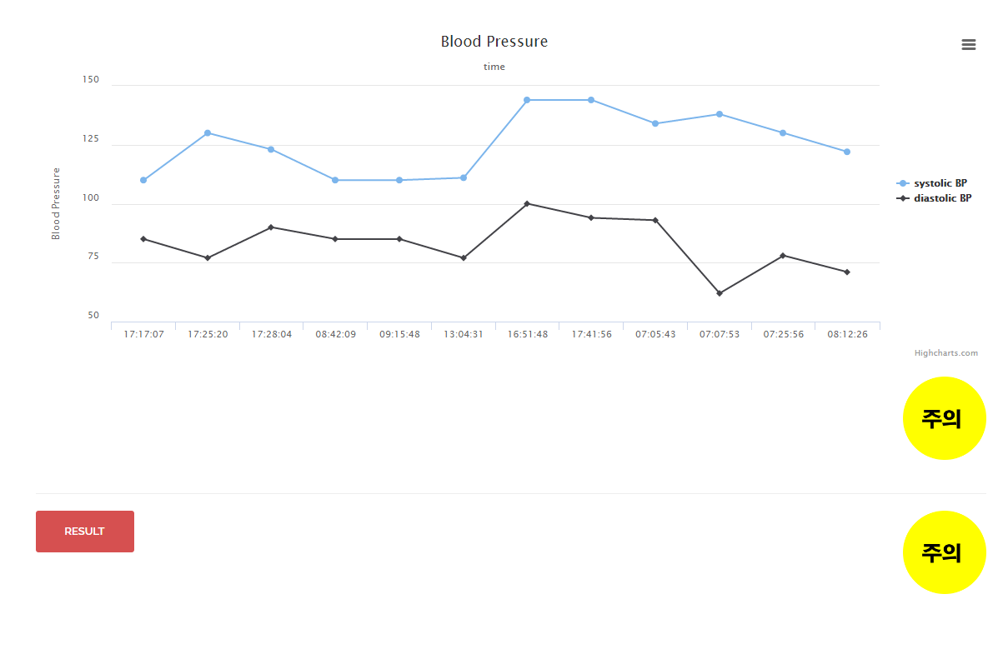
HOM
Implementation
Risk Analysis
4
Risk analysis from collected each data
Visualization of each feature
Monitoring rapid change
Reference standard table

Slide 18
03
Result & Marketing Plan

Slide 19
HOM
Result & Marketing Plan

Slide 20
HOM
Result & Marketing Plan
Business Mission
Provide service platform that integrated, properly managed, and analyzed medical data appropriately for users and medical experts.
SWOT analysis
Strength – You can manage patients who need to be monitored at all times in order to be able to grasp the status and location of illusions in real time. | Weakness – Depending on the wearable equipment used by each hospital, each service should be provided separately
Opportunity – Nowadays, as the healthcare industry develops internationally, many industries are in the spotlight for telemedicine and real-time monitoring of patients. | Threat – As the healthcare industry became active, many companies grew up together, and large corporations began to enter the research.

Slide 21
HOM
Result & Marketing Plan
Identify opportunities
- Segmentation
Hospital manager, patients who need real-time monitoring, doctors who has to control multiple patients
- Targeting
Hospitals with many patients who need real-time monitoring
- Positioning
Support as web service and hospital wearable device support
Implement marketing mix
- Product
Web-based Health Related Data Management platform
- Price
Depends on the type of device supported.
Rent server cost, wearable device, APP
- Place
Office that has central server and remote service.
- Promotion
Customize the system to suit the hospital own.

