Slide 1

COLLEGE OF ENGINEERING
CHENGANNUR
DEPARTMENT OF COMPUTER ENGINEERING

Slide 2
SEMINAR
PRESENTATION
GUIDE:
Alka Vijay
Assistant Professor
Department of Computer Science & Engineering
PRESENTED BY:
Jia Chinnu Abraham
CHN23CS101
Roll No:35
2

Slide 3
A Hybrid Deep Learning Framework for Deepfake Detection Using Temporal and Spatial Features
Fazeel Zafar, Talha Ahmed Khan, Salas Akbar, Muhammad Talha Ubaid,
Sameena Javaid, and Kushsairy Abdul Kadir, Senior Member, IEEE
IEEE Access, vol. 13, 2025 • DOI: 10.1109/ACCESS.2025.3566008
3

Slide 4
How is Deepfake Detection Done Generally ?
A video is generated or manipulated using Generative Adversarial Networks (GANs), producing hyper-realistic fake media.
Detection systems split the video into frames and analyze each one for spatial artifacts — unnatural textures, blending edges, or lighting mismatches.
Advanced detectors also study temporal inconsistencies across frames to catch motion and expression flaws that GANs struggle to keep consistent.
4

Slide 5
INTRODUCTION
Hybrid EfficientNet B0 + TempCNN Approach
1. Spatial Feature Extraction
Enhanced EfficientNet B0 extracts fine-grained facial features and landmarks from each video segment.
2. Temporal Pattern Recognition
TempCNN analyzes the sequence of extracted features to catch inconsistent motion or expressions that GANs leave behind.
3. Balanced Trade-off
The framework targets high detection accuracy without the heavy computational cost of many hybrid or attention-based models.
5

Slide 6
Related Work and Research Gap
Year | Technique | Dataset | Accuracy
2024 | Inception Net (CNN) | Kaggle (401 videos) | 92.3%
2023 | SVM + PCA (YCbCr input) | Custom dataset | 92.8% (72.2% without PCA)
2025 | Attention features + Optimized LSTM | FF++, DFDC, Celeb-DF, WildDeepfake | 94.65% (heavy model)
2024 | CNN+RNN / DAFDN / Hybrid Inception ResNet v2 | Comprehensive dataset | 94.8% / 97.8% / 98%
2022 | MesoNet (lightweight) | FF++, Celeb-DF | 88%
2022 | MTCNN + EfficientNet | FaceForensics++ | 62.5%
2021 | EfficientNet versions | DFDC | 82.9%
Research gap: accurate models (attention, OLSTM, hybrids) are computationally heavy, while light models (MesoNet, plain EfficientNet) lose accuracy or ignore temporal cues. This paper combines Enhanced EfficientNet B0 with a TCN to get both accuracy and low cost (0.45 GFLOPs).
6

Slide 7
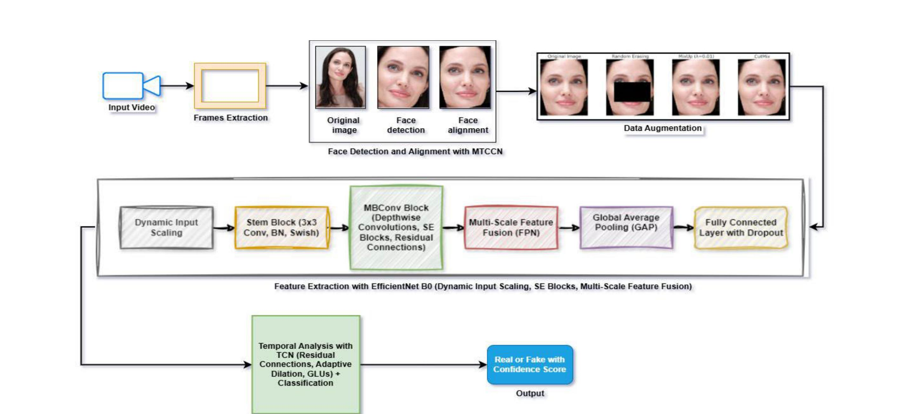
Overall Architecture
The main architecture of the proposed framework
7

Slide 8
Video Segmentation and Preprocessing
The input video is split into discrete segments, and each segment is processed independently so that more features can be examined.
Eq. (1) Video segmentation
V = {S1, S2, S3, ... , SN}
Video V is divided into N segments (frames); Si denotes the i-th segment.
Eq. (2) Preprocessing of each segment
S'i = A( R( N( Si ) ) )
N = normalization, R = resizing, A = augmentation (CutMix, MixUp, Random Erasing). Applied in this order to every segment.
8

Slide 9
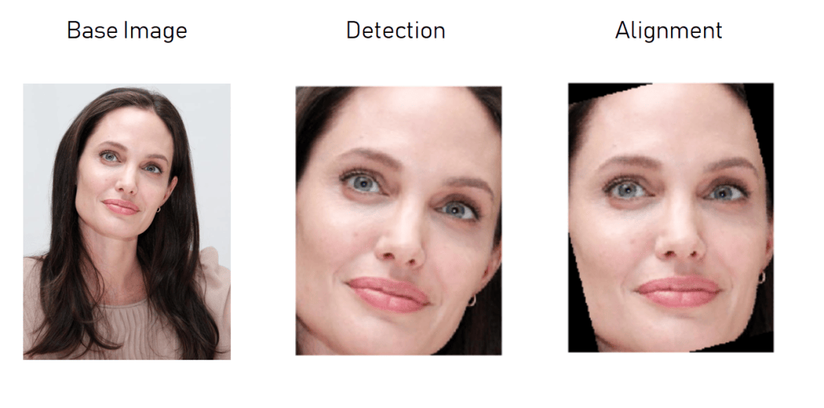
Face Detection & Alignment (MTCNN)
A Multi-Task Convolutional Neural Network (MTCNN) maps each frame to a set of facial landmarks, filtering out background noise so the model concentrates only on the pertinent facial regions.
L = F_CNN(X), L = {(x1,y1), (x2,y2), ... , (xn,yn)}
9

Slide 10
Data Augmentation
CutMix, MixUp, and Random Erasing artificially distort training segments, strengthening the model's resistance to the kinds of modifications and distortions often encountered in deepfake content.
CutMix
Combines two images by cutting and pasting regions together, exposing the model to diverse data combinations.
MixUp
Generates synthetic samples by averaging two images, smoothing decision boundaries and reducing overfitting.
Random
Erasing
Randomly erases parts of an image so the model learns to recognize features even when input is missing or altered.
10

Slide 11
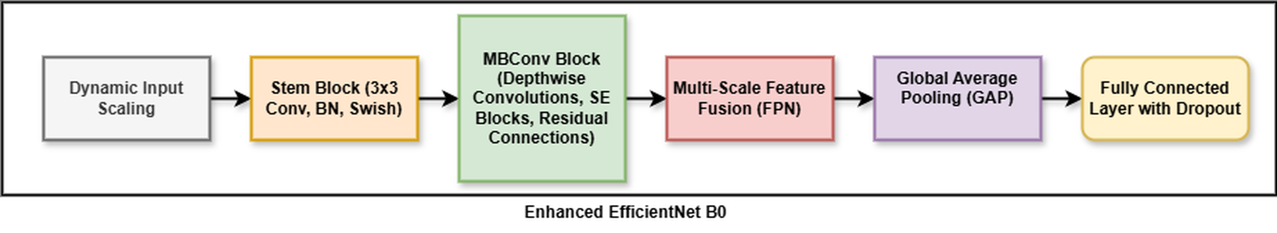
Enhanced EfficientNet B0 Backbone
Dynamic Input Scaling adapts resolution to segment complexity. The Stem Block applies a 3×3 convolution with Batch Normalization and Swish activation; MBConv blocks then use depthwise convolutions and Squeeze-and-Excitation (SE) to highlight the most informative channels.
11

Slide 12
EfficientNet B0: Key Equations
Stem block, Swish activation and the Squeeze-and-Excitation (SE) channel attention inside every MBConv block.
Eq. (4) Stem block (3x3 conv, 32 filters)
Z = Swish( BN( Conv(W, X) ) )
Convolution, then Batch Normalization, then Swish activation.
Eq. (5) Swish activation
Swish(x) = x . sigmoid(x) = x / (1 + e^-x)
Smooth, non-monotonic activation; keeps small negative values, which helps gradient flow.
Eq. (6) Squeeze-and-Excitation
X' = X . sigmoid( W2 . ReLU( W1 . GAP(X) ) )
GAP squeezes spatial size; W1, W2 are weight matrices; sigmoid gives channel weights that highlight forgery-related channels and suppress the rest.
12

Slide 13
Feature Pyramid Network (FPN)
The FPN fuses features from the initial, middle, and deeper layers of the EfficientNet B0 backbone. This multi-scale combination captures broad contextual cues — such as irregularities in facial shape — alongside minute details like subtle facial motion, sharpening the model's sensitivity to deepfake artifacts.
Shallow Layer
(fine detail)
Middle Layer
(local structure)
Deep Layer
(broad context)
↓ ↓ ↓
Fused Multi-Scale Feature Map
13

Slide 14
Temporal Convolutional Network (TCN)
Because deepfake edits often cause inconsistent motion and expressions over time, the TCN models temporal relationships between segments. Residual TCN layers preserve gradient flow, Adaptive Dilation adjusts the receptive field, and Gated Linear Units (GLUs) regulate which temporal deviations matter most.
Feature
Sequence
→
Residual TCN
Layers
→
Adaptive
Dilation
→
Gated Linear
Units (GLU)
→
Temporal
Logit
14

Slide 15
TCN: Dilated Convolution and Gating
Temporal inconsistencies of a fake video are captured by dilated causal convolutions over the sequence of segment features, controlled by gates.
Eq. (7) Dilated temporal convolution
Ht = SUM (i = 0 to k-1) Wi . F(t - i*d)
Wi = learnable weights, k = filter size, F = feature vector, d = dilation rate. Larger d covers longer time spans (adaptive dilation).
Eq. (8) Gated Linear Unit (GLU)
O = X . sigmoid(G)
G is the gate signal; sigmoid(G) decides how much of X passes, so the network focuses on subtle temporal deviations such as erratic face movement.
15

Slide 16
Classification & Majority Voting
Each segment's TCN output passes through a linear classification layer to produce a single logit. Binary Cross-Entropy loss keeps training focused on the hardest, most subtle cases. Predictions from every segment are then combined by majority vote, together with a confidence score, to reach the final Real / Fake decision for the whole video.
Per-Segment
Logit
→
Sigmoid
Probability
→
Threshold
@ 0.5
→
Majority Vote
Across Segments
→
Final Label +
Confidence Score
16

Slide 17
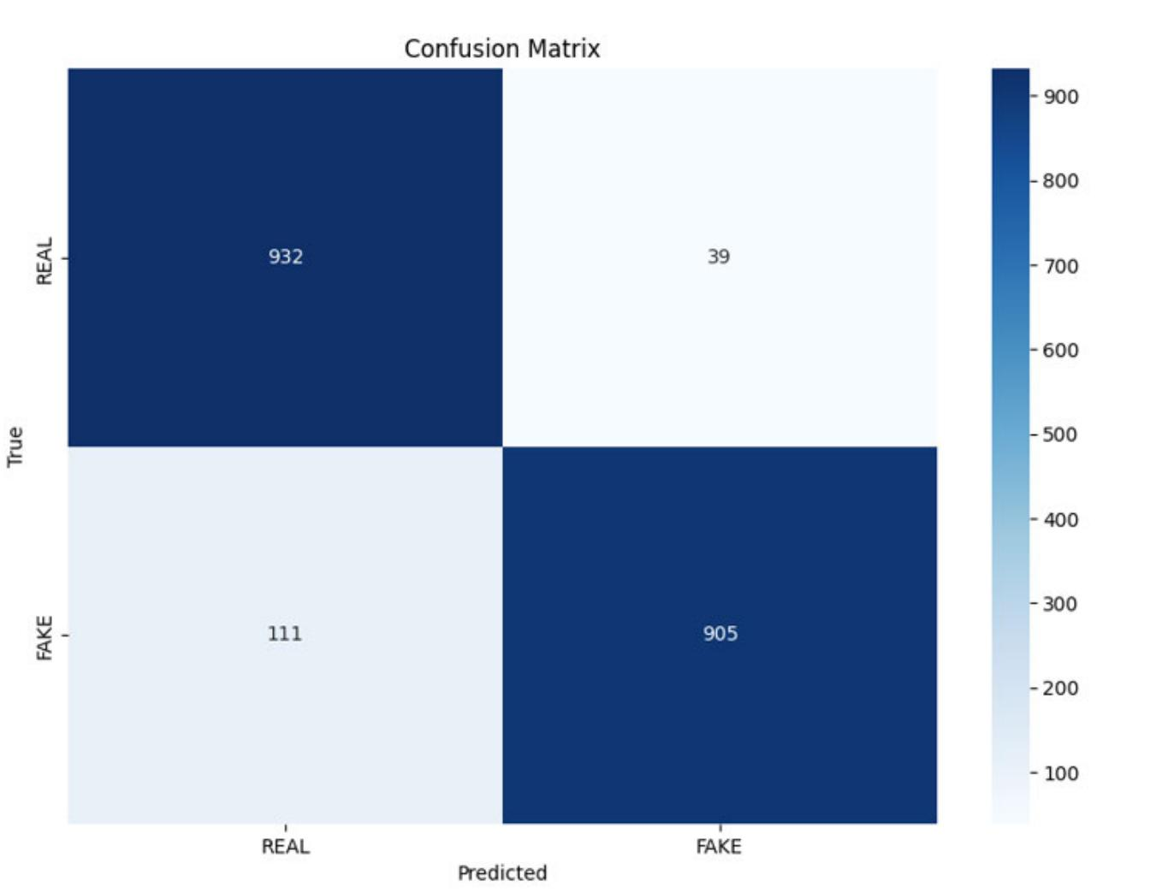
Confusion Matrix & Computational Efficiency
0.45 GFLOPs → very low computational cost
MBConv + depthwise separable convolutions → fewer operations
FPN feature reuse → reduces redundant computation
Dynamic input scaling → higher resolution only when needed
Adaptive TCN dilation → captures temporal information efficiently
Confusion matrix (test set)
TP 932 | TN 905 | FP 39 | FN 111
Accuracy = (932 + 905) / 1987 = 92.45%
17

Slide 18
Conclusion
This work presents a hybrid deepfake detection framework combining:
Enhanced EfficientNet B0 with MBConv, SE blocks and FPN for extracting spatial artifacts
Temporal Convolutional Network (TCN) for detecting cross-frame inconsistencies
MTCNN for accurate face detection and alignment
CutMix, MixUp and Random Erasing to improve model robustness
Key Result
92.45% Test Accuracy | 0.45 GFLOPs
The model achieves a strong balance between detection accuracy and computational efficiency on the balanced FFIW-10K dataset.
18

Slide 19
Future Scope
Directions for Further Work
• Use larger, more diverse datasets with different deepfake methods and real-world scenarios
• Add audio and text to build a full multimodal detection system
• Apply adversarial training to resist emerging generation techniques
• Improve efficiency and precision further for real-time use
• Researchers and policymakers work together on ethics and best practices
19

Slide 20
References
[1] A. Rössler, D. Cozzolino, L. Verdoliva, C. Riess, J. Thies, and M. Nießner, "FaceForensics++: Learning to detect manipulated facial images," 2019, arXiv:1901.08971.
[2] O. de Lima, S. Franklin, S. Basu, B. Karwoski, and A. George, "Deepfake detection using spatiotemporal convolutional networks," 2020, arXiv:2006.14749.
[3] V.-T. Hoang and K.-H. Jo, "Practical analysis on architecture of EfficientNet," in Proc. 14th Int. Conf. Hum. Syst. Interact. (HSI), Jul. 2021, pp. 1–4.
[4] C. Lea, R. Vidal, A. Reiter, and G. D. Hager, "Temporal convolutional networks: A unified approach to action segmentation," in Proc. Comput. Vis.-ECCV Workshops, Cham, Switzerland: Springer, Jan. 2016, pp. 47–54.
[5] F. B. Aissa, M. Hamdi, M. Zaied, and M. Mejdoub, "An overview of GAN-DeepFakes detection: Proposal, improvement, and evaluation," Multimedia Tools Appl., vol. 83, no. 11, pp. 32343–32365, Sep. 2023.
[6] D. V. Nagagopiraju, K. Ayyappa, P. Anshulalitha, J. Srikanth, and K. T. Teja, "A efficient deep fake face detection using deep inception net learning algorithm," Turkish J. Comput. Math. Educ., vol. 15, no. 1, pp. 138–141, Mar. 2024.
[7] Z. Wang, Q. She, and T. E. Ward, "Generative adversarial networks in computer vision: A survey and taxonomy," 2019, arXiv:1906.01529.
[8] H. Sabah Abdul kareem and M. S. Mahdi Altaei, "Detection of deep fake in face images based machine learning," Al-Salam J. Eng. Technol., vol. 2, no. 2, pp. 1–12, Feb. 2023.
[9] R. R. Sekar, T. D. Rajkumar, and K. R. Anne, "Deep fake detection using an optimal deep learning model with multi head attention-based feature extraction scheme," Vis. Comput., vol. 41, no. 4, pp. 2783–2800, Mar. 2025.
[10] X. Wang et al., "ESRGAN: Enhanced super-resolution generative adversarial networks," 2018, arXiv:1809.00219.
[11] A. Rajeev and P. Raviraj, "Performance evaluation of deep learning models for detecting deep fakes," Int. J. Systematic Innov., vol. 8, no. 1, pp. 49–62, 2024.
20

