Slide 1
Sentiment Analysis of Product Reviews
Presented By:
Jia Menahil Rasheed
June/06/2025

Slide 2
Executive Summary
1,000 reviews analyzed with 97.3% model accuracy
39.8% negative sentiment - Crisis requiring immediate action
Clear path forward: Strong positive indicators guide improvement strategy

Slide 3
Methodology & Model Performance
Technical Approach
Machine Learning Models:
Logistic Regression (Primary) + Naive Bayes
Validation:
VADER sentiment analysis (0.829 correlation)
Feature Engineering:
TF-IDF with n-grams (1-3)
Performance:
97.3% accuracy enables reliable business decisions

Slide 4
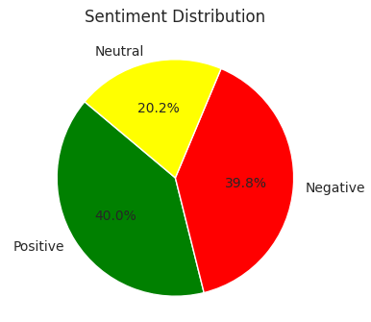
Sentiment Distribution
Polarized Customer Base: Near 50/50 split positive/negative

Slide 5
Product Performance Scorecard
36-point performance gap represents significant revenue opportunity
Rank | Product | Rating | Sentiment Score | Status | Action Required
1 | Product A | 3.13 | 0.144 | Champion | Scale & Promote
2 | Product C | 3.09 | 0.118 | Stable | Monitor
3 | Product E | 3.02 | 0.108 | Stable | Monitor
4 | Product B | 3.01 | 0.012 | At Risk | Investigate
5 | Product D | 2.77 | 0.006 | Critical | Urgent Fix

Slide 6
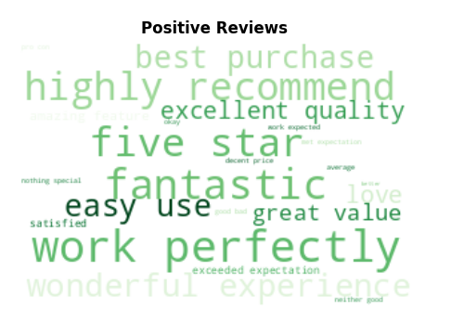
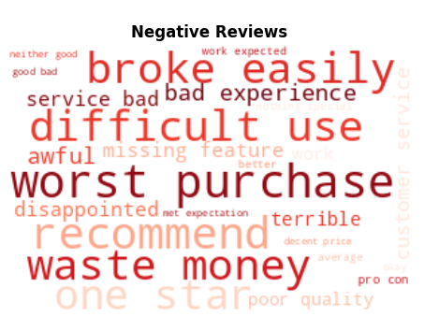
Customer Voice Analysis

Slide 7
Action Plan
Customer Experience Focus
Address Core Pain Points
Durability improvements
Enhanced customer service
Better product documentation
Marketing Optimization
Message Refinement
Use positive sentiment language
Proactively address concerns
Strategic testimonial deployment

