Slide 1
CS5432 Advanced UNIX Programming Exercises Process
Cheng-Hsin Hsu (chsu@cs.nthu.edu.tw)
National Tsing Hua University
Department of Computer Science

Slide 2
Chapter 7. Process Environment

Slide 3
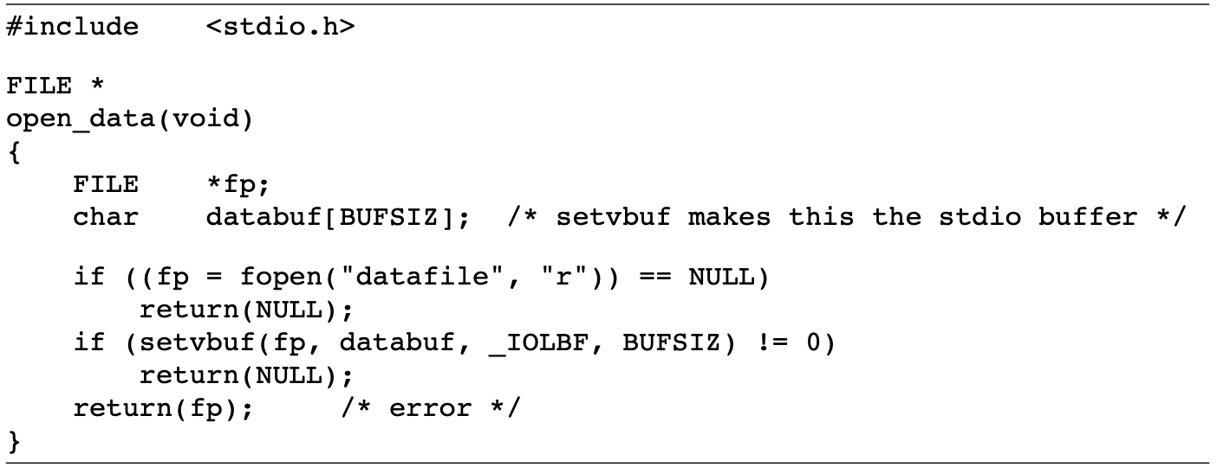
Q: Stack Frame
At the end of Section 7.10, we showed how a function can’t return a pointer to an automatic variable.
The problem is that when open_data returns, the space it used on the stack will be used by the stack frame for the next function that is called. However, the standard I/O library will still use that memory portion for its stream buffer.

Slide 4
Q: Stack Frame
Then, is the following code correct?
int f1(int val)
{
int num = 0;
int *ptr = &num;
if (num == 0)
{ /* text had val == 0, but val is not in scope */
int val;
val = 5;
ptr = &val;
}
return(*ptr + 1);
}

Slide 5
Q: Stack Frame
In your implementation, you should:
(1) Answer the question. You need to explain why it is correct/incorrect in your report.
(2) Implement a C program to verify your answer.
a. Create a variable called val and set its value to “5” in the main function.
b. Get the address of val in the f1 function. (Getting the address in the main
function directly is forbidden!)
c. Print the value and the address of val as the sample output shows.

Slide 6
A: Stack Frame
(1)
The code is incorrect, since it references the automatic integer val through a pointer after the automatic variable is no longer in existence. Automatic variables declared after the left brace that starts a compound statement disappear after the matching right brace.

Slide 7
A: Stack Frame
(2)
int* f1(int val){
int num = 0;
int*ptr = &num;
if(num == 0){
int val;
val = 5;
ptr = &val;
}
return ptr;
}
int main(void){
int val = 5;
int *ptr = f1(val);
printf("Value %d is at %p\n", *ptr, ptr);
return 0;
}

Slide 8
Chapter 8. Process Control

Slide 9
Q: Zombie Process
This question will help you get familiar with the zombie process.
Write a program that creates a zombie process, and justify that the process is a zombie using ps(1)command. In your implementation, the ps(1) command should be implemented in your .c file. Please do not use it outside of your file.

Slide 10
Q: Zombie Process
In your implementation, you should:
(1) Write a program that creates a zombie process.
(2) Verifies that the process is a zombie in your code using ps(1) command.
(3) Describe your implementation in your report.

Slide 11
A: Zombie Process
(1)
int main(void){
pid_t p = fork();
int link[2];
if(pipe(link) == -1){
printf("Create Pipe fail\n");
exit(-1);
}
if(p<0){
printf("Fork fail\n");
} else if(p == 0){
exit(0);
} else if(p != 0){
char *arg[2] = {"ps",NULL};
pid_t ps_p = fork();
if(ps_p == 0){
close(link[0]);
dup2(link[1], STDOUT_FILENO);
execvp("ps", arg);
}else{
close(link[1]);
sleep(1);
char buf[200];
FILE * pipe_out;
int nbytes = read(link[0], buf, 200);
printf("%s\n", buf);
int status;
}
}
return 0;
}

Slide 12
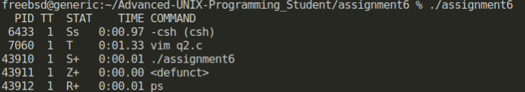
A: Zombie Process
(2)
Z+: Zombie process

Slide 13
A: Zombie Process
(3)
1. Use pipe to communicate between processes. Create a child process using fork, and exit(0) to immediately turn it into a zombie process.
2. Use execvp to invoke the UNIX ps(1) command. Introduce sleep(1) in the child process to ensure sufficient time for termination.
3. In the result, STAT Z+ and <defunct> show that the process is a zombie process.

Slide 14
Chapter 9. Process Relationships

Slide 15
Q: PID, PGRP, and TPGID
This question will help you get familiar with the child process, PID, PGRP, and TPGID.
Write a small program that calls fork and has the child create a new session. Verify that the child becomes a process group leader and that the child no longer has a controlling terminal.

Slide 16
Q: PID, PGRP, and TPGID
In your implementation, you should:
(1) Fork a new child.
(2) Create a new session in the child process.
(3) Verify that the child is a process group leader and no longer has a controlling
terminal by using ps command to print PID, PGRP, and TPGID.
(4) Explain why the child process has no controlling terminal. What are PID, PGRP, and
TPGID values in this case? What are their meanings? Please answer these
questions in your report.

Slide 17
A: PID, PGRP, and TPGID
(1)
pid = fork()
(2)
if( pid == 0 )
{
if( setsid() < 0 )
{
fprintf( stderr, "Setsid error errno %d: %s\n", errno, strerror(errno) );
exit(-1);
}
fprintf( stdout, "Child: PID=%d, PGRP=%d, TPGID=%d\n", getpid(), getpgrp(), tcgetpgrp(STDIN_FILENO) );
}

Slide 18
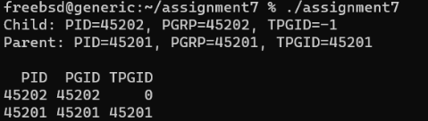
A: PID, PGRP, and TPGID
(3)
char command[50];
snprintf(command, sizeof(command), "ps -o pid,pgrp,tpgid --pid=%d,%d", getpid(), pid);
system(command);

Slide 19
A: PID, PGRP, and TPGID
(4)
PID: a unique numeric identifier assigned to each process in the system
PPID: the PID of the parent process that spawned or created the current process
PGID: a unique identifier assigned to a collection of processes that form a process group. All processes in the same process group have the same PGID.

Slide 20
Chapter 13. Daemon Process

Slide 21
Q: Daemon Process
This question will help you get familiar with the daemon process.
Write a program that calls the daemonize function given in daemonize.c. After calling this function, call getlogin to see whether the process has a login name now that it has become a daemon. Print the results to a file.

Slide 22
Q: Daemon Process
In your implementation, you should:
(1) Call the daemonize function correctly.
(2) Create a text file called “assignment11.txt”, use getlogin to get the login
name, and write “login name: [login name]” in assignment11.txt.
(3) Explain the purpose of every step executed in the daemonize function.
(4) Discuss what would happen to the process after becoming a daemon process.

Slide 23
A: Daemon Process
if (sigaction(SIGHUP, &sa, NULL) < 0)
err_quit("%s: can’t ignore SIGHUP", cmd);
if ((pid = fork()) < 0)
err_quit("%s: can’t fork", cmd);
else if (pid != 0)
exit(0);
if (chdir("/") < 0)
err_quit("%s: can’t change directory to /", cmd);
if (rl.rlim_max == RLIM_INFINITY)
rl.rlim_max = 1024;
for (i = 0; i < rl.rlim_max; i++)
close(i);
fd0 = open("/dev/null", O_RDWR); fd1 = dup(0); fd2 = dup(0);
openlog(cmd, LOG_CONS, LOG_DAEMON);
if (fd0 != 0 || fd1 != 1 || fd2 != 2)
{
syslog(LOG_ERR, "unexpected file descriptors %d %d %d", fd0, fd1, fd2);
exit(1);
}
}
(1)
void daemonize(const char *cmd)
{
int i, fd0, fd1, fd2;
pid_t pid;
struct rlimit rl = {};
struct sigaction sa = {};
umask(0);
if (getrlimit(RLIMIT_NOFILE, &rl) < 0)
err_quit("%s: can’t get file limit", cmd);
if ((pid = fork()) < 0)
err_quit("%s: can’t fork", cmd);
else if (pid != 0)
exit(0);
setsid();
sa.sa_handler = SIG_IGN;
sigemptyset(&sa.sa_mask);
sa.sa_flags = 0;

Slide 24
A: Daemon Process
(2)
FILE *fp;
char *login_name = getlogin();
fp = fopen( "assignment11.txt", "w" );
if( fp == NULL )
{
fprintf( stderr, "Open file assignment11.txt error: %s\n", strerror(errno) );
return -1;
}
fprintf( fp, "Login name: %s\n", login_name );
fclose( fp );

Slide 25
A: Daemon Process
(3)
Clear File Creation Mask (umask(0)):
Sets the file mode creation mask to `0` to ensure that any files or directories created by the daemon have the permissions that the daemon explicitly sets. This avoids inheriting default permission masks which might restrict access to these files by other processes.
Get Maximum Number of File Descriptors:
The call to getrlimit(RLIMIT_NOFILE, &rl) retrieves the maximum number of file descriptors that a process can open. This is used later to close all possible open file descriptors. This step ensures that the daemon does not unintentionally keep open file descriptors from the parent process, which can lead to resource leaks and security issues.
Become a Session Leader (fork() and setsid()):
The process forks and the parent exits. This is done to ensure that the process is not a process group leader. Then, setsid() is called to start a new session, making the process the session leader and detaching it from the terminal (TTY). This step is crucial for a daemon as it ensures independence from the control terminal and prevents the daemon from being accidentally terminated.

Slide 26
A: Daemon Process
Ignore SIGHUP Signal:
The SIGHUP signal is sent to a process when its controlling terminal is closed. In this context, ignoring SIGHUP ensures that the daemon keeps running even if the user who started it logs out.
Second fork() to Ensure No Controlling TTY:
The process forks a second time, and again the parent exits. This pattern (double-forking) is a traditional way to ensure that the daemon cannot acquire a controlling terminal, as it's no longer a session leader.
Change Working Directory to Root (chdir("/")):
Changing the working directory to the root directory (“/”) ensures that the daemon does not keep any directory in use, which might prevent a file system from being unmounted.

Slide 27
A: Daemon Process
Close All Open File Descriptors:
This step iterates through all possible file descriptors and closes them. It's a cleanup action to make sure the daemon does not inherit any open file descriptors from the parent, which could lead to resource leaks or security issues.
Redirect Standard File Descriptors to /dev/null:
Opens /dev/null and duplicates it to file descriptors “0” (standard input), “1” (standard output), and “2” (standard error). This is a common practice in daemons to prevent them from reading input or writing output to any terminal or file that might be associated with the process. It effectively silences the daemon.
Initialize the Log File:
Calls openlog to start logging for the daemon. This is part of proper daemon etiquette, ensuring that any messages or errors are logged using the system's logging mechanism instead of being printed to a terminal or standard output/error.

Slide 28
A: Daemon Process
(4)
After becoming a daemon, the process detaches from its controlling terminal and runs independently in the background. It avoids disruption from user logouts by handling signals like SIGHUP and prevents interference with the system by closing inherited file descriptors and redirecting standard inputs and outputs to /dev/null. The daemon changes its working directory to the root to avoid hindering filesystem operations and sets a clear file creation mask for unrestricted file operations. Finally, it initializes system logging for efficient monitoring and reporting, ensuring it operates reliably and unobtrusively as a background service.

