Slide 1
CS5432 Advanced UNIX Programming Exercises Threads
Cheng-Hsin Hsu (chsu@cs.nthu.edu.tw)
National Tsing Hua University
Department of Computer Science

Slide 2
Chapter 11. Threads

Slide 3
Q: pthread_barrier_wait
This question will help you get familiar with the functionality of pthread_barrier_wait.
What synchronization primitives would you need to implement a barrier? Provide an implementation of the pthread_barrier_wait function.

Slide 4
Q: pthread_barrier_wait
In your implementation, you should:
(1) Use pthread to create 5 threads and print “Starting thread i” for each thread
before calling the thread-create function.
(2) Implement your barrier by using synchronization primitives to block the threads and
await the completion of the creation process for all threads.
(3) Print “Thread # running” after calling the barrier.
(4) Make sure that your program functions correctly. All threads can only run after the
other threads finish starting.

Slide 5
A: pthread_barrier_wait
(1)
int num_threads = 5;
pthread_t threads[num_threads];
pthread_mutex_init(&mutex, NULL);
pthread_cond_init(&cond, NULL);
for( long i = 0; i < num_threads; ++i )
{
printf(stdout, "Starting thread %ld\n", i);
pthread_create( &threads[i], NULL, thread_function, (void*)i);
}

Slide 6
A: pthread_barrier_wait
(2) (3)
pthread_t tid = thread_id;
pthread_mutex_lock(&mutex);
count++;
if( count == 5 )
pthread_cond_broadcast( &cond );
else
{
while( count < 5 )
pthread_cond_wait( &cond, &mutex );
}
pthread_mutex_unlock( &mutex );
tid = pthread_self();
fprintf( stdout, "Thread %ld running\n", tid );
pthread_exit( NULL );

Slide 7
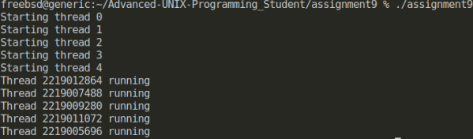
A: pthread_barrier_wait
(4)

Slide 8
Chapter 12. Thread Control

Slide 9
Q: getenv
This question will help you get familiar with getenv.
getenv is a standard C library function that can retrieve the value of an environment variable.

Slide 10
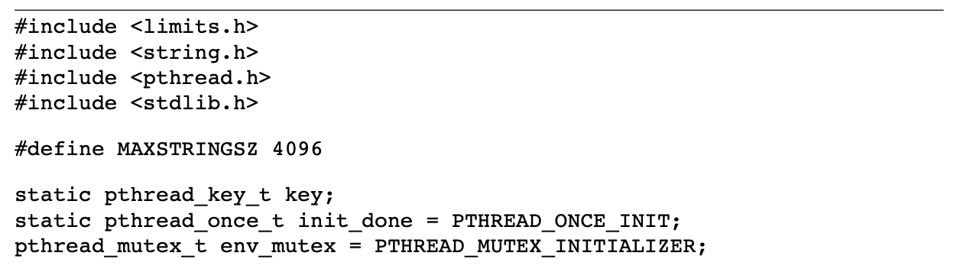
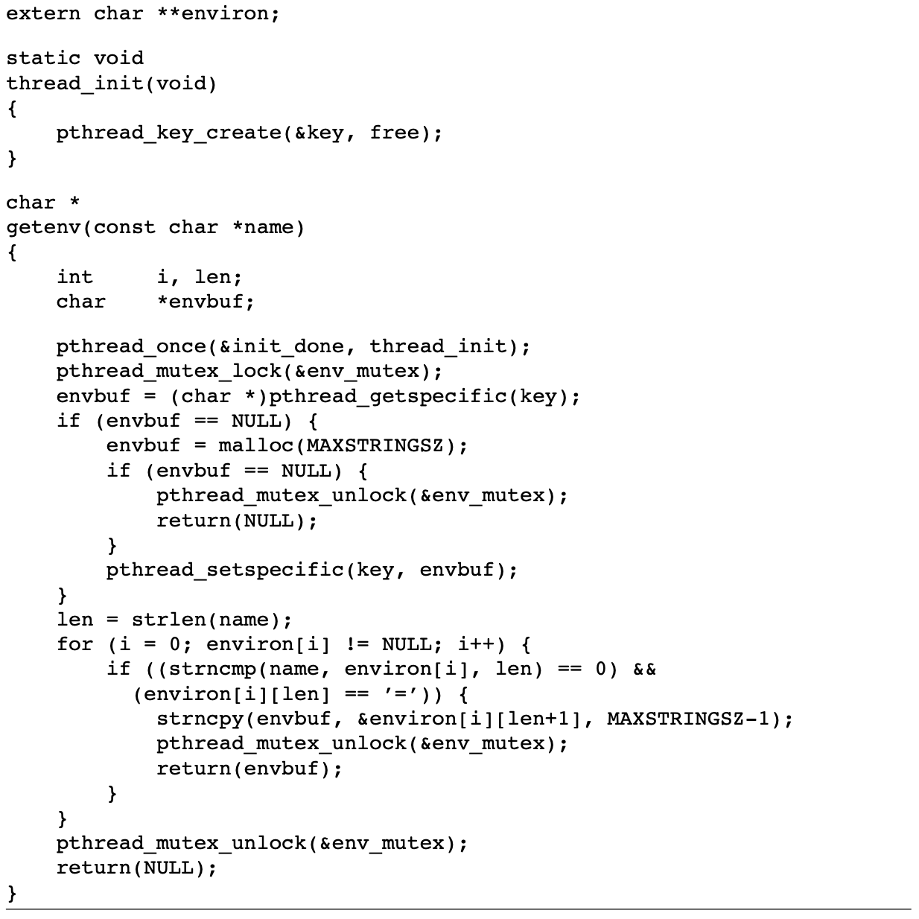
Q: getenv
In figure 12.13 in the textbook, there is a thread-safe version of getenv

Slide 11
Q: getenv
According to the version of getenv above, please answer the following questions in your report:
(1) Explain how this version of getenv achieve thread-safe according to code above?
(2) Is it possible to make this getenv function async-signal safety by temporarily
blocking signals at the beginning of the function and then restoring the previous
signal mask before the function returns? Explain.
(3) Please run assignment10.c on FreeBSD and see if it can run successfully. If not,
try to explain what happened. You can use gdb to help you find out why it crashes.

Slide 12
A: getenv
(1)
If a function can be safely called by multiple threads at the same time, we say that the function is thread-safe. This version of getenv is thread-safe because of the following mechanisms:
pthread_mutex_t: use a mutex to prevent the change of environment while getenv is called. A recursive mutex is used to prevent deadlock when getenv is called by the signal handler.
pthread_key_t: to maintain thread-private data. A thread’s private data is associated with a key.
pthread_once_t: make sure that only one key is created for each thread, preventing re-creation.

Slide 13
A: getenv
(2)
A function is async-signal safe if it can be safely called by a signal handler. malloc is the reason why this version of getenv is not async-signal safe. So if temporarily block signals at the beginning of the function and then restore the previous signal mask before the function returns, while the call of malloc remains, this version of getenv will still not be async-signal safe.

Slide 14
A: getenv
(3)
The stack calls indicate that the getenv function is being called recursively inside malloc before pthread_once is called, creating an infinite loop. Changing the name of getenv to getenv_m lets us run the program with correct results. A potential way to fix this without renaming the function is to allow initialization of thread safe data elsewhere, shifting the code for malloc outside the getenv function.

