Slide 1

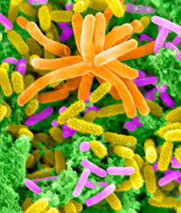
Soil microbial community analysis
Edisa Garcia & Xiu Jia 27 Jan. 2017

Slide 2
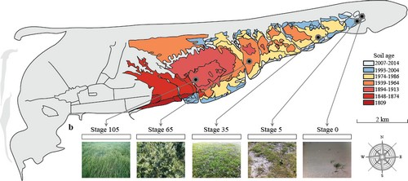
Description of the samples
454 pyrosequencing
May & July 2012
30 samples:
2 months X 5 succession stages Х triplicate
Illustration Dini-Andreote
Notes:
454Life Sciences commercially developed a 454 pyrosequencing technique, which allows massive parallel high-throughput
sequencing of hypervariable regions of 16S rRNA genes
Multiple environmental samples can be combined in a single run, and after sequencing, the reads
can be parsed through their assigned nucleotide barcode, which is added in templates
during PCR

Slide 3


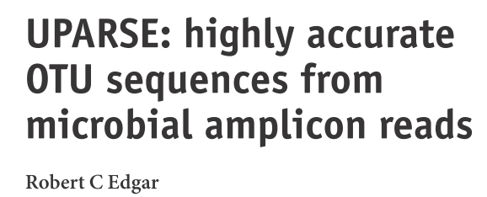

Robust plataform based on PyCogent toolkit that allows rapidly insights about microbial communities
Highly modular → Multiple options in quality filtering
Accurate in chimera detection and OTU generation
Most comprehensive statistical analysis package available

Slide 4
Aim
Integrate different softwares to optimize the pipeline analyzing microbial communities.

Slide 5
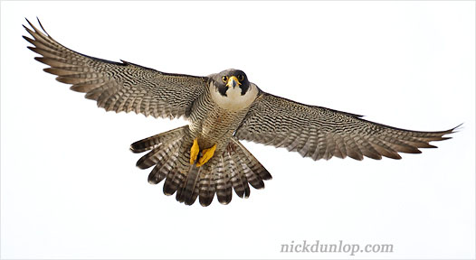
Workflow
Obtain 16S rRNA sequencing data
Merge paired-end reads*
Quality filtering of fastq reads*
Change the data format
Size annotation and remove singletons
Pick OTU
Make OTU table
Change the data format
Taxonomy annotation
Generate OTU table with taxonomy
Change the data format
alpha diversity (Richness, Shannon and Simpson analysis)
beta diversity analysis

Slide 6
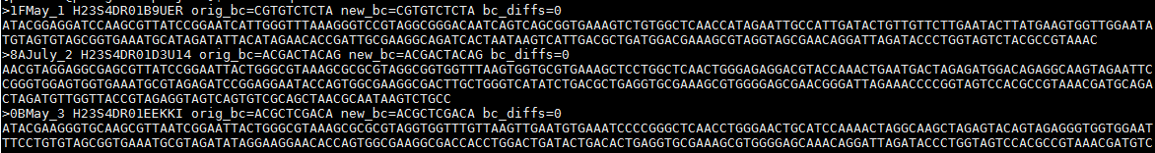
Pipeline
Obtain sequences
The sequences are already merged and quality filtered in QIIME.
2 . Format change
sed 's/\s.*$//' seqs.fna > seqs.fa
Notes:
Importance of.microorganisms are essential components of the Earth’s biota and represent a large unexplored reservoir of genetic diversity

Slide 7
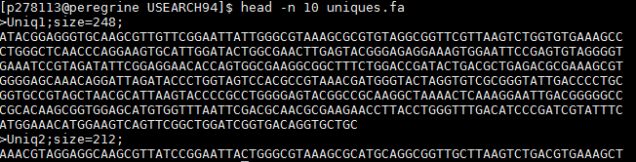
3. Use USEARCH to remove singletons, pick OTU and make OTU table
### Create the script1.sh
#!/bin/bash
#SBATCH --job-name=project_EX
#SBATCH --time=00:10:00
#SBATCH --nodes=1
#SBATCH --ntasks=4
#SBATCH --cpus-per-task=1
#SBATCH --mem=2G
#SBATCH --partition=short
pwd
## Size annotation and remove singletons
/data/miceco/software/usearch9.2.64_i86linux32 -fastx_uniques seqs.fa -fastaout uniques.fa -sizeout -relabel Uniq
head uniques.fasta

Slide 8
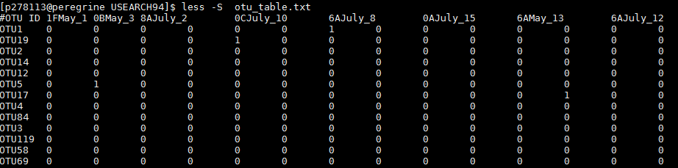
##pick OTUs
/data/miceco/software/usearch9.2.64_i86linux32 -cluster_otus uniques.fa -otus otus.fa -relabel OTU -minsize 2
head otus.fa
grep -c "^>" otus.fa
## make otu table
/data/miceco/software/usearch9.2.64_i86linux32 -usearch_global seqs.fna -db otus.fa -strand plus -id 0.97 -otutabout otu_table.txt
less –S otu_table.txt

Slide 9
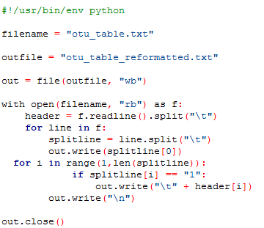
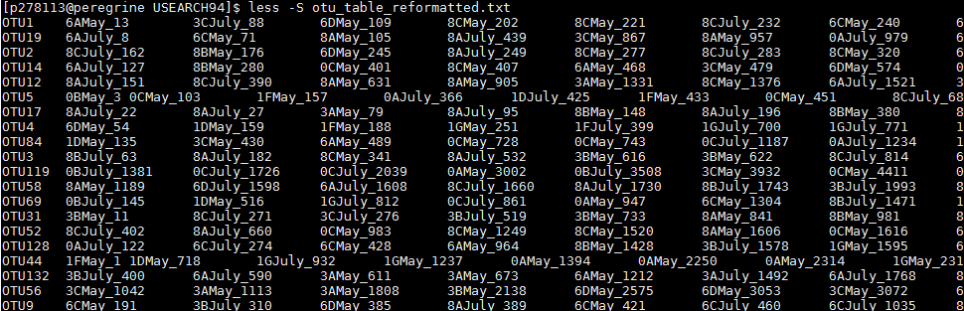
4. Change the OTU table format Using reorder_file.py to change the usearch format in "otu_table.txt" to QIIME format in order to use it in the pick representative OTU sequences step.
reorder_file.py
otu_table_reformatted.txt:

Slide 10
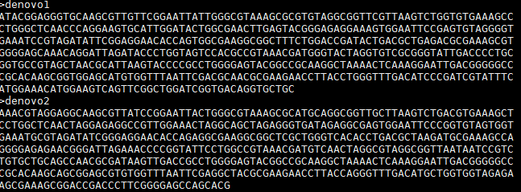
5. OTU sequences format edition

Slide 11
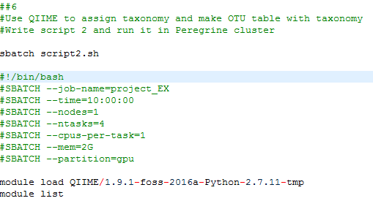
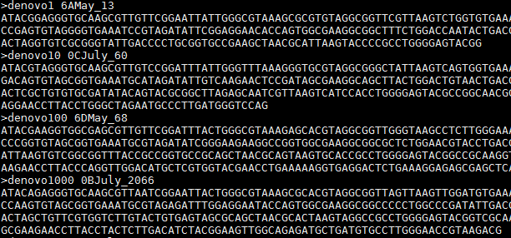
6. Use QIIME to assign taxonomy and make OTU table with taxonomy
Make script2.sh

Slide 12
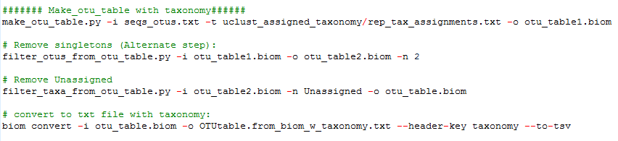
rep_tax_assignments.txt

Slide 13
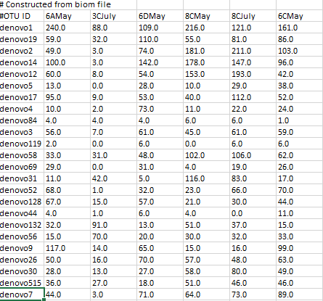
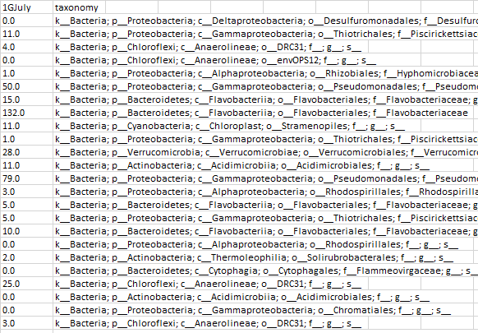
OTU table with taxonomy!

Slide 14
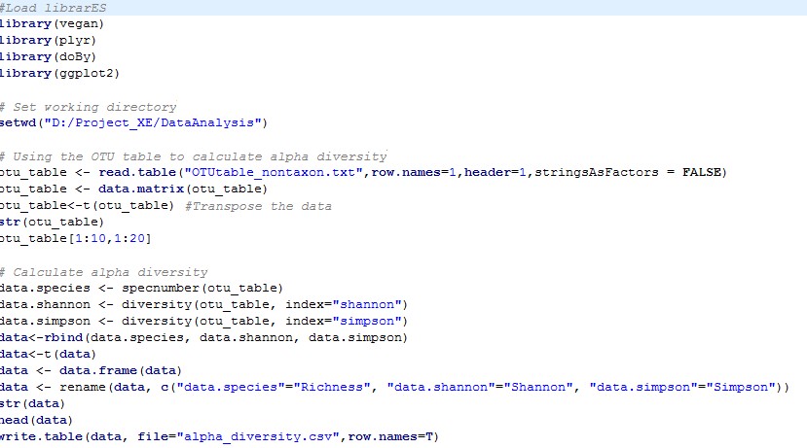
7. α-diversity Install R and Rstudio; Create the script alpha_diversity.R Using OTUtable_nontaxon.txt to calculate alpha diversity (Richness, shannon and simpson) and draw the bar plot (Richness.png, Shannon.png and Simpson.png) using alpha_diversity.R

Slide 15
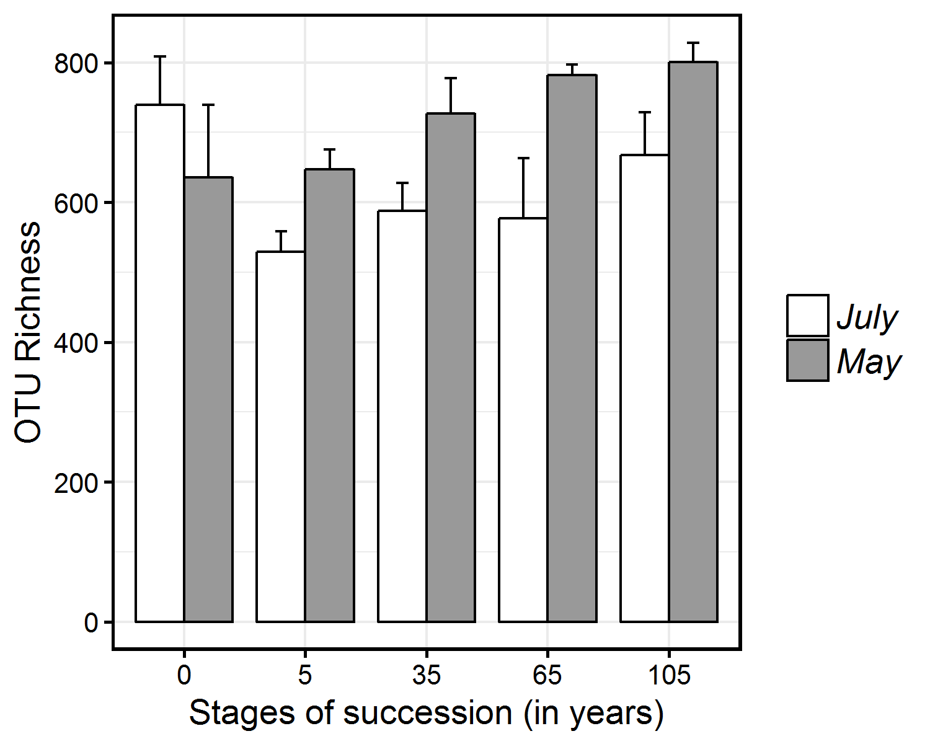
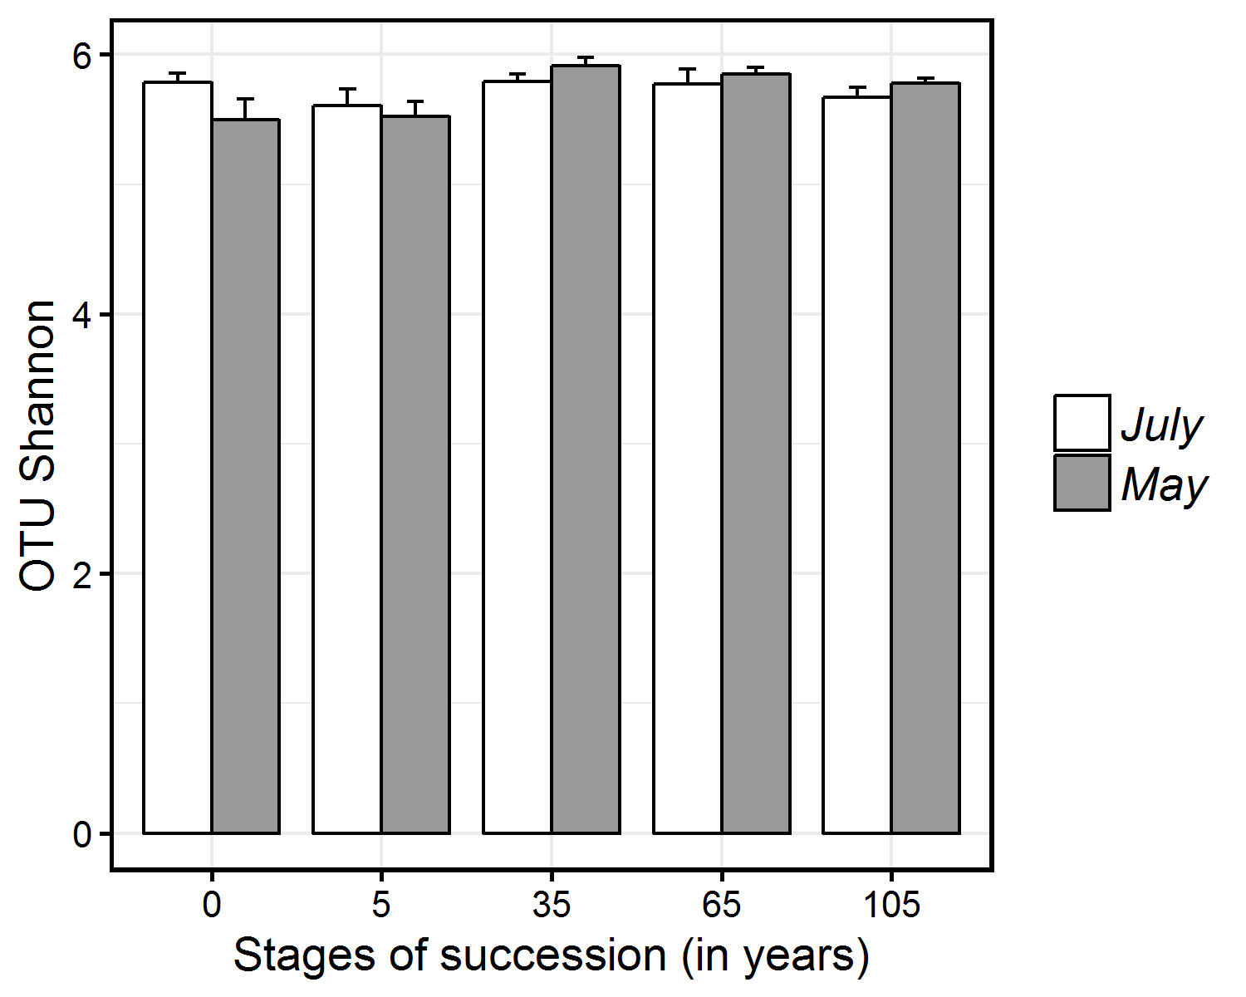
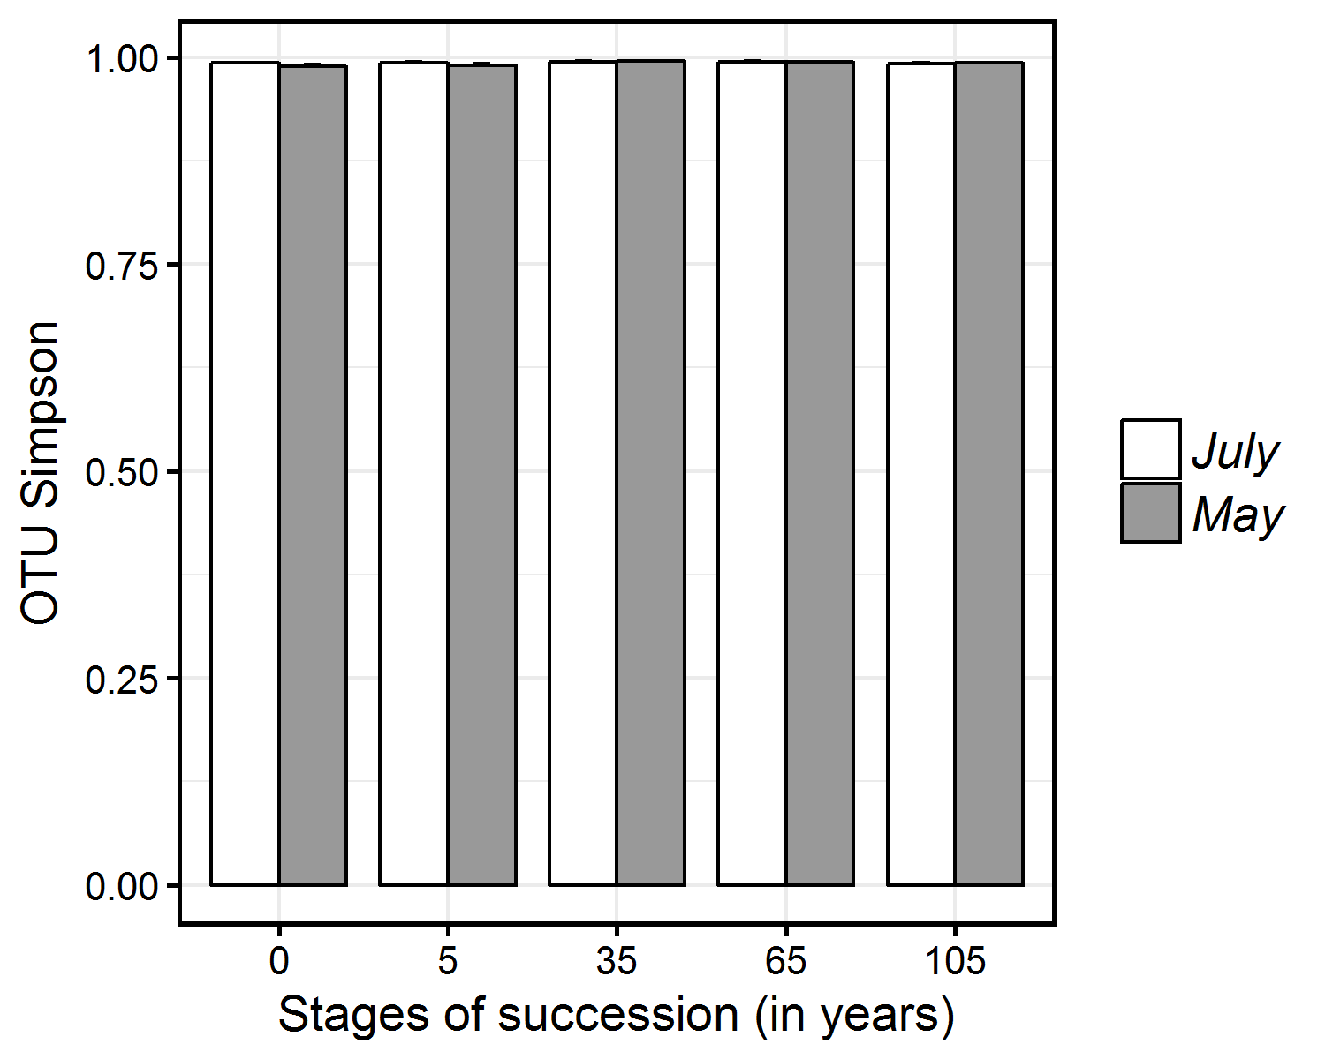

Slide 16
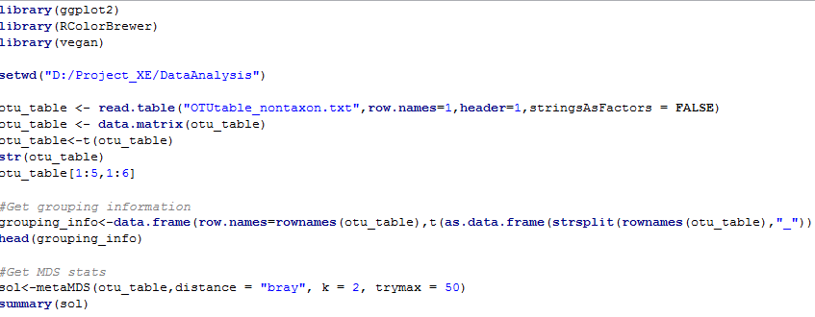
8. β-diversity
Create the script NMDS.R

Slide 17
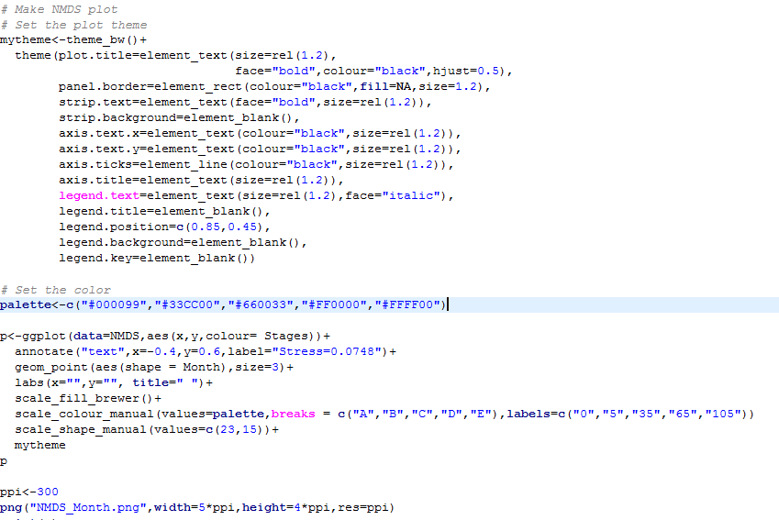

Slide 18
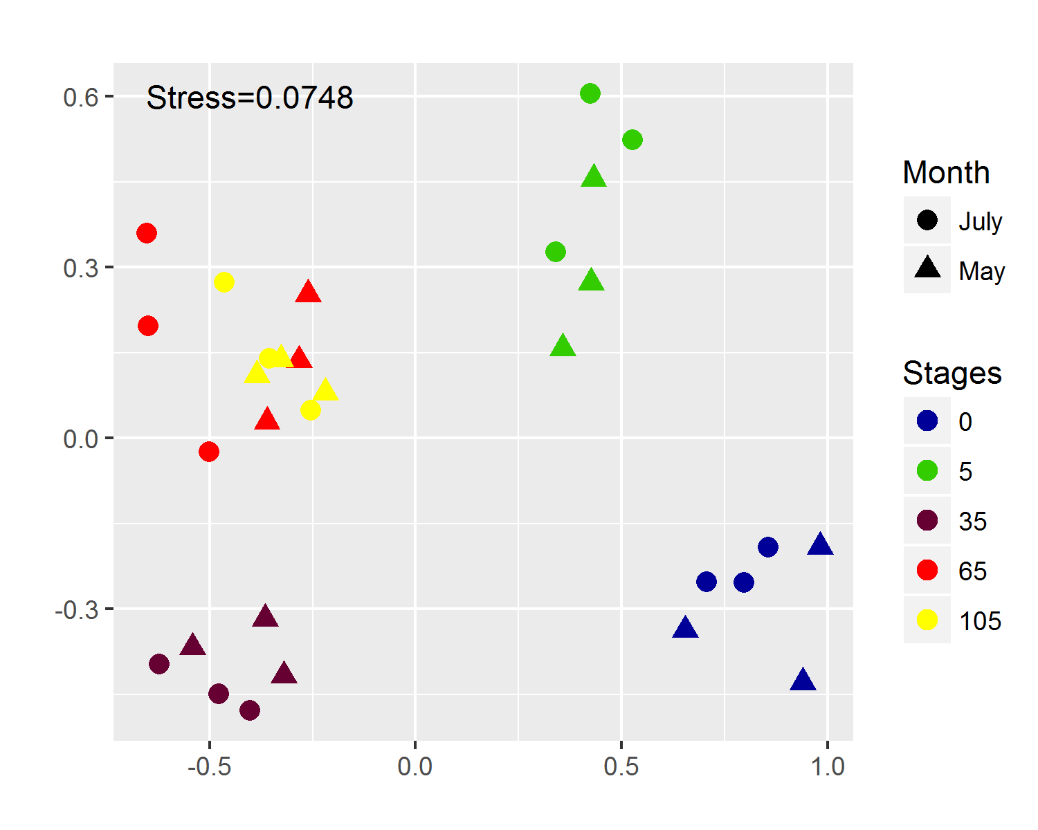
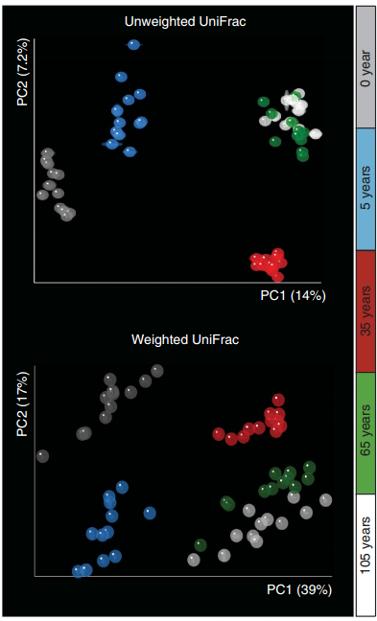
β-diversity (Bray-Curtis)
NMDS based on Bray-Curtis
PCA based on UniFrac

Slide 19
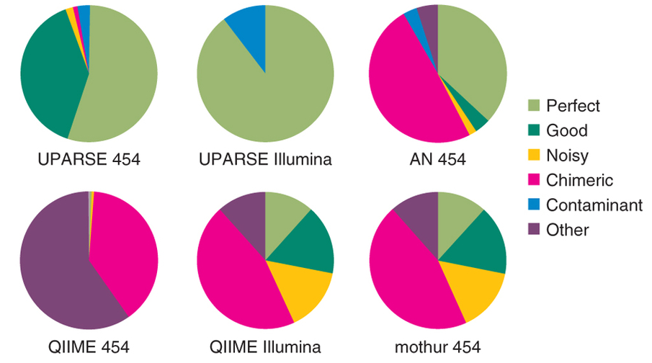
Discussion
USEARCH and QIIME can be combined but the format changing is tricky.
The pipeline can be improved by decreasing the steps in a unique script.
Even though the β-diversity pattern is similar using another method, UPARSE is more accurate picking OTUs.

Slide 20
Conclusion
The integration of two softwares optimize the microbial communities analysis

