Slide 1


GRE镇考机经词串讲班（上）
主讲：张巍
微信公众号：张巍老师

Slide 2

串讲PPT下载，GRE资料下载
公众号：张巍老师

Slide 3
acerbic
韦氏释义：expressing harsh or sharp criticism in a clever way

Slide 4
acerbic
-aci, -acu, -acri 尖，酸，锐利
acrid 刻薄的，辛辣的
acumen 敏锐
acute 敏锐的
acid 酸的
acidic 酸性的
acrimonious 刻薄的

Slide 5
尖酸刻薄
bitter
astringent
harsh
pungent（抨击他）
piquant（批判他）
mordant（妈蛋的）
sarcastic
satiric
acrimonious
cutting

Slide 6
acrimonious
sanctimonious
韦氏释义: pretending to be morally better than other people

Slide 7
GRE真题
Despite a tendency to be overtly _____, her poetry does not consist solely of pious sentiments: it often sparks the imagination and provides lively entertainment.
A. preachy
B. querulous
C. insincere
D. sanctimonious
E. plaintive
F. disingenuous

Slide 8
GRE真题
Despite a tendency to be overtly _____, her poetry does not consist solely of pious sentiments: it often sparks the imagination and provides lively entertainment.
A. preachy（爱讲道的）
B. querulous（易怒的）
C. insincere（不真诚的）
D. sanctimonious（假装虔诚的）
E. plaintive（悲哀的）
F. disingenuous（不真诚的）
答案：AD

Slide 9
adulation
韦氏释义: excessive or slavish admiration or flattery

Slide 10
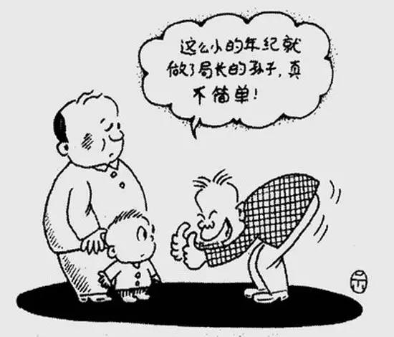
谄媚，拍马屁
adulation-adulate
flattery-flatter（服了，头）
sycophancy-sycophantic（三个粉丝）
fawn（幼鹿）
toady-toad（癞蛤蟆）

Slide 11
GRE真题
While early biographies of Florence Nightingale tended to be quite _____, Lytton Strachey’s irreverent 1918 essay about her ushered in a new era, making it acceptable, even fashionable, to criticize her.
A. unsympathetic
B. sycophantic
C. unsentimental
D. censorious
E. pedantic

Slide 12
GRE真题
While early biographies of Florence Nightingale tended to be quite _____, Lytton Strachey’s irreverent 1918 essay about her ushered in a new era, making it acceptable, even fashionable, to criticize her.
A. unsympathetic（不同情的）
B. sycophantic（谄媚的）
C. unsentimental（不动感情的）
D. censorious（爱挑剔的）
E. pedantic（迂腐的）
答案：B

Slide 13
anachronistic（ anachronism ）
韦氏释义：
(1)out of date or old-fashioned 􁬦􀷸􁌱
(2)something that is mistakenly placed in a time where it does not belong in a story, movie, etc. 􀷸􀕤􁲙􁧏􁌱

Slide 14
-ana 错误，分开
anachronistic 时代错误的
analogy 类比
analysis 分析
anatomy 解剖

Slide 15
-chron=time 时间
chronic 慢性的，长期的
chronology 年代学，年表
chronicle 编年史，记录
synchronize 使同步
anachronistic 时代错误的

Slide 16

过时的
anachronistic
old-fashioned
outmoded
antediluvian
obsolete
antiquated
archaic
superannuated

Slide 17
-anti和-ante区别

Slide 18

-ann, -enn=year 年
annual 年度的，每年的
anniversary 纪念日
annuity 养老金
perennial 常年的

Slide 19
GRE真题
Up to the 1970s, histories of science tended to be (i)_____ not least in their focus on discoveries and theories that could be read as anticipating later scientific orthodoxies, rather than on those deemed (ii)_____ in their own periods. Historians of science are now routinely far more sensitive on such scores.
Blank(i) | Blank(ii)
A anachronistic | D major
B convoluted | E fallacious
C undogmatic | F inessential

Slide 20
GRE真题
Up to the 1970s, histories of science tended to be (i)_____ not least in their focus on discoveries and theories that could be read as anticipating later scientific orthodoxies, rather than on those deemed (ii)_____ in their own periods. Historians of science are now routinely far more sensitive on such scores.
Blank(i) | Blank(ii)
A anachronistic（超前的） | D major（重大的，主要的）
B convoluted（复杂的） | E fallacious（有错误的）
C undogmatic（非教条的） | F inessential（不重要的）
答案：AD

Slide 21
augment
韦氏释义:
(1) to increase the size or amount of (something)
(2) to add something to (something) in order to improve or complete it
argument

Slide 22
banal
韦氏释义: boring or ordinary: not interesting

Slide 23
陈腐，非原创
banal
cliché
insipid
trite
hackneyed
platitude
bromide
humdrum
pedestrian
stereotyped
vapid

Slide 24
-ped=foot 脚
impede 阻碍
expedite 加速
pedal 脚踏板
peddle 沿街叫卖
pedestrian 行人
pedicure 足疗

Slide 25
-ped=child 孩子
pedology 儿科学
pedant 迂腐的教师
pediatrist 儿科以上
pedogogy 教育学

Slide 26

创新，先锋
innovative
avant-garde
original
cutting-edge
pioneering
experimental
vanguard

Slide 27
belie
韦氏释义:
(1) to give a false idea of (something)
(2) to show (something) to be false or wrong

Slide 28
同义词
第一类: disguise, conceal, misrepresent, veil
第二类: disprove, contradict, contravene, repudiate

Slide 29
capricious
韦氏释义: changing often and quickly

Slide 30
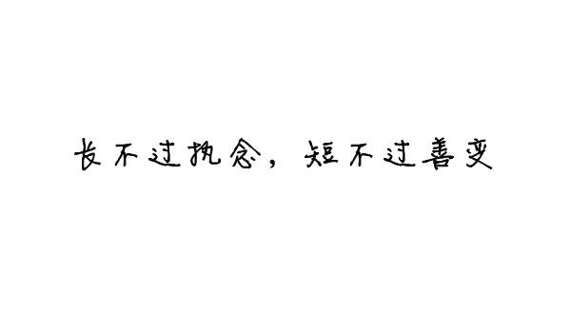
善变
unpredictable
impulsive
inconstant
fickle
mercurial
mutable
volatile
unstable
unsteady
freakish-freak
erratic
whimsical-whim

Slide 31
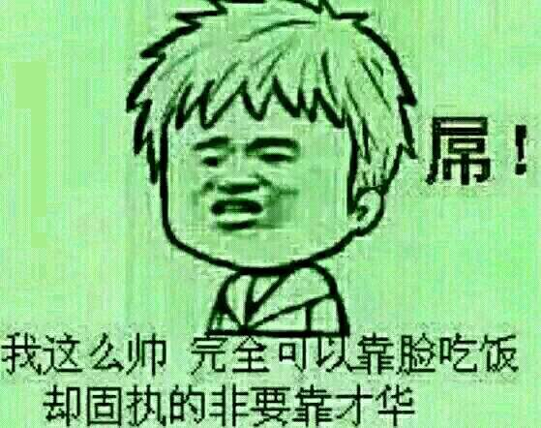
不变—固执
不变
stable
steadfast
steady
enduring
固执
unyielding
obdurate
adamant
implacable
obstinate
uncompromising

Slide 32

chimera
韦氏释义: something that exists only in the imagination and is not possible in reality

Slide 33
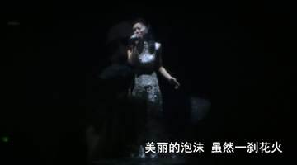
假
chimera
illusion
bubble
delusion
fancy
mirage

Slide 34

游戏里的GRE词汇
taunt 嘲讽
venom 毒素
remnant 残余的
serpent 蛇，狡猾的人
fury 愤怒，复仇女神
feeble 无力的
phantom 幻影，错觉的
prophet 先知
acolyte 寺僧

Slide 35

游戏里的GRE词汇
ensnare 诱入陷阱
annihilate 歼灭
rabid 猛烈的
guise 伪装
maelstrom 大漩涡
siege 包围
devour 吞食
dire 可怕的，悲惨的
void 虚空

Slide 36
circumspect
韦氏释义: thinking carefully about possible risks before doing or saying something
discreet
discrete
discretion

Slide 37
-circum 四周
circumscribe 限制
circumlocution 话多
circumference 周长 perimeter
circumnavigate 环球航行
circumstance 环境
circumvent 回避

Slide 38
-spect 看
aspect 方面，样子
expect 期望
inspect 检查
perspective 看法，观点
retrospect 回顾
suspect 怀疑
spectacle 眼镜
spectator 观众

Slide 39
clandestine
韦氏释义: done in a private place or way

Slide 40
秘密的，偷偷的
clandestine
secret
surreptitious
furtive
private
underground

Slide 41
compromise
韦氏释义:
(1) settlement of differences by arbitration or by consent reached by mutual concessions
(2) to damage or weaken (something)

Slide 42
GRE真题
The government has no choice but to (i)_____ the incessant demands for land reform, and yet any governmental action that initiated land reform without requisite attention to agrarian reform would (ii)_____ the overall goal of economic modernization.
Blank(i) | Blank(ii)
A anticipate | D delineate
B heed | E condone
C silence | F compromise

Slide 43
GRE真题
The government has no choice but to (i)_____ the incessant demands for land reform, and yet any governmental action that initiated land reform without requisite attention to agrarian reform would (ii)_____ the overall goal of economic modernization.
Blank(i) | Blank(ii)
A anticipate（期望） | D delineate（描述）
B heed（留意） | E condone（原谅）
C silence（沉默） | F compromise（削弱）
答案：BF

Slide 44
conundrum
韦氏释义: a confusing or difficult problem

Slide 45
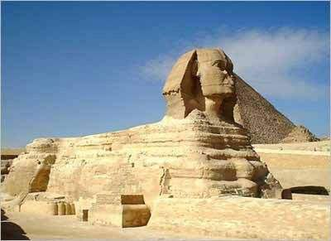
谜
conundrum
mystery
enigma
puzzle
riddle
sphinx
可难琢磨！

Slide 46
daunting
韦氏释义: tending to make people afraid or less confident

Slide 47
几大姑
haunt 经常出没，闹鬼
flaunt 炫耀
taunt 嘲讽
vaunt 吹牛
daunt 使气馁

Slide 48
GRE真题
My grandma has a strong belief in all things _____: she insists, for example, that the house in which she lived as a child was haunted.
A. clamorous
B. invidious
C. numinous
D. empirical
E. sonorous

Slide 49
GRE真题
My grandma has a strong belief in all things _____: she insists, for example, that the house in which she lived as a child was haunted.
A. clamorous（吵闹的）
B. invidious（诽谤的）
C. numinous（神秘的，超自然的）
D. empirical（经验主义的）
E. sonorous（响亮的）
答案：C

Slide 50
deliberate
韦氏释义:
(1) done or said on purpose
(2) done or decided after careful thought
(3) to think about or discuss something very carefully in order to make a decision

Slide 51
先做题，再讲词
Investors are grateful that the attorney general has stepped in to pursue inquiries into misfeasance in the financial markets, given that the regulators officially charged with policing the industry have been _____.
A. diffident
B. meticulous
C. straightforward
D. implacable
E. tenacious

Slide 52
先做题，再讲词
Investors are grateful that the attorney general has stepped in to pursue inquiries into misfeasance in the financial markets, given that the regulators officially charged with policing the industry have been _____.
A. diffident（不自信的，犹豫不决的）
B. meticulous（极其仔细的）
C. straightforward（直接的）
D. implacable（难以平息的）
E. tenacious（固执的）
答案：A

Slide 53
diffident
韦氏释义:
(1) lacking confidence
(2) hesitant in acting or speaking through lack of self-confidence

Slide 54

-fid 信任，忠心
fidelity 忠心
confidential 保密的
perfidy 不忠诚
infidel 异教徒

Slide 55
disingenuous
韦氏释义: not truly honest or sincere
ingenuous 天真的，坦白的
ingenious 灵巧的，机灵的

Slide 56
empirical
韦氏释义: based on testing or experience

Slide 57
ephemeral
韦氏释义: lasting a very short time

Slide 58
短暂
ephemeral
transient
transitory
momentary
evanescent
fleeting
instantaneous

Slide 59
instantaneous
spontaneous
simultaneous

Slide 60
持久
enduring
eternal (external)
everlasting
lasting
immortal
permanent
perpetual (perpetuate/perpetrate)

Slide 61
GRE真题
In Japanese aesthetics, especially but not only in Noh, beauty contains the idea of _____: beauty must have an air of evanescence, the intimation of its own demise.
A. transience
B. symmetry
C. decay
D. simplicity
E. balance
F. deterioration

Slide 62
GRE真题
In Japanese aesthetics, especially but not only in Noh, beauty contains the idea of _____: beauty must have an air of evanescence, the intimation of its own demise.
A. transience（短暂）
B. symmetry（对称）
C. decay（衰退）
D. simplicity（简单）
E. balance（平衡）
F. deterioration（衰落）
答案：CF

Slide 63
exculpate:
韦氏释义: to clear from alleged fault or guilt
vindicate
韦氏释义: to free from allegation or blame

Slide 64
GRE真题
Some ethicists worry that a deeper understanding of the brain may be tantamount to _____; if we discover that free will is an illusion of neural circuitry, how will we hold people responsible for their actions?
A. vindication
B. proscription
C. ministration
D. valediction
E. exculpation

Slide 65
GRE真题
Some ethicists worry that a deeper understanding of the brain may be tantamount to _____; if we discover that free will is an illusion of neural circuitry, how will we hold people responsible for their actions?
A. vindication（证明清白）
B. proscription（禁止）
C. ministration（援助）
D. valediction（告别词）
E. exculpation（开脱罪行）
答案：E

Slide 66

founder
韦氏释义:
(1) one that founds or establishes
(2) to experience failure
(3) to fill with water and sink

Slide 67
hodgepodge
韦氏释义: a mixture of different things

Slide 68
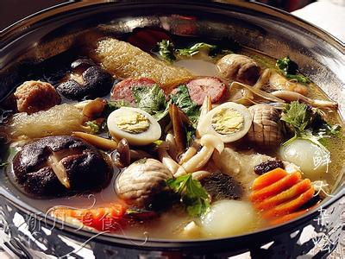
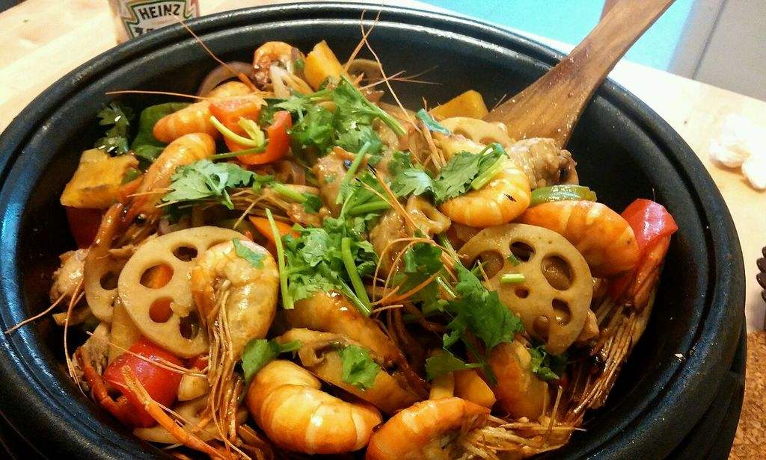
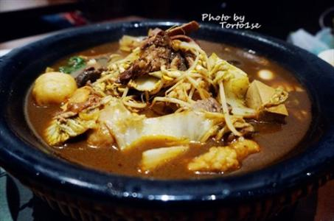
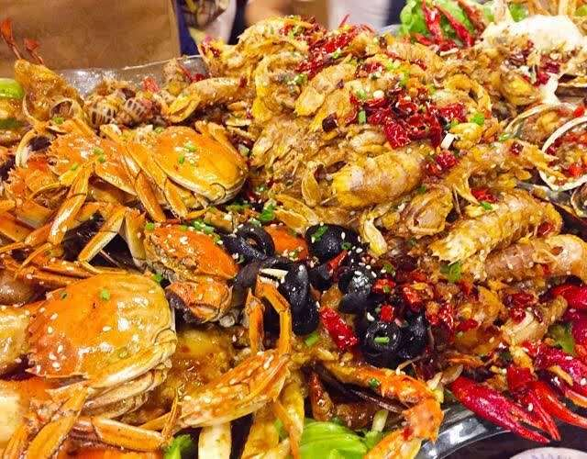
大杂烩
hodgepodge
hotchpotch
pastiche
patchwork
jumble
welter
medley
motley
montage

Slide 69
impassioned
韦氏释义: showing of feeling very strong emotions
impassive
passive
dispassionate
compassion

Slide 70
GRE真题
It’s a sign of John Dramani Mahama’s maturity as a writer that he is willing to consider his country’s future so _____: his memoir is appealingly honest, given to clear-eyed assessments rather than exaggerated accounts of achievements.
A. cheerfully
B. dispassionately
C. insightfully
D. evocatively
E. analytically
F. blithely

Slide 71
GRE真题
It’s a sign of John Dramani Mahama’s maturity as a writer that he is willing to consider his country’s future so _____: his memoir is appealingly honest, given to clear-eyed assessments rather than exaggerated accounts of achievements.
A. cheerfully（开心地）
B. dispassionately（冷静客观地）
C. insightfully（有见解地）
D. evocatively（启发地）
E. analytically（冷静分析地）
F. blithely（快活地）

Slide 72
GRE镇考机经词串讲班（下）
主讲：张巍
微信公众号：张巍老师

Slide 73
ironic
韦氏释义: strange or funny because something is different from what you expected
irenic
韦氏释义: favoring, conducive to, or operating toward peace, moderation or conciliation
同义词: pacific, peaceful, dovish, placatory

Slide 74
GRE真题
Although in his new book he tends to repeat himself like a _____ uncle, McHughen makes a persuasive case for the safety of tinkering with genes to create new foods.
A. taciturn（沉默寡言的）
B. reserved（沉默寡言的）
C. prototypical（典型的）
D. cantankerous（脾气差的）
E. loquacious（爱BB的）
F. garrulous（爱BB的）
答案：EF

Slide 75
loquacious
韦氏释义: full of excessive talk

Slide 76
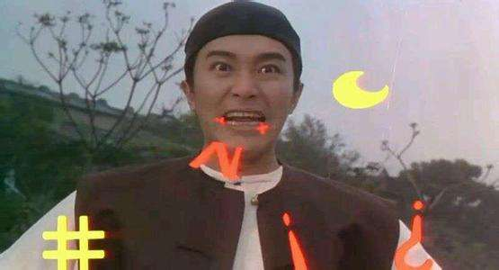
话多
loquacious
garrulous
prolix
verbose
voluble
talkative
wordy
gabby

Slide 77
话少
curt
laconic
reserved
reticent
taciturn

Slide 78
GRE真题
Although in his new book he tends to repeat himself like a _____ uncle, McHughen makes a persuasive case for the safety of tinkering with genes to create new foods.
A. taciturn
B. reserved
C. prototypical
D. cantankerous
E. loquacious
F. garrulous

Slide 79
maverick
韦氏释义: a person who refuses to follow the customs or rules of a group

Slide 80
奇葩，反传统
iconoclast
nonconformist
heterodox
heretical
unconventional

Slide 81
GRE真题
The contemporary trend whereby fashion designers flout mainstream tradition is unique only in its (i)_____; earlier fashion designers experience the same (ii)_____ impulse, albeit in a less extreme form.
Blank(i) | Blank(ii)
A subversiveness | D indiscriminate
B intensity | E iconoclastic
C culpability | F temperate

Slide 82
GRE真题
The contemporary trend whereby fashion designers flout mainstream tradition is unique only in its (i)_____; earlier fashion designers experience the same (ii)_____ impulse, albeit in a less extreme form.
Blank(i) | Blank(ii)
A subversiveness（颠覆） | D indiscriminate（不加区分的）
B intensity（强度） | E iconoclastic（反传统的）
C culpability（有罪） | F temperate（节制的）
答案：BE

Slide 83
先做题
The stories in Yiyun Li’s recent collection are distinctive particularly for the strong contrast between their emotional intensity and their consistently _____ tone.
A. affable
B. ebullient
C. measured
D. irascible
E. overwrought

Slide 84
先做题
The stories in Yiyun Li’s recent collection are distinctive particularly for the strong contrast between their emotional intensity and their consistently _____ tone.
A. affable（和蔼的）
B. ebullient（热情洋溢的）
C. measured（谨慎的）
D. irascible（易怒的）
E. overwrought（极度悲伤的）
答案：C

Slide 85
measured
韦氏释义: done with thought and care

Slide 86
同根不同义词
measured 谨慎的
taxing 费力的
guarded 谨慎的
wanting 缺乏的
assuming 傲慢的
noisome 恶臭的
involved 复杂的

Slide 87
mixed
韦氏释义:
(1) made of different kinds of things mixed together or combined
(2) including or accompanied by inconsistent, incompatible, or contrary elements

Slide 88
mixed=inconsistent=contrary

Slide 89
GRE真题
Joshua Gisemba Bagaka found that the pedagogical results of group projects and other engaged learning activities in Kenyan mathematics classroom were _____; such activities, then, may not be the best way of improving mathematics education.
A. overstated
B. counterintuitive
C. mixed
D. discouraging
E. inconsistent
F. inexplicable

Slide 90
GRE真题
Joshua Gisemba Bagaka found that the pedagogical results of group projects and other engaged learning activities in Kenyan mathematics classroom were _____; such activities, then, may not be the best way of improving mathematics education.
A. overstated（夸张的）
B. counterintuitive（违反直觉的）
C. mixed（矛盾的）
D. discouraging（使人气馁的）
E. inconsistent（不一致的）
F. inexplicable（难以解释的）
答案：CE

Slide 91
GRE真题
Although movie critic Pauline Kael had a distaste for sycophancy, she also had a need for (i)_____; as a consequence of these competing feelings, she sent very (ii)_____ signals to friends and colleagues.
Blank(i) | Blank(ii)
A solitude | D direct
B obeisance | E subtle
C clarity | F mixed

Slide 92
GRE真题
Although movie critic Pauline Kael had a distaste for sycophancy, she also had a need for (i)_____; as a consequence of these competing feelings, she sent very (ii)_____ signals to friends and colleagues.
Blank(i) | Blank(ii)
A solitude（独处） | D direct（直接）
B obeisance（敬礼） | E subtle（不明显）
C clarity（清晰） | F mixed（矛盾的，混合的）
答案：BF

Slide 93
mundane
韦氏释义: dull and ordinary

Slide 94
平凡，世俗
mundane
jejune
commonplace
earthly
prosaic

Slide 95
Reading chunks of Shapiro’s verse in one sitting, it must be said, exposes the _____ nature of his writing: scads of poems are too glancing to strike a nerve, scarcely worth a second reading.
A. jejune
B. esoteric
C. corrosive
D. finicky
E. indiscreet

Slide 96
Reading chunks of Shapiro’s verse in one sitting, it must be said, exposes the _____ nature of his writing: scads of poems are too glancing to strike a nerve, scarcely worth a second reading.
A. jejune（平凡的）
B. esoteric（晦涩的）
C. corrosive（腐蚀性的）
D. finicky（过分讲究的）
E. indiscreet（不谨慎的）
答案：A

Slide 97
先做题
In order to cultivate new repertoire, the music industry is providing a hearing for previously _____ composers.
A. idle
B. thwarted
C. celebrated
D. renowned
E. anonymous
F. obscure

Slide 98
先做题
In order to cultivate new repertoire, the music industry is providing a hearing for previously _____ composers.
A. idle（闲置的）
B. thwarted（挫败的）
C. celebrated（称赞的）
D. renowned（有名声的）
E. anonymous（无名的）
F. obscure（不出名的）
答案：EF

Slide 99
obscure
韦氏释义:
(1) not well-known
(2) difficult to understand
(3) dark, dim

Slide 100
晦涩难懂
obscure
enigmatic
recondite
cryptic
occult
abstruse
arcane
esoteric
hermetic
abstract

Slide 101
panacea
韦氏释义: something that will make everything about a situation better

Slide 102
万能药
panacea
cure-all
elixir
nostrum（那是传闻）

Slide 103
-pan 全
panoply 全副武装
pandemic 广泛流行的
pansophic 无所不知的
pantheon 万神殿
panorama 全景

Slide 104
GRE真题
Mark Messina’s book The Simple Soybean and Your Health exudes recognition much less unrestrained in the description of the soy's medical efficiency than its versatility, but the author cautions against soy to be a _____.
A. cure-all
B. solitude
C. efficacy
D. effectuality
E. panacea
F. placebo

Slide 105
GRE真题
Mark Messina’s book The Simple Soybean and Your Health exudes recognition much less unrestrained in the description of the soy's medical efficiency than its versatility, but the author cautions against soy to be a _____.
A. cure-all（万能药）
B. solitude（孤独）
C. efficacy（有效）
D. effectuality（有效性）
E. panacea（万能药）
F. placebo（安慰剂）
答案：AE

Slide 106
presage
韦氏释义: to give or be a sign of (something that will happen or develop in the future

Slide 107
预言，先知
presage
foreshadow
foretell
forecast
augur
prognosticate
prophesy
harbinger
portend

Slide 108
先做题
The maps in this volume are meant not as guides but as _____: they are designed to make the reader think anew about the city.
A. adornments
B. references
C. truisms
D. provocations
E. valedictions

Slide 109
先做题
The maps in this volume are meant not as guides but as _____: they are designed to make the reader think anew about the city.
A. adornments（装饰）
B. references（参考）
C. truisms（陈腐）
D. provocations（挑衅，引发）
E. valedictions（告别词）
答案：D

Slide 110
provoke
韦氏释义：
(1) to cause (a person or animal) to become angry, violent, etc.
(2) to cause the occurrence of (a feeling or action)

Slide 111
qualify
韦氏释义：
(1) to give (someone) the necessary skill or knowledge to do a particular job or activity
(2) to reduce from a general to a particular or restricted form

Slide 112
unqualified 如何理解？

Slide 113
GRE真题
For parents, the pleasure of letting children choose which book to read aloud together is not always _____: I well remembered my inner groans when my child would constantly pick my least favorite book from the shelf.
A. intangible
B. enduring
C. impalpable
D. unalloyed
E. ephemeral
F. unqualified

Slide 114
GRE真题
For parents, the pleasure of letting children choose which book to read aloud together is not always _____: I well remembered my inner groans when my child would constantly pick my least favorite book from the shelf.
A. intangible（难以触摸的）
B. enduring（持久的）
C. impalpable（难以触摸的）
D. unalloyed（纯粹的）
E. ephemeral（短暂的）
F. unqualified（纯粹的，绝对的）
答案：DF

Slide 115
quixotic
韦氏释义: hopeful or romantic in a way that is not practical

Slide 116
音译词
唐吉坷德
乌托邦
霓虹

Slide 117
resonate
韦氏释义:
(1) to continue to produce a loud, clear, deep sound for a long time
(2) to have particular meaning or importance for someone
(3) to relate harmoniously

Slide 118
The characters in this comic strip fret about the (i)_____ of their “little counterculture lives”, especially when terrible things are happening in the world, but the cartoonist makes their lives (ii)_____ in ways that do not seem (iii)_____ at all. Real things happen here—births, deaths, adoptions, affairs, breakups, commitments, ceremonies, civil union—and they matter.
Blank(i) | Blank(ii) | Blank(iii)
A unpredictability | D stagnate | G outlandish
B arduousness | E resonate | H inconsequential
C triviality | F compete | I intangible

Slide 119
The characters in this comic strip fret about the (i)_____ of their “little counterculture lives”, especially when terrible things are happening in the world, but the cartoonist makes their lives (ii)_____ in ways that do not seem (iii)_____ at all. Real things happen here—births, deaths, adoptions, affairs, breakups, commitments, ceremonies, civil union—and they matter.
Blank(i) | Blank(ii) | Blank(iii)
A unpredictability（难以预测） | D stagnate（停滞） | G outlandish（奇怪的）
B arduousness（艰难） | E resonate（有重要意义） | H inconsequential（不重要的）
C triviality（不重要） | F compete（竞争） | I intangible（难触摸的）
答案：CEH

Slide 120
robust
韦氏释义: strong and healthy

Slide 121
品牌中的GRE词汇
rejoice 高兴
crest 顶峰
Kindle 点燃
dodge 躲避
badger 獾
converse 相反
colgate
canon 经典
carrefour 十字路口

Slide 122
scaremonger
韦氏释义: one inclined to raise to excite alarms especially needlessly
profitmonger
warmonger

Slide 123
先做题
In one theory, as people learn things throughout the day, connections between neurons get strengthened, but during sleep then all synapses are weakened, tenuous connections are _____ and only the strongest bonds could remain.
A. reinforced
B. reproduced
C. replaced
D. stimulated
E. severed

Slide 124
先做题
In one theory, as people learn things throughout the day, connections between neurons get strengthened, but during sleep then all synapses are weakened, tenuous connections are _____ and only the strongest bonds could remain.
A. reinforced（加强）
B. reproduced（复制）
C. replaced（替代）
D. stimulated（激励）
E. severed（切断）
答案：E

Slide 125
sever
韦氏释义: to cut off (something)
severe
韦氏释义: very harsh

Slide 126
sullen
韦氏释义: dismal, gloomy

Slide 127
忧郁
sullen
dismal
dour
gloomy
glum
saturnine
melancholy

Slide 128
Saturn 土星
Mercury 水星
Mars 火星

Slide 129
trivial
韦氏释义: not important

Slide 130
不重要
trivial
trifling
negligible
frivolous
inconsequential
slight

Slide 131
GRE真题
The sailors realized too late that winds had shifted the ice in such a way as to obstruct the ship’s path; this process had been so _____ that it was completed by the time they discovered the effect.
A. gradual
B. negligible
C. unpredictable
D. time-consuming
E. inconsequential
F. imperceptible

Slide 132
GRE真题
The sailors realized too late that winds had shifted the ice in such a way as to obstruct the ship’s path; this process had been so _____ that it was completed by the time they discovered the effect.
A. gradual（逐渐的，难以觉察的）
B. negligible（不重要的）
C. unpredictable（难以预测的）
D. time-consuming（耗时的）
E. inconsequential（不重要的）
F. imperceptible（难以觉察的）
答案：AF

Slide 133
welter
韦氏释义: a state of wild disorder: turmoil

Slide 134
混乱
welter
turmoil
agitation
convulsion
commotion
tumult

Slide 135
串讲PPT下载，GRE资料下载
公众号：张巍老师

Slide 136
考满分GRE课程介绍
All In One课程
考前冲刺班

