Slide 1

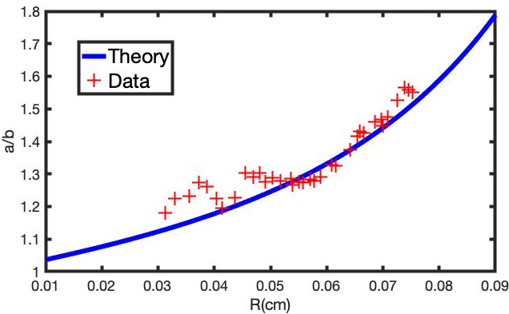
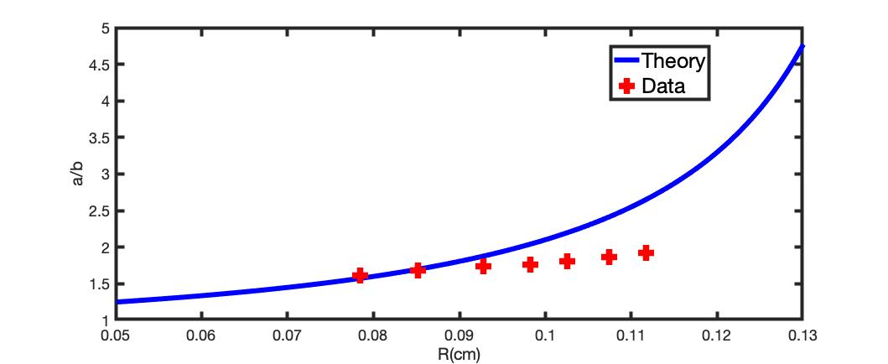
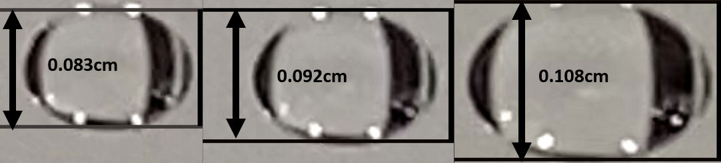
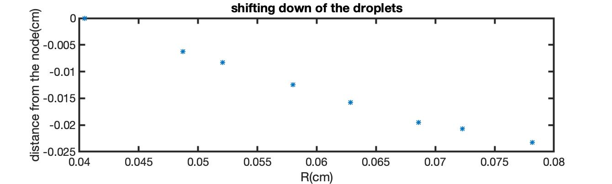
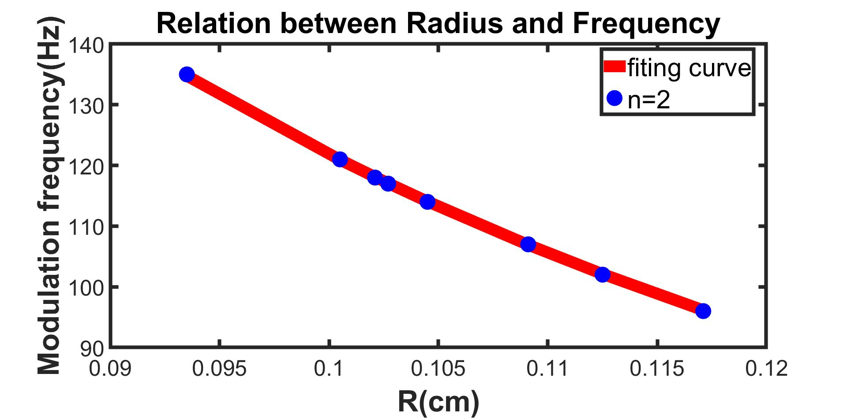
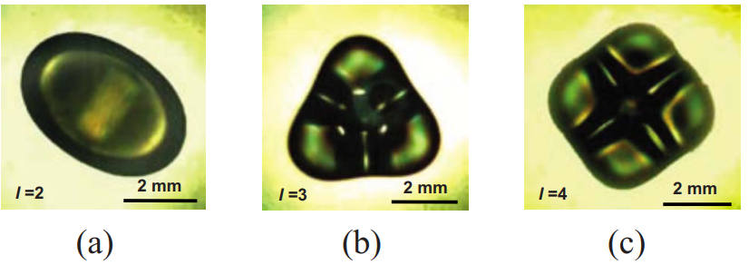
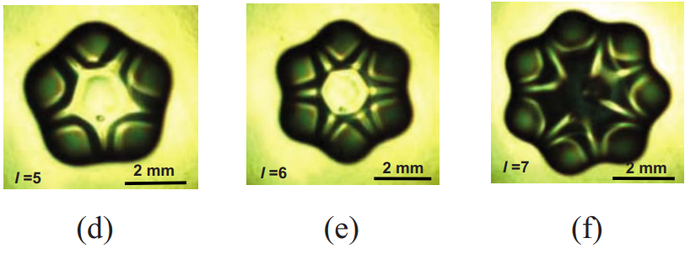
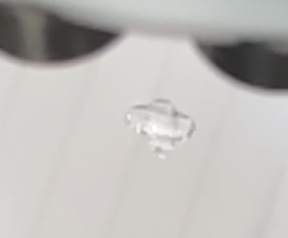
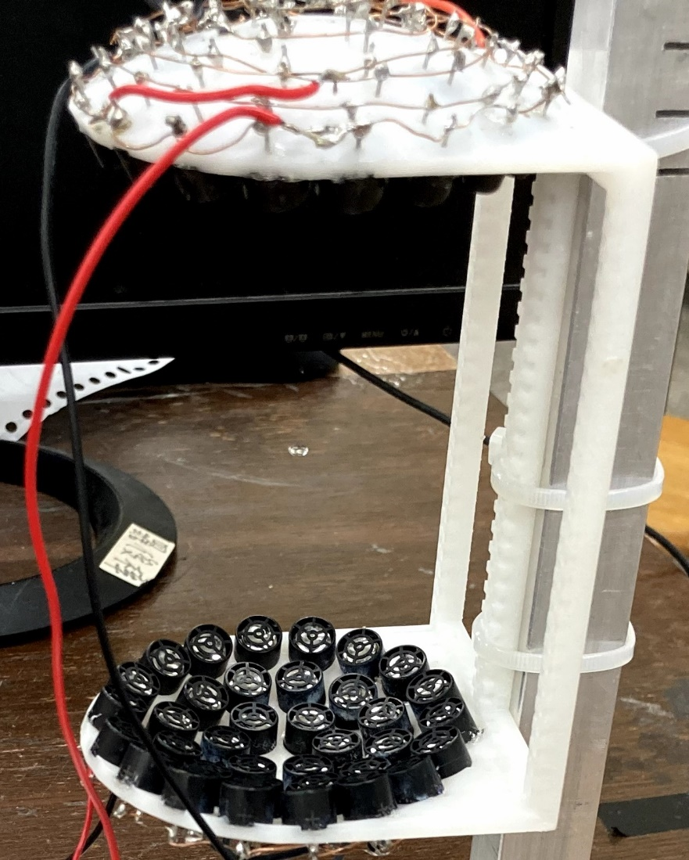
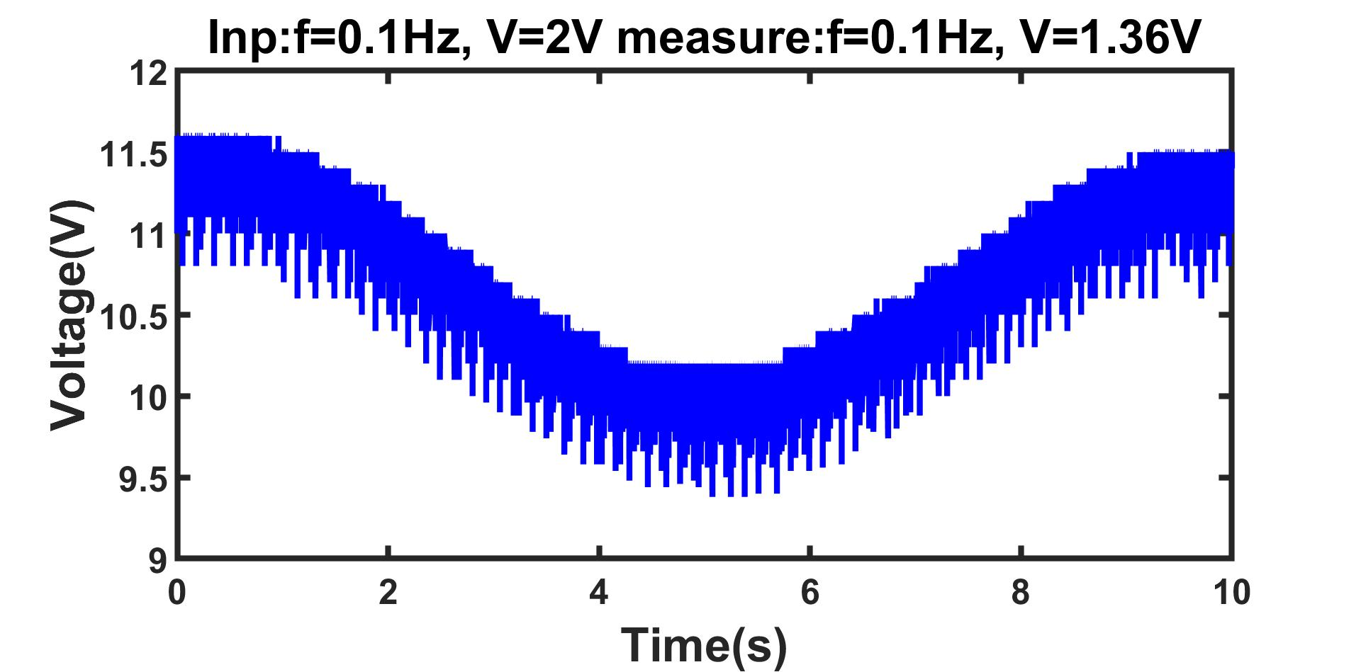
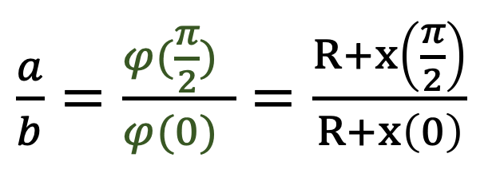


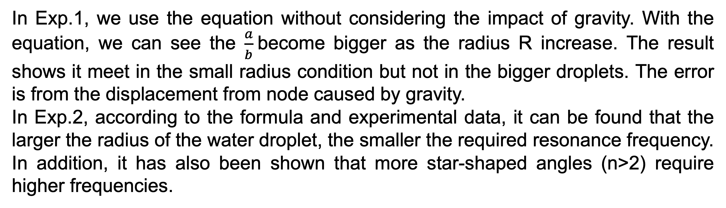
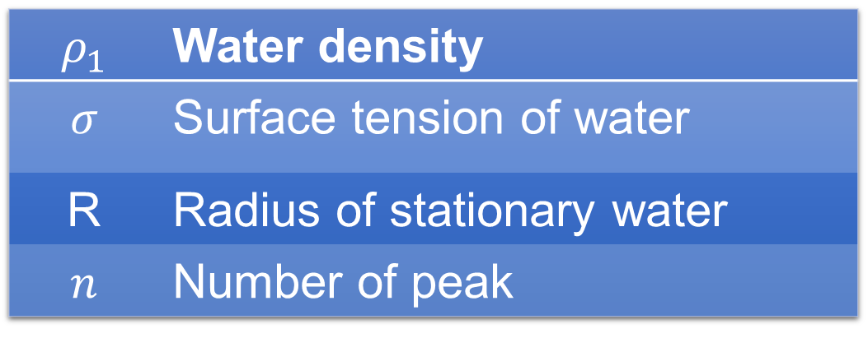


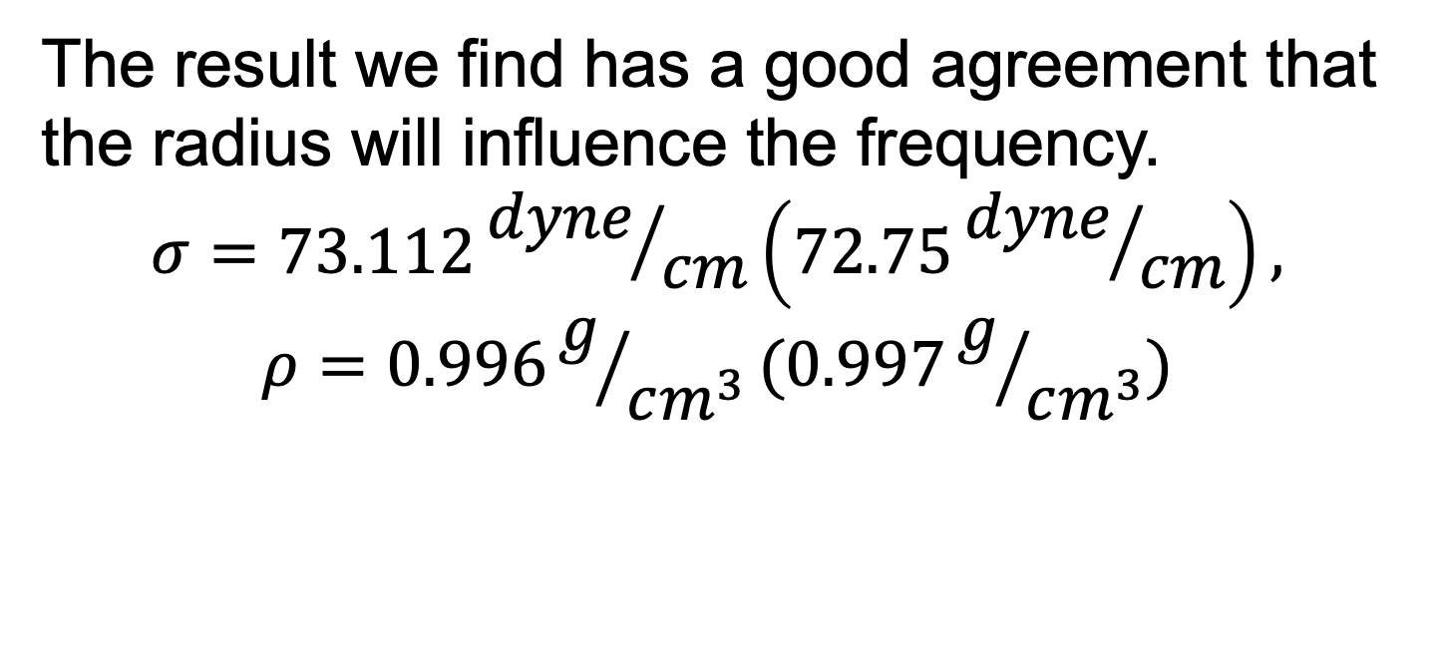
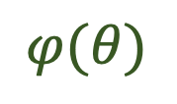
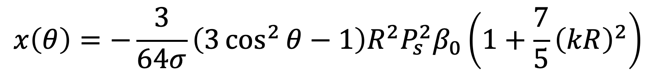
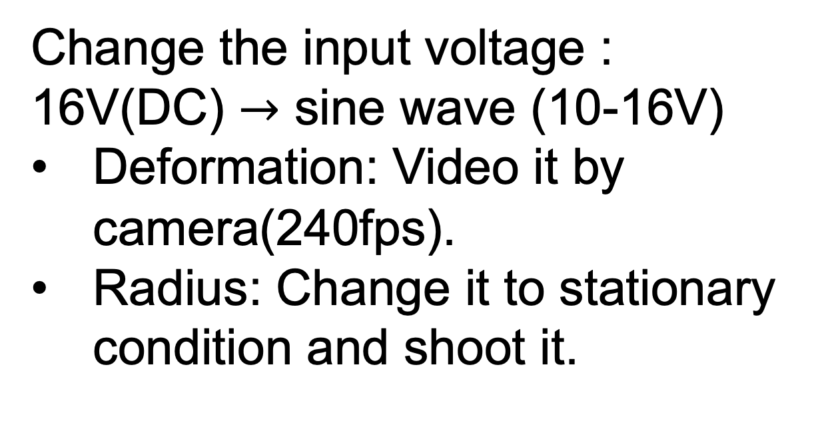
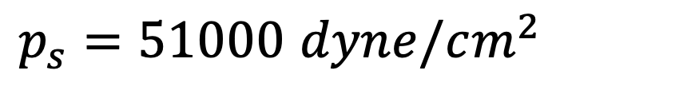
Deformation of water droplet levitated in the acoustic field
Bing-Chian Chou, Jia-Chang Chang, Po-Hao Yang, Kai-I Chu (TA), Yung-Fu Chen(Thesis Advisor)
National Central University, Taoyuan, Taiwan
A small water droplet can be levitated around the node of the acoustic standing field. The sound pressure acting on the surface of the droplet will deform the water drop, but the surface tension of water will try to keep the water droplet a sphere. As the size of the droplet grows, the deformation will become greater. However, the error ​​of experiment results of deformation as a function of the size compared to theoretical prediction [1] becomes larger. Therefore, we try to improve the equation that also will have a good prediction at the large size of water. Furthermore, we also study the dynamic deformation ​via the modulating the acoustic field.
Introduction
Result
Exp.1
Suspension is a fantasy phenomenon on earth due to gravity. The most common causes are magnetic, electrical, etc. In our first experiment, we redo the levitation of the droplet caused by acoustic standing wave field and analyze what happens the deformation will be under the interaction of surface tension and acoustic pressure. In the second experiment, we try to find out the dynamic deformation if we change the form of amplitude into a signal and analyze its characteristics.
Smaller Droplet
Bigger Droplet
$p_{s}=51000$ $dyne/cm^{2}$
Theory
The deformation of the smaller water droplets can fit the curve we expect. But For the bigger droplets, the data start not to fit the theoretical curve. The bigger droplet seems to have smaller deformation compared with our expectation.
Deformation of water droplet:
Since gravity doesn’t affect the deformation, this equation doesn’t include the influence of gravity.
Since we fix the camera, we find out that there are shifting down for the bigger droplets. We think the displacement from the node makes the result doesn’t fit the equation.
$$θ$$
R | radius of a sphere with the same volume
$σ$ | surface tension of water
$P_{s}$ | Amplitude of the standing wave
$β_{0}$ | compressibility of air
$$k$$ | wave number
R
b
$$φ(θ)$$
a
$\frac{a}{b}=\frac{φ(\frac{π}{2}) }{φ(0) }$ $=\frac{R+x\left(\frac{π}{2}\right)}{R+x\left(0\right)}$
$$x\left(θ\right)=−\frac{3}{64σ}\left(3\cos^{2}{θ}−1\right)R^{2}P_{s}^{2}β_{0}\left(1+\frac{7}{5}{\left(kR\right)}^{2}\right)$$
[1]
Dynamic of drop by modulation:
Since the bigger droplet needs more supporting force to levitate, the force upward is greater than the force downward. Since the deformation of droplets needs two forces with different directions to squeeze, the larger difference between these two forces makes the deformation smaller.
After changing the amplitude into modulation, it will become a star shape deformation, the reference of modulation frequency will be
$$ρ_{1}$$ | Water density
$$σ$$ | Surface tension of water
R | Radius of stationary water
$$n$$ | Number of peak
$$f_{m}=\frac{1}{2π}\sqrt{\frac{σ}{ρR^{3}}n(n−1)(n+2)}$$
Exp.2
[3]
[3]
Experiment Method
Exp.1
After modulation, it will appear like a circular standing wave. In our experiment, we perform a two-peak one for several groups.
The result we find has a good agreement that the radius will influence the frequency.
$$σ=73.112{dyne}/{cm}\left(72.75{dyne}/{cm}\right),$$
$$ρ=0.996g/{cm^{3}}(0.997g/{cm^{3}})$$
Fig1. There are 36 transmitters above and below each. [2]
*Frequency of the sound wave: 40kHz
*Sound pressure $P_{s}$: Using a receiver.
*Input 16V(DC), $P_{s}$: about 51000 𝑑𝑦𝑛𝑒/𝑐𝑚^2
13.6cm
Summary
In Exp.1, we use the equation without considering the impact of gravity. With the equation, we can see the $\frac{a}{b}$become bigger as the radius R increase. The result shows it meet in the small radius condition but not in the bigger droplets. The error is from the displacement from node caused by gravity.
In Exp.2, according to the formula and experimental data, it can be found that the larger the radius of the water droplet, the smaller the required resonance frequency. In addition, it has also been shown that more star-shaped angles (n>2) require higher frequencies.
Exp.2
Change the input voltage : 16V(DC) $→$ sine wave (10-16V)
Deformation: Video it by camera(240fps).
Radius: Change it to stationary condition and shoot it.
40khz
Reference
0.1hz
[1]. Trinh, "Equilibrium shapes of acoustically levitated drops." J. Acoust. Soc. Am. 79.5 (1986)
[2]. Marzo, "TinyLev: A multi-emitter single-axis acoustic levitator." Rev. Sci. Instrum. (2017)
[3]. Shen, "Parametrically excited sectorial oscillation of liquid drops floating in ultrasound." Phys. Rev. E 81.4 (2010)
Fig2. Input 0.1hz (9.5V~11.5V) with 40khz signal.

