Slide 1

COMP4432
Machine Learning
Don’t Overfit! II
WEN LING CHI | 19009897X
Wan Qinyu | 15102641D
Boyuan Zheng | 19009913x
Jia Ding | 19009867x
Notes:
Okay Today i‘ll talk about our project don’t overfit
and im wenling chi

Slide 2
Outline
Introduction
Exploratory Data Analysis
Basic Models
Feature Selection
Final Implementation
Result & Conclusion
Notes:
This is our outline
Firstly, We conducted exploratory data analysis to the data. And get some idea about the data distribution .
Secondly, We build basic model to run the data and get the basic result. Afterwards, we improve our model based on the data distribution and running result.
Specially, the feature selection part is extremely important for this project, so we pay much attention to this part

Slide 3
Introduction
Using a mere handful of training samples to test a large of testing samples.
training set 250(300 features)
testing set 19,750(300 features)
Notes:
This project “don’t overfit”is to use a mere handful of training samples to test a large of testing samples, like we only have 250 samples in training set, but we need to test around 20 thousand samples in testing set.
It is easy to overfit
So we should pay attention to prevent the model from overfitting

Slide 4
Introduction
To solve the problem of overfitting
To increase the datasets(x)
To drcrease the dimensions(ok)-features selection
To explicitly penalize overly complex models(ok)-lasso
Notes:
To solve the problem of overfitting, we thought 3 methods
One is to increase the datasets, but we can’t use this because we only get stationary numbers of data
Second is to decrease the dimensions, this one we try to select useful features
Third is to explicitly penalize overly complex, this one, we use lasso model

Slide 5
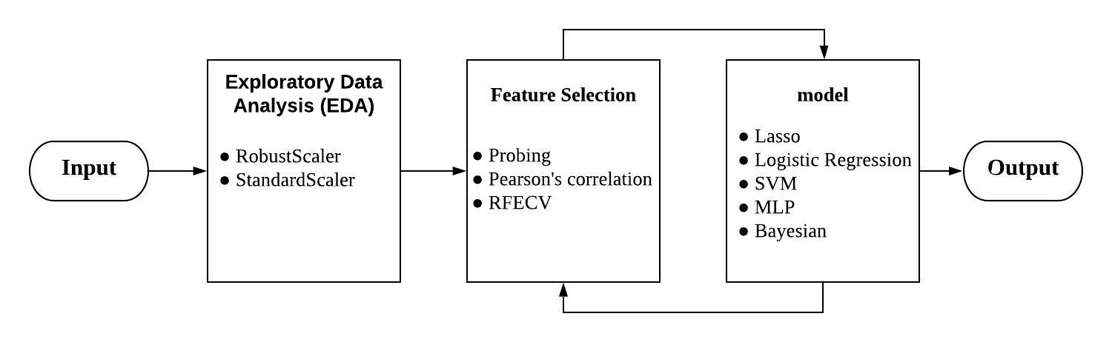
Work Flow
Notes:
This is our work flow
First, we input our data to analyze it, and use different scalers to standard it, and then use different methods to select our features, in the end , we use 5 models to train our data.

Slide 6
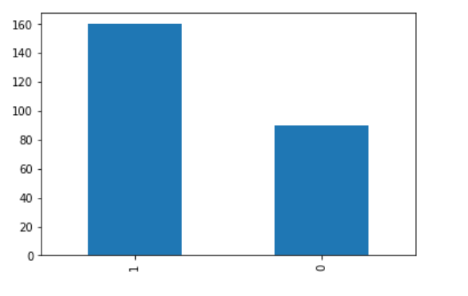
Exploratory Data Analysis (EDA)
Notes:
Firstly, we count the instance with 1 and 0 labels, this is the result.

Slide 7
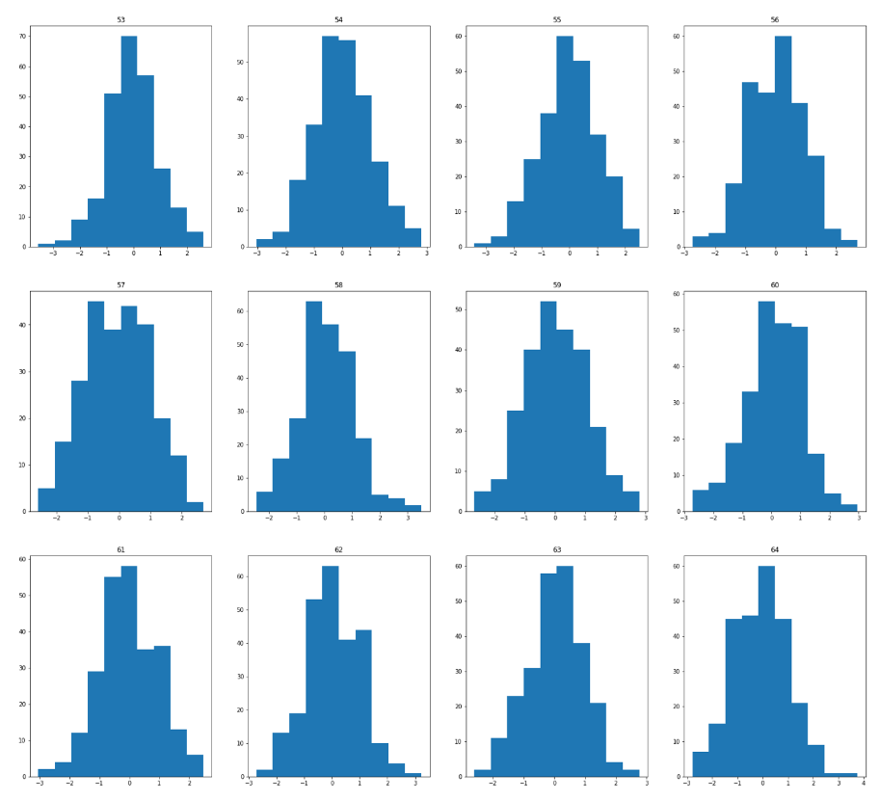
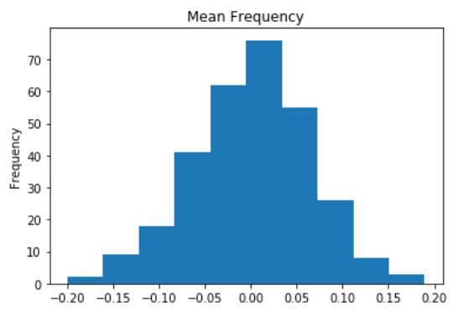
Exploratory Data Analysis (EDA)
Notes:
We found that our data has some outliers, so we use scalars to standard it
After standard the data, we made the graph, according to the graph, we make a hypothesis that the distribution of the data is like similar to Gaussian distribution
And the right side is that we randomly select 12 samples, and made the graphs, it shows that each one is also like Gaussian distribution

Slide 8
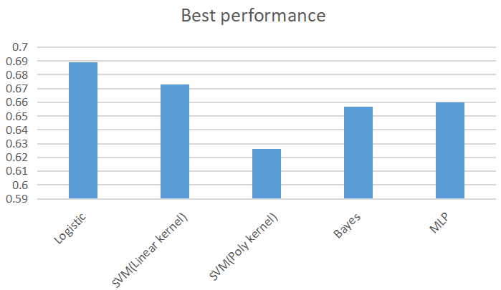
Basic models
After EDA, we do some basic experiments using some simple model
We choose: Logistic Regression, SVM(linear), SVM(poly), MLP, Bayesian
·MLP、SVM(Linear kernel) and Logistic model perform well
·SVM(Poly kernel) do not perform well
Hypothesis:
The data is linear separable
Linear model is suitable for this data
Notes:
After EDA, we use some models to do first step experiments. We use logistic regression, svc mlp, and linear.
According to analysis, we found that the simple models like linear and logistic regression have better result than complexity models like svc.
we make a hypothesis that our data is linear separable.
And why mlp got good result? We think it may fit a linear discriminant function

Slide 9
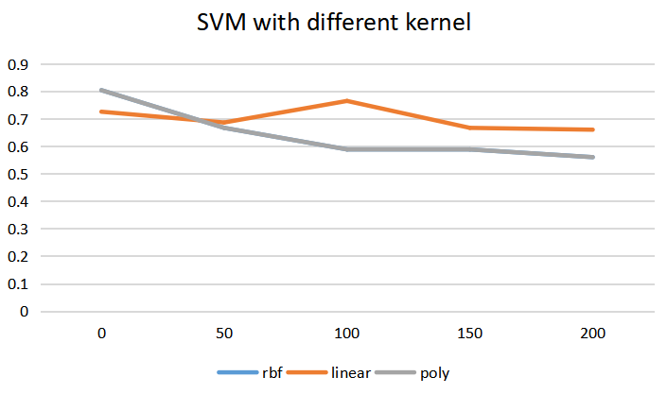
Further exploration
Further test in SVM using different kernel functions
Linear kernel is better,too
Do prove that the data is approximate linear separable
So we decide to use linear model in second try
SVM(rbf) and SVM(poly) overlap with each other
Notes:
We did another experiment to check is that linear or not
This one we use different kernels in svm like linear and poly, and found linear kernel got better performance, so we decide to use linear model in second try.

Slide 10
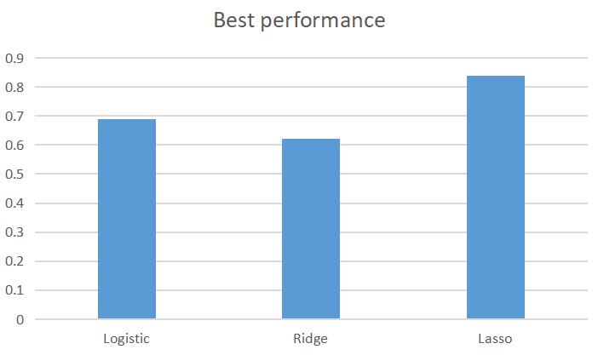
Better Model
We further explore our hypothesis and choose other linear model
Logistic, Ridge, Lasso Regression
·Lasso model performs better
·Feature selection is effective and important for this data
Notes:
And this is our second try
We use other linear models like Lasso and Ridge, they all got the great performances
Therefore, we thought linear models can get better performance with this data, and the distribution of the data is linear, too
Compare with Lasso and Ridge, lasso has better performance because Lasso is good at feature selection
we make a hypothesis that Feature selection is effective and important for this data
我们进行进一步的实验来判断是否如此，
我们使用了其他的linear model: Lasson, Rige，表现都是很不错的
因此我们认为线性模型在这个数据上表现比较好，这个数据的分布是线性的。
而我们发现Lasso和Rige相比，Lasso效果更好，Lasso的特征选择能力更强一些
我们做一个假设，针对这个数据，更强的feature selection能力会更有效果
我们进一步进行特征选择，
最后

Slide 11
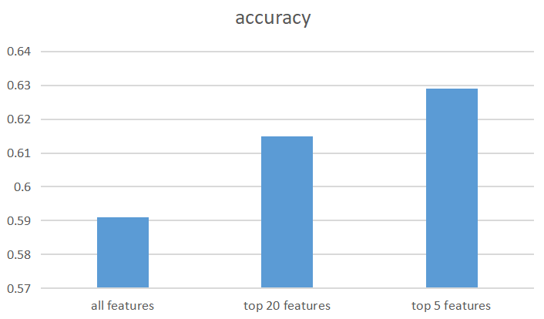
Feature selection
·Classifier with 5 feature perform better
·There are redundant and irrelative features,misleading the classifier
·Feature selection is important for this model
Notes:
And Also, there are redundant and irrelative features to mislead the classifier
But reducing to 5 features means we will lose so much information and it reduces the robustness and accuracy for new data
Thus, the accuracy in kaggle is limited
We should find a balance between overfit and information lack
That's why we begin to look for feature selection methods

Slide 12
Feature Selection
1.Pearson’s correlation
Use pearson's correlation to see which features are highly correlated to target
2.RFECV(Lasso)
use Lasso model and RFECV method to find the features
3.Probing
Upload 250 csv, and see which features got the high grade
Notes:
We use 3 methods to select our features
First one is pearson’s correlation, this one is to delete outliers, and we got 126 features.
Second one is RFECV, this one we uee Lasso to get 90 features
The last one is the most rude method, but it is intuitive to think of it. We train each column, and then test the trained model. If we can successfully test the testing set that means this column can stayed
we tested 300 times because there has 300 features, in the end we got 49 features.

Slide 13
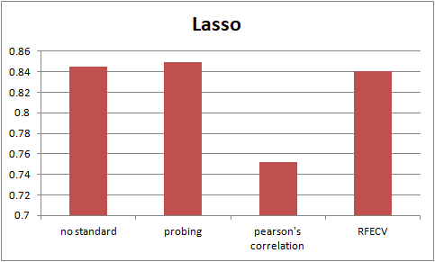
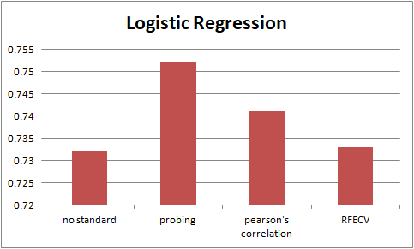
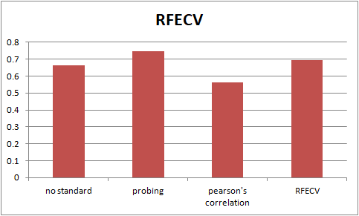
Feature Selection
All data
SVC
All data
All data
Notes:
We use the simple models like logistic regression, lasso , and svc to test, and it shows that probing has the best performance

Slide 14
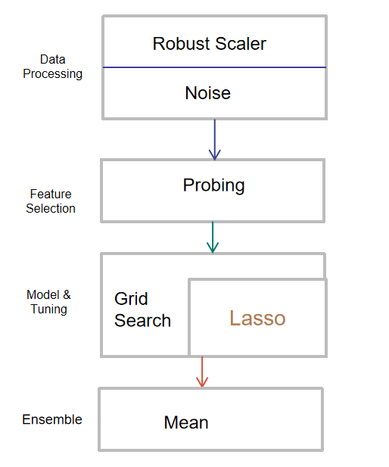
Final Implementation:
Scale deviated attributes to avoid overfitting
Avoid overfitting
Select features based one submission results
GridSearch to find best parameters
Lasso: Linear model + peanlty to select features
Calculate the mean of predictions of selected models.
Notes:
Our final implementation is to use lasso model
in the data preprocessing, we use robustscalar to standard our data, and use probing to select features, and in the part of training model, we use grid search and lasso. Gridsearch is for randomly adjusting the parameters, and lasso is our model

Slide 15
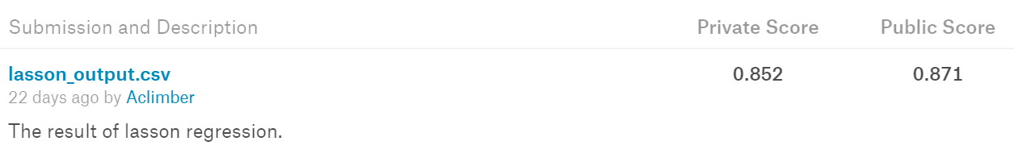
Conclusion&Result
Notes:
And finally, this is our eventually result in kaggle, and we got 87% of accuracy.

Slide 16
The End

