Slide 1

Background presentation
Jia Geng
Drozdetskiy A, Cole C, Procter J & Barton GJ. Nucl. Acids Res. (first published online April 16, 2015) doi: 10.1093/nar/gkv332

Slide 2
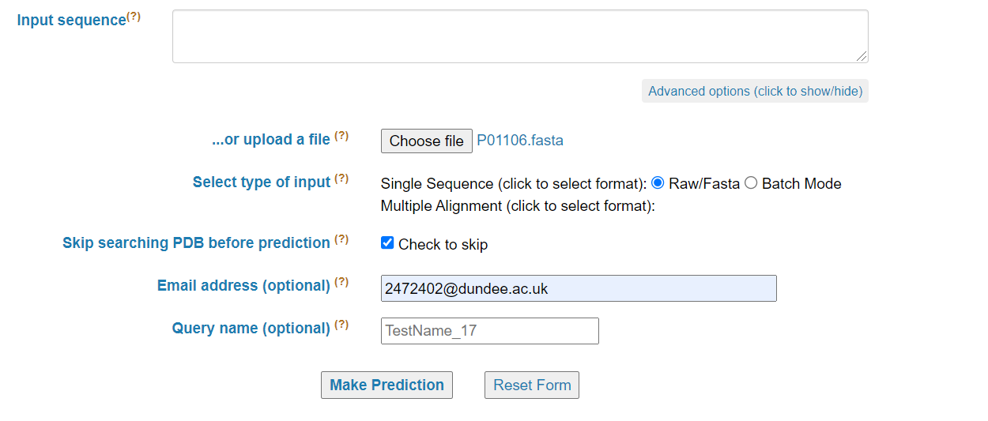
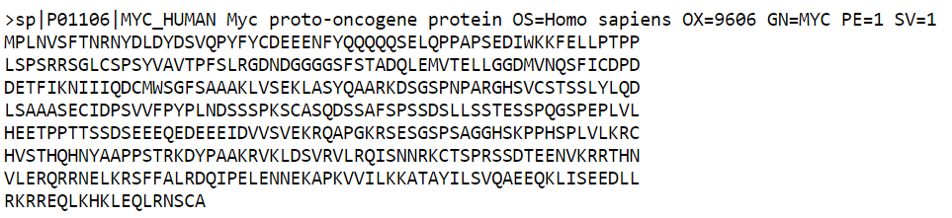
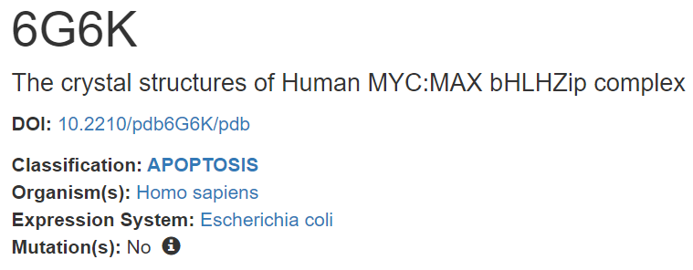
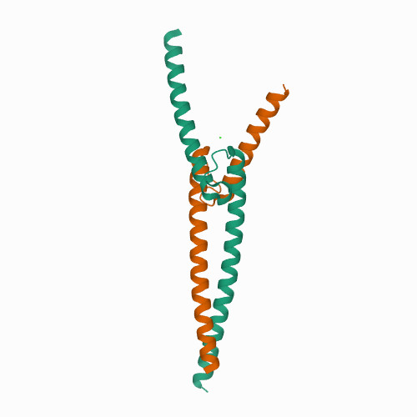
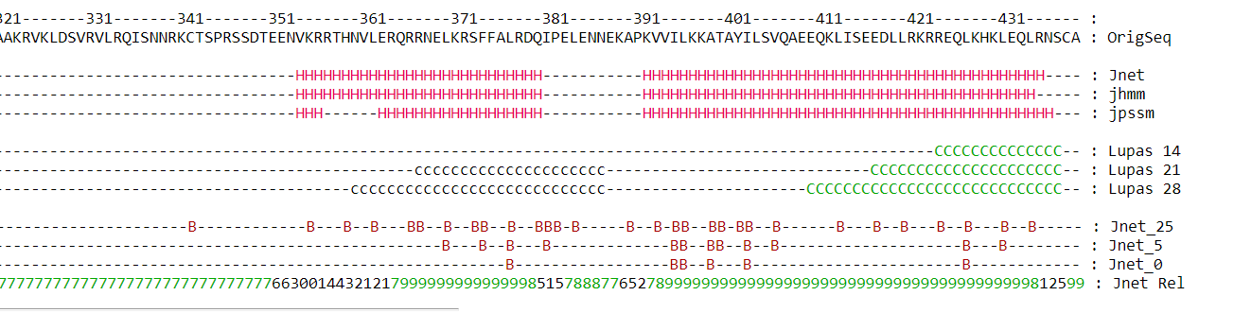
What is JPred
Many applications
Notes:
JPred is an online server that mainly predicts the secondary structure of protein sequences, although it also predicts solvent accessibility, and coiled-coil regions
A user submits a single amino acid sequence or a multiple sequence alignment
The server then returns a 3-state secondary structure prediction at every residue position along with a confidence score
The confidence score indicates the reliability for each residue and is as important as the prediction
There are many applications of JPred, including predicting structure ab initio, act as a constraint in fold-recognition algorithms, and in the design of site directed mutants that do not destabilize folding

Slide 3
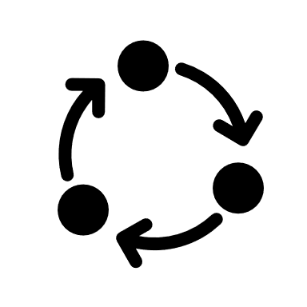
JPred algorithm
Input option 1
PDB search
for structural homologues
PSI-BLAST
Single sequence
PSSM profile
Jnet v2.3.1
PSSM network
HMM network
Multiple sequence alignment
HMMer3
HMM profile
Input option 2
Prediction
Notes:
In this slide I want to talk about my understanding of the algorithm underlying JPred4
The actual prediction itself relies on Jnet, an ensemble of artificial neural networks that returns the secondary structure prediction given sequence.
However, the main bulk of JPred’s computation time lies in generating the input for Jnet
In JPred4, the two inputs for Jnet are two profiles – a PSI-BLAST position-specific scoring matrix (or PSSM) profile and a hidden markov model profile
Step 1 – multiple sequence alignment
This step only applies if a user submits a single sequence
PSI-BLAST searches for related sequences in UniRef90. This step is done iteratively with increasingly stringent criteria.
The set of related sequences are then aligned against the query sequence to generate a multiple sequence alignment
Step 2 – Generation of profiles
Using the multiple sequence alignment, an HMM profile is generated from the HMMer program, and a PSSM profile is generated from PSI-BLAST
Together, the two profiles are fed as input into Jnet
Step 3 – Prediction using Jnet
I will now discuss more about Jnet on the next slide

Slide 4
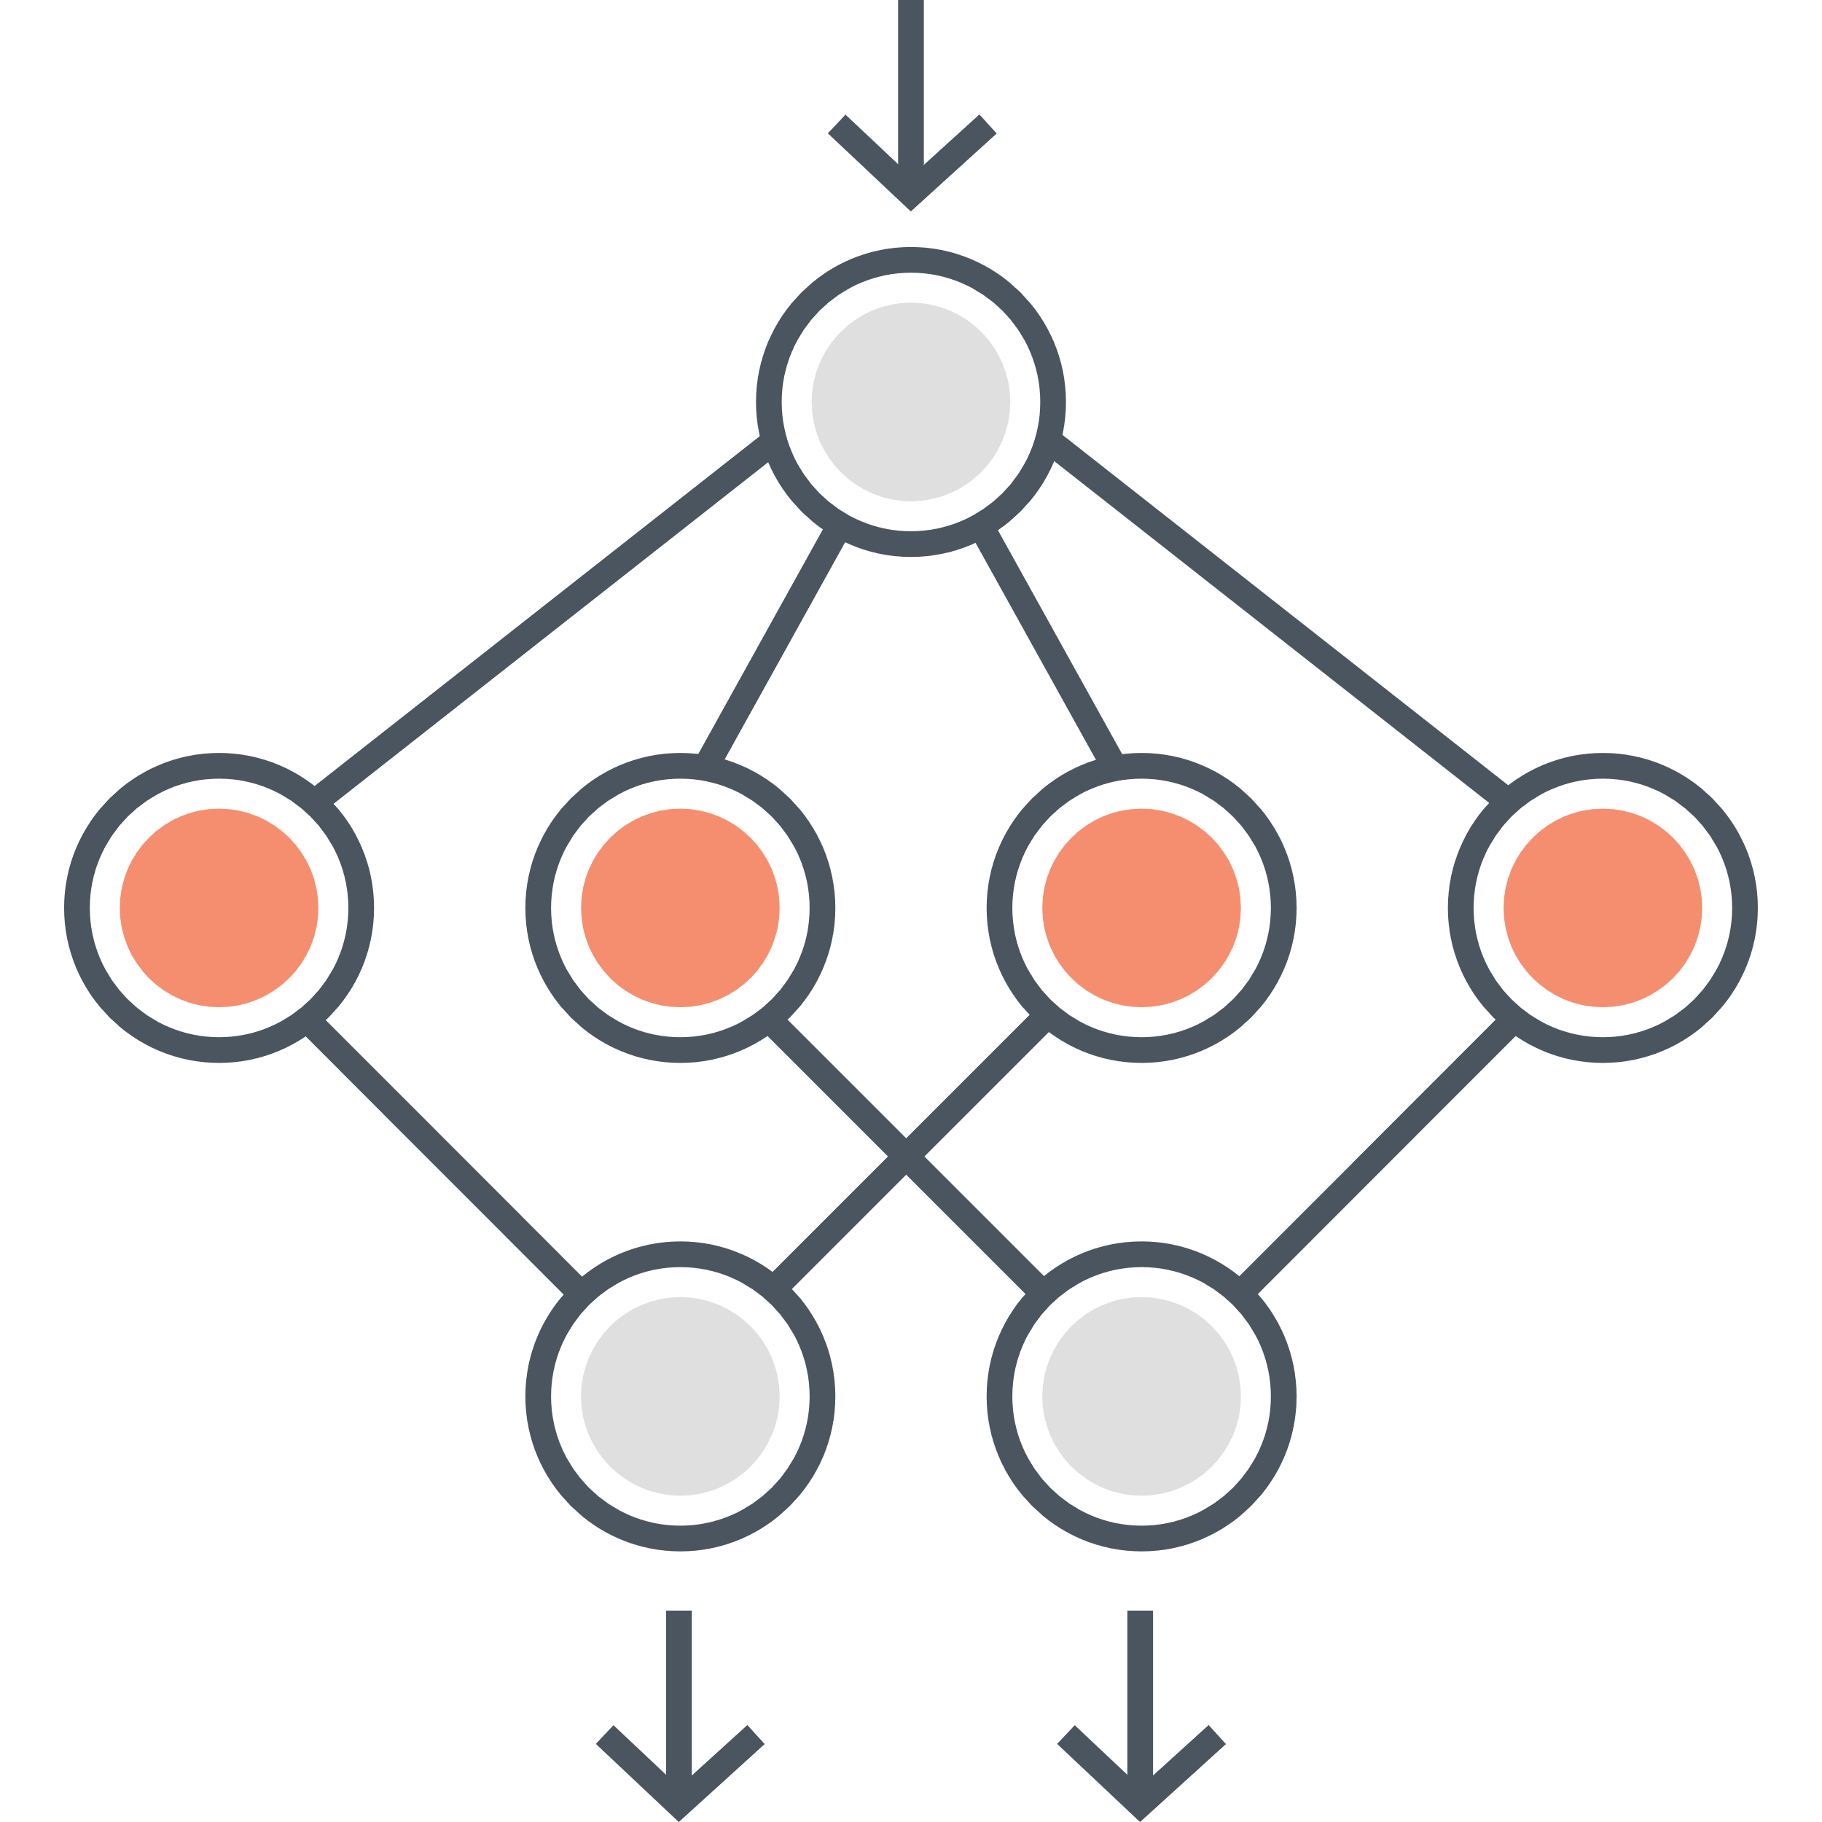
Jnet architecture
PSSM profile
HMM profile
17 residue sliding window
9 hidden layers
3 output nodes: H, E, coil
Sequence to structure net
19 residue sliding window
9 hidden layers
3 output nodes: H, E, coil
Structure to structure net
Mathematical average = prediction
Notes:
Jnet v2.3.1 is an ensemble of neural networks in 2 dimensions:
On one hand, one arm of Jnet accepts a PSSM profile as input, the other accepts an HMM profile as input
On the other hand, each arm is a sequence-to-structure neural net feeding into a structure-to-structure net
The sequence-to-structure nets have input nodes constructed by passing the profiles through a sliding window of 17 residues, or more correctly 17 columns. This calculates possible secondary structures of residue i in the context of residues i-8 to i+8.
These nets have 9 hidden layers and 3 output nodes, 1 for each secondary structure state.
The output of the sequence-structure network is windowed into 19 residues. This becomes the input for the structure-to-structure net, which also have 9 hidden layers and 3 output nodes.
The prediction is the mathematical average of the output from the HMM net and PSSM net.

Slide 5
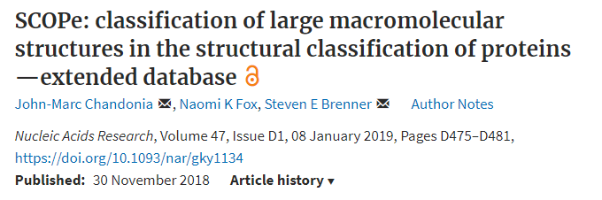

Jnet data selection
1987
Pick superfamily representatives
Some superfamilies are not represented in this dataset
1681
Filter by resolution
1654
Filter by length
DCPB1500
1507 domain sequences for training and testing
1634
Remove multi-chain domains
1634
Check for pairwise redundancy
1524
Check for missing DSSP info.
Notes:
Having described the architecture of Jnet, I will now discuss the data used to train Jnet
Jnet is trained with annotated data from a database known as structural classification of proteins extended, or SCOPe
SCOPe is a hierarchical database of protein domains, where a domain is defined as a globular protein unit that has been experimentally determined to fold and exist on its own. Protein domains in SCOPe are classified into class, fold, superfamily and family.
To train Jnet, 1 representative sequence was taken from each superfamily to give 1987 representative sequences
The following filtering steps were then applied to refine the data set:
Removing sequences whose corresponding structures had low resolution
Filtering by length. Sequences need to be long enough to fold as domains, but too long and PSIBLAST computation will take too much time
Domains made up of more than one polypeptide chain but are removed. There is no reason given but I think it is because multi-chain domains are made of super-secondary structures
Sequences were checked for pairwise redundancy using the AMPS algorithm with 100 randomizations. No such sequences removed
110 sequences which had missing secondary structure assignments in the DSSP database were excluded.
A few more sequences were manually removed giving us 1507 sequences for training and testing – unfortunately, some superfamilies are not represented in this dataset
More on DSSP:
DSSP is a database of ‘ground truth’ secondary structures extracted from crystal structures of protein domains on PDB.
DSSP database contains 8 states, which is reduced to 3 states to train Jnet – state H contains all types of helices, state E contains beta sheets, and all other is denoted as coils

Slide 6
Jnet data selection
1987
Pick superfamily representatives
Some superfamilies are not represented in this dataset
1681
Filter by resolution
1654
Filter by length
DCPB1500
1507 domain sequences for training and testing
1634
Remove multi-chain domains
1634
Check for pairwise redundancy
1524
Check for missing DSSP info.
Notes:
Having described the architecture of Jnet, I will now discuss the data used to train Jnet
Jnet is trained with annotated data from a database known as structural classification of proteins extended, or SCOPe
SCOPe is a hierarchical database of protein domains, where a domain is defined as a globular protein unit that has been experimentally determined to fold and exist on its own. Protein domains in SCOPe are classified into class, fold, superfamily and family.
To train Jnet, 1 representative sequence was taken from each superfamily to give 1987 representative sequences
The following filtering steps were then applied to refine the data set:
Removing sequences whose corresponding structures had low resolution
Filtering by length. Sequences need to be long enough to fold as domains, but too long and PSIBLAST computation will take too much time
Domains made up of more than one polypeptide chain but are removed. There is no reason given but I think it is because multi-chain domains are made of super-secondary structures
Sequences were checked for pairwise redundancy using the AMPS algorithm with 100 randomizations. No such sequences removed
110 sequences which had missing secondary structure assignments in the DSSP database were excluded.
A few more sequences were manually removed giving us 1507 sequences for training and testing – unfortunately, some superfamilies are not represented in this dataset
More on DSSP:
DSSP is a database of ‘ground truth’ secondary structures extracted from crystal structures of protein domains on PDB.
DSSP database contains 8 states, which is reduced to 3 states to train Jnet – state H contains all types of helices, state E contains beta sheets, and all other is denoted as coils

Slide 7
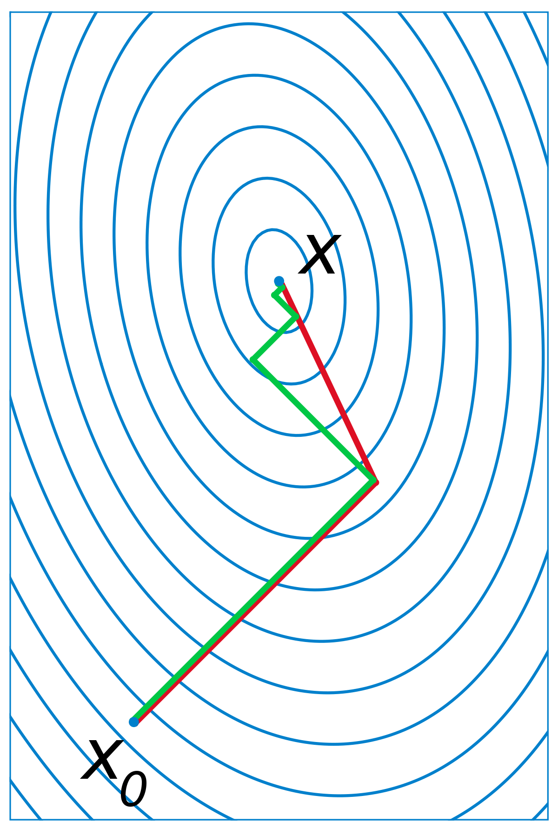
Jnet training and testing
1507 sequences
1348 training*
<1% difference in helical, sheet, and coil contents
149 blind-test
7x cross-validation
SCG (Moller 1993)
Results | Jnet v2.0 | Jnet v2.3.1
Secondary structure Q3 | 81.5% | 82.0%
Solvent accessibility >0% | 88.9% | 90.0%
>5% | 82.4% | 83.6%
>25% | 77.8% | 78.1%
*2015 NAR paper quoted 1358 training sequences, but it should be 1348
Notes:
The 1507 sequence dataset was divided into a training subset with 1348 sequences and a blind-test subset with 149 sequences
The training subset and blind-test subsets were chosen such that the percentage content of helix, sheet, and coil of the were within 1% of each other. This produces a similar distribution of secondary structure compositions as training sequences to avoid biasing the reported accuracy of blind test results.
250 epochs of scaled conjugate gradient (SCG) were applied from nodes initialized with randomly assigned weights of values between 0.005 and -0.005 with no optimization of the number of epochs
In each epoch, 7-fold cross validation was performed on the training subset
The blind-test subset comprised of one representative each of 149 superfamilies not used in training
Accuracy assessed by comparison with DSSP information

Slide 8
Aims and considerations
Aims
Considerations
Rewrite Jnet in python
Retrain Jnet with newer ML techniques
Update dataset/database
Prediction of conserved sites in homologous human sequences
Report results
Is there still redundancy in the dataset?
HMM and PSSM profiles - necessary and sufficient?
Upper bound for prediction accuracy?
Notes:
Rewrite Jnet in python to keep up with the times. Do so without modifications to its training method and sequence dataset, and verify that prediction accuracies remain unchanged
- Jnet v2.3.1 is built using SNNS which has not been updated since 1995
Retrain Jnet with modern machine learning techniques with the aim of improving prediction accuracy – in terms of network architecture, database, feature engineering
Retrain Jnet with an updated dataset that includes new representatives from new superfamilies from SCOPe, and use an updated version of Uniref90 for the building of the MSA
Add a new network to Jnet that takes in a multiple sequence alignment of homologous human sequences (either from different individuals or paralogous sequences within the same individual) and predicts which sites are conserved – identification of relevant databases will be the first step to including such a functionality

Slide 9



Project timeline
Week 1
Week 3
Week 7
End
Rewriting Jnet
19 Jul – 30 Jul
+ learning the ropes
2 weeks
Retraining Jnet
2 Aug – 3 Sep
Dataset, architecture, human genetic variation
5 weeks
Results presentation
30 Aug – 10 Sep
Presentation, poster, abstract
2 weeks
8 weeks
Notes:
Phase 1: Rewriting Jnet with python
2 week
Phase 2: Tweaking Jnet (updating dataset, loss function, ANN architecture, )
5 weeks
Phase 3: Wrapping up (poster writing, report writing, presentation)
1 week

Slide 10
Ideas
Update instead of retraining Jnet from scratch
i.e. start from current weights
Train on new data only
Train on both new and old data
Speed up training by using lower-fold cross validation
Use faster training algorithm
Freeze existing layers and add new layers,
Introduce more than 1 instance per superfamily
Notes:
Rewrite Jnet in python to keep up with the times. Do so without modifications to its training method and sequence dataset, and verify that prediction accuracies remain unchanged
- Jnet v2.3.1 is built using SNNS which has not been updated since 1995
Retrain Jnet with modern machine learning techniques with the aim of improving prediction accuracy – in terms of network architecture, database, feature engineering
Retrain Jnet with an updated dataset that includes new representatives from new superfamilies from SCOPe, and use an updated version of Uniref90 for the building of the MSA
Add a new network to Jnet that takes in a multiple sequence alignment of homologous human sequences (either from different individuals or paralogous sequences within the same individual) and predicts which sites are conserved – identification of relevant databases will be the first step to including such a functionality

