Slide 1

Current challenges and future directions for JPred4
Jia Geng

Slide 2
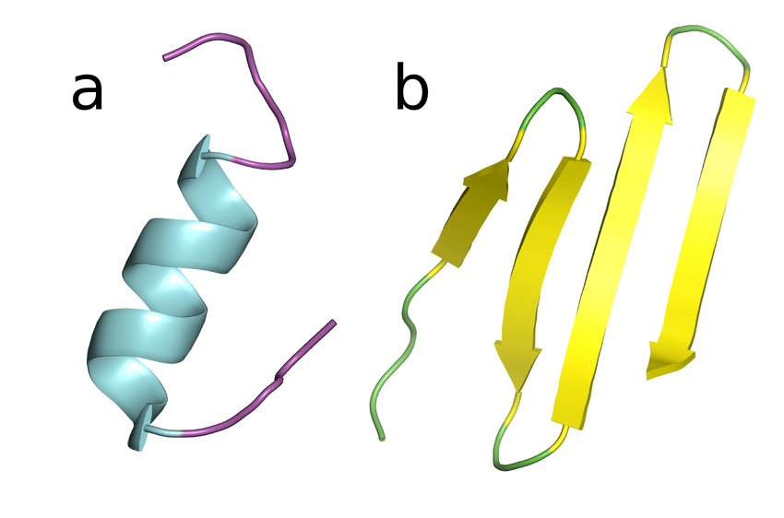
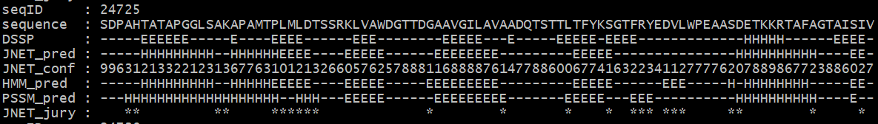
Secondary structure prediction with ML
Task:
Given a sequence of amino acids, predict whether each amino acid belongs to part of a helix (H), sheet (E), or anything else (C, for coil, or –)
Also known as 3 state secondary structure prediction
Approach:
Gather protein sequences with known 3D structures
Obtain secondary structure from 3D structures
DSSP - a hydrogen bond estimation algorithm
DSSP does not predict secondary structure
H
E
C
AA
Truth
Prediction
Confidence

Slide 3
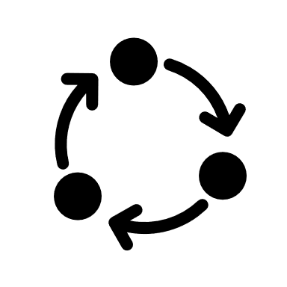
JPred algorithm
Input option 1
PDB search
for structural homologues
PSI-BLAST
Single sequence
PSI matrix
Jnet v2.3.1
2 PSSM neural nets
1 HMM neural nets
Multiple sequence alignment
HMMer3
Profile HMM matrix
Input option 2
Prediction
Proteocache
Drozdetskiy A, Cole C, Procter J & Barton GJ. Nucl. Acids Res. (first published online April 16, 2015) doi: 10.1093/nar/gkv332
Notes:
In this slide the algorithm underlying JPred4 is covered
The actual prediction itself relies on Jnet, an ensemble of artificial neural networks that returns the secondary structure prediction given sequence.
However, the main bulk of JPred’s computation time lies in generating the input for Jnet
In JPred4, the two inputs for Jnet are two profiles – a PSI-BLAST position-specific scoring matrix (or PSSM) profile and a hidden markov model profile
Step 1 – multiple sequence alignment
This step only applies if a user submits a single sequence
PSI-BLAST searches for related sequences in UniRef90. This step is done iteratively with increasingly stringent criteria.
The set of related sequences are then aligned against the query sequence to generate a multiple sequence alignment
Step 2 – Generation of profiles
Using the multiple sequence alignment, an HMM profile is generated from the HMMer program, and a PSSM profile is generated from PSI-BLAST
Together, the two profiles are fed as input into Jnet
Step 3 – Prediction using Jnet
I will now discuss more about Jnet on the next slide

Slide 4

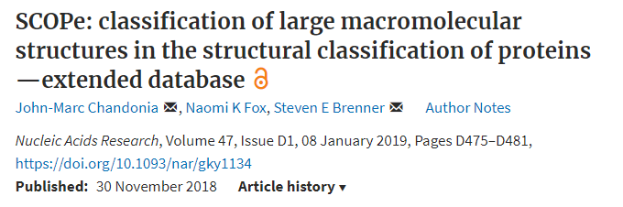
Data selection
1987
Pick superfamily representatives
1681
Filter by resolution
DCPB1500
1507 domain sequences for training and testing
1654
Filter by length
1634
Remove multi-chain domains
1634
Check for pairwise redundancy
1524
Check for missing DSSP info.
Notes:
This slide covers the filtering process for the data used to train Jnet
Jnet is trained with annotated data from a database known as structural classification of proteins extended, or SCOPe
SCOPe is a hierarchical database of protein domains, where a domain is defined as a globular protein unit that has been experimentally determined to fold and exist on its own. Protein domains in SCOPe are classified into class, fold, superfamily and family.
To train Jnet, 1 representative sequence was taken from each superfamily to give 1987 representative sequences
The following filtering steps were then applied to refine the data set:
Removing sequences whose corresponding structures had low resolution
Filtering by length. Sequences need to be long enough to fold as domains, but too long and PSIBLAST computation will take too much time
Domains made up of more than one polypeptide chain but are removed. There is no reason given but I think it is because multi-chain domains are made of super-secondary structures
Sequences were checked for pairwise redundancy using the AMPS algorithm with 100 randomizations. No such sequences removed
110 sequences which had missing secondary structure assignments in the DSSP database were excluded.
A few more sequences were manually removed giving us 1507 sequences for training and testing – unfortunately, some superfamilies are not represented in this dataset
More on DSSP:
DSSP is a database of ‘ground truth’ secondary structures extracted from crystal structures of protein domains on PDB.
DSSP database contains 8 states, which is reduced to 3 states to train Jnet – state H contains all types of helices, state E contains beta sheets, and all other is denoted as coils

Slide 5

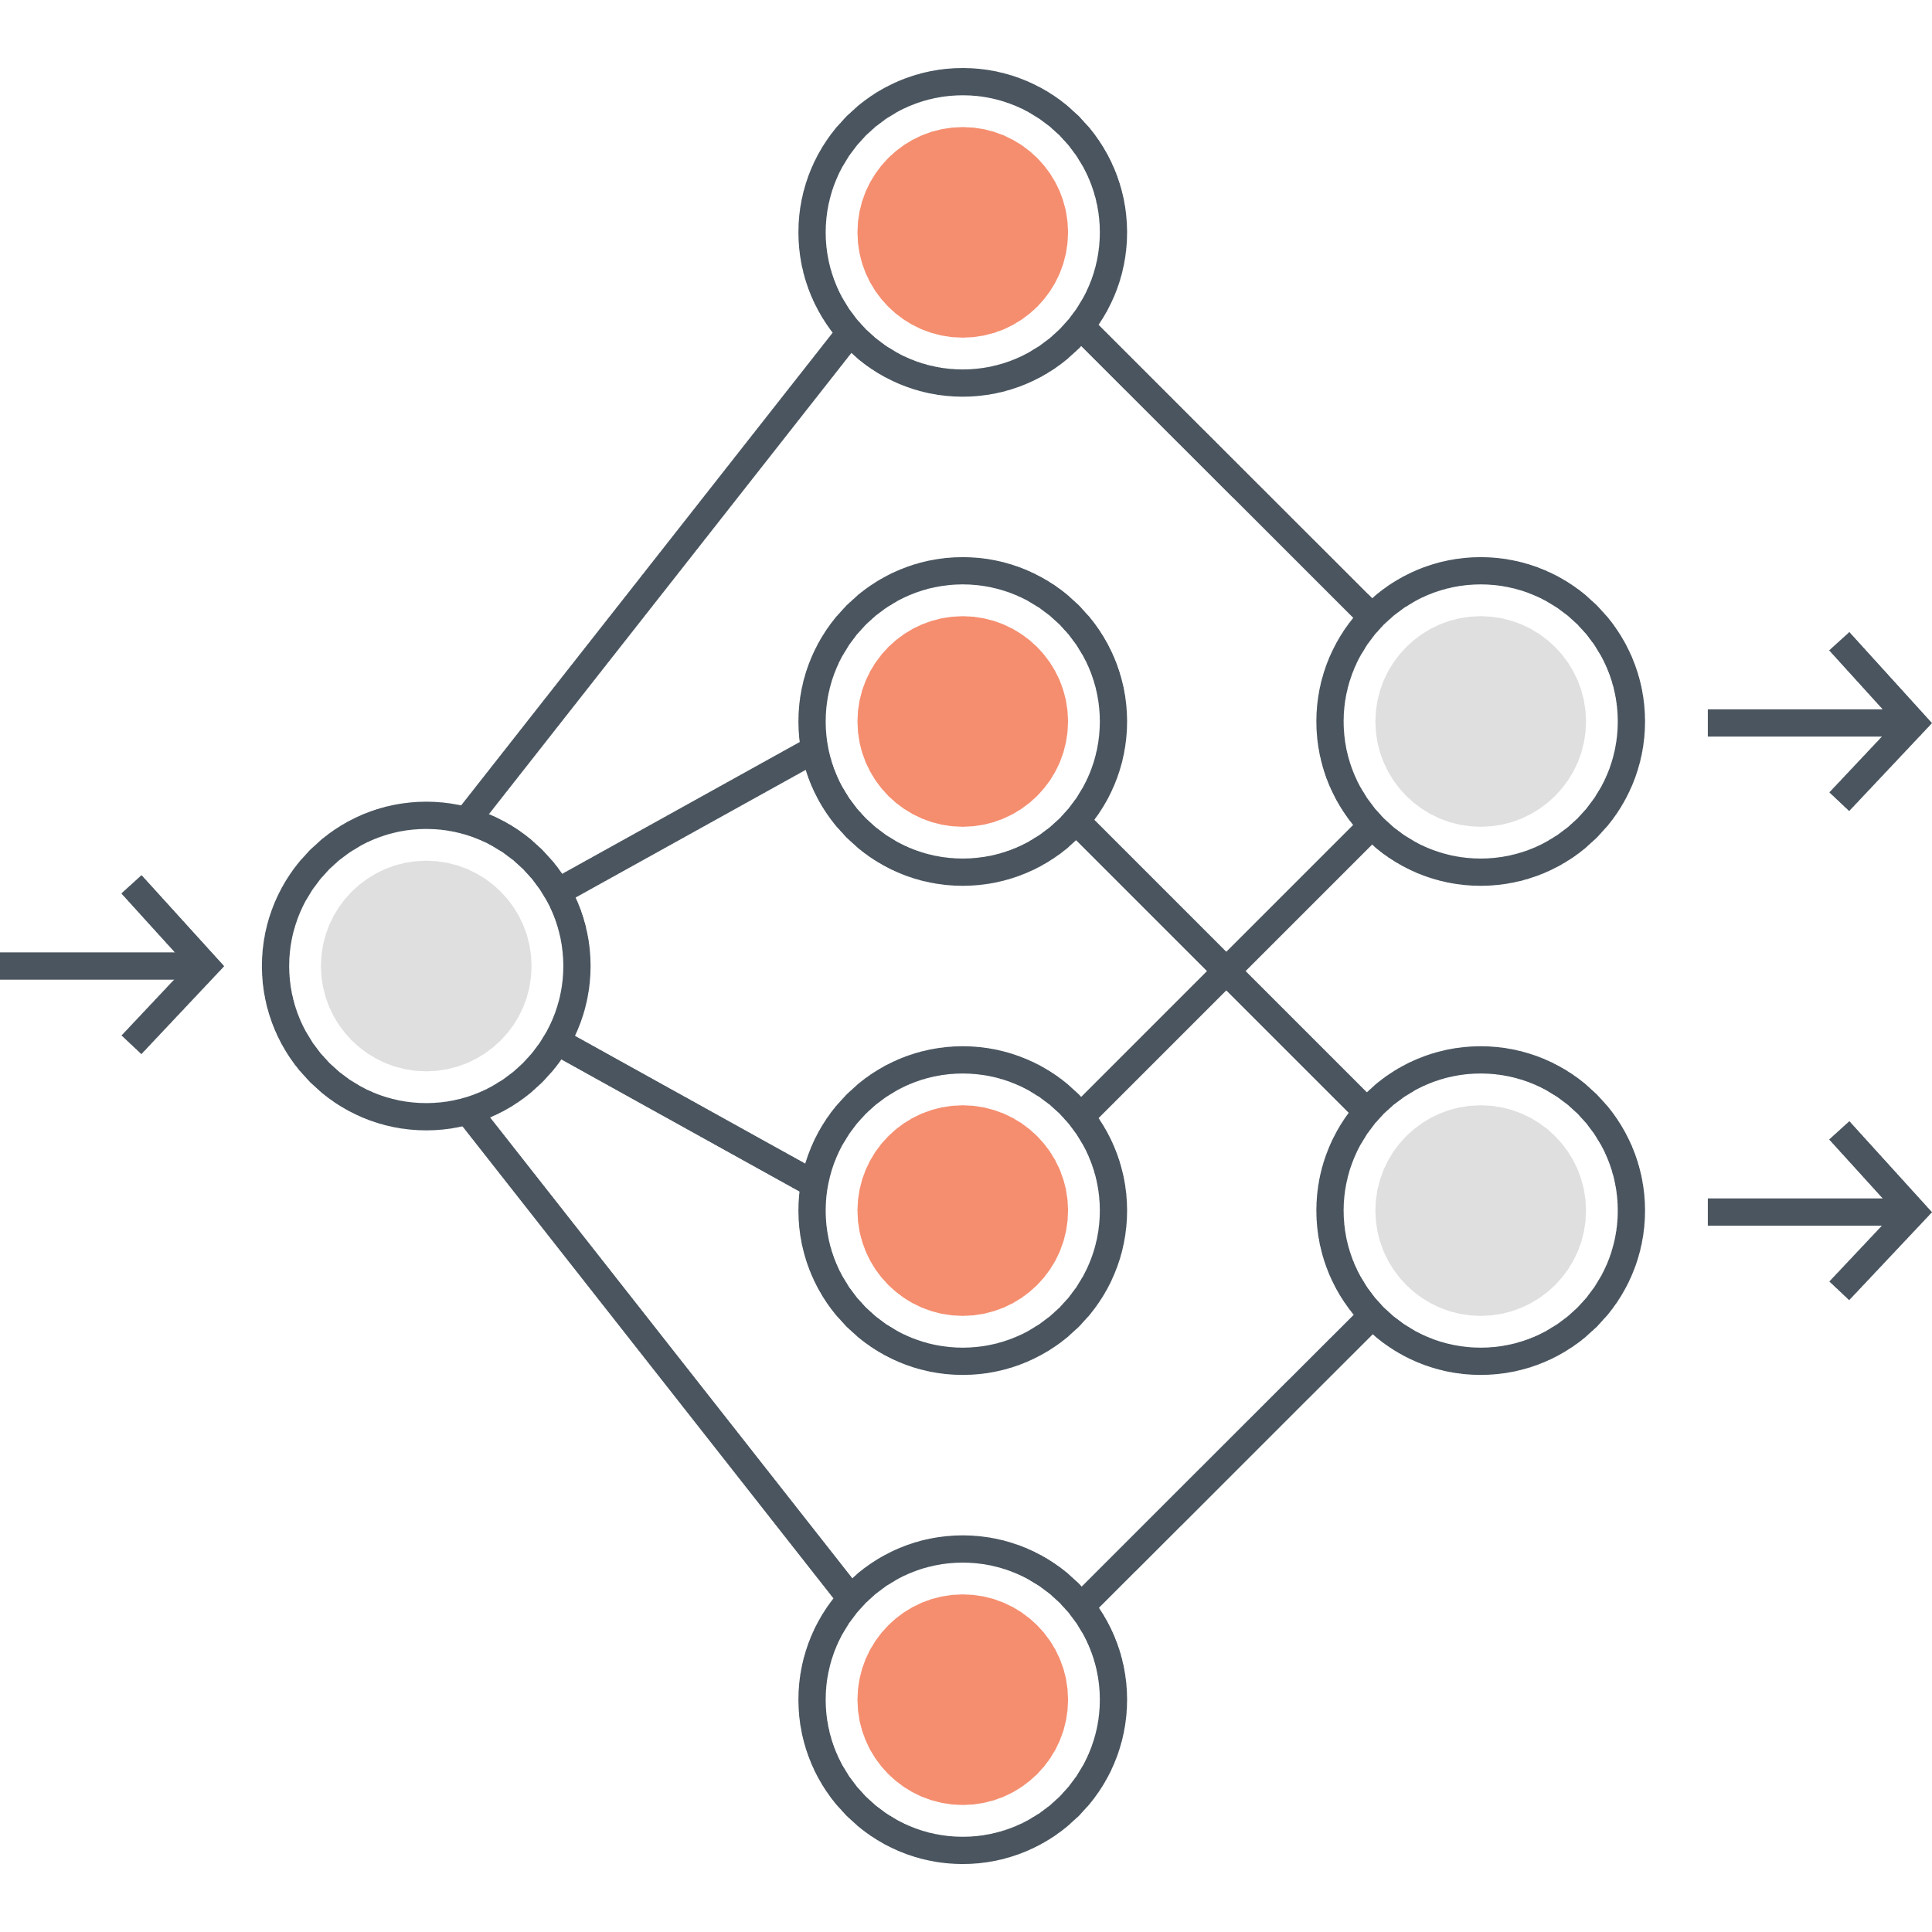
Jnet architecture
Input
Matrix
PSI matrix
Profile HMM
matrix
Windowing op 1
408 input units
100 hidden units
3 output units
Sequence to structure net
Windowing op 2
57 input units
100/20 hidden units
3 output units
Structure to structure net
0.25
0.25
0.5
Prediction is a 1:1:2 weighted average of the 3 pairs of nets
Notes:
Jnet v2.3.1 is an ensemble of neural networks in 2 dimensions:
On one hand, one arm of Jnet accepts a PSSM profile as input, the other accepts an HMM profile as input
On the other hand, each arm is a sequence-to-structure neural net feeding into a structure-to-structure net
The sequence-to-structure nets have input nodes constructed by passing the profiles through a sliding window of 17 residues, or more correctly 17 columns. This calculates possible secondary structures of residue i in the context of residues i-8 to i+8.
These nets have 9 hidden layers and 3 output nodes, 1 for each secondary structure state.
The output of the sequence-structure network is windowed into 19 residues. This becomes the input for the structure-to-structure net, which also have 9 hidden layers and 3 output nodes.
The prediction is the mathematical average of the output from the HMM net and PSSM net.

Slide 6
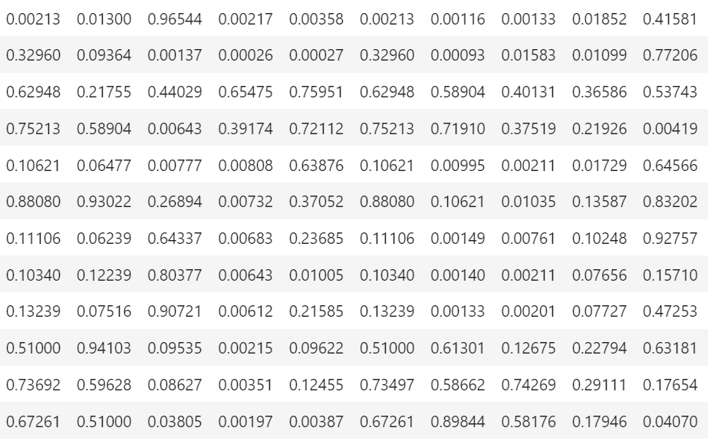
Window operation on PSI/HMM matrix
2p + 1 rows per amino acid position (p = flank size)
1 row per amino acid position
Shuffle rows
1 row = 1 training example for neural net
Notes:
PSI/HMM matrices are variable along the vertical dimension
Neural network predicts secondary structure of one amino acid at a time, so training examples have to be 1 amino acid at a time
Fixed sized input, where 1 amino acid is a [1 row x n column] vector
Naïve approach: take each row of PSI/HMM matrix as a training example
Predicting secondary structure based on how conserved an amino acid is
We can do better…
Assumption – secondary structure of most amino acids depends on the propensities of neighbouring amino acids
The PSI/HMM matrix is windowed
Each row contains information of p previous rows and p later rows
In JPred, this so-called flank size is 8 (and 9)
One weakness of this approach – poor prediction of beta strands, which form over widely separated regions of a polypeptide

Slide 7
Jnet training and testing
1507 sequences
1348 training
<1% difference in helical, sheet, and coil contents
149 blind-test
7x cross-validation
Notes:
Jnet is trained with annotated data from a database known as structural classification of proteins extended, or SCOPe
SCOPe is a hierarchical database of protein domains, where a domain is defined as a globular protein unit that has been experimentally determined to fold and exist on its own. Protein domains in SCOPe are classified into class, fold, superfamily and family.
To train Jnet, 1 representative sequence was taken from each superfamily to give 1987 representative sequencesq
The following filtering steps were then applied to refine the data set:
Removing sequences whose corresponding structures had low resolution
Filtering by length. Sequences need to be long enough to fold as domains, but too long and PSIBLAST computation will take too much time
Domains made up of more than one polypeptide chain but are removed. There is no reason given but I think it is because multi-chain domains are made of super-secondary structures
Sequences were checked for pairwise redundancy using the AMPS algorithm with 100 randomizations. No such sequences removed
110 sequences which had missing secondary structure assignments in the DSSP database were excluded.
A few more sequences were manually removed giving us 1507 sequences for training and testing – unfortunately, some superfamilies are not represented in this dataset
The 1507 sequence dataset was divided into a training subset with 1348 sequences and a blind-test subset with 149 sequences
The training subset and blind-test subsets were chosen such that the percentage content of helix, sheet, and coil of the were within 1% of each other. This produces a similar distribution of secondary structure compositions as training sequences to avoid biasing the reported accuracy of blind test results.
250 epochs of scaled conjugate gradient (SCG) were applied from nodes initialized with randomly assigned weights of values between 0.005 and -0.005 with no optimization of the number of epochs
In each epoch, 7-fold cross validation was performed on the training subset
The blind-test subset comprised of one representative each of 149 superfamilies not used in training
Accuracy assessed by comparison with DSSP information

Slide 8
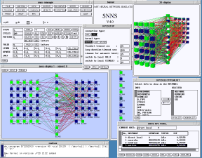

Issues around retraining Jnet
Motivation
JPred training code was mostly written in Perl around 20 years ago
Neural nets are trained with SNNS (Stuttgart University Neural Network Simulator) - outdated
Switch to a widely adopted language like Python so more people to work on it
Switch to faster, scalable, and customizable library such as TensorFlow 2 and its high-level API Keras
Aims of project
Rewrite JPred training code in Python as a staging language
Achieve similar validation accuracies with TF2
Compare predictions of JPred with that of AlphaFold
TensorFlow: A system for large-scale machine learning (https://research.google/pubs/pub45381/)

Slide 9
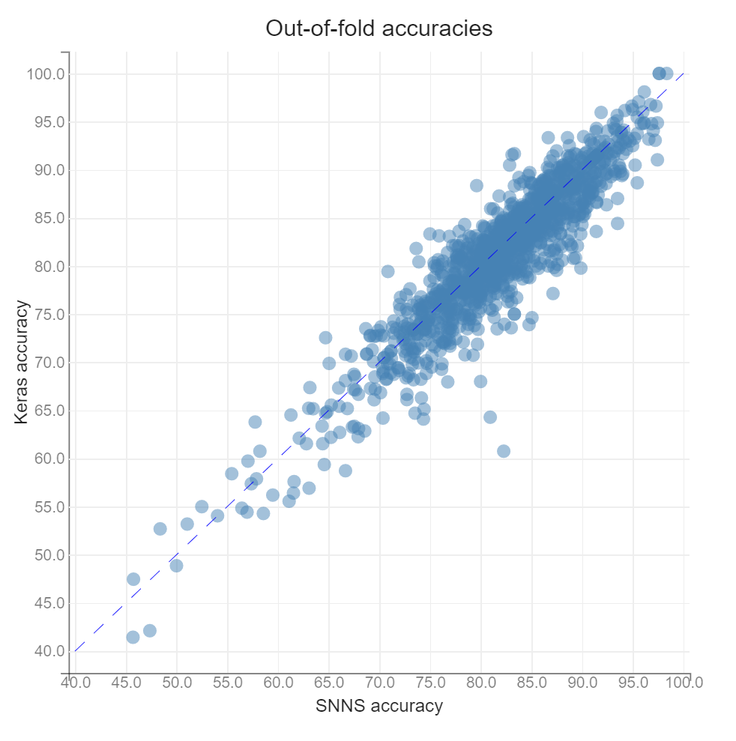


JPred retraining results
Retrained both SNNS and Keras on the same 7 fold split
SNNS outperforms Keras based on this cross-validation
**
Hyperparameters
Loss: SSE, MSE
Optimizer: scaled conjugate gradients
Batch size: *
Epochs: 300
Learning rate: *
Initializer: random uniform (± 0.05)
Activation: logistic, logistic
Hyperparameters
Loss: CCE
Optimizer: stochastic gradient descent
Batch size: 128
Epochs: 300
Learning rate: 0.01
Initializer: glorot_uniform
Activation: logistic, softmax
**
Experiment name: 26Aug_jpred
Source: /cluster/gjb_lab/2472402/results/[snns,keras]/26Aug_jpred
*Were not specified in SNNS batch file – perhaps refer to SNNS documentation for default values

Slide 10
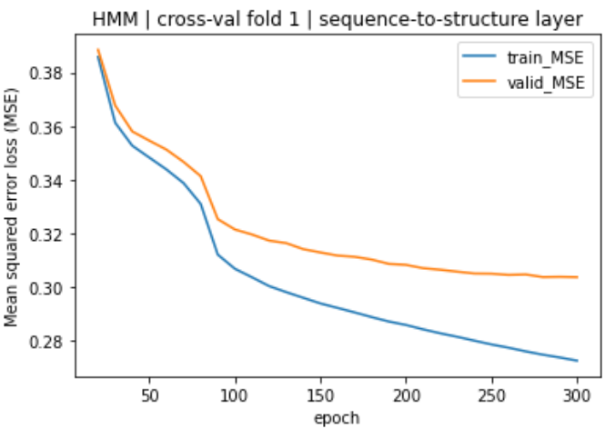
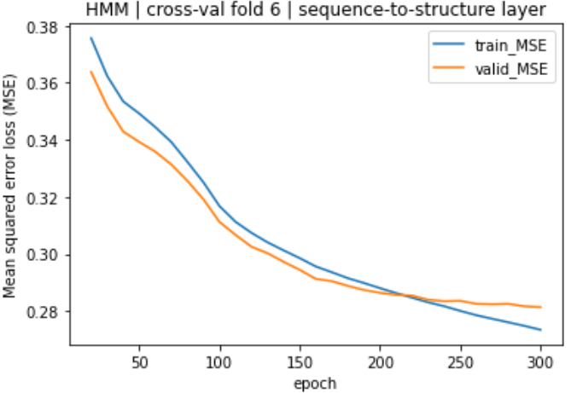
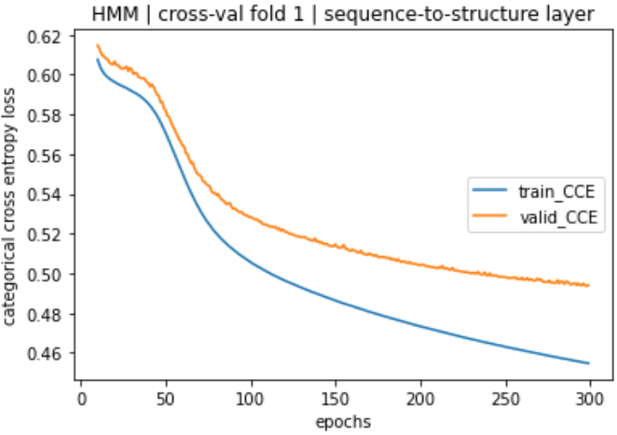
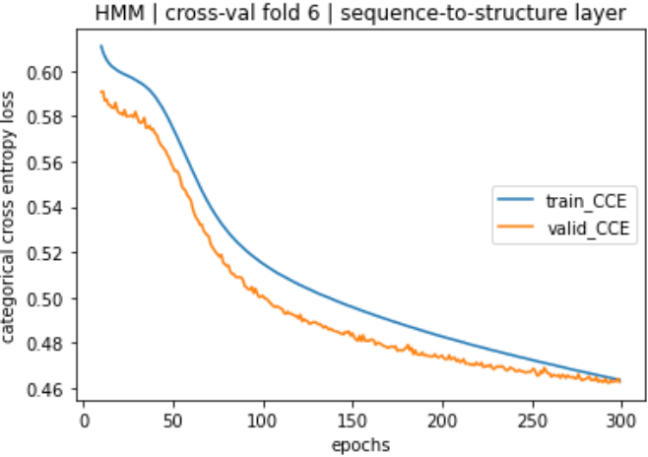
Comparison of SNNS and Keras training curves
SNNS:
Mean square error (MSE) loss
In most folds, loss curves* resemble left
In one fold, loss curve resembles right
Examples in validation set were ‘easier’ to predict than those in training set?
Keras:
Categorical cross-entropy (CCE) loss**
Issue with validation loss in the same fold as SNNS
Could this be due to an uneven SS content across splits?
*Similar results for PSSM neural nets. Refer to /cluster/gjb_lab/2472402/jupyter_notebooks/visualization/CV-plots.ipynb
**MSE was also used but led to concave learning curve – results are in /cluster/gjb_lab/2472402/outputs/keras_train_CV_old/[hmm,pssm]_cross_val_mse

Slide 11
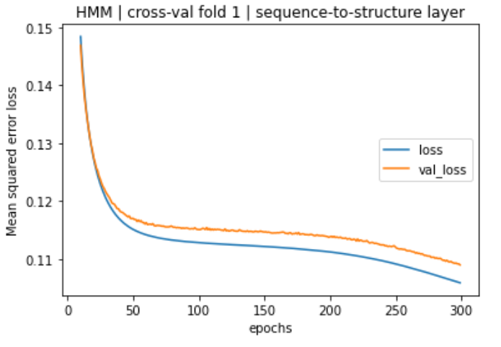
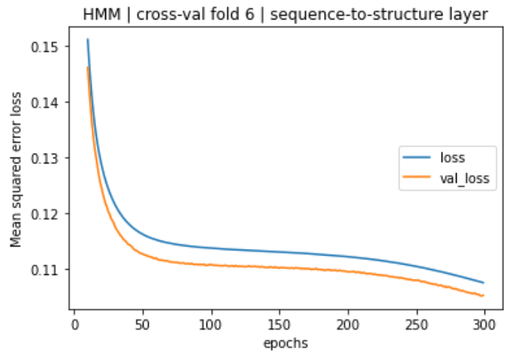
The issue persists when MSE loss is used

Slide 12
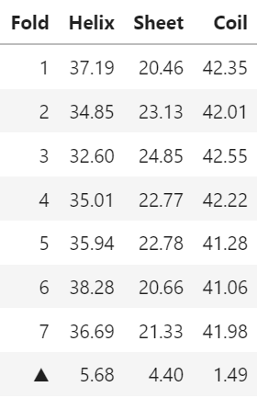

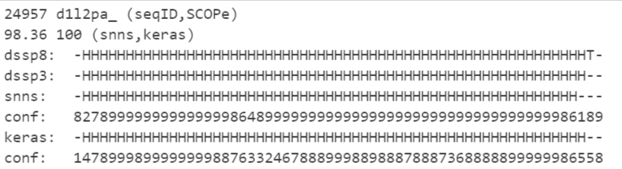
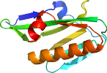
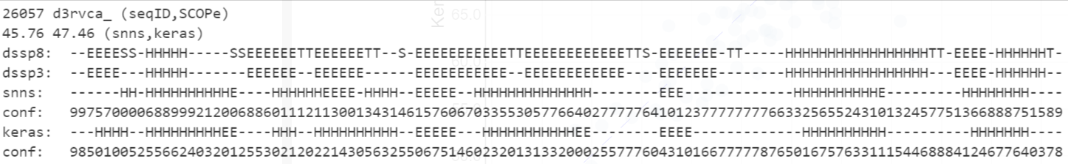
Comparing SS content across cross-validation folds
Easy case
Split into 7 sets
High Q3 accuracy
Difficult case
Low Q3 accuracy
Huge range in SS content…
Notes:
1348 sequences are randomly split into 7 subsets
Secondary structure is almost always unbalanced
Refer to the table where last row shows the difference between the maximum and minimum percentage content across the first 7 rows
This can be a problem as…
protein sequences with higher helix content are generally easier to predict
A fold that is tested on examples with high helix content will score better
As such, the disparity in secondary structure content across the folds becomes the prime suspect for the apparent uneven distribution in difficult-to-predict sequences

Slide 13
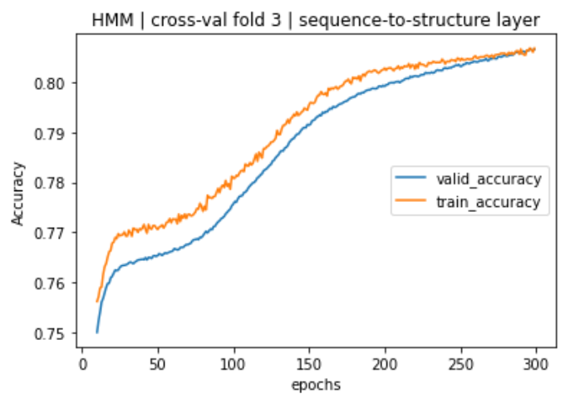
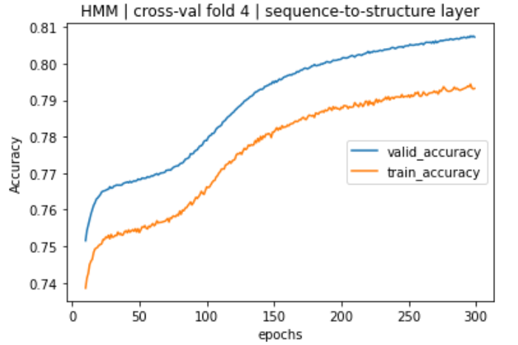
Hypothesized pathological scenario
Train set
Validation set
Expected: Validation accuracy is lower than train accuracy
Train set
Validation set
Surprising: Validation accuracy is greater than train accuracy

Slide 14
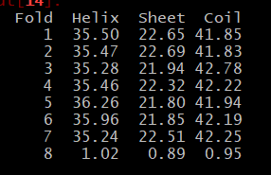
Retraining with balanced splits
Δ
Source: ~/jupyter_notebooks/machine_learning/2021-09-21-measure-shuffle-SS-content.ipynb
~/scripts/2021-09-21-measure-shuffle-SS-content.py
Notes:
Generated 7-fold splits until SS contents were close enough of each other
In this case the range of secondary structures is around 1% , compared to the previous 5%
Ensures that each class is evenly represented across the folds
One thing to note is that they are shuffled at the protein sequence level, not the amino acid level – a future area will be to explore doing the train test split on the 218,000 or so individual examples – which will eliminate any worries about uneven distribution of classes
The code to is available bottom right
In previous attempts I forgot verify that the secondary structure contents of the obtained splits were indeed similar – upon checking, they were not the same. Was almost led to think that the validation loss issue had nothing to do with uneven distribution.
Lesson learnt to write functions to test output

Slide 15
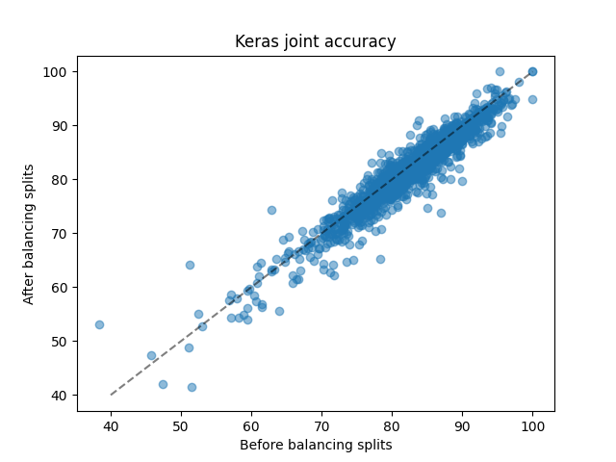
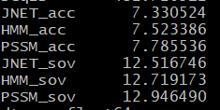
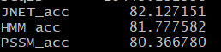
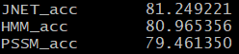
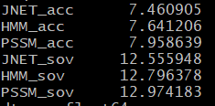
Retraining on balanced split
For reference…
Experiment names: Vertical axis – 21Sep, Horizontal axis – 26Aug_jpred
Notes:
Scores for SNNS are not ready yet

Slide 16
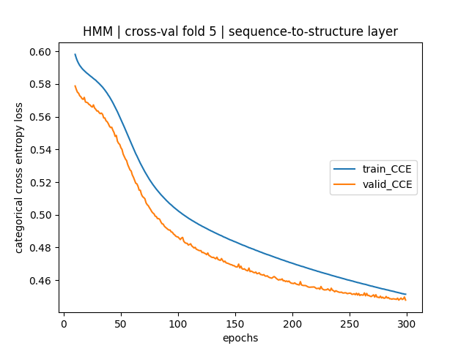
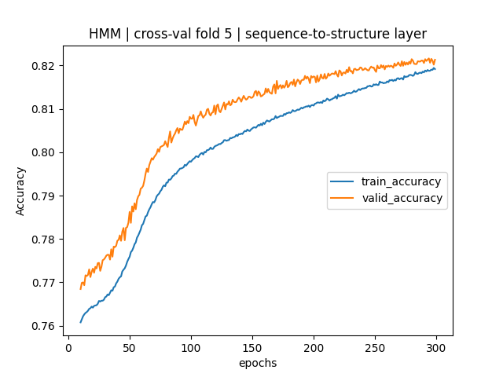
Balanced split – no effects on loss curves?

Slide 17
Newer versions of retraining
Trained on variable batch sizes – lowers accuracy
Batch size = sequence length
Convenient to code
Training both layers at the same time – lowers accuracy

Slide 18

AlphaFold secondary structure prediction
N = 1348
N = 365198
Out-of-fold predictions of SCOPe domains
Predictions of UniProt reference proteome
N = 451
Source: /cluster/gjb_lab/2472402/data/alphafold-alignments/summary_threshold_0.90.txt
Notes:
Alphafold has 90% accuracy in 3D prediction, and it is relevant to ask how well it predicts secondary structure
Using it for secondary structure prediction is an overkill, but it is interesting to compare how well alphafold and jpred agree with each other, and in which domains they do not
Of the 1348 Jpred training sequences, 451 of them already had AlphaFold predictions. I found this by obtaining the uniport IDs of these SCOPe domains, and searching the AlphaFold database for these Uniprot IDs
Downloaded the 451 PDBe files
Ran DSSP on AF 451 PDBe files to get secondary structure predictions
Aligned UniProt sequences (on which AlphaFold PDB structures are based) to SCOPe domain sequences. In most cases, the UniProt sequence is longer and is truncated
In the next slide I show the alignments
Yet to be able to score position by position, so next slide is just showing visually the aligned predictions of a select few sequences
Makes scoring slightly involved as it involves alignment

Slide 19
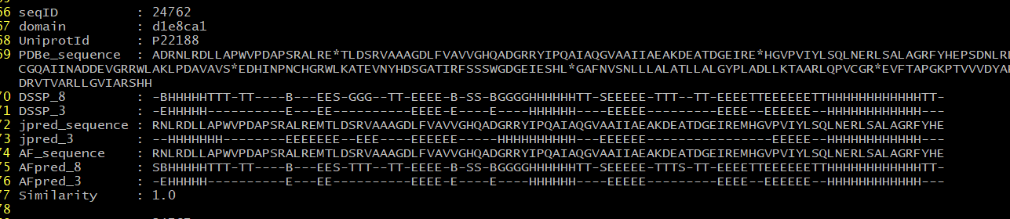
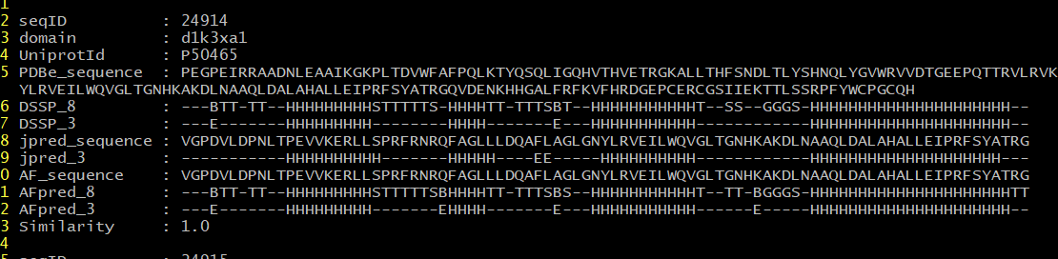
Performance of JPred vs AlphaFold
source ~/data/alphafold-alignments/summary_threshold_0.90.txt
Notes:
Similarity is the percentage match between SCOPe sequence (jpred_sequence) and UniProt sequence (AF_sequence)
AF predictions are originally in the 8 letter DSSP state, reduced to 3 letter DSSP for comparison with Jpred
This is not a matched comparison – it is unknown whether AlphaFold has been trained on these sequences, which will then be a form of recall. It probably is because these are sequences for which solved structures exist, and would have been used to train AlphaFold
On the other hand, JPred predictions are in-fold predictions – recall accuracy
The best comparison would be to compare predictions against sequences the two have never encountered

Slide 20
Conclusion
Retrained Jnet with newer ML techniques
Similar accuracy*
Compared predictions of Jpred and AlphaFold
Based on retraining with most recent (21/09/2021) balanced split

Slide 21
Thank you!

