Slide 1
Multi-omics analysis of functional high risk patients in CoMMpass
Chang Jia Geng

Slide 2
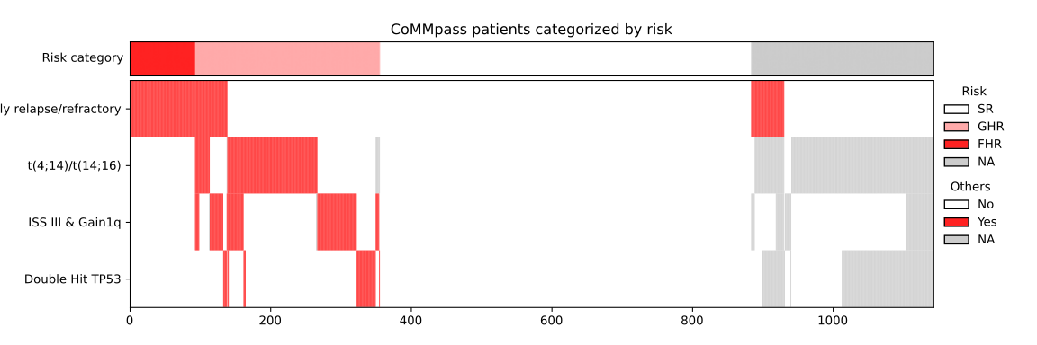
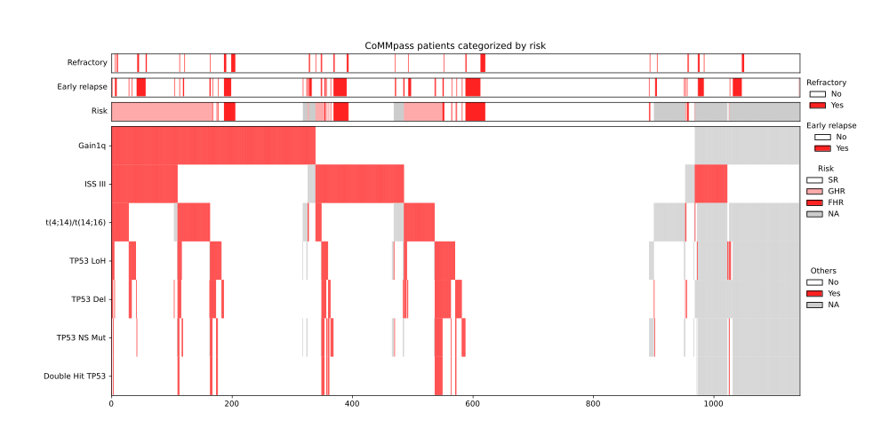
Defining functional high risk in CoMMpass
Early relapse: progression within 18 months since treatment start or within 12 months of autologous stem cell transplant
Refractory: the “best response” column is “Stable disease” or “Progressive disease”
Double hit TP53: Non-synonymous mutation of TP53 AND 17p13 deletion (copy number segment mean < -0.2) OR loss of heterozygosity (B-allele frequency < 0.25 )

Slide 3
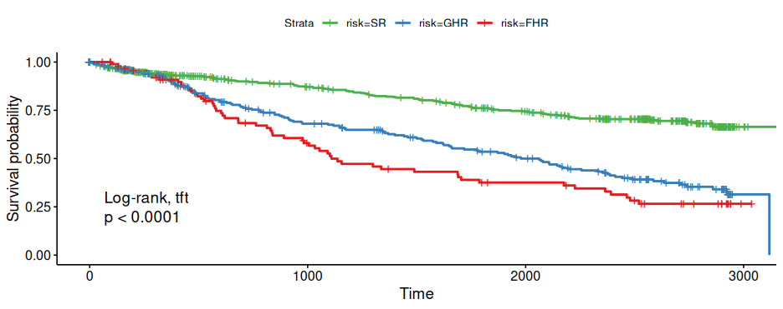
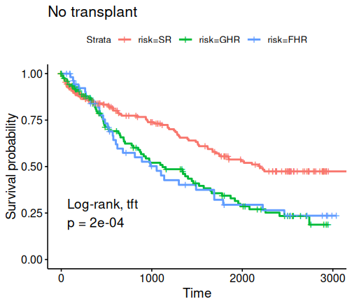
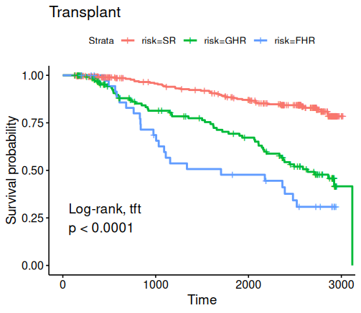
Baseline characteristics of FHR patients
 | SR: 528 (60%) | GHR: 263 (30%) | FHR: 93 (10%)
Age***
<63 | 281 | 130 | 28
>=63 | 247 | 133 | 65
Gender
Male | 322 | 152 | 56
Female | 206 | 111 | 37
ISS***
I | 234 | 54 | 30
II | 201 | 75 | 32
III | 83 | 130 | 28
Transplant received*
None | 221 | 126 | 55
Autologous | 305 | 137 | 38
Allogenic | 2 | 0 | 0
Chi-squared test significance: * p < 0.05, **p < 0.005, ***p < 0.0005

Slide 4
Unsupervised omic clustering of MM cases
Simultaneous modeling of multiple data types with a shared latent space with iClusterBayes
673 samples with “quadruplet” data set – expression, mutation, copy number, and risk labels
Unsupervised feature selection - top 1000 variably expressed genes, mutation rate 5% (18 genes), 1464 copy number segments (merged with iClusterPlus::CNregions)

Slide 5
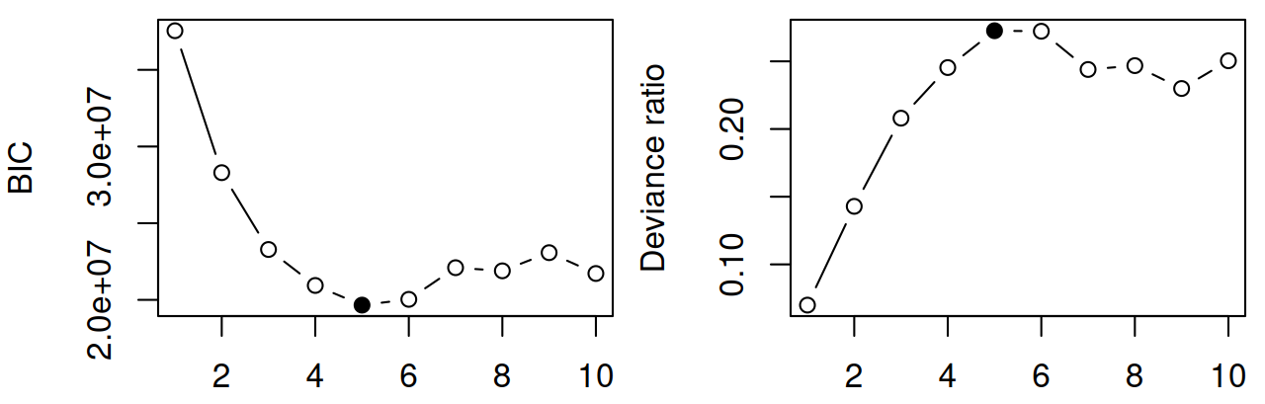
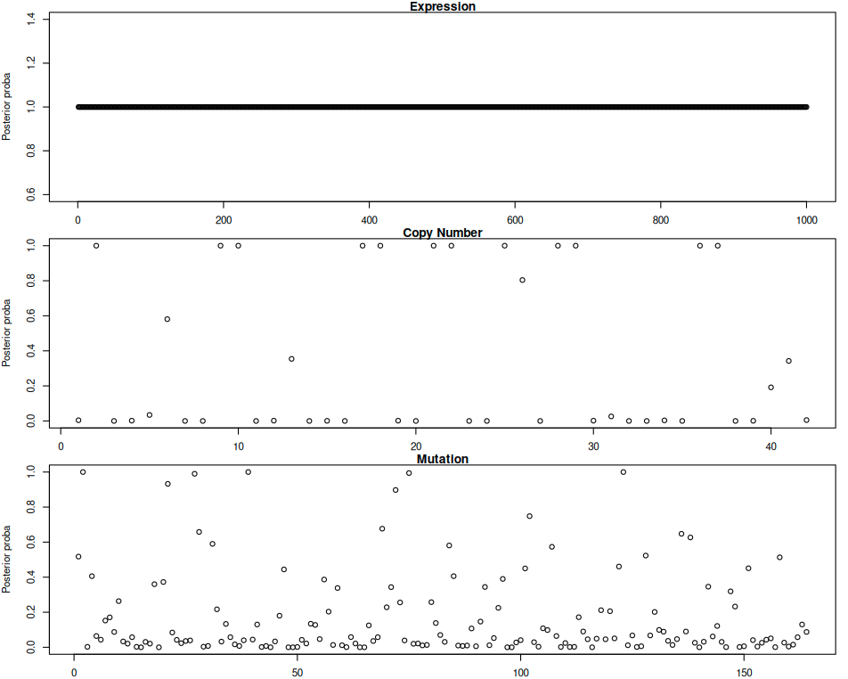
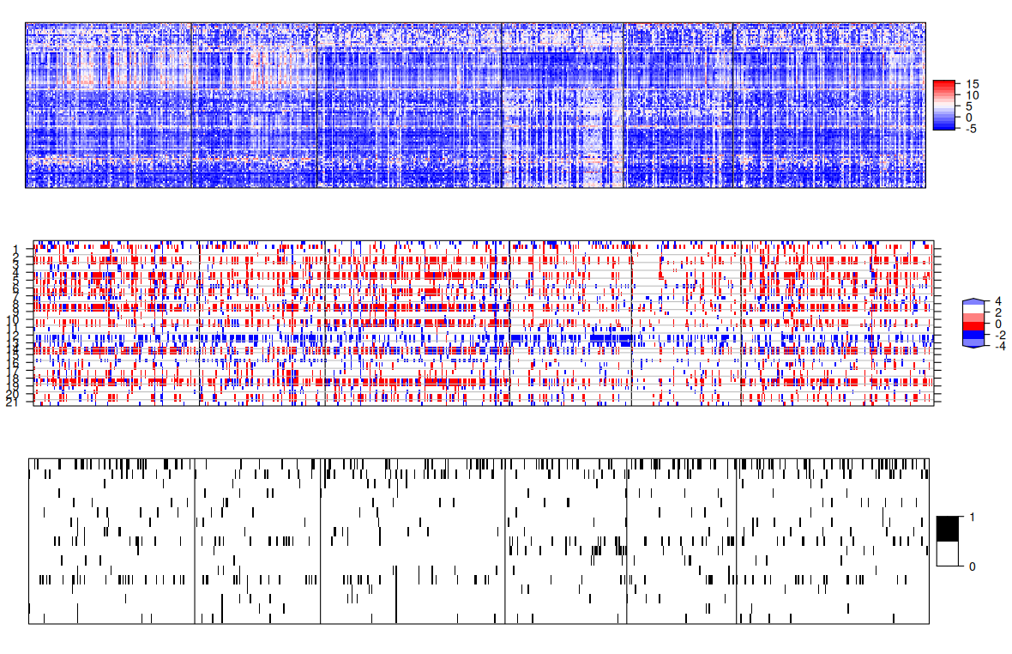
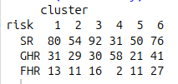
Unsupervised multi-modal clustering does not isolate FHR
K=5 (6 clusters) is optimal
Feature importance (0-1)
Bayesian Information Criterion and deviance ratio support K=6 (7 clusters) as the optimal solution
Feature importance indicate that clustering is mostly driven by gene expression
There is no enrichment of FHR or GHR in any cluster. Cluster 3 is depleted in FHR.
Heat map of gene expression (top 100), copy number (all 42) and mutations (top 16)
Number of FHR patients in each cluster

Slide 6
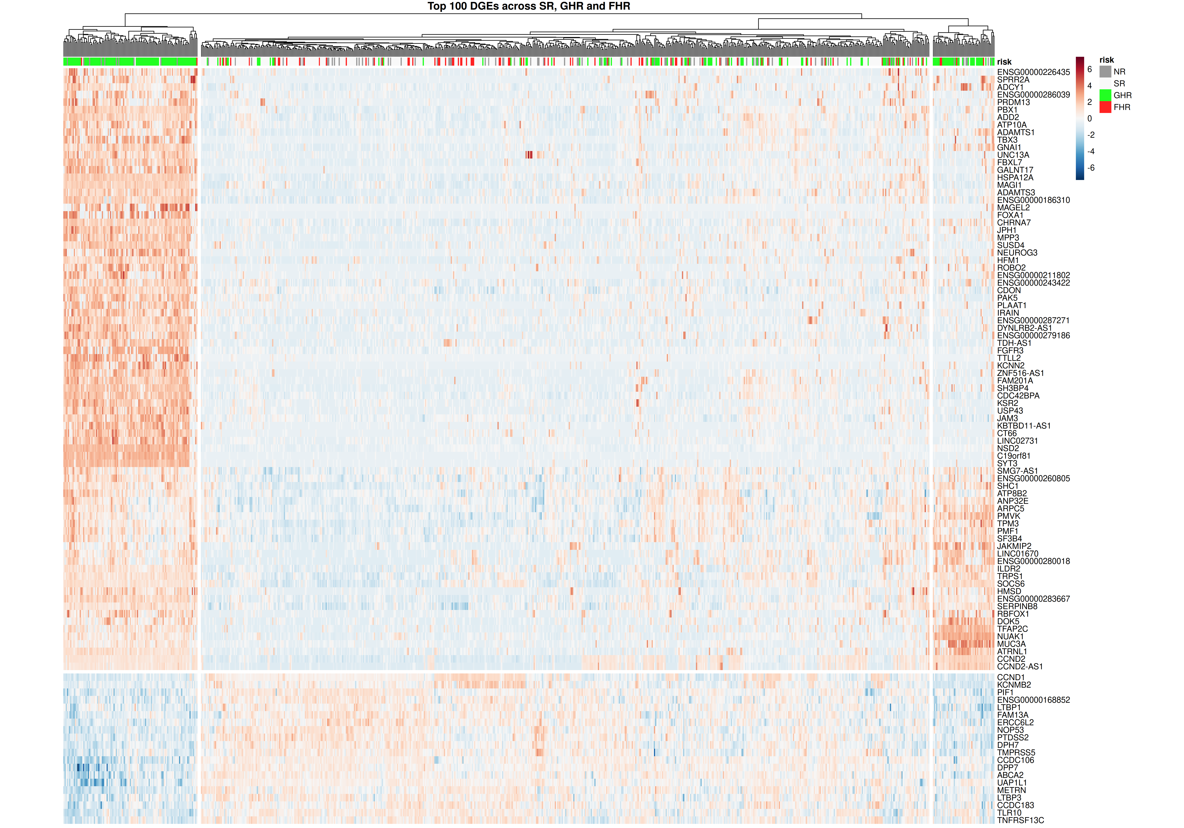
Hierarchical clustering with gene expression only clusters GHR
Perform hierarchical clustering on top 100 significant genes
  Based on pairwise comparisons of SR, GHR, and FHR groups
  DGE workflow on next slide
Clustering of a majority of GHR cases
No separation between SR and FHR
Unsupervised clustering of log counts per million expression of 100 genes. Plotted with R pheatmap.

Slide 7
Differential gene expression (DGE) pipeline
Start with salmon gene-level read count estimates
Filter genes by expression level (EdgeR::filterByExpr)
Transform counts into log2-CPM (EdgeR::voom)
Fit a microarray linear model (limma:lmFit)
Compute fold changes and t-statistics between the 3 risk groups FHR,GHR,SR (limma:contrasts.fit,eBayes)
Adjusted p values (BH) < 0.05:
  3873 for FHR vs GHR, 32 for FHR vs SR, 7807 for GHR vs SR

Slide 8
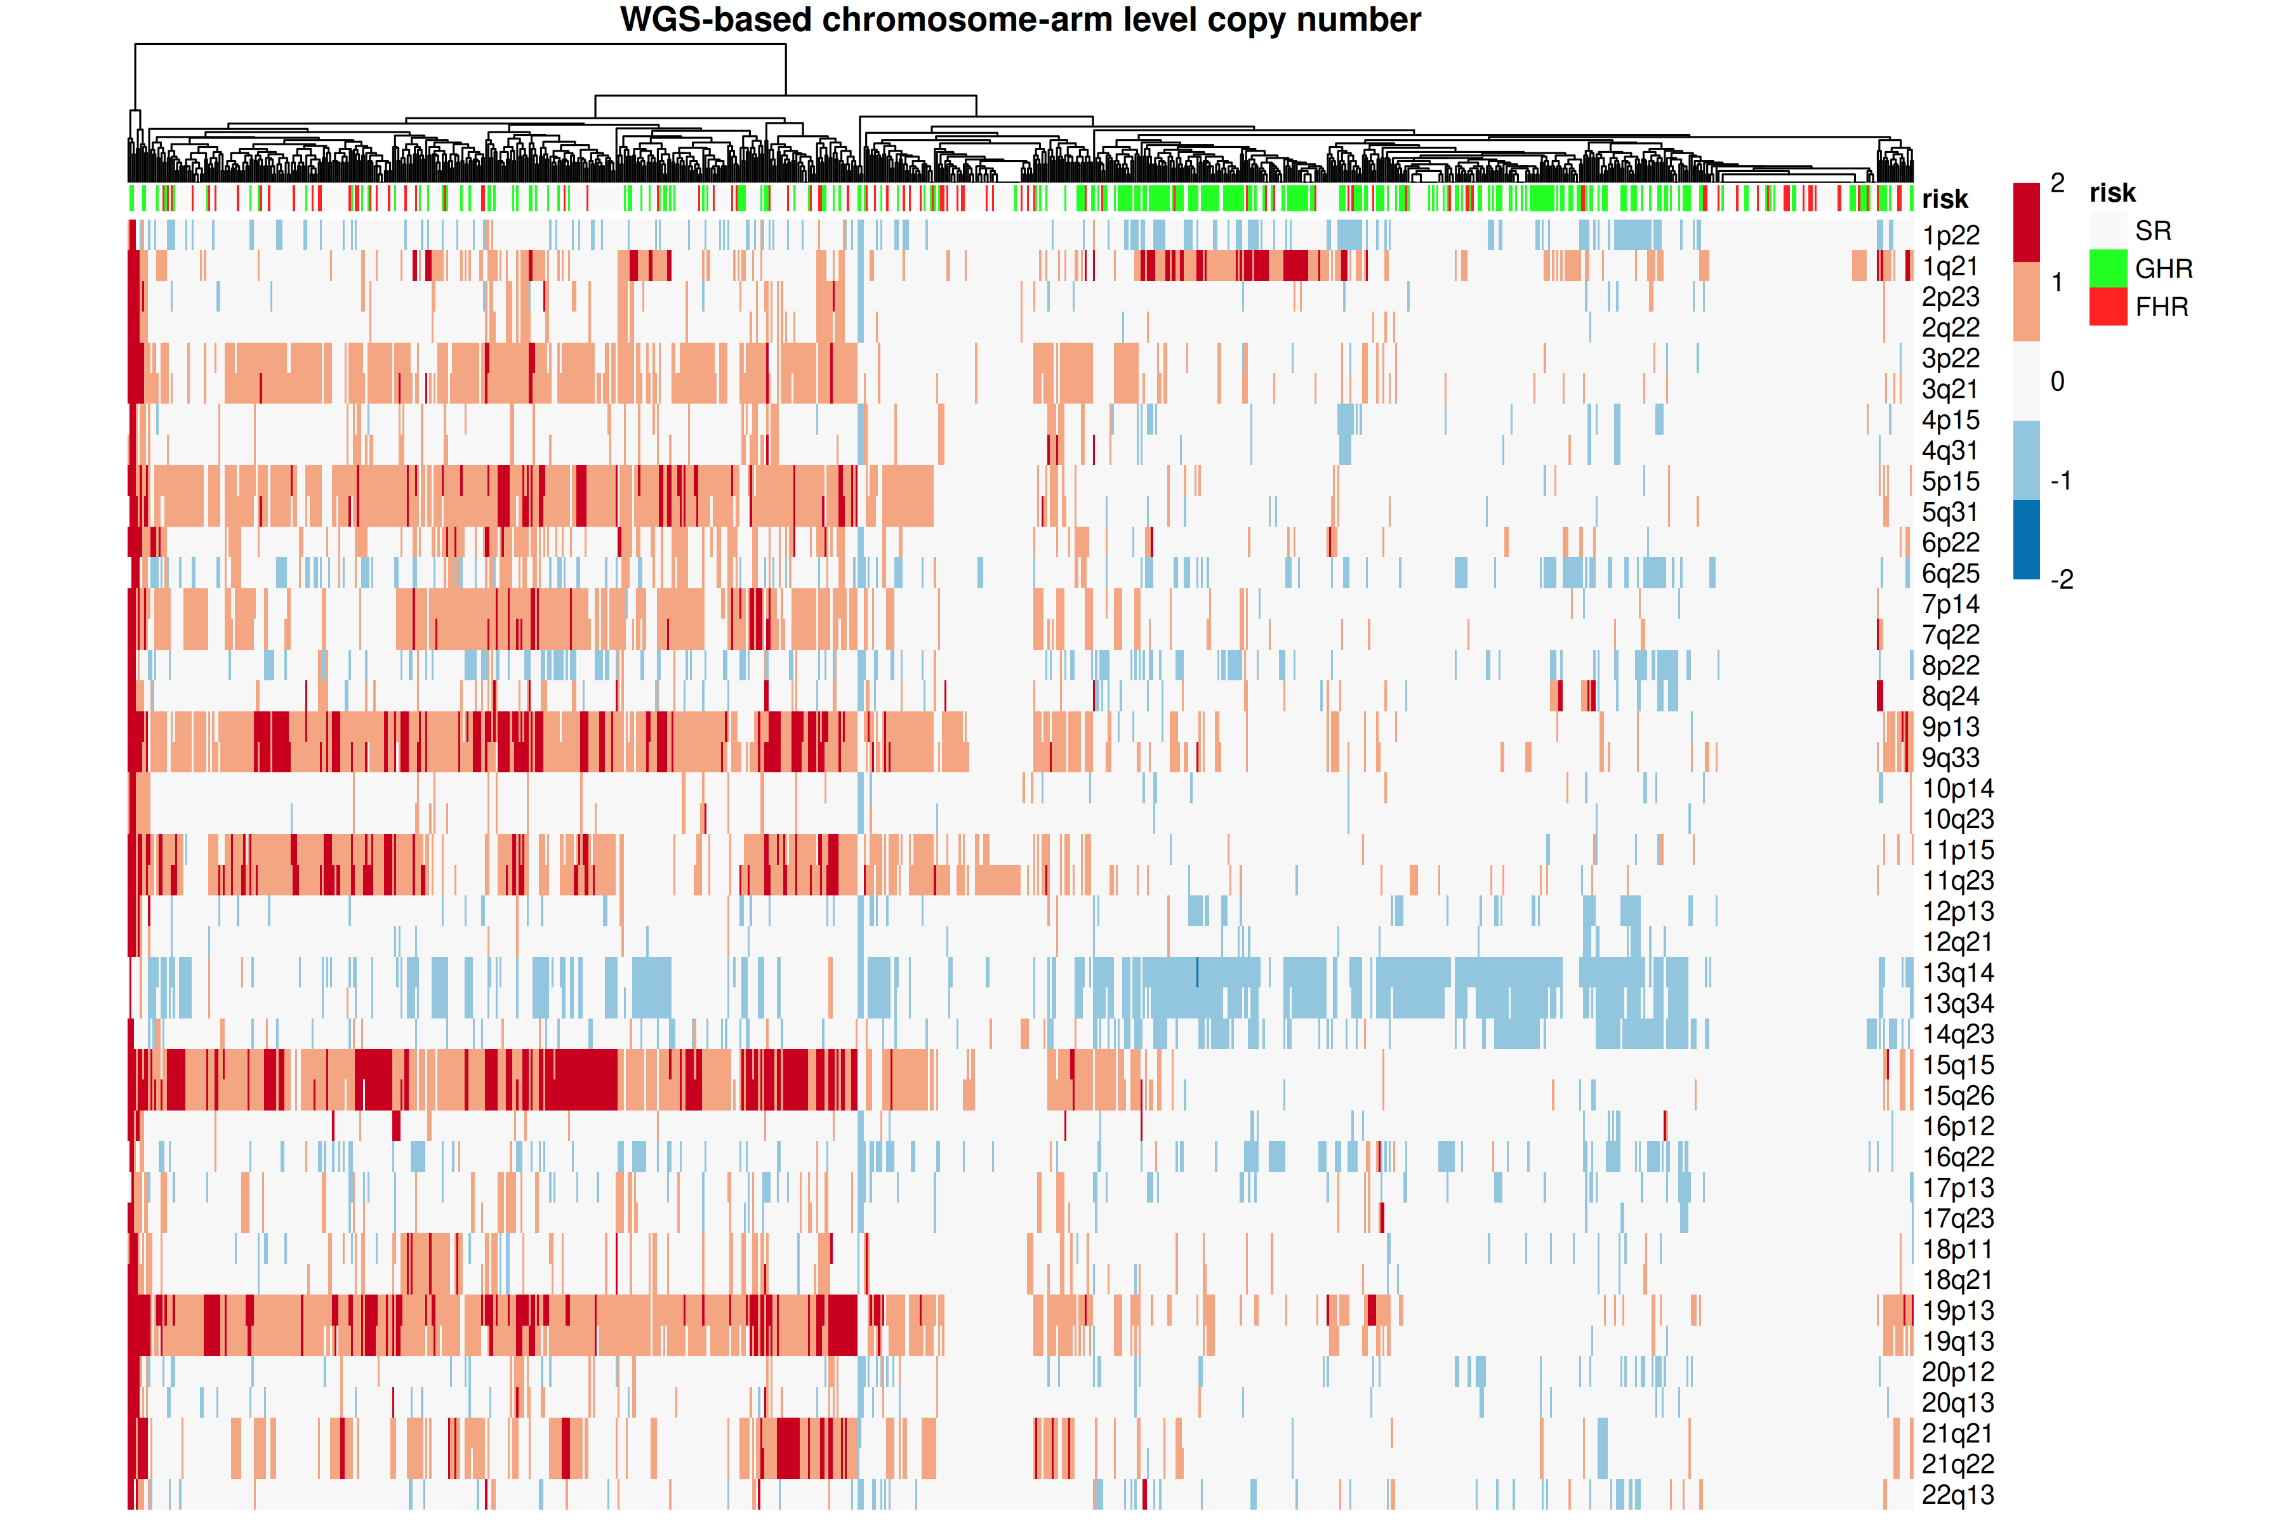
Hierarchical clustering with arm-level CN can weakly cluster GHR
Copy number statuses of 42 autosome chromosome arms
GHR cluster is marked by gain1q21 and del13q
Weak association of hyperdiploidy and non-GHR cases
No indications of difference between SR and FHR
Unsupervised clustering with integer copy number status of 42 chromosome arms. Plotted with R pheatmap.

Slide 9
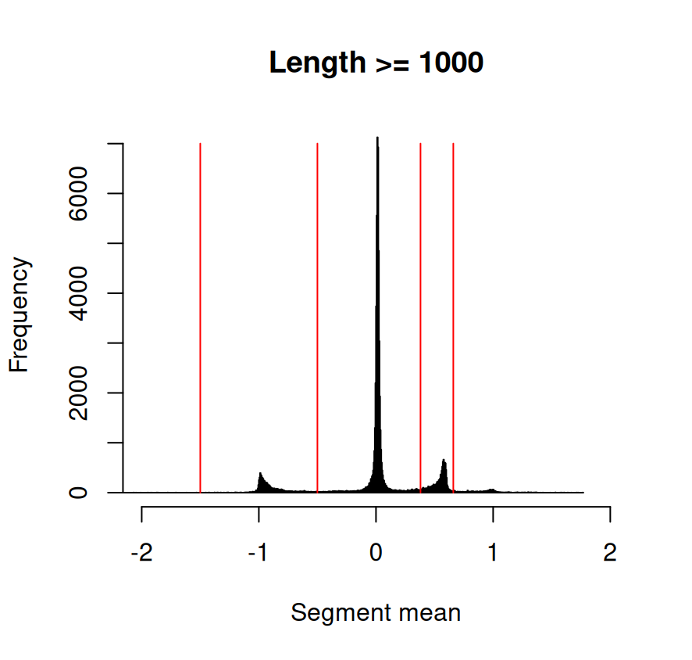
Pipeline for copy number aberrations (CNA)
Integer copy number levels
3 levels of CN analysis
  Chromosome-arm level
  Non-redundant segment level
  Gene level
Use iCluster::CNregions to get 1146 non-redundant segments
  Merging of segments with >50% overlap
For gene level CN, if the the value changes in the middle a gene, take the average
For all levels, convert raw segmentation values to copy number statuses (-2, -1, 0, +1, +2)
(,-1.5] → -2
[-1.5,-0.5) → -1
[-0.5, 0.38) → 0
[0.38, 0.66) → +1
[0.66, ) → +2
Thresholds for conversion of segment mean values to integer copy number statuses

Slide 10
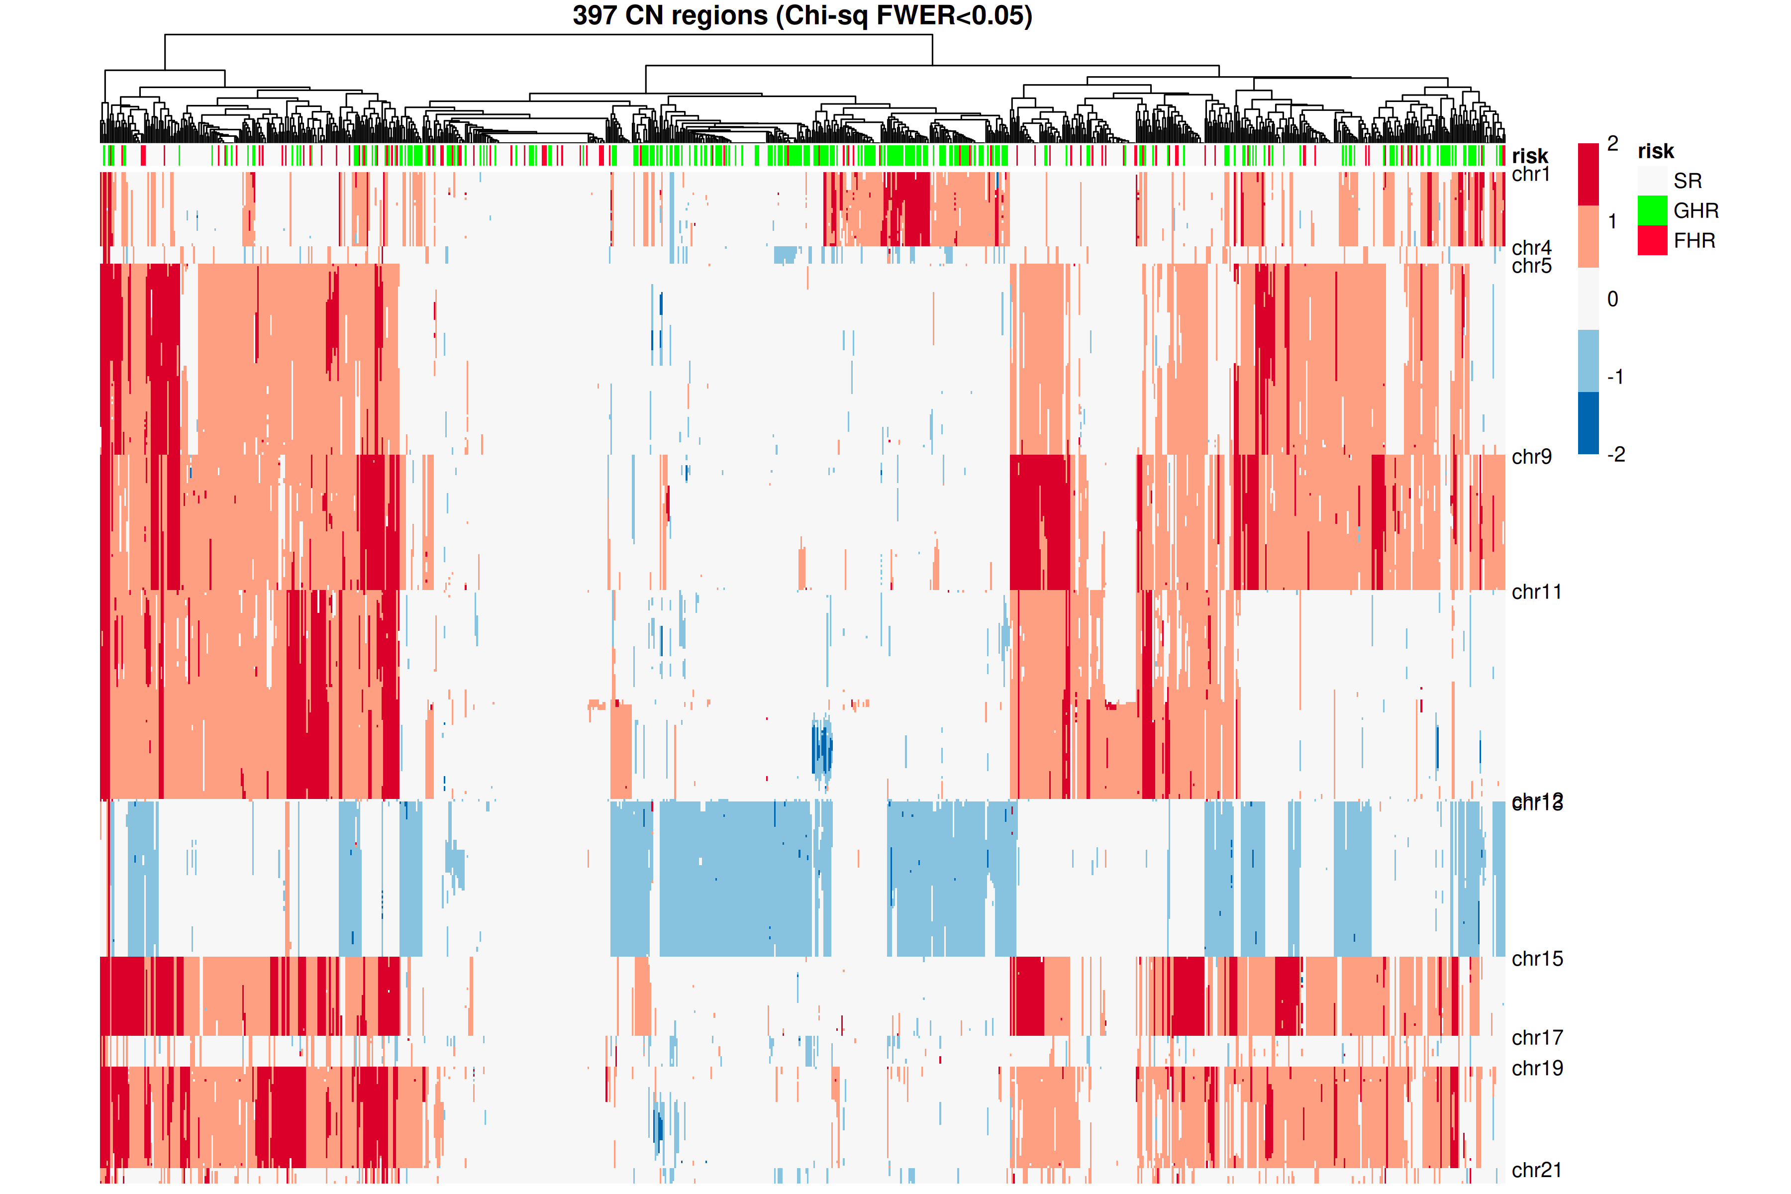
Hierarchical clustering with segment CNA gives similar results
Use 397 segments with p<0.05* on Chi-squared test
GHR cases in the middle share gain1 and del13
Other significant segments are mostly located in chromosomes implicated in hyperdiploidy – 5, 9, 11, 15, 19
 | -2 | -1 | 0 | +1 | +2
SR
GHR
FHR
*p values are adjusted with the Bonferroni method which controls the family wise error rate

Slide 11
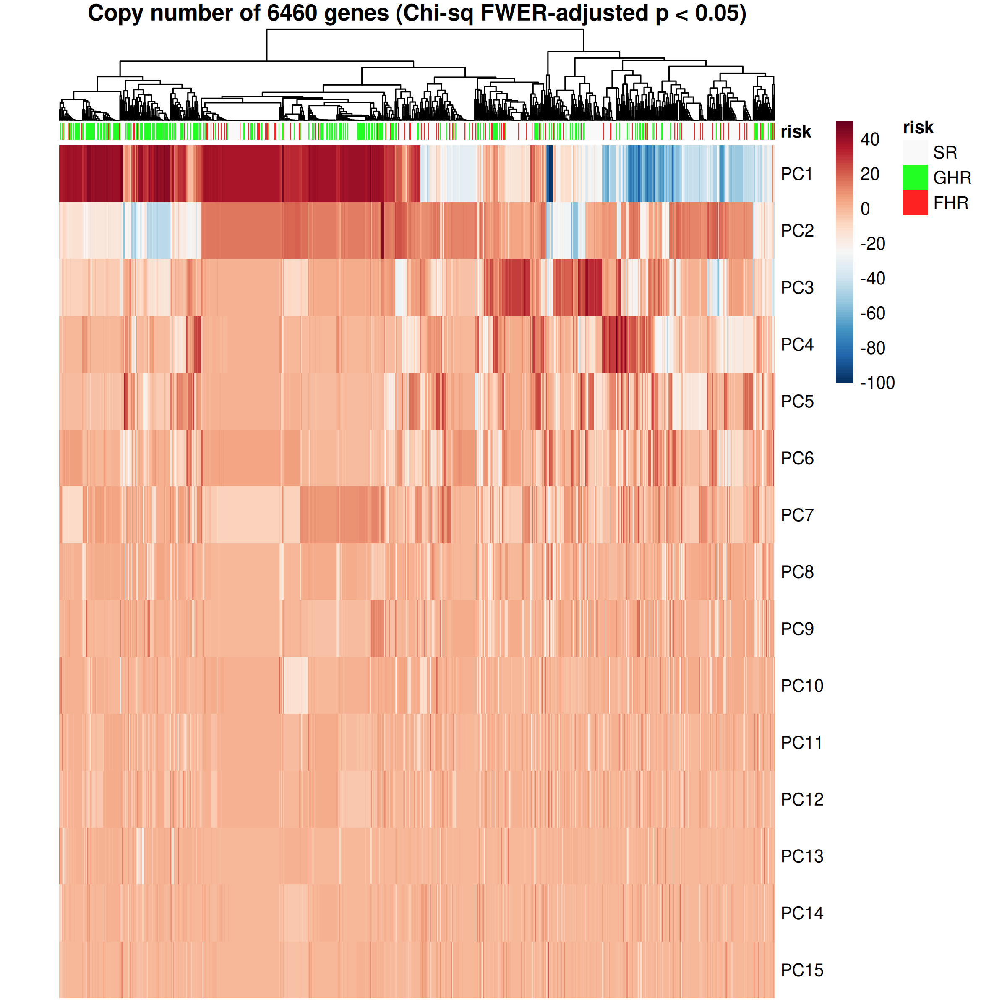
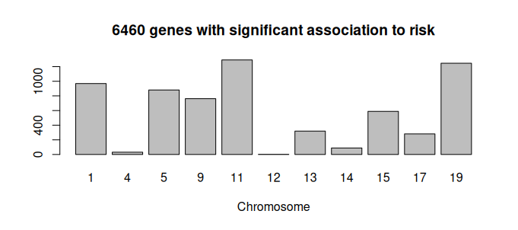
Hierarchical clustering with gene-level CN is unremarkable
PCA of 6460 significant genes with Chi-square p-value* < 0.05
PC1 concentrates some GHR cases
The 6460 genes are concentrated at hyperdiploid chr or one of chr1, 13, 17
Most of these genes are adjacent – gene level resolution is not meaningful
*p values are adjusted with the Bonferroni method which controls the family wise error rate

Slide 12
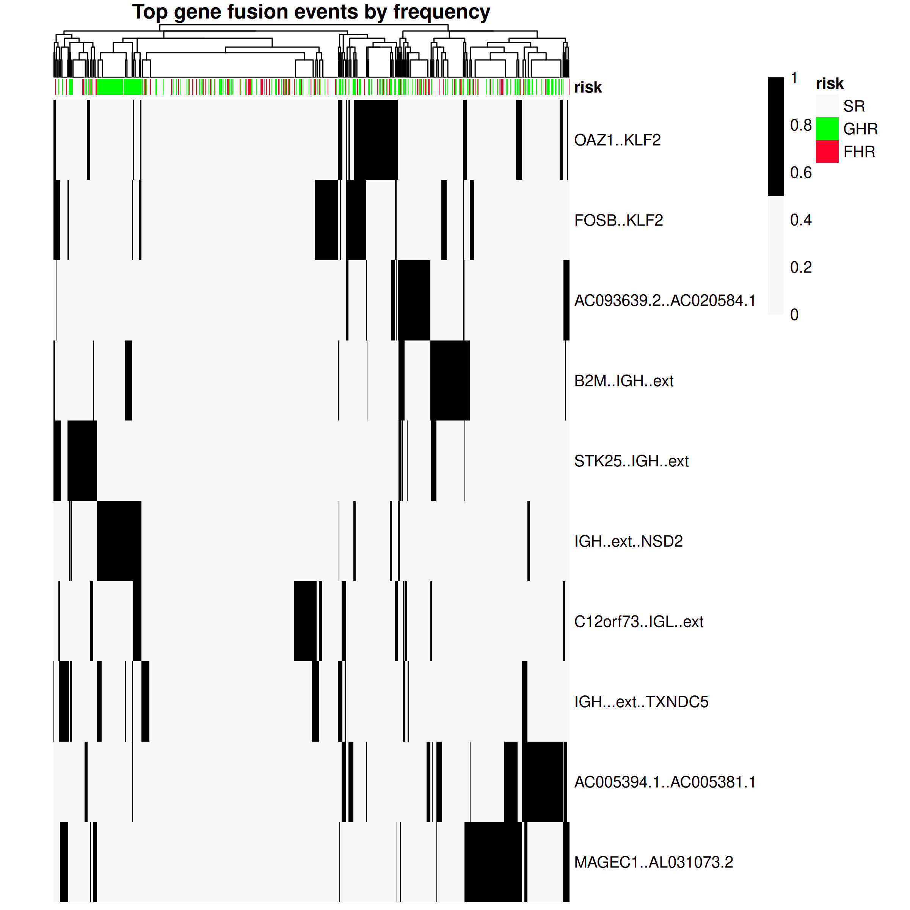
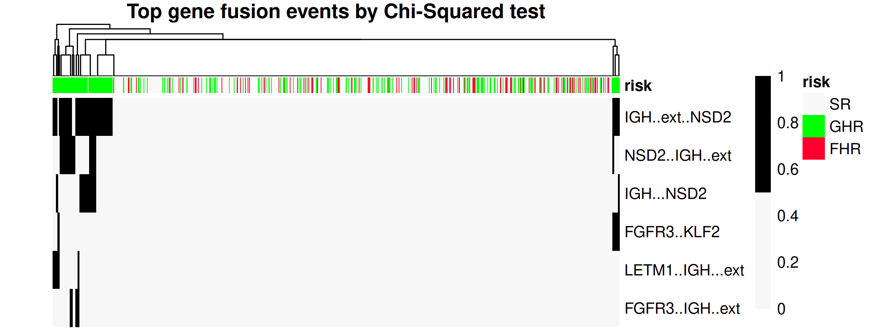
Hierarchical clustering with gene fusions picks out t(4;14) GHR
Gene fusions detected by STAR
Use top gene fusions based on chi-squared test significance or by frequency of occurrence
The t(4;14) cases of GHR group together because of the IGH-NSD2 fusion
However, nothing differentiates FHR from SR
Unsupervised clustering with most significant events
Unsupervised clustering with most frequent events

Slide 13
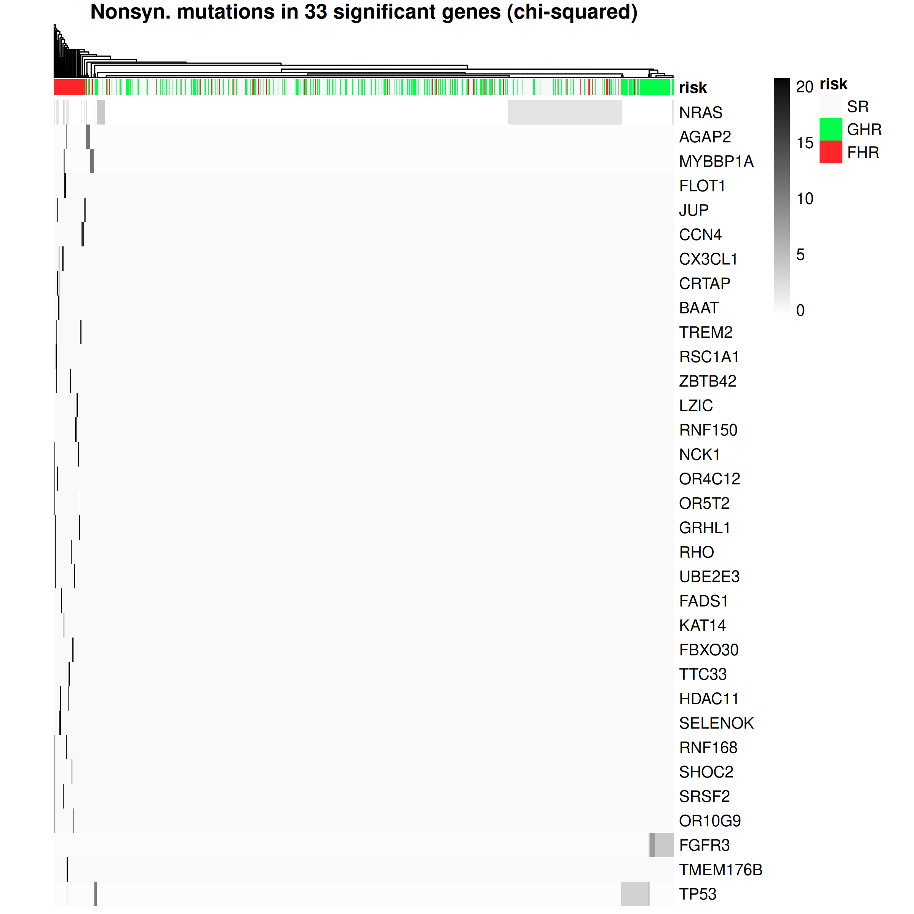
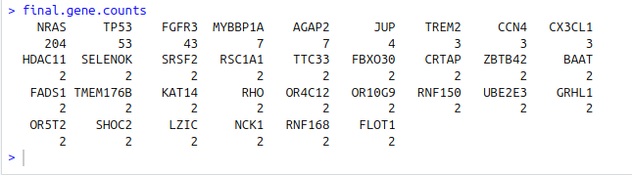
FHR patients carry rare mutations in 1 of 30 genes
Number of non-synonymous mutations of 10,564 protein coding genes having >1 non-synonymous mutation
Chi-squared test identifies 33 significant genes
  3 commonly mutated genes: NRAS, TP53, FGFR3. The latter two are associated with GHR.
  30 rarely mutated genes linked to FHR
Rather than classification, anomaly detection algorithms may work better on mutation data
*Chi-squared p < 0.05. p values are adjusted with the Benjamini-Hochberg method which controls the false discovery rate

Slide 14
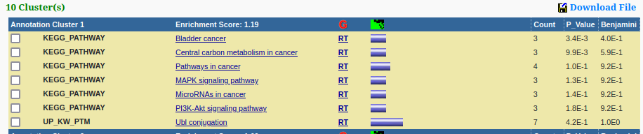
Functions of significantly mutated genes
33 significantly mutated genes from Chi-squared test
Functional annotation with DAVID using all human genes as background
Cancer terms dominate the top annotation cluster
https://davidbioinformatics.nih.gov/ - Database for Annotation, Visualization, and Integrated Discovery

Slide 15
Set-up of classification task
Labels: SR (60%), GHR (30%), FHR (10%)
Prior expectation: GHR is distinct, but SR and FHR are similar
Metrics: Weighted F1 score, SR’s precision (avoid falsely classifying FHR as SR), FHR’s recall (proportion of FHR correctly identified)
Features | Clinical | mRNA | miRNA | Arm-level CN | Mutation | Gene fusion
N. total |  | 18658 |  | 42 | 14302 | 550
N. to use |  | 77 |  | 42 | 33 | 6

