Slide 1
Dengue Cases in SG
Teehee! Dengue!

Slide 2
Do you know Aedes?
When do they bite/feed?
In the night OR in the day?
Which is heavier?
Aedes mosquito OR a small grain of sand?
Who can fly further?
Aedes mosquito OR a fruit fly?

Slide 3
Why is this creature thriving here?
Moisture
Temperature
Urbanization
Needs water to birth
“I like warm, ok?~”
Dense human population? YASS “google me pls”

Slide 4
35,315
679
32
Dengue cases reported in 2020
Cases reported weekly
Deaths in 2020
Notes:
https://www.ncid.sg/Health-Professionals/Articles/Pages/Epidemic-Dengue-in-Singapore-During-COVID-19-Pandemic.aspx

Slide 5
🤔
“How might we use weather and search data to predict dengue cases?”

Slide 6
Table of contents
01
02
03
04
EDA
Models
Exploratory Data Analysis
Models
CBA
Conclusion
Cost Benefit Analysis
Recommendations

Slide 7
Datasets
Dengue Cases | Weekly Data 2014 to 2018
Weather Conditions | Rainfall Temperature Wind Speed
Google Trend | Search Interest by keyword

Slide 8
01
EDA
Explore. Detect. Analyze.

Slide 9
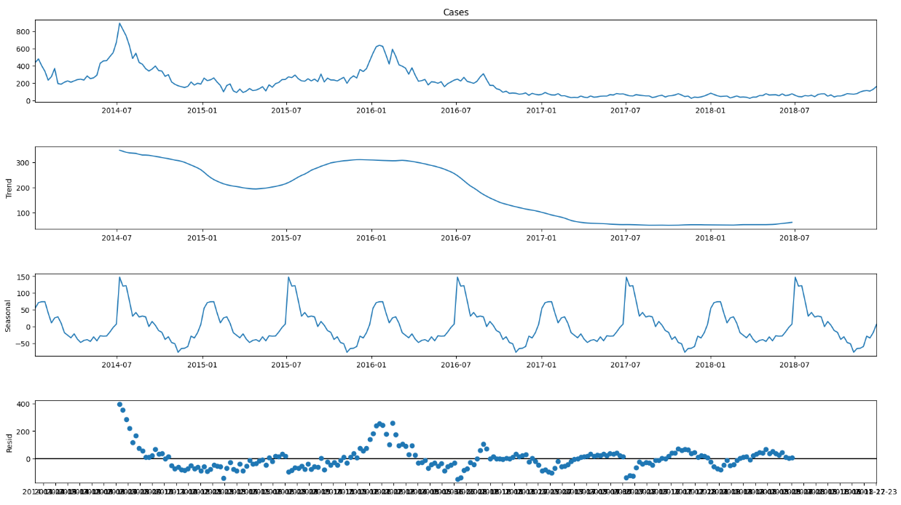
Time Series Decomposition

Slide 10
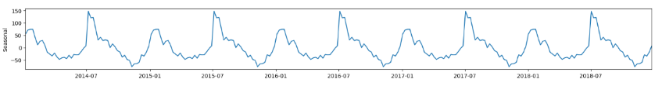
Cases: Southwest > Northeast Monsoon
SW monsoon: Avg 219 cases (Jun, Jul, Aug,Sep) NE monsoon: Avg 214 cases (Dec, Jan , Feb)
Optimum Rainfall Amount
Wet weather boosts mosquito breeding, but heavy rain in the northeast monsoon leads to a "flushing effect," washing away larvae and reducing cases.
Higher mean temperature
Being a cold-blooded insects, they are more likely to bite when the weather is warm and sunny. This is because they like to breed in warm, humid areas

Slide 11
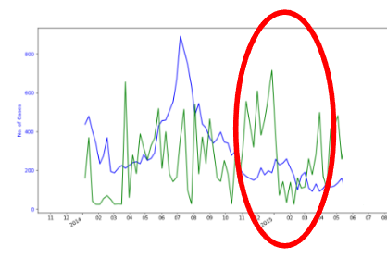
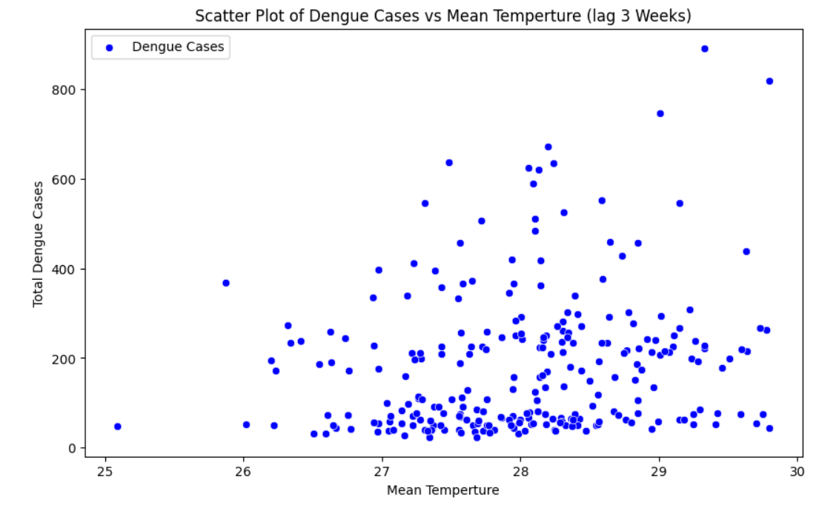
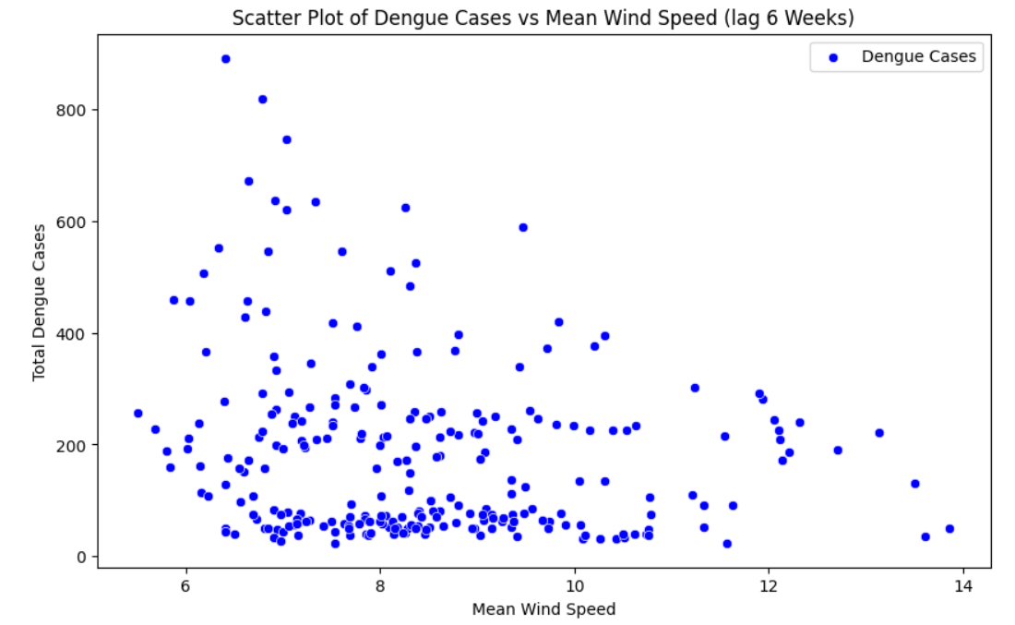
Weather Conditions
Rainfall
Temperature
Wind
⇧ rain, ⇧ cases
⇧ °C, ⇧ cases
⇧ rain, ⇩ cases
However, there’s a “threshold” limit before flushing effect occurs
The warmer it is,
the faster they grow
Mosquitos can get
blown away, literally.

Slide 12
02
Models
LSTM, SARIMA,Random Forest

Slide 13
Model comparison
LSTM | Train RSME: 82.4 | Test RSME: 18.6
Auto ARIMA (0,1,0)(1,0,1,28) | Train RSME: 57.9 | Test RSME: 26.0
Random Forest | Train RSME: 101.5 | Test RSME: 70.3

Slide 14
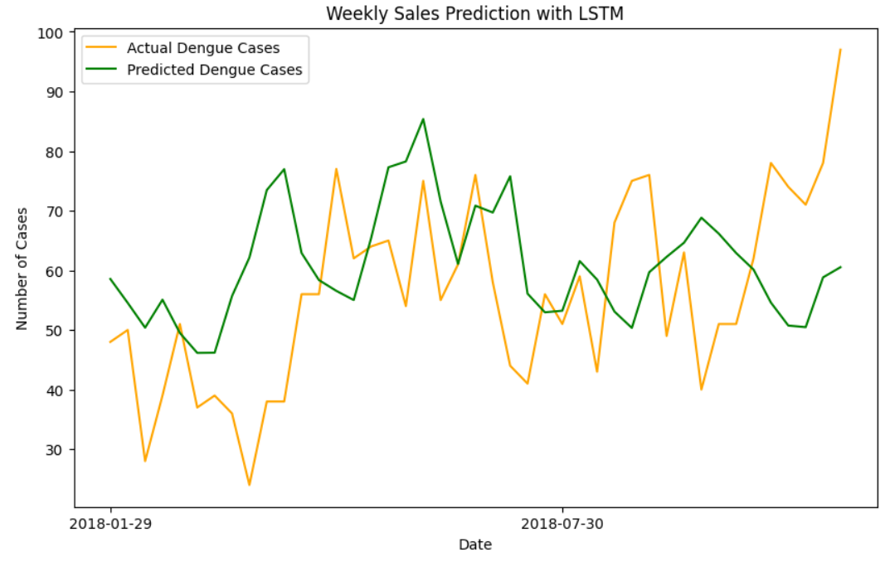
LSTM
Lag Variables
 | Cases | 2 wks
 | Wind speed | 6 wks
 | Avg Rainfall | 6 wks
 | Avg Temp. | 3 wks
 | Search Interest | 2 wks
Notes:
LSTM fail to capture sudden spike
Explain Potential Reasons:
Briefly discuss possible reasons why the visual comparison might be lacking, even with a good RMSE. Here are some options:
Model limitations: LSTMs might struggle with capturing certain aspects of the data, like sharp spikes or sudden changes.
Data characteristics: The data itself might be noisy or have outliers, impacting the visual representation.

Slide 15
Insights from Random Forest
Feature Importance
Using RandomForestRegressor, we determined the ranking of our lag variables.
Lag Variables
1 | Cases | 2 wks
2 | Search Interest | 6 wks
3 | Wind speed | 6 wks
4 | Avg Temp. | 3 wks
5 | Avg Rainfall | 2 wks

Slide 16
Model Comparison
Method Description | LSTM | Auto ARIMA | Random Forest
Pros | Incorporate additional input features Handle non-linear relationship better | Fast to train, simple to implement Better recognition and understanding of time patterns | Handle non-linear relationship better Provide insights into feature importance
Cons | Tendency to overfit, getting stuck at local optimum Difficult to build the architecture | Is a Linear model Dependency on Historical Data Struggle with complex seasonal pattern | Tendency to overfit Do not account for the sequential nature of time series data #manually add lags
Notes:
Do not account for the sequential nature of time series data
manually create lagged features
Together

Slide 17
03
CBA
You can enter a subtitle here in case you need it
Notes:
Crystal

Slide 18
Recap on Dengue
Viral infection transmitted by Aedes mosquitoes
There’s no antiviral treatment. Symptoms of dengue: sudden onset fever, joint & muscle pain. In severe cases, dengue hemorrhagic fever (DHF) or dengue shock symptom (DSS) can lead to life-threatening complications
Prevention measures focuses on mosquito control
Outbreaks have public health and economic impacts (e.g. healthcare costs, productivity loss, etc)
Notes:
Crystal

Slide 19
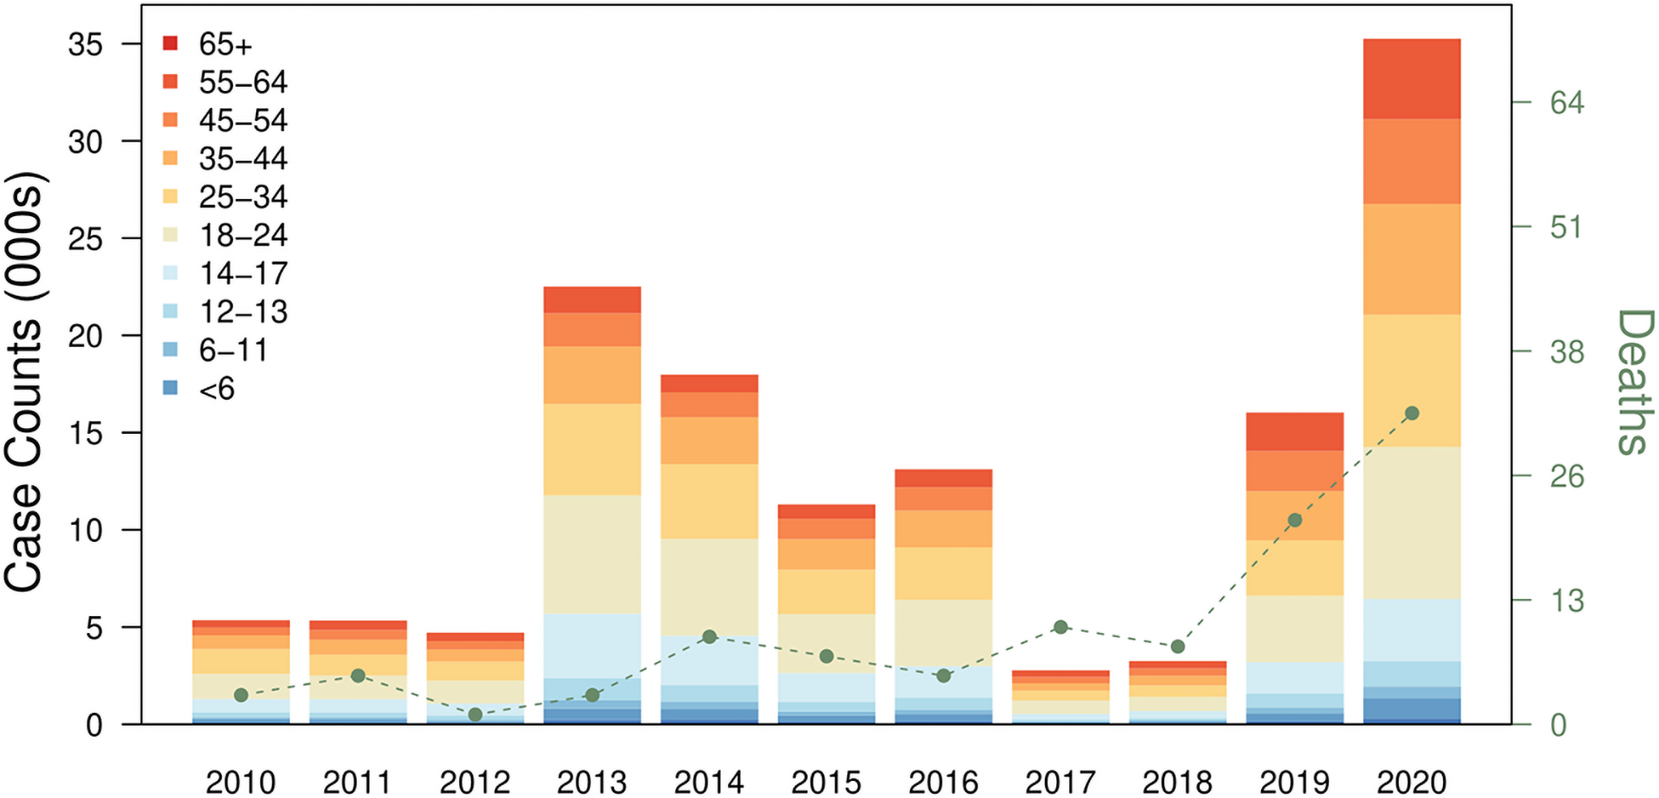
Impact of Dengue
The economic impact of dengue in Singapore was estimated to be between $1.014 billion and $2.265 billion (USD) from 2010 to 2020.
Dengue resulted in 7,645–21,262 DALYs from 2010–2020.
(DALYs stands for disability-adjusted life years, which is a measure of years of healthy life lost.)
Notes:
Crystal

Slide 20
We estimate a team of 25 = $157.5k/month on personnel alone
Personnel
Equipment
Supplies
SGD 3,500 to SGD 7,000 per headcount
Efforts to maintain and calibrate them. (Cost: NEA available info)
Consumables in relation to R&D
(Cost: NEA available info)
Operations
R&D
Overheads
Estimates based on project phase launches
(Cost: NEA available info)
Specialised knowledge for Wolbachia
(Cost: NEA available info)
Standard expenses
(Cost: NEA available info)
Notes:
Crystal

Slide 21
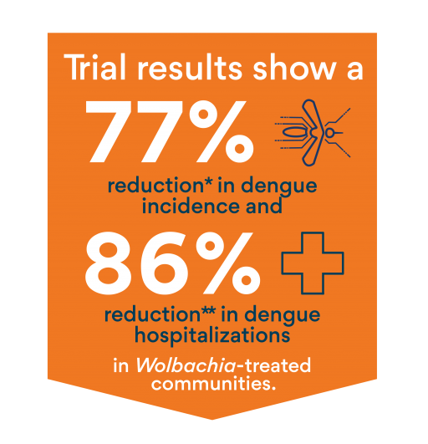
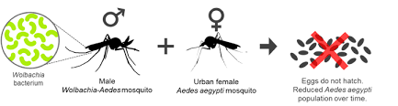
Project Wolbachia
However, it is very expensive - Est $40Milion.
The effectiveness is influenced by other factors too, such as weather conditions.
This is not the best solution as proven during covid period .
Are there other solutions?
Notes:
$40 Million
Jessica

Slide 22
o4
Recommendation
Action points

Slide 23

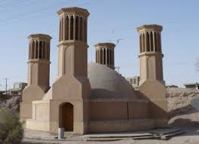

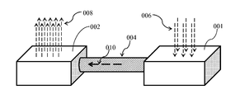
Recommendations
Optimum Wolbachia Release Indicators
Wind & Rainfall: Lag 6 weeks
Temperature: Lag 3 weeks
Artificial Wind Generator
Wind Tower
Qatar University: Designed for fresh air in, hot air out
Work with universities and/or energy companies
Notes:
Lag 6 Weeks Wind Speed & Avg Rainfall
Lag 3 Weeks Mean Temperature

Slide 24
Thanks
Please hire us without asking questions. lol
Please keep this slide for the attribution

