Slide 1
Fraudulent Job Prediction
Group 15 (RL)
Lim Sze Sing (22109557)
Gan Jing Wen (22065433)
Law Jia Jin (22071390)
Nur Shafiqah M. Johari (22119564)
Nur Nazifa Zhamri (22088840)

Slide 2
Table of Contents
01
02
03
04
Introduction
Problem Statement & Objective of Project
Data Pre-Processing
Approach & Innovation
Data Description & Pre-Processing
06
Overall Development
Model Development
Commercialization
07
Development & Practical Implementation
Commercial Strategy
Model Evaluation
Market Validation
08
Milestone & Success Matrix
Cross Matrix & Computational Performance Comparison
Model Deployment
05
Testing, Storing, Simulation & Deploying Product

Slide 3
01
Introduction
Problem Statement &
Objective of Project

Slide 4



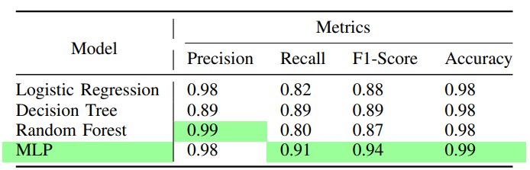
Introduction
Problem Statement
Decision trees
Logistic regression
Random forests
MLP model
Area for improvement
for fake job postings detection
Rising online fraud cases in Malaysia
Objectives:
To evaluate the performance of different models.
To identify the most suitable model for detecting fake job postings.
To enhance the overall performance of classification results, focusing on precision and recall metrics.

Slide 5
02
Data Pre-Processing
Data Description & Pre-Processing

Slide 6
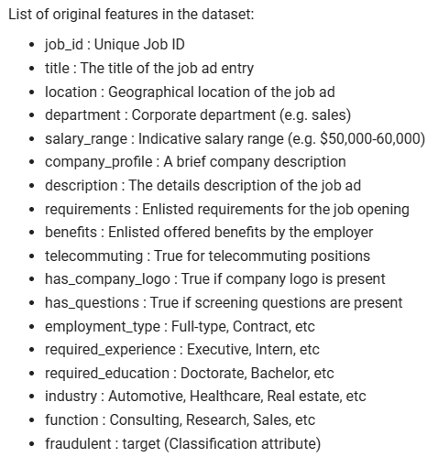
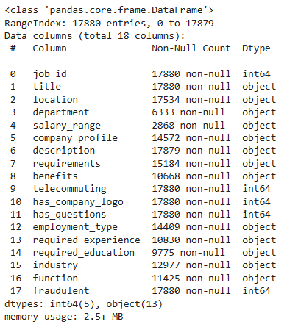
Data Description
Dataset: " fake_job_postings.csv "
Figure : Data information of dataset

Slide 7
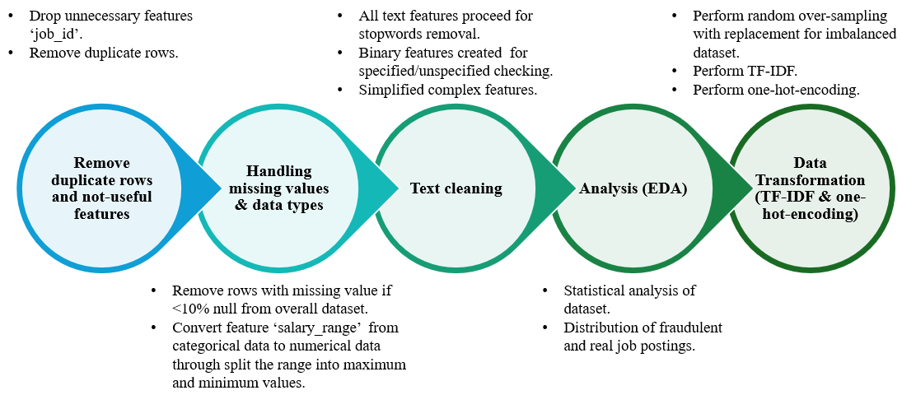
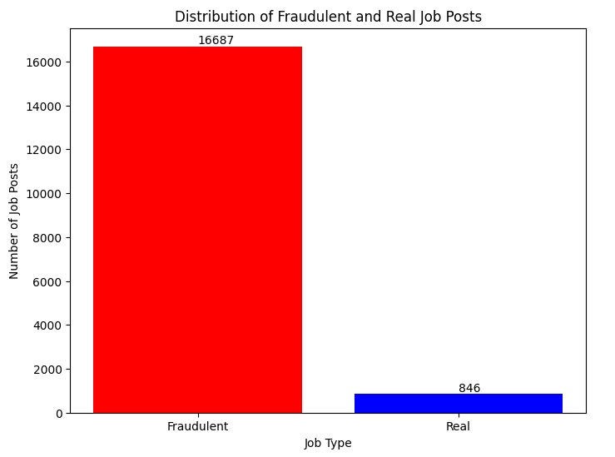
Data Pre-processing

Slide 8
03
Model Development
Development & Practical Implementation

Slide 9
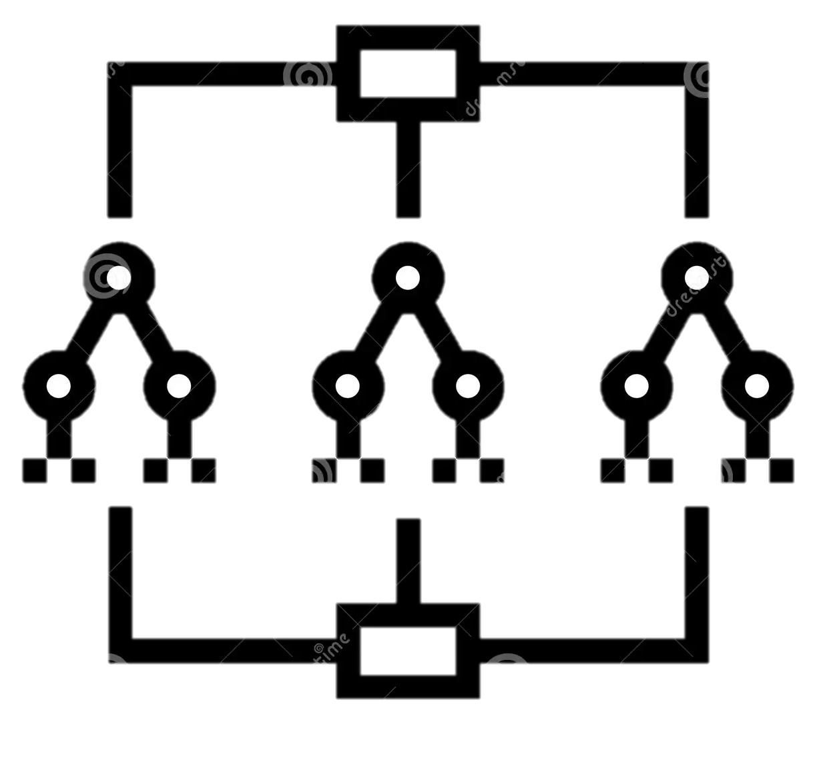
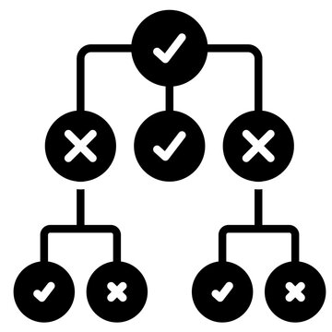
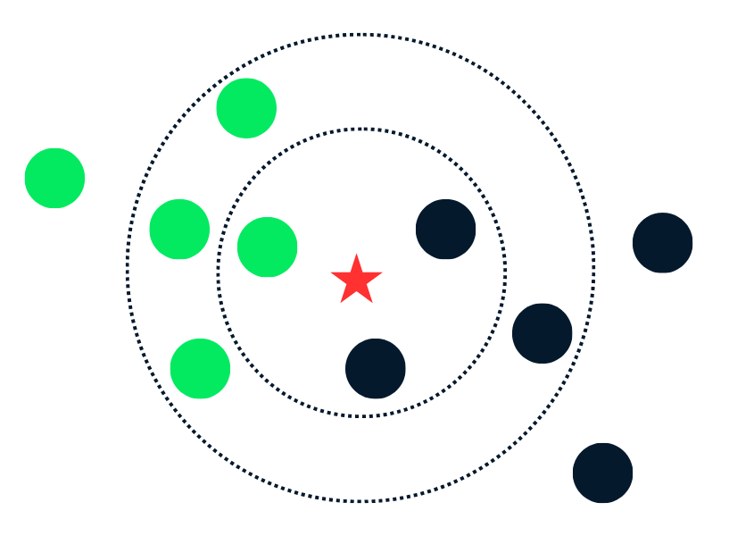
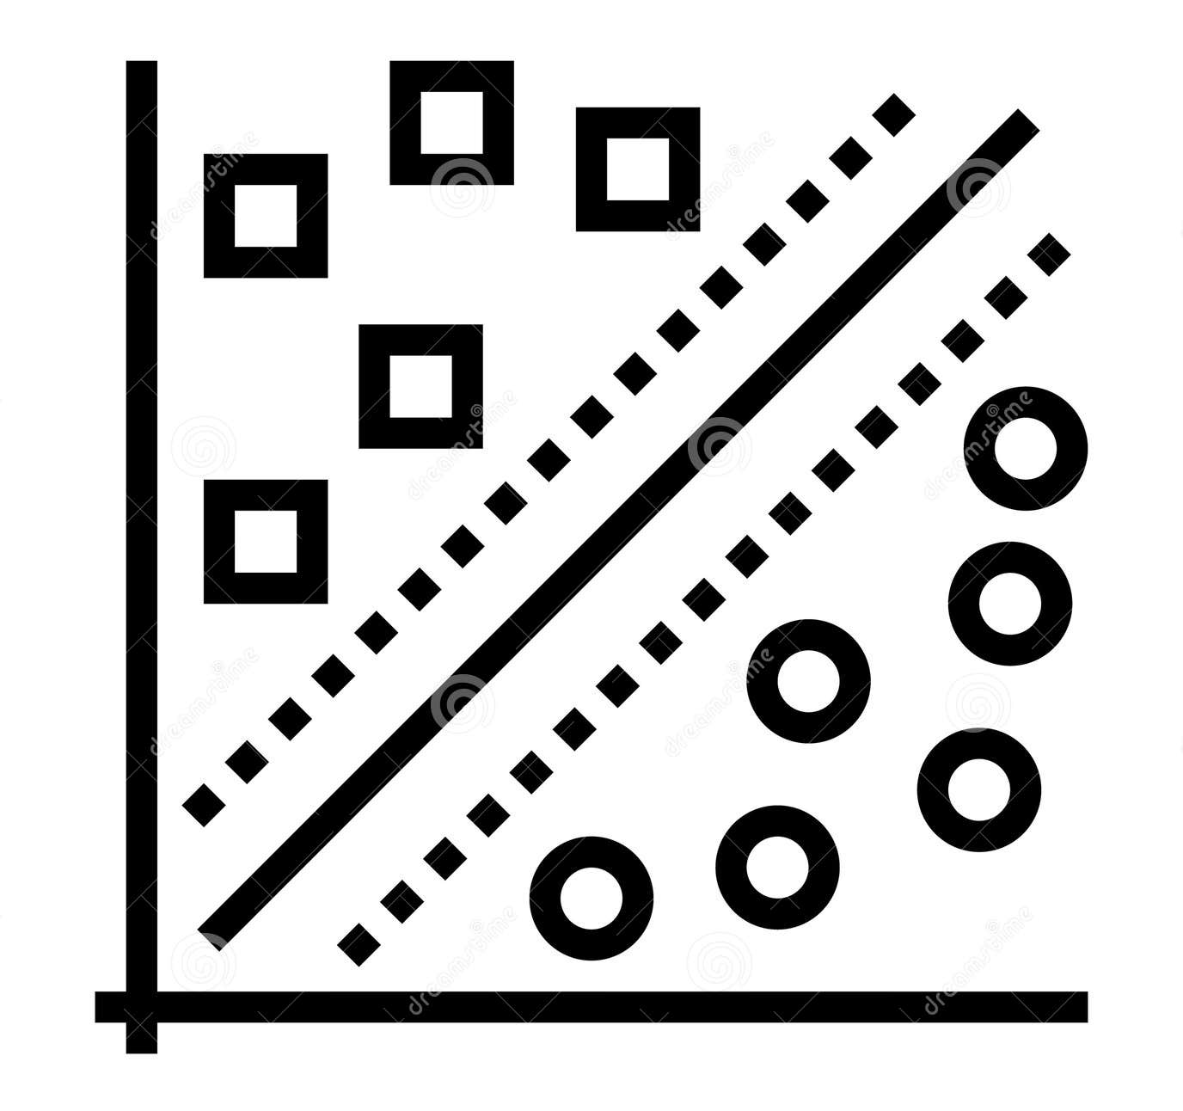
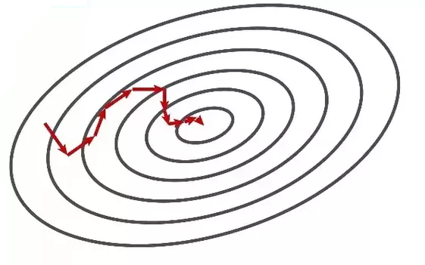
Classification Supervised Machine Learning
Random Forest
Decision Tree
K-Nearest Neighbors (KNN)
Linear SVM
Stochastic Gradient Descent (SGD)

Slide 10
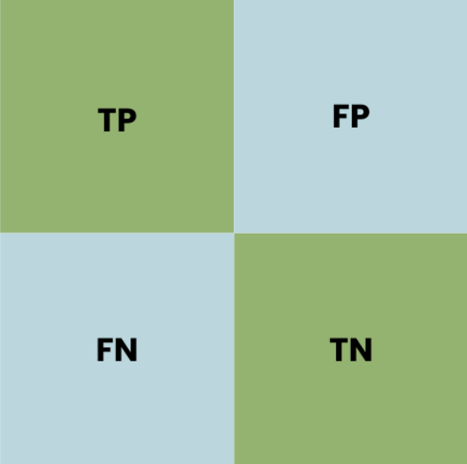


Model Development Process
Programming language: Python
Splitting dataset: 80 train & 20 test
Python library: Scikit-learn
5 Classification ML
Model evaluation: Evaluation metrics

Slide 11
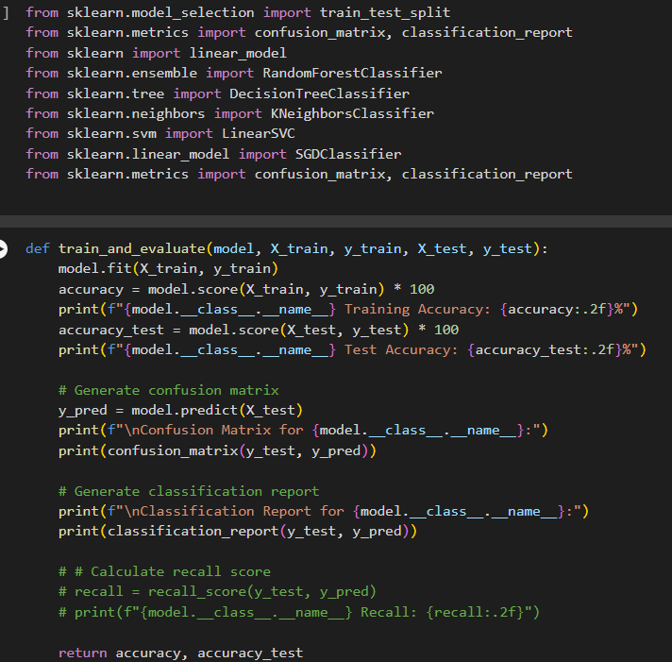
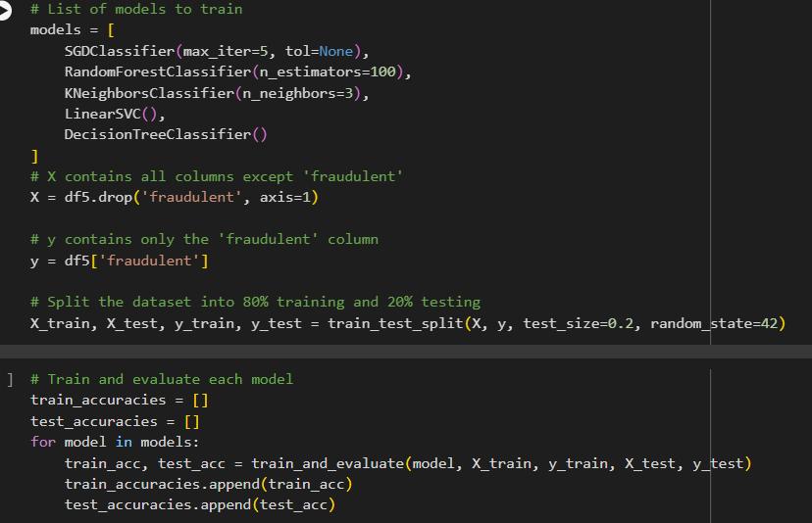

Slide 12
04
Model Evaluation
Cross Matrix & Computational Performance Comparison

Slide 13
Model Comparison
 | Random Forest | Decision Tree | KNN | Linear SVC | SGD
Accuracy | 99.95% | 98.81% | 96.71% | 92.43% | 73.60%
Recall | 99.95% | 98.81% | 96.72% | 92.43% | 73.60%
Precision | 99.95% | 98.83% | 92.79% | 94% | 74.49%
F1 Score | 99.95% | 98.81% | 92.42% | 94% | 73.36%
Execution Time | 25.6 secs | 20.22 secs | 57.63 secs | 25.78 secs | 3.67 secs
Memory usage | 49.1% | 51.4% | 51.4% | 51.5% | 49%
Random Forest
Most Ideal & Balanced Model

Slide 14
05
Model Deployment
Testing, Storing, Simulation & Deploying Product

Slide 15
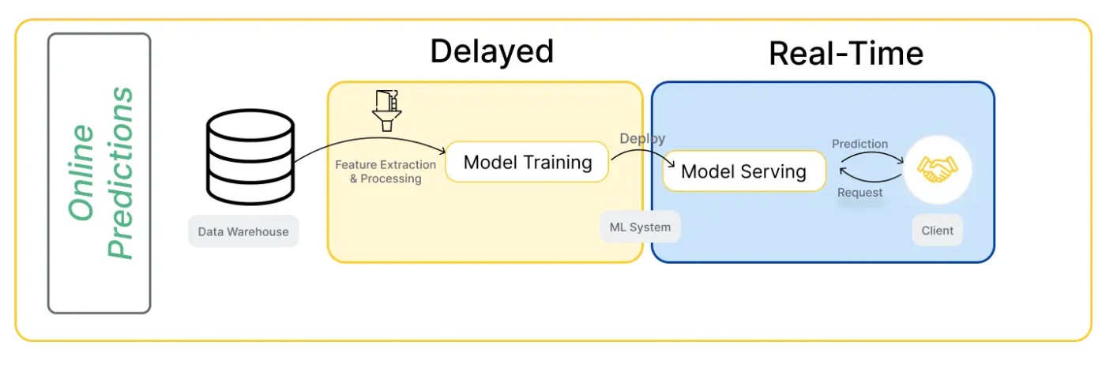



Deployment Architecture

Slide 16
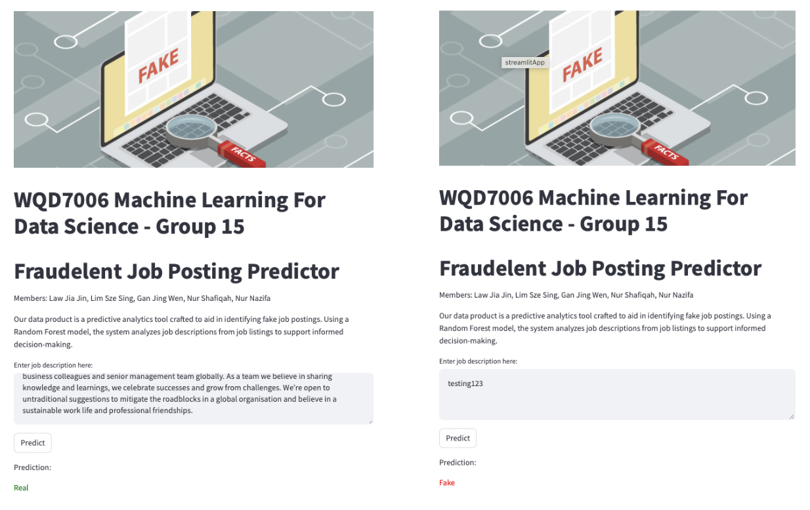
Model Deployment
https://fakejobsdeploy-wqd7006-group15.streamlit.app
Notes:
Fake example :
A Newly established company seeks outgoing, friendly people person with a can do attitude for a Admin Assistant/ Receptionist position yet to be occupiedJob duties include answering phones, setting appts and working with the owner to keep the office running smooth. Processing of tax returns, keeping database current and scanning of all tax documents.

Slide 17
06
Approach & Innovation

Slide 18
Approach & Innovation
Aspect | Description
Data Preprocessing | Using adaptive oversampling, context-aware TF-IDF, and hierarchical one-hot encoding to improve how imbalanced datasets, text features, and categories are handled.
Model Evaluation | Evaluation metric approach simplifies comparing and choosing the best model by considering all important factors equally.
Deployment Strategy | Prioritizes platforms such as Google Colab, GitHub, and Streamlit for deploying machine learning models helps minimize costs for smaller businesses or projects with limited budgets.
Performance Monitoring & User Experience | By ensuring predictions are delivered within 30 seconds with 99.95% accuracy, the deployment not only meets but enhancing user satisfaction and trust in the application.

Slide 19
07
Commercialization

Slide 20
Our Strategy
Startup funds
Business Model
01
02
Malaysia Digital X-port Grant (MDXG) & potential investors
Licensing technology and offer customization services
Partnership
Potential customers
03
04
Integration partnerships
Offer free trials or pilot programs

Slide 21
08
Market Validation

Slide 22
Milestone
Market Research (Month 1-2)
Prototype Development (Month 3-4)
Beta Testing (Month 5-6)
Iteration and Improvement (Month 7-8)
Launch and Marketing (Month 9-12)
Notes:
Market Research:
Conduct surveys and interviews with HR professionals, job seekers, and recruitment agencies.
Competitive Analysis: Analyse existing solutions in the market and identify gaps and opportunities that our solution can address better.
Price Sensitivity Testing: Present different pricing models (subscription, per-use fee, freemium) to potential customers. Use conjoint analysis to understand which features are most valued and how much customers are willing to pay for them.
Prototype Development: Build a minimum viable product (MVP)
Beta Testing:
Engage a select group of users from the market research phase to test the MVP
Collect feedback on usability, accuracy, and relevance of the predictions.
Iteration and Improvement:
Refine the model and user interface based on beta testing feedback.
Implement additional features as requested by users.
Launch & Marketing:
Roll out the final product.
Marketing Strategy:
Networking and Partnerships: Attend industry conferences, webinars, and networking events to establish connections with potential users and industry influencers.
Direct Outreach: Contact HR departments and recruitment firms directly and offer to demonstrate the MVP.
Pilot Programs: Propose pilot programs where selected companies can use the tool for free or at a discounted rate in exchange for feedback and testimonials.

Slide 23
Success Matrix
Prediction Accuracy
Customer Satisfaction
Conversion Rate
Revenue Target
User Engagement
Notes:
User Engagement: Number of active users during beta testing and after launch.
Prediction Accuracy: Percentage of correctly identified fake job postings.
Customer Satisfaction: Net Promoter Score (NPS) and user feedback ratings.
Conversion Rate: Percentage of beta users converting to paying customers.
Revenue Targets: Meeting or exceeding projected revenue goals within the first year.

Slide 24
Thanks!
Do you have any questions?

Slide 25
Appendix

Slide 26
9
Cost Analysis

Slide 28
10
Conclusion
Analysis, Innovation & Future Works

Slide 29
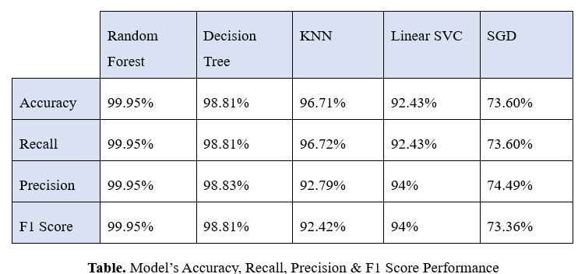
Conclusion | Future Work
Improve generalizability
Integration with additional data sources
Improve accuracy
Random Forest algorithm
Feature engineering and hyperparameter tuning
Maintain model’s performance
Best overall performance!!
Implementing real-time model monitoring and automated retraining pipelines

Slide 30
References
Ali, I., Mughal, N., Khand, Z. H., Ahmed, J., & Mujtaba, G. (2022). Resume classification system using natural language processing and machine learning techniques. Mehran University Research Journal Of Engineering & Technology, 41(1), 65-79.
Bhd, T. D. (2024). Glassdoor. Retrieved from https://www.glassdoor.com/Job/malaysia-software-developer-jobs-SRCH_IL.0,8_IN170_KO9,27.htm
Calculator, G. C. (2024). Google Cloud. Retrieved from https://cloud.google.com/products/calculator?_gl=1*132v8qp*_up*MQ..&gclid=8de111347c1718f904b877782af9be2c&gclsrc=3p.ds&hl=en&dl=CiQyMjNmNTBkNC1lNDQwLTQxYjgtYTg0Mi1iMWE0ZjM1YmEzZTAQCBokQTQ0RjM5OEYtNzQyRi00MjAwLThCN0YtQkYyNjdFOUM4RUJF
Glassdoor. (2024). Glassdoor. Retrieved from https://www.glassdoor.com/index.htm
Klushin, P. (2024, January 29). What does it take to deploy ML models in production? | Qwak’s Blog. Www.qwak.com. https://www.qwak.com/post/what-does-it-take-to-deploy-ml-models-in-production
Muhammad, L. J., Algehyne, E. A., & Usman, S. S. (2020). Predictive supervised machine learning models for diabetes mellitus. SN Computer Science, 1(5), 240.
Nasteski, V. (2017). An overview of the supervised machine learning methods. Horizons. b, 4(51-62), 56.
NodeFlair. (2024). Glassdoor. Retrieved from https://www.glassdoor.com/Job/malaysia-data-scientist-jobs-SRCH_IL.0,8_IN170_KO9,23.htm

Slide 31
References
Pablo, Guillermo and Alberto. (2023). Fake Job Detection with Machine Learning: A Comparison. Monterrey, Mexico: ResearchGate. Retrieved from https://www.researchgate.net/publication/371508732_Fake_Job_Detection_with_Machine_Learning_A_Comparison
Unifi. (2024). Unifi. Retrieved from https://unifi.com.my/all-in-one
Wang, X., Yan, L., & Zhang, Q. (2021, September). Research on the application of gradient descent algorithm in machine learning. In 2021 International Conference on Computer Network, Electronic and Automation (ICCNEA) (pp. 11-15). IEEE.
WeWork. (2024). WeWork. Retrieved from https://www.wework.com/search?capacity=20&workspace=privateOffice

