Slide 1
Selective search in Amazons
Jens Lieberum
Mathematical Institute Basel
Switzerland
lieberum@math.unibas.ch
www.math.unibas.ch/~lieberum/amazong/amazong.html

Slide 2
Outline
rules of Amazons and examples
how to evaluate Amazons positions
selective extensions are needed !
avoid searching in hopeless lines
pre-evaluations: avoid bad moves at once
how to improve move order step by step

Slide 3
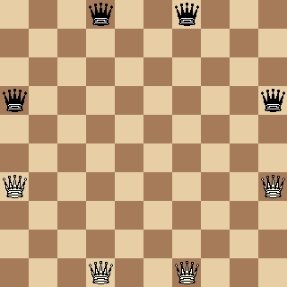
Rules of Amazons
Starting position :
two players
each player has four amazons

Slide 4
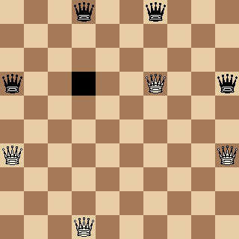
Rules of Amazons
move consists of two parts:
(1) moving an Amazon like a queen in chess
(2) shooting
peaceful game:
no capture
no shooting of amazons

Slide 5
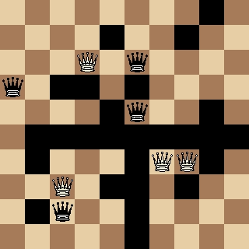
Rules of Amazons
No moving or shooting across black squares
Player cannot move ⇒ loser

Slide 6




Territory
Defective territory
Zugzwang
Hot position

Slide 7
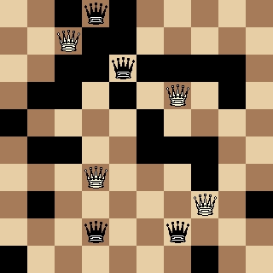
Minimal distance evaluation
Amazong-8QP (Maastricht 2002)

Slide 8
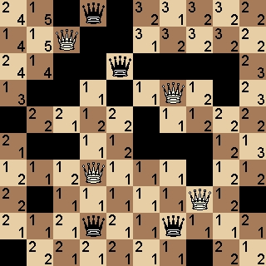
Minimal distance evaluation
The player who can reach an empty square with less moves than his opponent owns that square

Slide 9
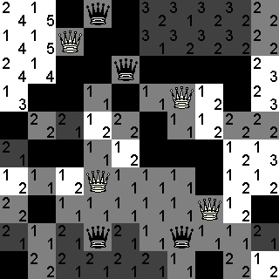
Minimal distance evaluation
The player who can reach an empty square with less moves than his opponent owns that square
21-18 = 3 is the minimal distance evaluation of the example

Slide 10
Deviations from minimal distance
Invader
tries to build large territorial frameworks
Amazong
tries to lock out an amazon of the opponent inside of a small territory
tries to understand Zugzwang
analyzes the distribution of Amazons

Slide 11
Amazong evaluation vs. minimal distance
generated from Amazong - Invader (Maastricht 2002)

Slide 12
Ingredients of Amazong’s evaluation function
generated from Amazong - Invader (Maastricht 2002)

Slide 13
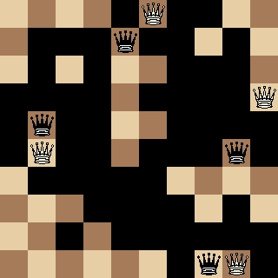
Selective search I: extending the search depth
Minimal distance evaluation is 0
Amazong evaluation with black to move is 6.5
correct value is 6.5
result of odd-ply-search is 3.25
Arrows - Amazong1.1 (2000)

Slide 14
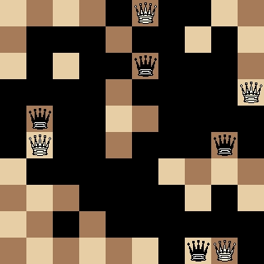
The unstable successor
Amazong evaluation with white to move is 3.25
correct value is 14.5
result of n-ply-search (n>0) is 14.5
previous position requires quiescence search or selective extensions at odd-ply-search
Analysis of Arrows - Amazong1.1 (2000)

Slide 15
Quiescence search in Amazong
Aim: evaluate at stable positions
Technique:
Use killer heuristic to generate quiescence moves
Also generate a pass move
Selective approach to quiescence search seems to be useful in Amazons

Slide 16
Killer and history heuristics
Killer heuristic: keep in mind the moves that
belong to main lines
are a refutation to important lines of play
Pairs of killers:
also keep in mind the preceeding move
History heuristic:
prepare statistics for squares involved in killer moves
combine with squares from actual line of play

Slide 17
Hash-keys in Amazons
The sequence of moves:
good for low-depth search and killer-sequences
The position:
search graph instead of tree
The position modulo two or eight symmetries:
important in opening books
The line segment graph:
important in endgame databases

Slide 18
It works !
2-ply-search: e9-f8-e8, f10-e9-f10
stored in killer hash-table
3-ply-search:
third move e9-f8-e8,
evaluations 6.5, 6.5, 3.25
⇒ selective extension
⇒ move f10-e9-f10 found in hash-table

Slide 19
Selective search II: heuristic cut-offs
Aim: early (heuristic) detection of refutations
Technique1: Null-move
cut-off when its your turn, your evaluation is good, and your opponent has no threat
Properties:
very save in hot positions, Zugzwang causes problems
realization is expensive in Amazons because of the high branching factor
more useful close to starting position

Slide 20
Technique 2: Prob-Cut
The technique I use:
cut-off when it is your turn and your evaluation is ‘good enough’
A technique I don’t use:
cut-off when it’s your turn and your evaluation is ‘hopeless’
Properties:
realization of Prob-cut is cheaper than Null-move
more dangerous than Null-move
usually causes more cut-offs than Null-move
more useful close to leave nodes

Slide 21
Selective search III: Pruning - reducing the tree width
generated from Amazong - Tanazon (Maastricht 2002)

Slide 22
Evaluations per second in the opening
3.000 Amazong evaluations during search
5.000 Amazong evaluations
20.000 Amazong minimal distance
100.000 8QP evaluations
500.000 Amazong pre-evaluations

Slide 23
Pre-evaluations
Are rough estimates of the evaluation
Are used to sort the list of all possible moves
Are used to exclude bad moves from search
Parts are computed incrementally
Use killer and history heuristics
Examples of pre-evaluations:
minimal distance with distances 1,∞ or 1,2,∞

Slide 24
First Sorting of all Moves
Sorting has time complexity Θ(n log(n))
Pre-evaluations are not precise, distribution known
Bucket sort:
use k arrays (= buckets)
pre-evaluation ⇒ choice of bucket
time complexity Θ(n)

Slide 25
Distribution of pre-evaluations

Slide 26
Evaluations of moves in the buckets
Evaluations between -18 and 9 in 6 intervals of size 4,5.

Slide 27
Improving the move order 1
results of n-ply-search (n>1) :
a) at least one exact minimax-value v₁
b) upper bounds < v₁ for remaining moves
Problem 1:
not enough exact minimax-values
Solution 1: k-best algorithm has results
a) at least k exact minimax-values v₁, ...,v_{k}
b) upper bounds < v_{k} for remaining moves

Slide 28
Improving the move order 2
Problem 2:
k-best algorithm is too slow to use it at all search depths simultaneously
Solution 2: k-best(δ, b) algorithm has results
a) at least one exact minimax value v₁
b) at least k good upper bounds v₂, ...,v_{k}∈[v₁- δ, v₁]
as long as there are k good moves
quality of the upper bounds depends on b
c) remaining upper bounds are < max(v_{k}, v₁- δ)

Slide 29
Pruning based on good move order
Iterative deepening
Sort moves: lexicographical order on pairs
(search depth, good upper bound of value)
Values more reliable ⇒ be more selective
k-best(δ, b) for low search depths
NegaScout or MTD(f) for high depths (6,...)

Slide 30
Computer Amazons tournaments
1998 and 1999: open computer-amazons championships, 1st place Yamazon
2000: amsbot beats Yamazon on ggs
2000 and 2001: 5th and 6th computer olympiad, 1st place 8QP
2001: Jenazon cup, 1st place J. de Koning and T. Tegos
2002: 7th computer olympiad, 1st place Amazong

Slide 31
Summary
Almost all positions in Amazons are difficult
Three types of selective search
extension of search depth
heuristic cut-offs
pruning
Interplay between pre-evaluations, evaluations, and search

Slide 32
Outlook
Selective search IV: extending an opening book
Amazons-specific criteria for selective extensions of search depth
Determine and use similarity of moves

