Slide 1
Spark大数据应用开发原理与实践
Spark机器学习-算法

Slide 2
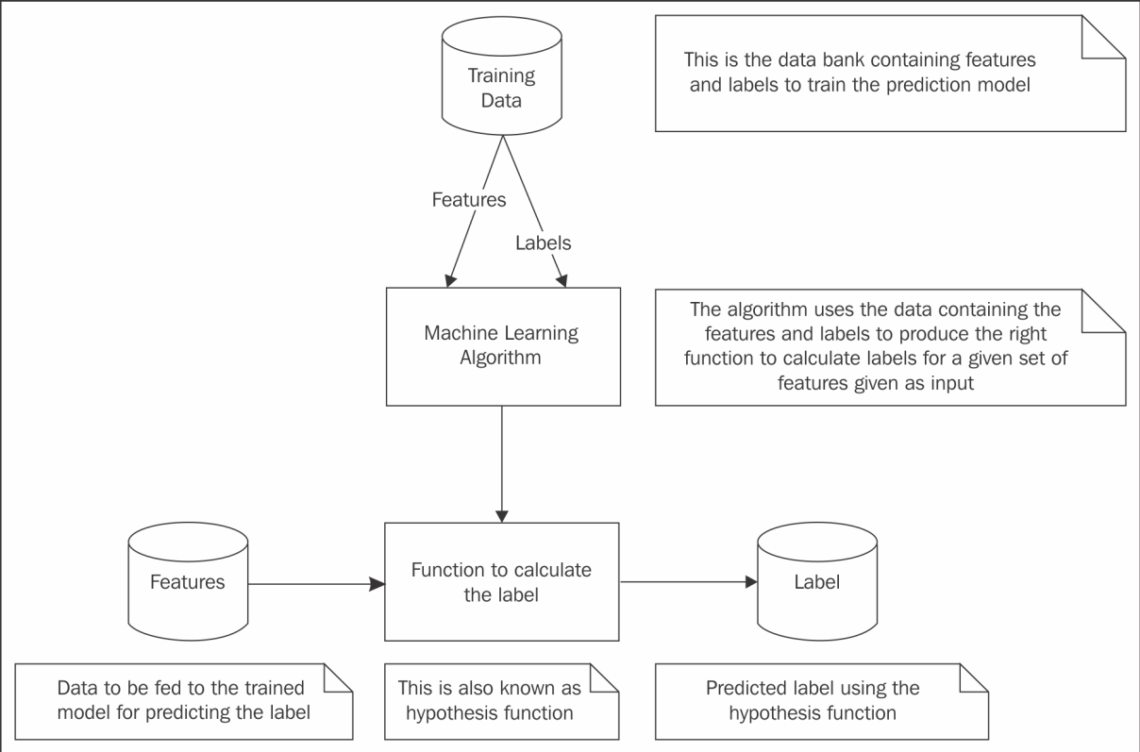
Spark Machine Learning

Slide 3
基本类型：向量（vectors）
本地向量分两种：稠密向量DenseVector和稀疏向量SparseVector
Dense vectors are stored as an array of values.
from pyspark.ml.linalg import Vector, Vectors
dense_v = Vectors.dense(10.0,0.0,20.0,30.0,0.0)
Sparse vectors are stored as two arrays：
the first array stores the non-zero value indices
the second array stores the actual values
Pass size, position index array and value array
sparse_v1 = Vectors.sparse(5,[0,2,3],[10.0,20.0,30.0])
Another way to create sparse vector with position, value tuples
sparse_v2 = Vectors.sparse(5,[[0,10.0],[2,20.0],[3,30.0]])
Notes:
toArray()

Slide 4
基本数据类型：矩阵（matrices）
Matrices may be local or distributed, dense or sparse.
A local matrix is stored on a single machine as a single dimensional array.
A dense local matrix is stored in column major order
from pyspark.ml.linalg import Matrix, Matrices
temp=Matrices.dense(3,2,[9.0,0,0,0,8.0,6])
temp.toArray()
a sparse matrix values are stored in Compressed Sparse Column (CSC) format
temp=Matrices.sparse(3,3,[0,2,3,6], [0,2,1,0,1,2],[1.0,2.0,3.0,4.0,5.0,6.0])
temp.toArray()
temp=Matrices.sparse(3,4,[0,2,3,3,6],[0,2,1,0,1,2],[1.0,2.0,3.0,4.0,5.0,6.0])
temp.toArray()
Notes:
static sparse(numRows, numCols, colPtrs, rowIndices, values)
If none of the elements in a column are non-zero, you will note the same index repeating.

Slide 5
Fundamental data types ---Distributed matrices
A distributed matrix is backed by one or more RDDs.
The basic type of distributed matrix is a RowMatrix, which is simply backed by an RDD of its rows.
Each row in turn is a local vector
from pyspark.mllib.linalg import Vector,Vectors
from pyspark.mllib.linalg.distributed import RowMatrix
dense_vlist=[Vectors.dense(11.0,12,13,14), Vectors.dense(21.0,22,23,24), Vectors.dense(31.0,32,33,34)]
rows=sc.parallelize(dense_vlist)
m = RowMatrix(rows)
Notes:
m.rows.collect()

Slide 6
Fundamental data types ---Distributed matrices
IndexedRowMatrix：stores a row index prefixed to the row entry.
This is useful in executing joins.
Just a wrapper over a (long, vector) tuple.
from pyspark.mllib.linalg.distributed import IndexedRowMatrix,IndexedRow
rows = sc.parallelize([IndexedRow(0, [1, 2, 3]),IndexedRow(1, [4, 5, 6])])
mat = IndexedRowMatrix(rows)
mat.rows.collect()

Slide 7
Regression ：Wine quality prediction
This is a regression problem.
It deals with modeling the relationship between a dependent variable (wine quality) and a set of independent variables (the features of the wine).
from pyspark.ml.linalg import Vectors
from pyspark.ml.regression import LinearRegression
lines = sc.textFile("winequality-red.csv")
splitLines = lines.map(lambda l: l.split(";"))
wineDataRDD = splitLines.map(lambda p: (float(p[11]), Vectors.dense([float(p[0]), float(p[1]), float(p[2]), float(p[3]), float(p[4]), float(p[5]), float(p[6]), float(p[7]), float(p[8]), float(p[9]), float(p[10])])))
trainingDF=spark.createDataFrame(wineDataRDD,['label', 'features'])
trainingDF.show()
Notes:
1 - fixed acidity ：非挥发性酸 2 - volatile acidity： 挥发性酸 3 - citric acid ：柠檬酸 4 - residual sugar ：残糖 5 - chlorides ：氯化物 6 - free sulfur dioxide ：游离二氧化硫 7 - total sulfur dioxide ：总二氧化硫 8 - density ：密度 9 - pH ：酸碱度 10 - sulphates ：硫酸盐 11 - alcohol ：酒精
Based on these features, the quality (score between 0 and 10) is determined.
dependent variable:因变量
independent variables: 自变量

Slide 8
Regression ：Wine quality prediction(2)
lr = LinearRegression(maxIter=10)
model = lr.fit(trainingDF)
testDF = spark.createDataFrame([(5.0, Vectors.dense([7.4, 0.7, 0.0, 1.9, 0.076, 25.0, 67.0, 0.9968, 3.2, 0.68,9.8])),(5.0, Vectors.dense([7.8, 0.88, 0.0, 2.6, 0.098, 11.0, 34.0, 0.9978, 3.51, 0.56, 9.4])),(7.0, Vectors.dense([7.3, 0.65, 0.0, 1.2, 0.065, 15.0, 18.0, 0.9968, 3.36, 0.57, 9.5]))], ["label", "features"])
testDF.createOrReplaceTempView("test")
testTransform = model.transform(testDF)
tested = testTransform.select("features", "label", "prediction")
tested.show()
predictDF = spark.sql("SELECT features FROM test")
predictDF.show()
predictTransform = model.transform(predictDF)
predicted = predictTransform.select("features", "prediction")
predicted.show()
Notes:
Linear regression parameter to make lr.fit() use at most 10 iterations

Slide 9
Predicting the chances of infant survival with ML(1)
Loading the data
import pyspark.sql.types as typ
labels = [
('INFANT_ALIVE_AT_REPORT', typ.IntegerType()),('BIRTH_PLACE', typ.StringType()),
('MOTHER_AGE_YEARS', typ.IntegerType()),('FATHER_COMBINED_AGE', typ.IntegerType()),
('CIG_BEFORE', typ.IntegerType()),('CIG_1_TRI', typ.IntegerType()),
('CIG_2_TRI', typ.IntegerType()),('CIG_3_TRI', typ.IntegerType()),
('MOTHER_HEIGHT_IN', typ.IntegerType()),('MOTHER_PRE_WEIGHT', typ.IntegerType()),
('MOTHER_DELIVERY_WEIGHT', typ.IntegerType()),('MOTHER_WEIGHT_GAIN', typ.IntegerType()),('DIABETES_PRE', typ.IntegerType()),
('DIABETES_GEST', typ.IntegerType()),('HYP_TENS_PRE', typ.IntegerType()),
('HYP_TENS_GEST', typ.IntegerType()),('PREV_BIRTH_PRETERM', typ.IntegerType())
]
Notes:
CIG_0 Cigarettes Before Pregnancy
CIG_2_TRI Cigarettes 2nd Trimester （the second trimester：孕中期）
MOTHER_HEIGHT_IN Mother’s Height in Total Inches Unknown or not stated ：99
DIABETES_GEST： 妊娠期 糖尿病 Y/N
Hypertension: 高血压
BIRTH_PLACE： 1 Hospital 2 Freestanding Birth Center 3 Home (intended) 4 Home (not intended) 5 Home (unknown if intended) 6 Clinic / Doctor’s Office 7 Other 9 Unknown

Slide 10
Predicting the chances of infant survival with ML(2)
Loading the data
schema = typ.StructType([
typ.StructField(e[0], e[1], False) for e in labels
])
births = spark.read.csv('births_transformed.csv.gz',
header=True,
schema=schema)
We specify the schema of the DataFrame;
Our severely limited dataset now only has 17 columns

Slide 11
Predicting the chances of infant survival with ML(3)
encode the BIRTH_PLACE variable:
import pyspark.ml.feature as ft
births.printSchema()
births = births.withColumn('BIRTH_PLACE_INT', births['BIRTH_PLACE'].cast(typ.IntegerType()))
births.printSchema()
encoder= ft.OneHotEncoder(inputCol='BIRTH_PLACE_INT',outputCol='BIRTH_PLACE_VEC')
Notes:
births.createOrReplaceTempView("births0")
spark.sql("select distinct BIRTH_PLACE from births0").show()
在很多机器学习任务中，特征并不总是连续值，而有可能是分类值。独热编码（One-Hot Encoding）:对于每一个特征，如果它有m个可能值，那么经过独热编码后，就变成了m个二元特征。并且，这些特征互斥.
需要把类别属性独热编码。比如性别，要变成一个二维向量，(1,0) 表示男，(0,1) 表示女等等。然后就可以用 Logistic Regression 了
withColumn函数就能实现对dataframe中列的添加
逻辑回归处理的都是连续型变量，分类型变量需要引入虚拟变量
查看OneHotEncoder：
temp=encoder.transform(births)
temp.createOrReplaceTempView("births0")
spark.sql("select BIRTH_PLACE,birth_place_int, BIRTH_PLACE_VEC from births0 where BIRTH_PLACE_int =3").take(1)
encoder = ft.OneHotEncoder(inputCol=‘BIRTH_PLACE_INT’,outputCol=‘BIRTH_PLACE_VEC’,dropLast=False) 是否丢弃最后的那个取值

Slide 12
Predicting the chances of infant survival with ML(4)
create a single column with all the features collated together:
featuresCreator = ft.VectorAssembler(
inputCols=[
col[0] for col in labels[2:]] + [encoder.getOutputCol()], outputCol='features'
)
Notes:
The inputCols parameter passed to the VectorAssembler object is a list
of all the columns to be combined together to form the outputCol—the
'features'.

Slide 13
Predicting the chances of infant survival with ML(5)
import pyspark.ml.classification as cl
logistic = cl.LogisticRegression(
maxIter=10,
regParam=0.01,
labelCol='INFANT_ALIVE_AT_REPORT')

Slide 14
Predicting the chances of infant survival with ML(6)
All that is left now is to create a Pipeline and fit the model
Here's how our pipeline should look like conceptually:
from pyspark.ml import Pipeline
pipeline = Pipeline(stages=[
encoder,
featuresCreator,
logistic
])

Slide 15
Predicting the chances of infant survival with ML(7)
split dataset into training and testing datasets.
births_train,births_test=births.randomSplit([0.7, 0.3], seed=666)
model = pipeline.fit(births_train)
test_model = model.transform(births_test)

Slide 16
数据分类是一个两步过程
第一步，事先利用已有数据样本建立一个数学模型
假定每个元组属于一个预定义的类，由一个类标号属性确定
基本概念
训练数据集：为建立模型的学习过程提供的具有类标号的数据
训练样本： 训练数据集中的单个样本（元组）
学习模型可以用分类规则、判定树或数学公式的形式提供
第二步，使用模型，对将来的或未知的对象进行分类
首先评估模型的预测准确率
对每个测试样本，将已知的类标号和该样本的学习模型类预测比较
模型在给定测试集上的准确率是正确被模型分类的测试样本的百分比
测试集要独立于训练样本集，否则会出现“过分适应数据”的情况

Slide 17
Example: implementation on Spark
from pyspark.ml.pipeline import Pipeline
from pyspark.ml.feature import StringIndexer, VectorIndexer, VectorAssembler, IndexToString
from pyspark.ml.classification import DecisionTreeClassifier, DecisionTreeClassificationModel
file_location = "d:/sparkdata/data/simple_file1.csv"
trainDF=spark.read.csv(file_location,header=True,inferSchema=True)
lblIdx=StringIndexer(inputCol="Label",outputCol = "indexedLabel")
labels = lblIdx.fit(trainDF).labels
fidx = StringIndexer(inputCol="Text",outputCol="indexedText")
va=VectorAssembler(inputCols=["indexedText"],outputCol="features")
Notes:
class pyspark.ml.feature.StringIndexer(*args, **kwargs): A label indexer that maps a string column of labels to an ML column of label indices. If the input column is numeric, we cast it to string and index the string values. The indices are in [0, numLabels), ordered by label frequencies. So the most frequent label gets index 0.
class pyspark.ml.feature.VectorIndexer(*args, **kwargs):Class for indexing categorical feature columns in a dataset of [[Vector]].
class pyspark.ml.classification.DecisionTreeClassifier(*args, **kwargs)：
class pyspark.ml.classification.DecisionTreeClassificationModel(java_model)：Model fitted by DecisionTreeClassifier
//StringIndexer maps labels(String or numeric) to label indices
//Maximum occurrence label becomes 0 and so on

Slide 18
Example: implementation on Spark（2）
dt=DecisionTreeClassifier(labelCol="indexedLabel",featuresCol="features")
lc=IndexToString(inputCol="prediction",outputCol="predictedLabel",labels=labels)
dt_pipeline=Pipeline(stages=[lblIdx,fidx,va,dt,lc])
dtModel=dt_pipeline.fit(trainDF)
dtDF=dtModel.transform(trainDF)
dtDF.select("Text","Label","indexedLabel","prediction", "predictedLabel").show()

